Slide 1
MARQUIS TECHNOLOGIES
Drive Route –Airtel, Idea, VODAFONE & Reliance JIO (FDD/TDD) LTE

Slide 2
Operator Information:
Operator | JIO 4G
MCC | 405
MNC | 866
APN | Jionet
Operator | Airtel 4G
MCC | 405
MNC | 53
APN | Airtelgprs.com
Operator | VI
MCC | 405
MNC | 753
APN | www
Operator | BSNL
MCC | 404
MNC | 76
APN | bsnlmms

Slide 3
Operator Information 1
Functionality | Airtel
Website: http://www.airtel.com/ WAP APN: airtelgprs.com
Customer care | 199
MNC | 53
Bands supported | Both FDD and TDD
 | LTE 2300 MHz – TDD(Band 40)
 | LTE 1800 – FDD(Band 3)
USSD | To check MDN: *282#
 | Balance check: *123#
 | Data Balance check: *121*114#
VoLTE | Supported
CSFB | Supported (CSFB to 2G)

Slide 4
Operator Information 2
Functionality | RELIANCE JIO
Website: http://www.jio.com WAP APN: jionet
Customer care | 198
MNC | 866
Bands supported | Both FDD and TDD
 | LTE 2300 MHz –TDD(Band 40)
 | LTE 850 MHz – FDD(Band 5)
 | LTE 1800 MHz –FDD(Band 3)
USSD | NA
 | NA
 | NA
VoLTE | Supported
CSFB | Not Supported

Slide 5
Operator Information 3
Functionality | VI
Website: http://www.myvi.in WAP APN: www
Customer care | 198
MNC | 753
Bands supported | Both FDD and TDD
 | LTE 1800 MHz –FDD(Band 3)
USSD | To check MDN*199#
 | Balance check*121#
 | Data Balance check:*121#
VoLTE | Supported
CSFB | Supported (Switched to 3G)

Slide 6
Drive Route
Near Cell :- Stationary: RSRP : -65dbm to -75dbm
Cell Edge :- Stationary: RSRP : -95dbm to -110dbm
Mixed :- Mobility: RSRP : -65dbm to -110dbm

Slide 7
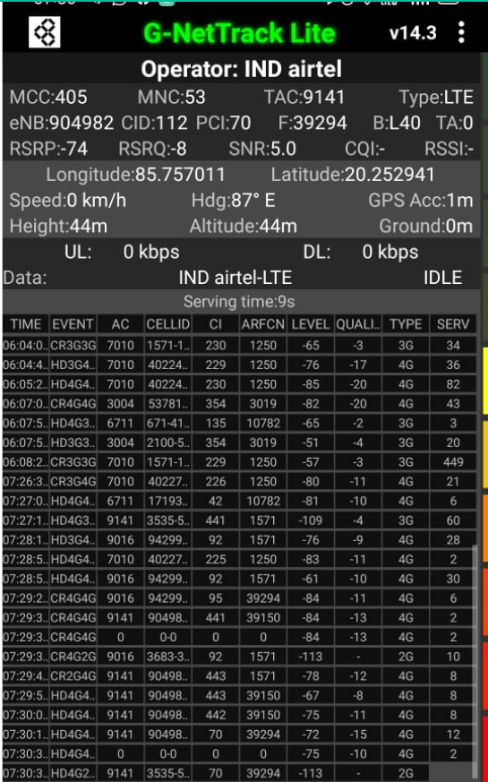
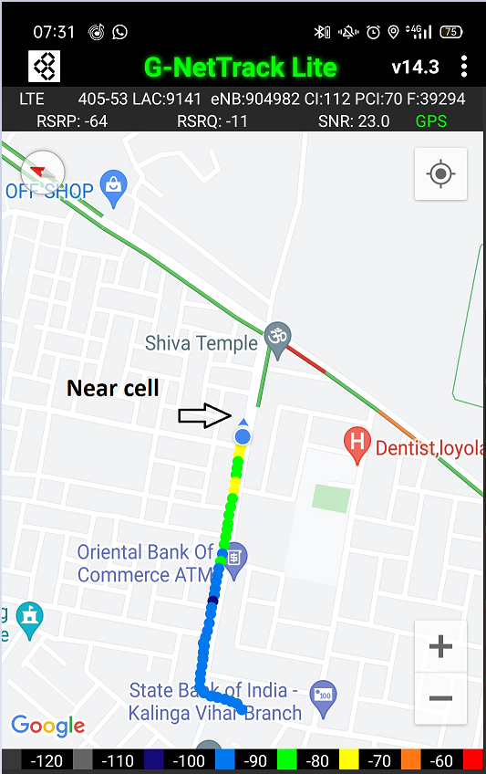
Near Cell (Airtel)
Near cell(NC) | longitude | latitude | RSRP | PCI | FDD E-ARFCN
1 | 85.757011 | 20.252941 | 74 | 70 | 39294
Kalinga Vihar
Kalinga Vihar LIG, Kalinganagar, Bhubaneswar, Odisha 752054
RSRP:
-65dbm to 75dbm

Slide 8
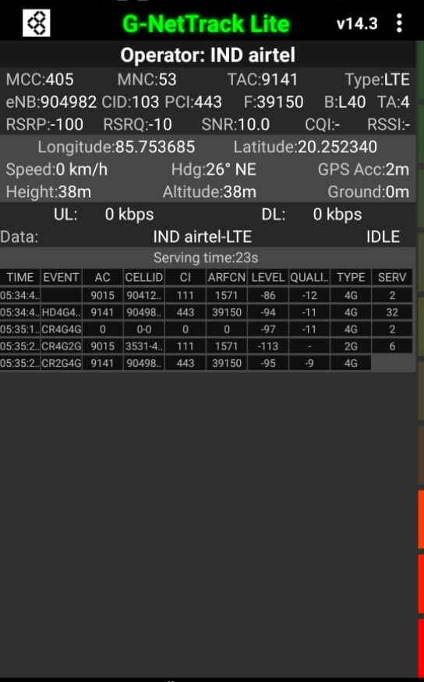
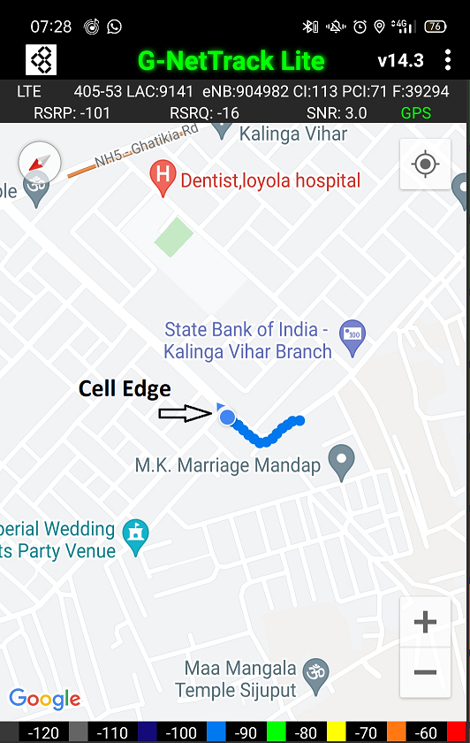
Edge Cell (Airtel)
Edge cell(EC) | longitude | latitude | RSRP | PCI | TDD E-ARFCN
1 | 85.753685 | 20.252340 | 100 | 443 | 39150
Kalinga Vihar
Kalinga Vihar LIG, Kalinganagar, Bhubaneswar, Odisha 752054
RSRP:
-95dbm to -110dbm

Slide 9
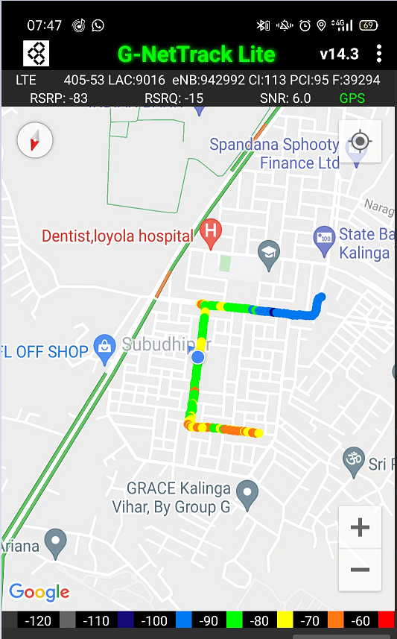
Mixed Mobility(Airtel)
Kalinga Vihar LIG, Kalinganagar, Bhubaneswar, Odisha 752054
RSRP: -65dbm to -110dbm

Slide 10
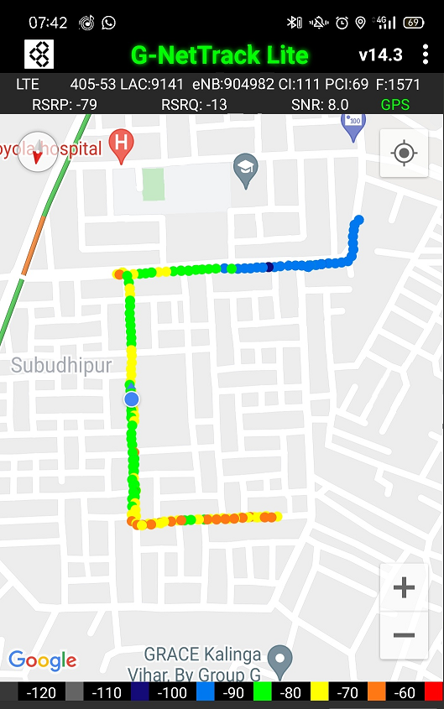
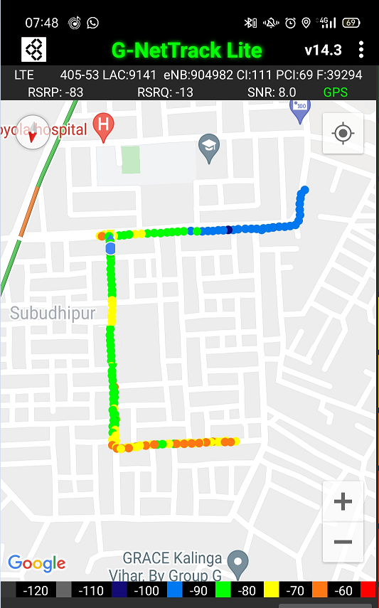
Airtel Band HO
Band Hand Over | Longitude | Latitude | RSRP
1 | 85.75308 | 20.2515 | -85 to 105 dBM
Band 40_3
Band 3_40

Slide 11
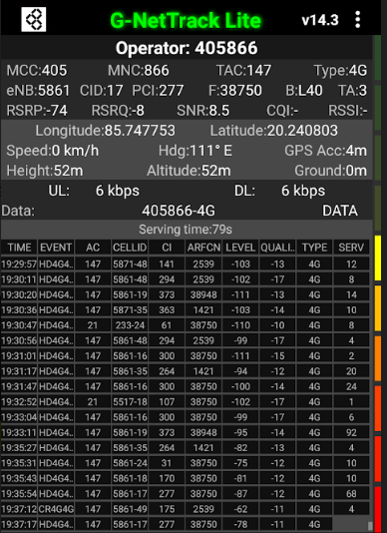
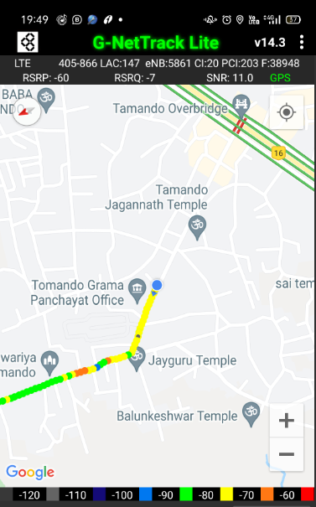
Near Cell (Reliance JIO)
Near cell(NC) | longitude | latitude | RSRP | PCI | TDD E-ARFCN
1 | 85.747753 | 20.240803 | 74 | 277 | 38750
Naragoda
Bhubaneswar, Odisha 752054
RSRP:
-65dbm to -75dbm

Slide 12
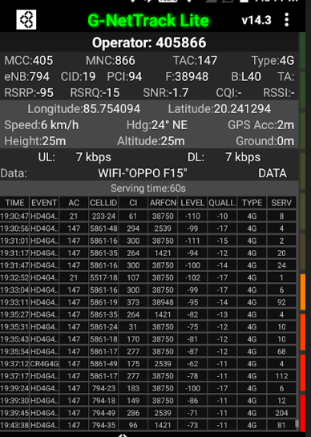
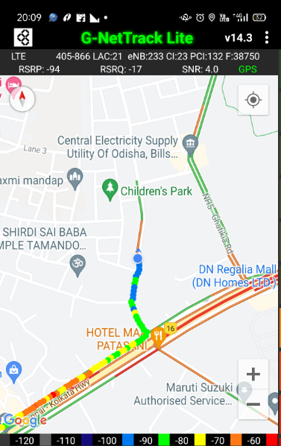
Edge Cell (Reliance JIO)
Edge cell(NC) | longitude | latitude | RSRP | PCI | TDD E-ARFCN
1 | 85.754094 | 20.241294 | 95 | 94 | 38948
Kalinga Vihar
Kalinga Vihar LIG, Kalinganagar, Bhubaneswar, Odisha 752054
RSRP:
-95dbm to -110dbm

Slide 13
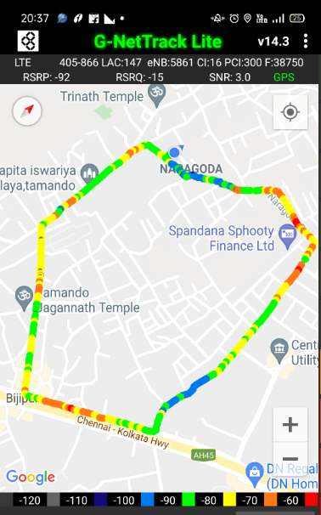
Mixed Mobility (Reliance JIO)
RSRP: -95dbm to -110dbm

Slide 14
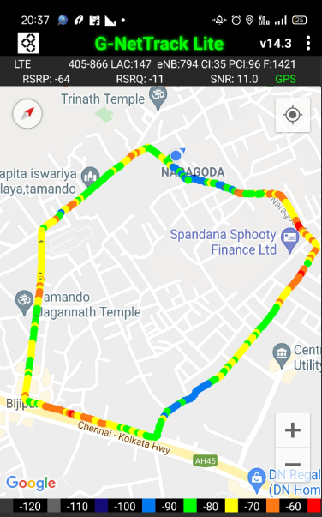
Reliance JIO Band HO
Band Handover | longitude | latitude | RSRP | PCI | TDD E-ARFCN
1 | 85.7496 | 20.2385 | 92 | 300 | 38750

Slide 15
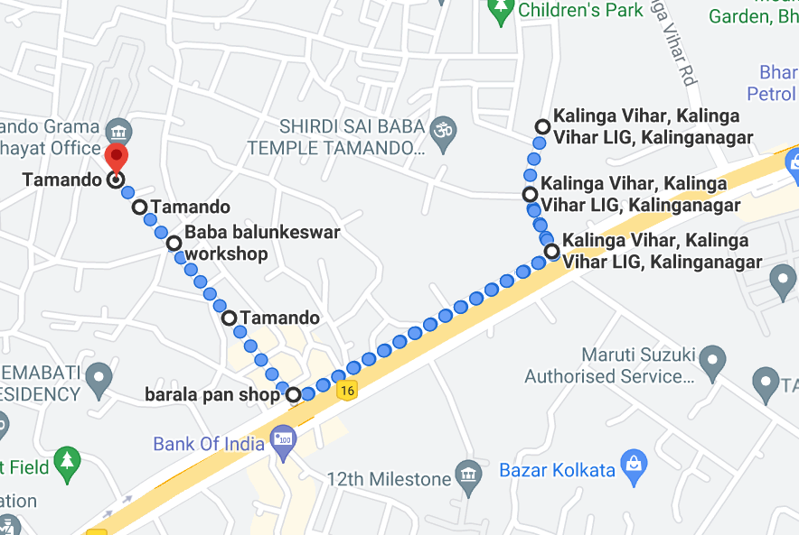
RJIO Band 40 Near Cell:
Near cell

Slide 16
RJIO Band 40 Edge Cell:
Cell Edge

Slide 17
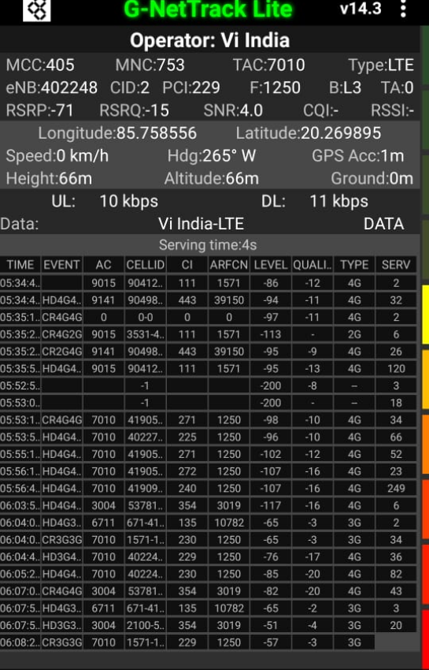
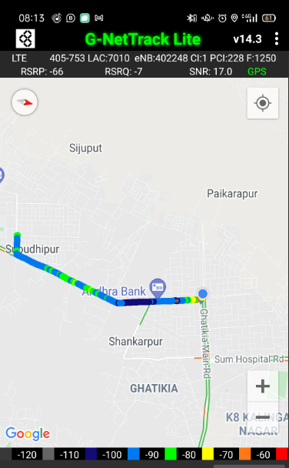
Near Cell (VIL)
Near cell(NC) | longitude | latitude | RSRP | PCI | TDD E-ARFCN
1 | 85.758556 | 20.269859 | 71 | 229 | 1250
Ghatikia Main Rd
Ghatikia, Bhubaneswar, Odisha 751003
RSRP:
-65dbm to -75dbm

Slide 18
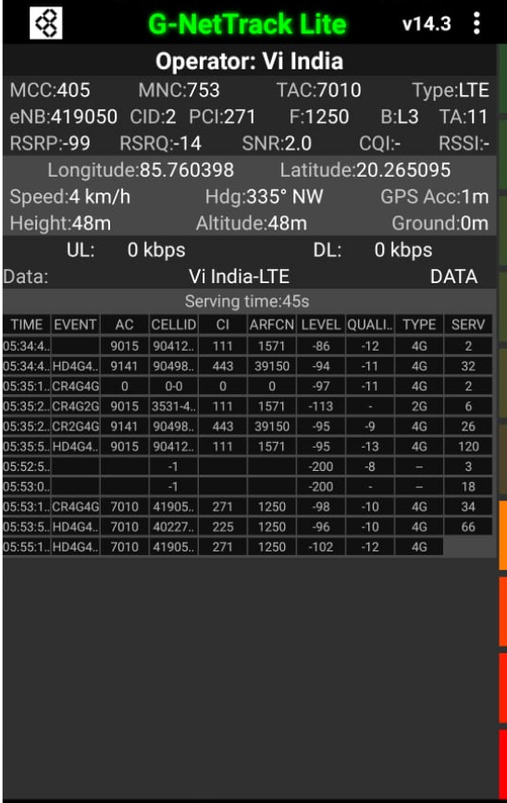
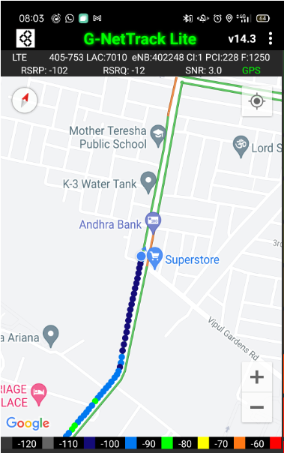
Cell Edge (VI)
Edge cell(EC) | longitude | latitude | RSRP | PCI | TDD E-ARFCN
1 | 85.760398 | 20.265095 | 99 | 271 | 1250
Kalinganagar
Bhubaneswar, Odisha 751003
RSRP:
-95dbm to -105dbm

Slide 19
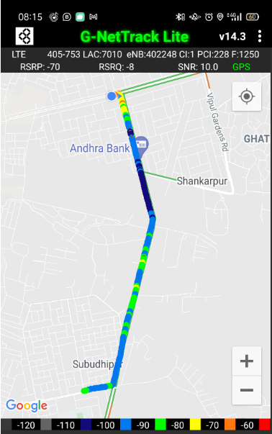
Mixed Mobility (VIL)

Slide 20
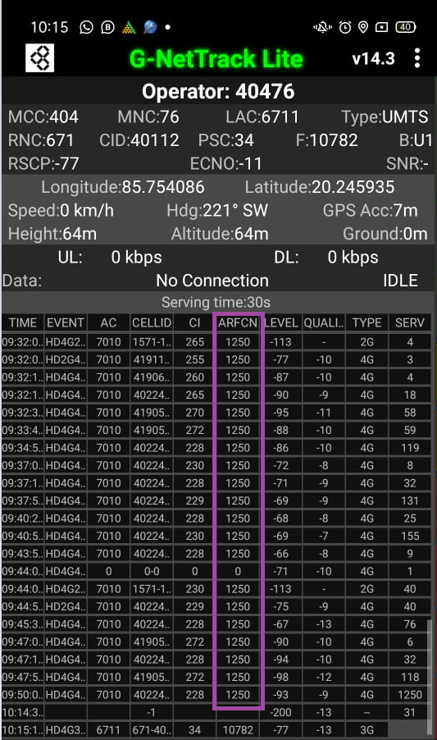
VIL Band HO
* In my location only band 3 available for operator VIL

Slide 21
G net Tracker Drive Route
Airtel
VIL
JIO

Slide 22
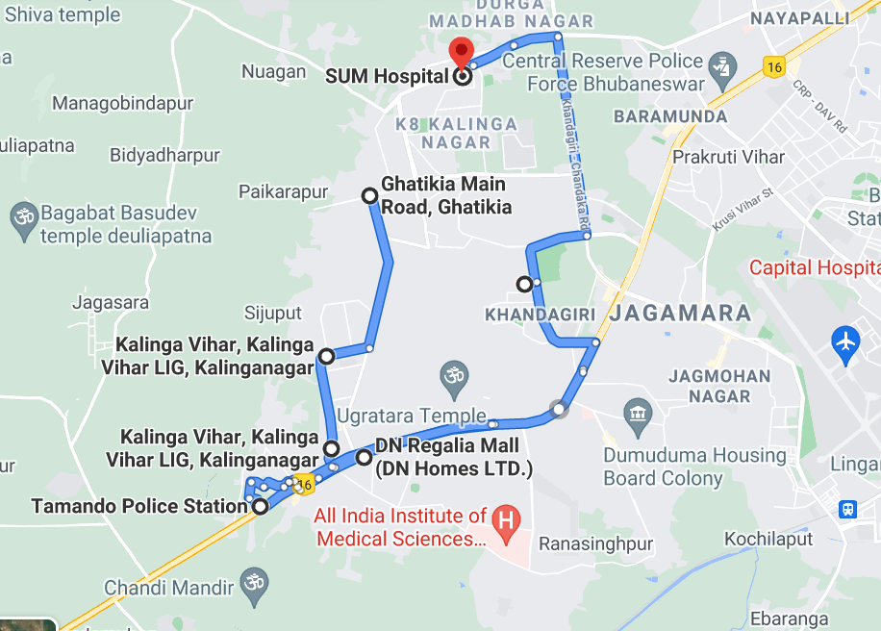
Google Driver Route

Slide 23
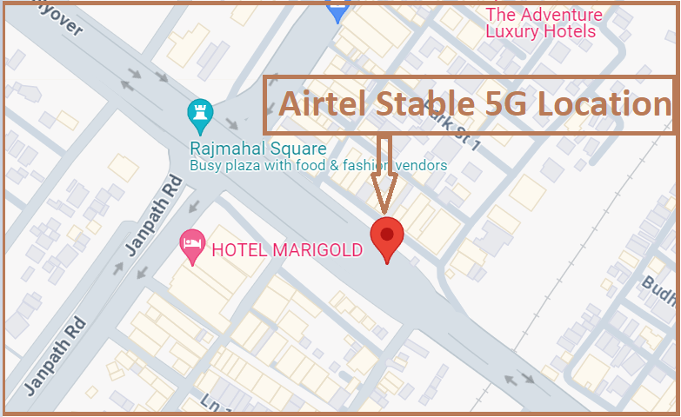
5G Near Cell,Airtel (Bhubaneshwar)
Lat/Long -20°15'38.8"N 85°50'17.1"E
Location-Rajmahal Flyover near The Shivalik hotel Ashok Nagar
Specification –Stable Airtel 5G NSA network
Good Throughput

Slide 24
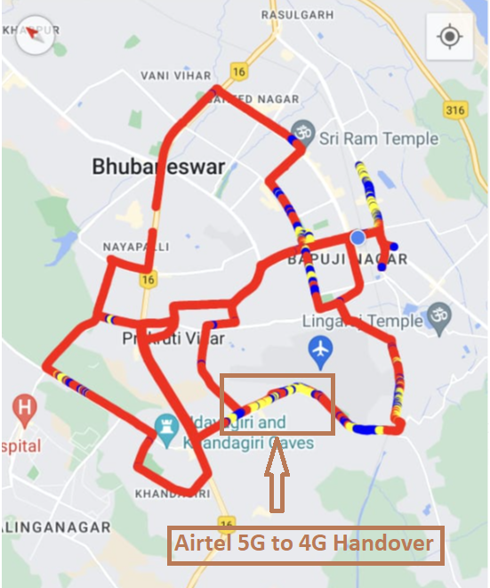
NR to LTE Handover ,Airtel (Bhubaneshwar)
Lat. 20.253972, 85.803454to Location –Kala Bhoomi Odisha Crafts Museum/Near Jagamara Specification –Band Handover ,Weak coverage

Slide 25
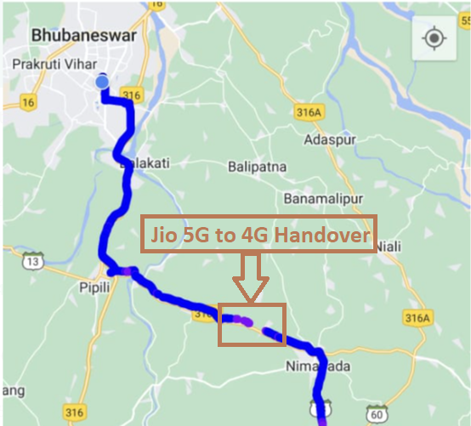
NR to LTE Handover ,JIO (Bhubaneshwar)
Lat/Long 20.083104, 85.949672 to
Lat/Long 20.089347, 85.926234 Location – Pipli Konark Road (Dhanua,Bhuan Bridge)
Specification –Band Handover ,Weak coverage

Slide 26
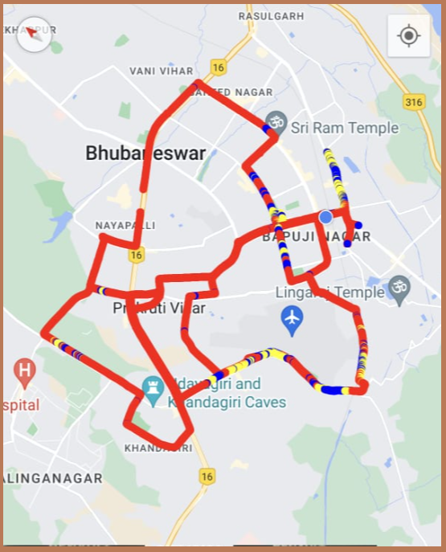
DRIVE ROUTE Airtel 5G (Bhubaneshwar) Specification-Call/Throughput/Handover/Cell Reselection/Redirection

Slide 27
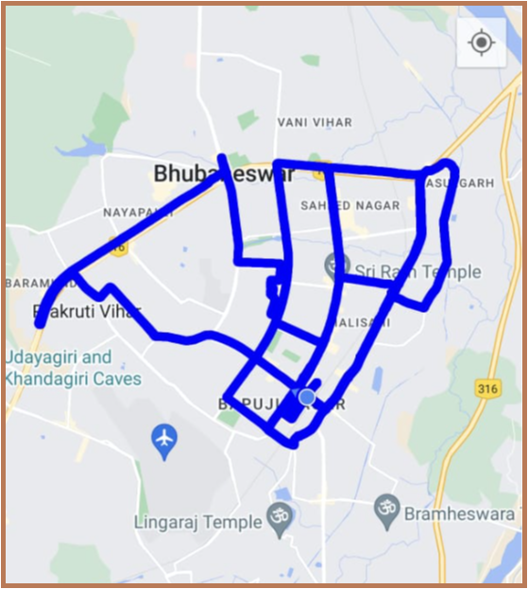
DRIVE ROUTE JIO 5G (Bhubaneshwar) Specification-Call/Throughput/Handover/Cell Reselection/Redirection

Slide 28
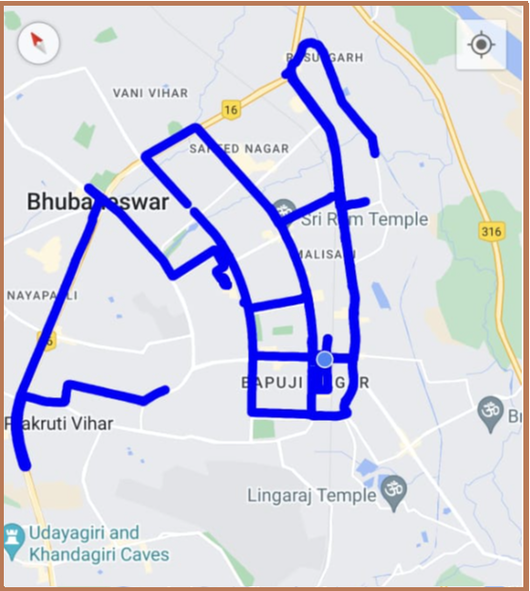
DRIVE ROUTE VI 4G (Bhubaneshwar) Specification-Call/Throughput/Handover/Cell Reselection/Redirection

Slide 29
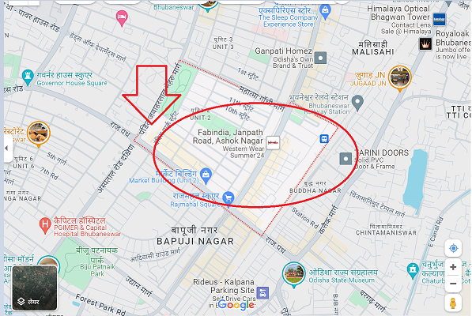
Airtel 5G SA location-Ashok Nagar lat/long-20.2663890, 85.837549

Slide 30
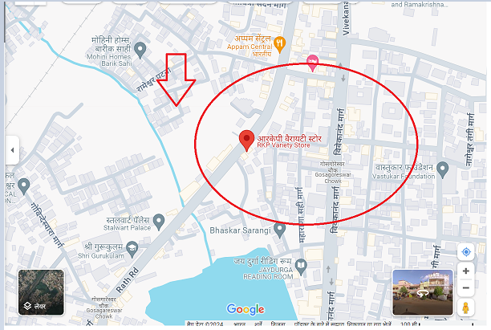
Airtel SA Throughput location- RKP variety store near Shiva Nagar lat/long-20.2486586, 85.8346281

Slide 31
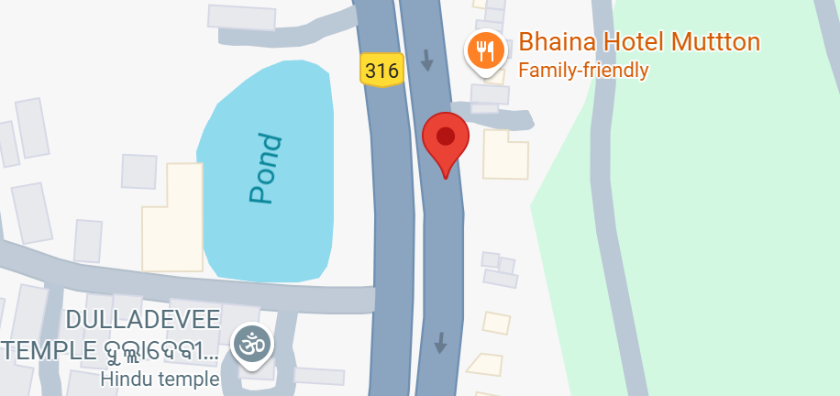
Airtel NSA Throughput location- near bhaina hotel lat/long- 20.1962559970576, 85.85988713515906

Slide 32
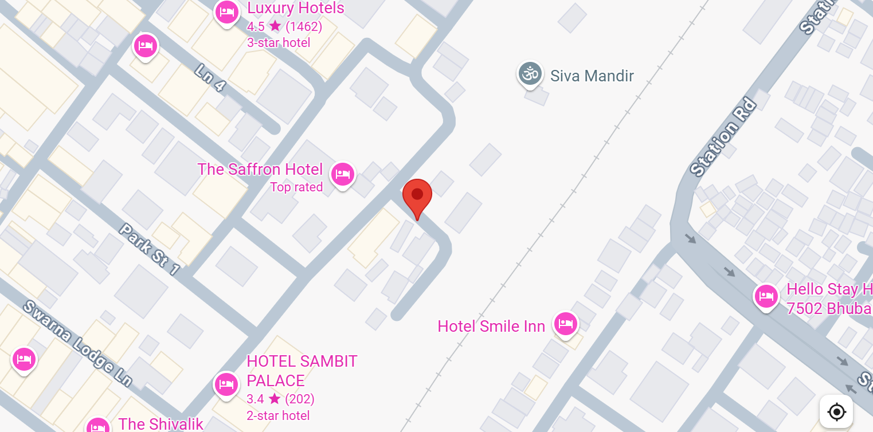
Jio LTE and SA Throughput location- the saffron hotel, ashok nagar lat/long- 20.262036954516592, 85.8398605945562

Slide 33
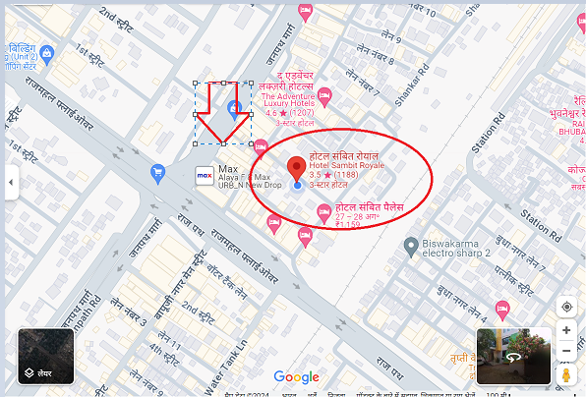
Location for 2 CA Throughput for JiO, Airtel,VI Lat / Long-20.262032, 85.83858 Location- Near Hotel Sambit Royale

Slide 34
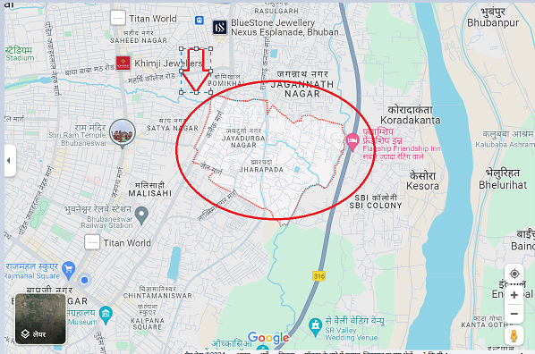
JIO 5G Location
Lat/ long 20.276639, 85.862195
Location –Jharapada

Slide 35
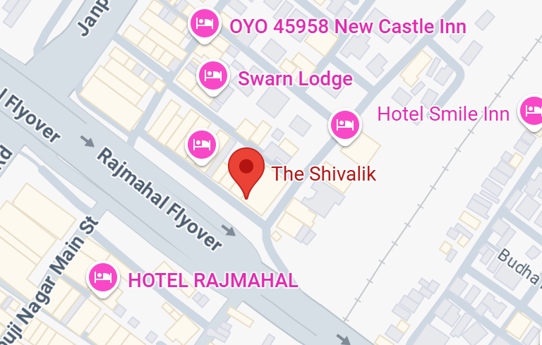
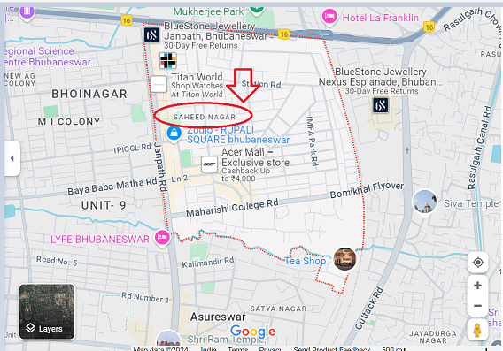
JIO 5G SA to 4G VoLTE handover Ashok Nagar Lat/Long- 20.261114312381487, 85.83839848628462

Slide 36
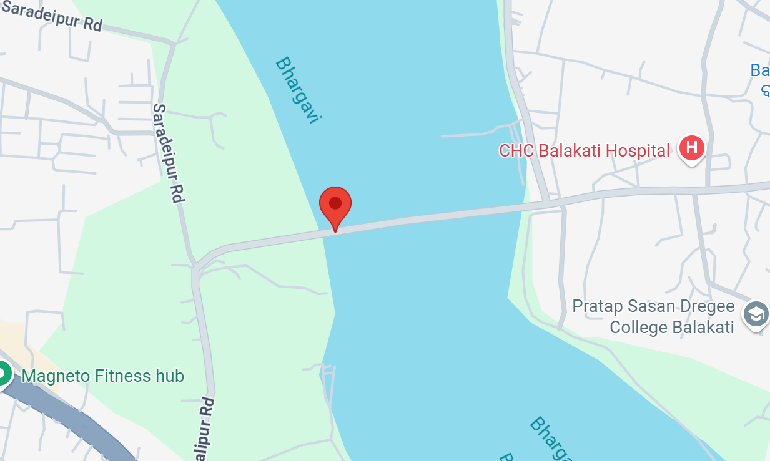
Airtel 5G to 4G VoLTE handover Banamalipur road Lat/Long- 20.202291381491747, 85.86243135573218

Slide 37
THANK YOU
MARQUIS TECHNOLOGIES

