Slide 1
MARQUIS TECHNOLOGIES
Drive Routes - Ghana, Accra
Note:- As in Ghana there was no Mobility testing all the Testing and Drive Route mentioned was according to stationary.

Slide 2
Travel to Ghana, Accra
Country | Ghana
Continent | Africa
City | Accra
Time Zone | GMT 5 Hour behind
International Dialing Code | +233
VISA | On Arrival Visa
VISA Duration | -
VISA Fees | Contact Nisha Deshpande
VISA Requirements | -
Yellow Fever Vaccination Certificate | -

Slide 3
Operators in Ghana
MCC | MNC | Operator | Bands (MHz)
620 | 1 | MTN | UMTS:-B1 (2100 MHz) B8 (900 MHz) LTE:- B7/B20(800MHz)
620 | 2 | Vodafone | UMTS:-B1 (2100 MHz) LTE:- B20(1800MHz)
620 | 03/06 | Airteltigo | UMTS:-B1 (2100 MHz)
620 | 07 | GLO | UMTS:-B1 (2100 MHz)

Slide 4
Operators and Related Information
All the operators are having implementation
MTN- Supports LTE, WCDMA and 2G
Vodafone- Supports LTE, WCDMA and 2G
Airteltigo- Only supports WCDMA &2G
GLO: Only supports WCDMA &2G

Slide 5
General Info of Operators
MTN network being the best in Ghana is commendably strong just like the other two operators.
Vodafone Network is to be ranked second although number of subscribers and network conditions are equally good as that of AIS.
Airteltigo service is inferior compared to other two operators but they are strengthening based on their latest implementations.

Slide 6
USSD codes for balance check
MTN balance check: *124# or *101#
MTN Top Up check: *138#
Vodafone Balance check: *144#
Vodafone Top up Check: *700#
Airteltigo Balance check: *144#
Airteltigo Top up Check: *533#
Glo Balance check: *124#
Glo Top up Check: *555#

Slide 7

Supplementary Services
MTN: Call forwarding and Call Waiting supported
Vodafone: Call forwarding and Call Waiting supported
Airteltigo: Call forwarding and Call Waiting supported
GLO: Call forwarding and Call Waiting supported

Slide 8
RSRP Criteria
Near Cell :-Stationary: RSRP : -55dbm to -85dbm
Cell Edge :-Stationary: RSRP : -95dbm to -110dbm
Mixed :-Mobility: RSRP : -55dbm to -120dbm

Slide 9
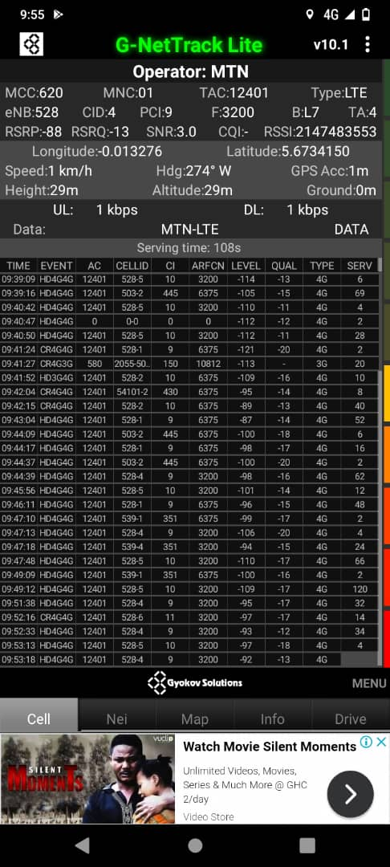
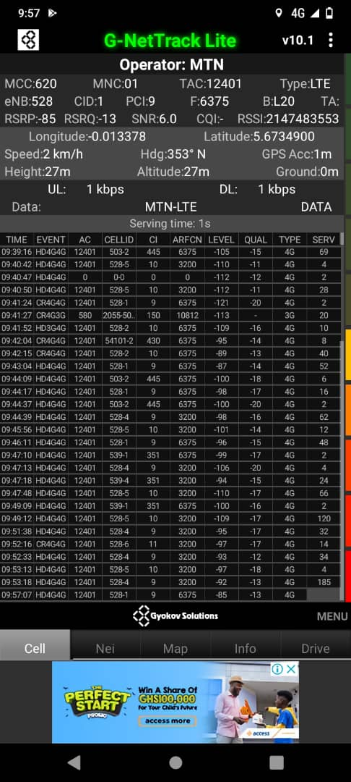
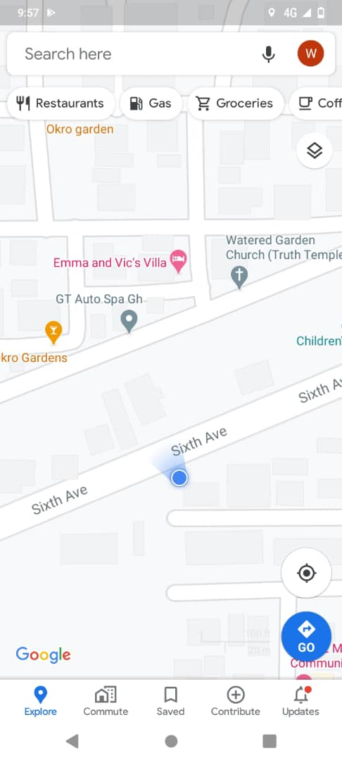
Band 7/20 Near Cell for MTN Operator:- Bethel Methodist chruch
B7 & B20
Maps

Slide 10
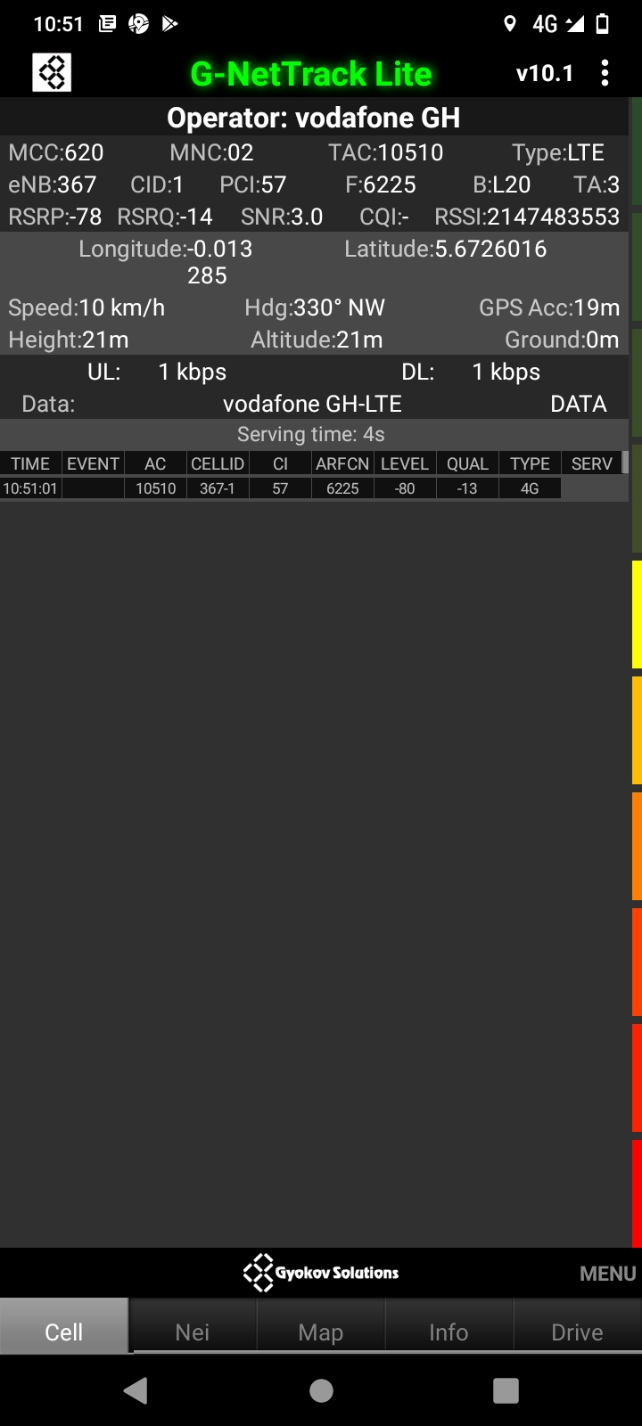
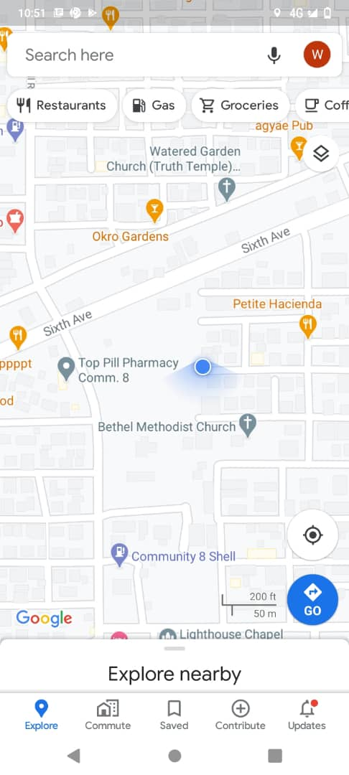
Band 20 Near Cell for Vodafone Operator:- Top hill Pharmacy
B20
Maps

Slide 11
Top Most Popular Android Apps used
Opera News
UTV news
Ghone News
Jumia
Tonaton
OLX
GPS
Bolt
Yango
VLC
Boomplay
whatsapp
messenger
snapchat
Samsung album
Racing Star
Dancing Road: Color Ball Run!

Slide 12
Local EM Number for Ghana
European general emergency phone number | 112
Local Police | 191
Ambulance(First aid Centre) | 999
Fire Brigade | 192
Emergency Centre | 193

Slide 13
Thank You

