Slide 1
MARQUIS TECHNOLOGIES
Drive Route –Airtel, VI& Reliance JIO ,BSNL(FDD/TDD) LTE

Slide 2
Operator Information:
Operator | JIO 4G
MCC | 405
MNC | 863
APN | Jionet
Operator | Airtel 4G
MCC | 404
MNC | 93
APN | Airtelgprs.com
Operator | VI
MCC | 404
MNC | 78
APN | Internet
Operator | BSNL
MCC | 404
MNC | 58
APN | bsnlnet

Slide 3
Operator Information 1
Functionality | Airtel
Website: http://www.airtel.com/ WAP APN: airtelgprs.com
Customer care | 199
MNC | 93
Bands supported | Both FDD and TDD
 | LTE 2300 MHz – TDD(Band 40)
 | LTE 1800,850 MHz – FDD(Band 3)
USSD | To check MDN: *282#
 | Balance check: *123#
 | Data Balance check: *121*114#
VoLTE | Supported
CSFB | Supported(2G)

Slide 4
Operator Information 2
Functionality | RELIANCE JIO
Website: http://www.jio.com WAP APN: jionet
Customer care | 198
MNC | 856
Bands supported | Both FDD and TDD
 | LTE 2300 MHz –TDD(Band 40)
 | LTE 850 MHz – FDD(Band 5)
 | LTE 1800 MHz –FDD(Band 3)
USSD | NA
 | NA
 | NA
VoLTE | Supported
CSFB | Not Supported

Slide 5
Operator Information 3
Functionality | VI
Website: https://www.vodafoneidea.com/ WAP APN: www
Customer care | 198
MNC | 78
Bands supported | Both FDD and TDD
 | LTE 2300 MHz –TDD(Band 41)
 | LTE 850 MHz – FDD(Band 8)
 | LTE 1800 MHz –FDD(Band 3)
USSD | To check MDN*199#
 | Balance check198
 | Data Balance check: 121
VoLTE | Not supported
CSFB | Supported (switched to 2G)

Slide 6
Drive Route
Near Cell :- Stationary: RSRP : -65dbm to -75dbm
Cell Edge :- Stationary: RSRP : -95dbm to -110dbm
Mixed :- Mobility: RSRP : -65dbm to -110dbm

Slide 7
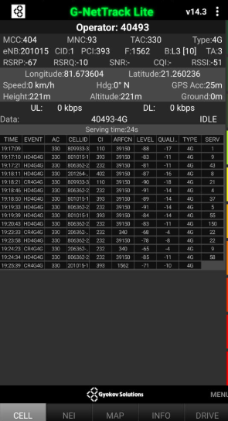
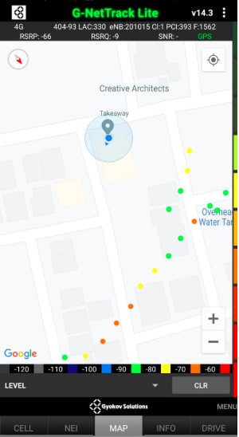
Near Cell (Airtel)
Near cell(NC) | longitude | Latitude | RSRP | Cell id | FDD E-ARFCN
1 | 81.673604 | 21.260236 | -67 | 1 | 1562
RSRP:
-65dbm to 75dbm

Slide 8
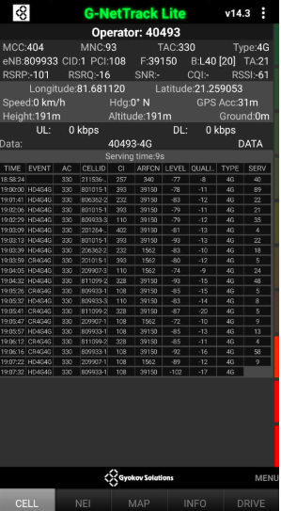
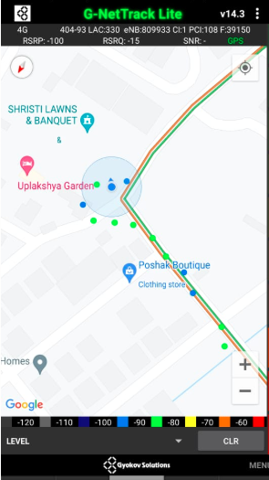
Edge Cell (Airtel)
Edge cell(EC) | longitude | latitude | RSRP | Cell id | TDD E-ARFCN
1 | 81.681120 | 21.259053 | -101 | 108 | 39150
RSRP:
--115

Slide 9
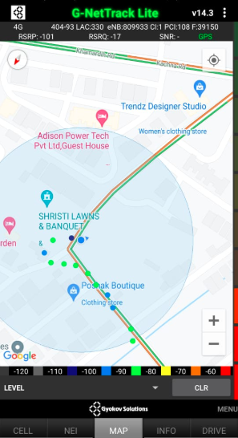
Mixed Mobility:- Airtel (Raipur )
RSRP: -60dbm to -110dbm

Slide 10
Airtel Band HO

Slide 11
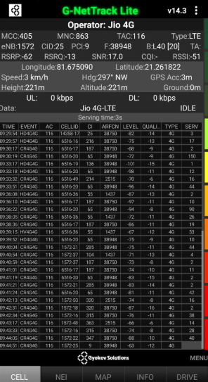
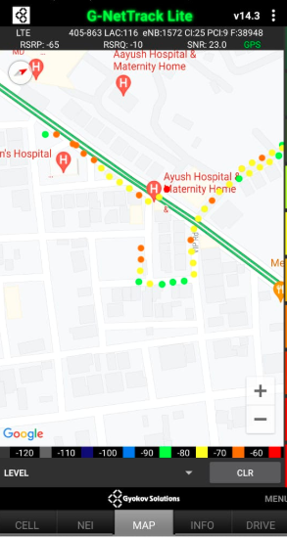
Near Cell (Reliance JIO)
Near cell(NC) | longitude | Latitude | RSRP | Cell id | TDD E-ARFCN
1 | 81.675090 | 21.261822 | 62 | 25 | 38948
SHANKAR NAGAR,
RAIPUR.
RSRP:
-57dbm to -75dbm

Slide 12
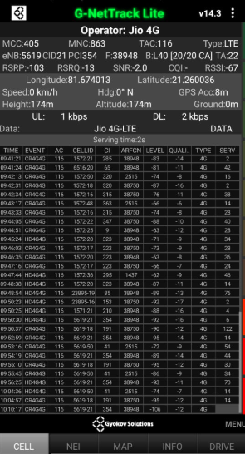
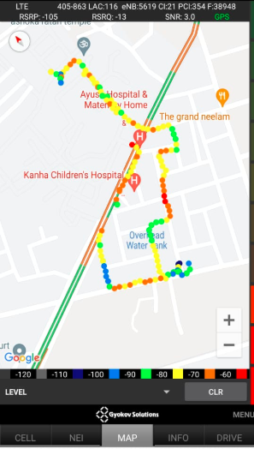
Edge Cell (Reliance JIO)
Edge cell(NC) | longitude | latitude | RSRP | Cell id | TDD E-ARFCN
1 | 81.674013 | 21.260036 | -95 | 21 | 38948
RSRP:
-95dbm to -110dbm

Slide 13
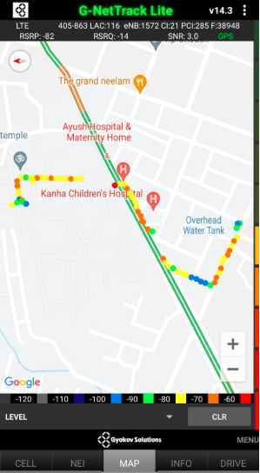
Mixed Mobility:- JI0 RAIPUR
RSRP: -60dbm to -110dbm

Slide 14
Inter Band Handover (FDD-TDD), JIO 4G

Slide 15
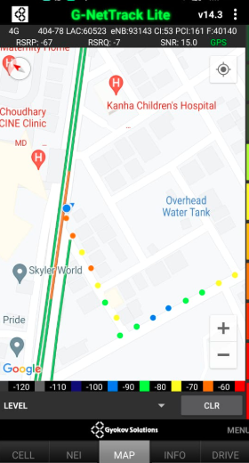
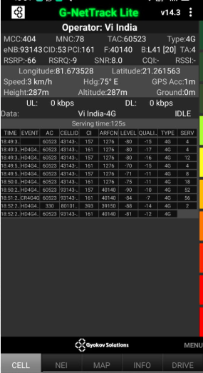
Near Cell VI:
Near cell(NC) | longitude | latitude | RSRP | Cell id | TDD E-ARFCN
1 | 81.673528 | 21.261563 | -66 | 53 | 40140
RSRP:
-65dbm to -75dbm

Slide 16
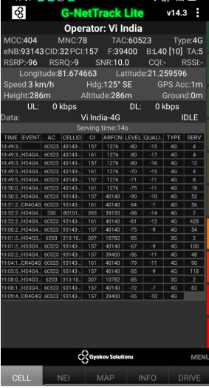
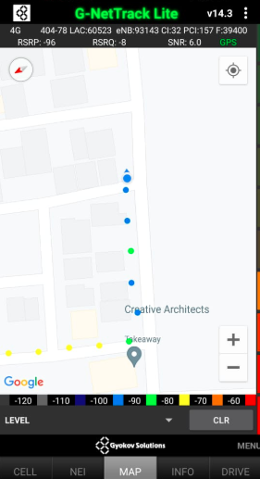
Cell Edge VI:
Edge cell(EC) | longitude | latitude | RSRP | Cell id | TDD E-ARFCN
1 | 81.674663 | 21.259596 | -96 | 32 | 39400
RSRP:
-95dbm to -105dbm

Slide 17
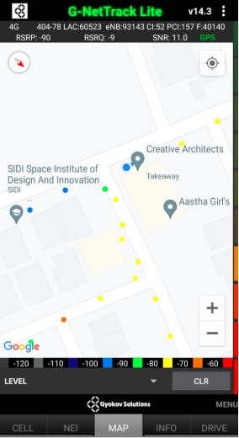
Mixed coverage area Vodafone:

Slide 18
Inter Band Handover (FDD-TDD), VI 4G

Slide 19
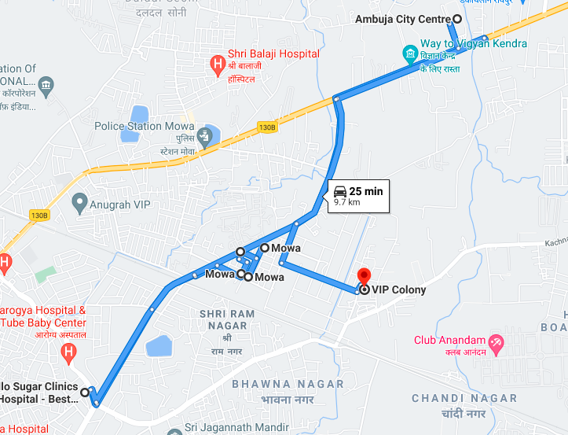
Overall Drive Route

Slide 20
THANK YOU
MARQUIS TECHNOLOGIES

