Slide 1
MARQUIS TECHNOLOGIES
Drive Route Norway

Slide 2
Drive Route
Near Cell :-Stationary: RSRP: -65dbm to -90dbm
Mixed :-Mobility: RSRP : -75dbm to -100dbm
Cell Edge :-Stationary: RSRP : -95dbm to -120dbm

Slide 3
Services Supported by Telenor VoLTE Operator
Telenor 5G/4G/3G/2G | GSM-900MHz & 1800MHz, B1(2100 MHz), B3(1800MHz), B7(2600MHz), B20(800MHz) , NR78 (3500 MHz),
OPERATOR | Features /Services | Supported(yes/No)
Telenor (Major) | Reselection | Yes
 | Redirection | Yes
 | MMS /SMS | Yes
 | Volte | Yes
 | vowifi | Yes
 | PS Handover | Yes

Slide 4
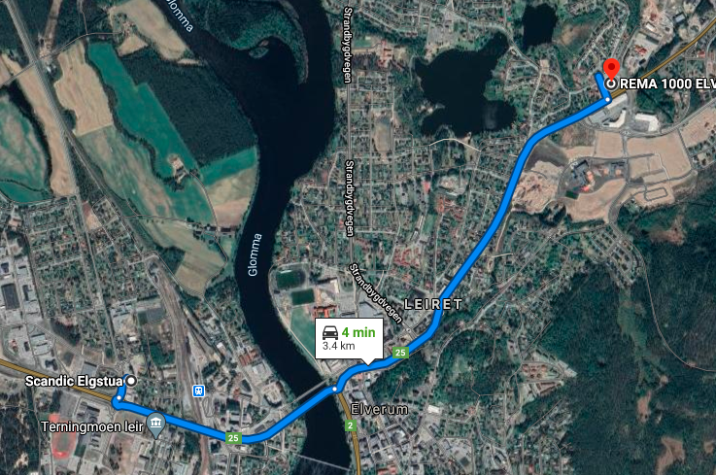

Telenor 5G VoLTE Good Coverage Area Band L3,L7 AND L20 WITH NR 78 BAND
Route >> Rema 1000 elverum >> Scandic ELgusta
L3 AND L7 BANDS WITH nr 78
L3 AND L20 BAND WITH NR 78

Slide 5
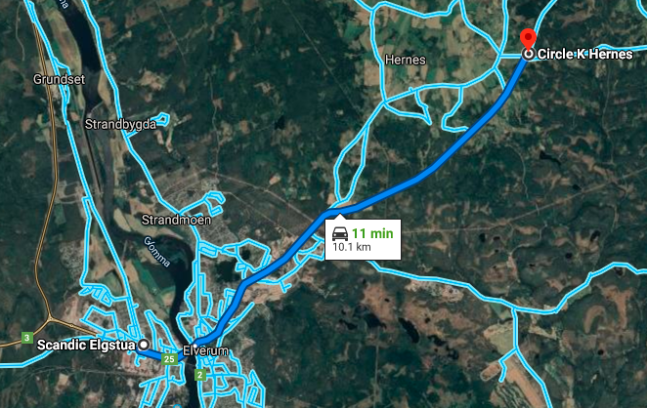
Telenor 5G and 4g VoLTE Mix Coverage Area
Route >> Scandic Elguesta >> Circle K Hermes Sørskogbygdvegen 2
5g coverage ends here
4g and 5g mixed coverage
5g area

Slide 6
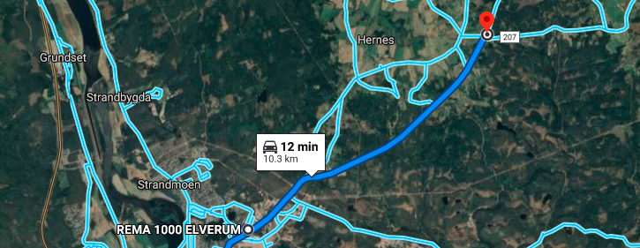
Telenor weak 5g VoLTE Coverage Area Band NR 78 , lte band L20 ,L3 AND L7
Route >> REMA 1000 >> Circle k 207
5g coverage ends
Weak 5g area Telenor

Slide 7
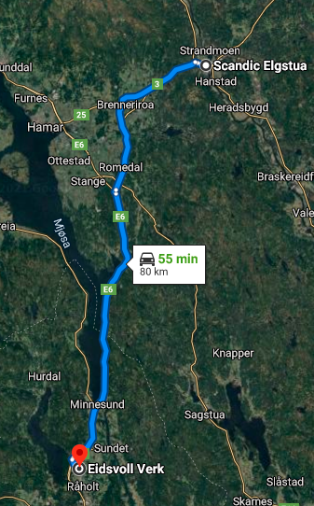
Telenor 5G VoLTE operator CA to non CA HO
(B3_CA NR 78 to 4g B7_Non CA)
Route>>Scandic Elgusta to Banneriroa to Eidsvoll
First handover point
5g to 4g handover
EC:2

Slide 8
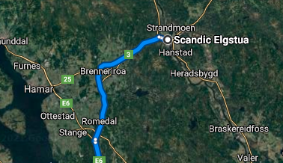
Band HO from B3 to B7 and B7 to B20 for Vodafone 4G VoLTE operator
Route Covered from Scandic Elgusta to Brenneriroa to Stange

Slide 9
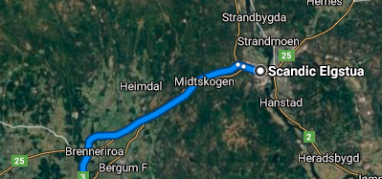
Band HO from B3 to B7 in NR78 region during ongoing MO call Telenor
Route>> Scandic Elguta to Brenneriroa

Slide 10
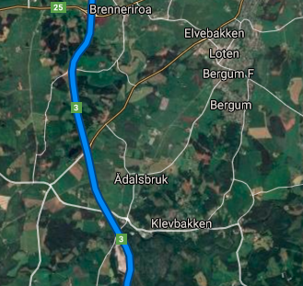
Band HO from B7 to B20 during ongoing MO call for Telenor
Brenneriroa to Klevbakken on Highway 3

Slide 11
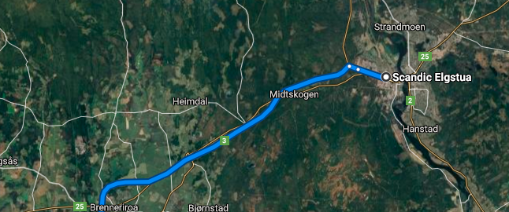
SRVCC Telenor 5G VoLTE to Telenor 4g Volte RAT
Scandic Elgusta to Brenneriroa

Slide 12
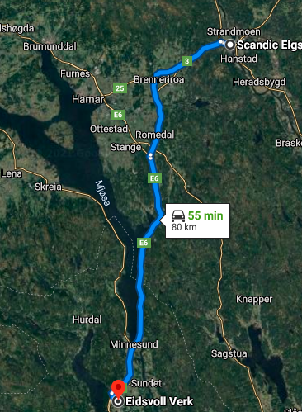
SRVCC TELENOR 4G TO 2G – Happens sometimes as 2g and 3g are being scrapped
Scandic Elgusta to Eidsvoll

Slide 13
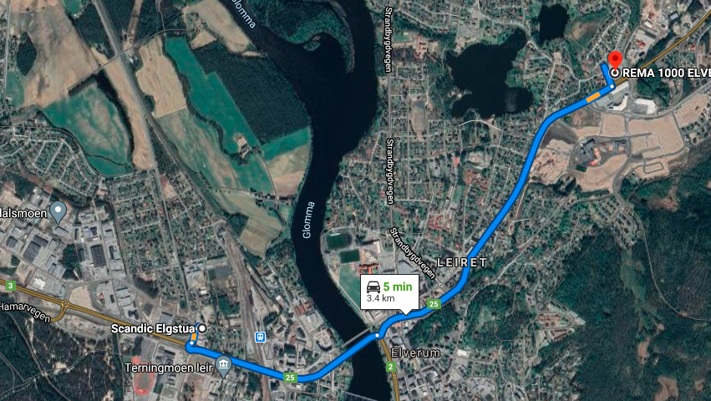
HO from one CA (B3 AND NR 78) cell to another CA cell for NR CELLS
Telenor 5G VoLTE operator
Route>> Scandic Elgusta to REMA 1000 elverum

Slide 14
Services Supported by Telia VoLTE Operator
Telia 5G/4G/3G/2G | GSM-900MHz & 1800MHz, B1(2100 MHz), B3(1800MHz), B7(2600MHz), B20(800MHz) , NR78 (3500 MHz),
OPERATOR | Features /Services | Supported(yes/No)
Telia (Major) | Reselection | Yes
 | Redirection | Yes
 | MMS /SMS | Yes
 | Volte | Yes
 | vowifi | Yes
 | PS Handover | Yes

Slide 15
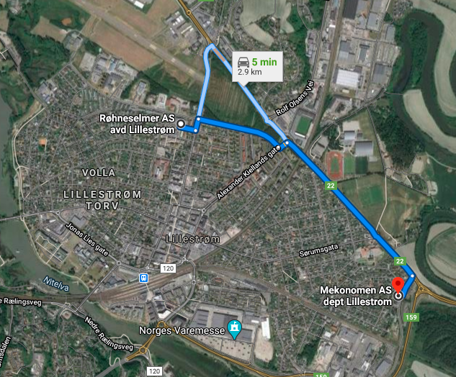
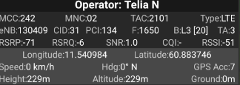
Telia 5G VoLTE Good Coverage Area Band l3 and L7 and L20
Route >> Mekonomen AS lilestrom>> Rehneselmer AS
Nr 78 with l7 ,l3 and L20 bands

Slide 16
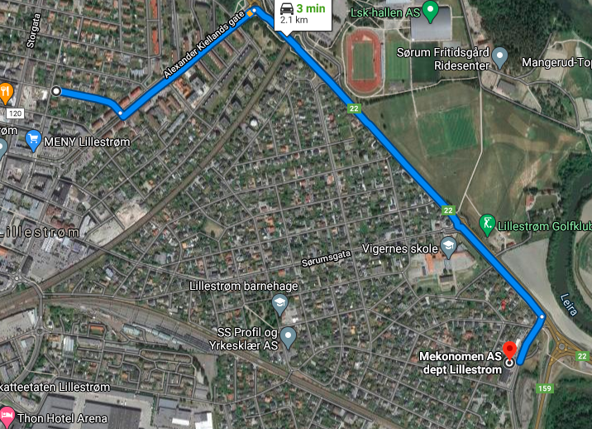
Telia 5g and 4G VoLTE Mix Coverage Area
Route >> Nannestadgata >> Mekonomen AS
5G 4G MIX
VERY WEAK 5G

Slide 17
Telia 5G VoLTE Weak Coverage Area Band NR 78
Route >> Fortis Hospital >> Nirupam Apartment >> Flex Apartment
VERY WEAK NR 78 BAND

Slide 18
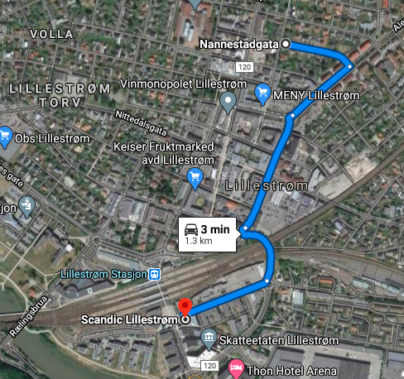
Telia 5g LTE BAND HANDOVER (B3 +B7) to Non CA B20
Route >> Nannestadgata >> Scandic Lillestrom

Slide 19
Telia 5g Volte Operator Band Handover (B3 – B20)
Route >> MENY LILLESTROM >> SCANDIC LILLESTROM

Slide 20
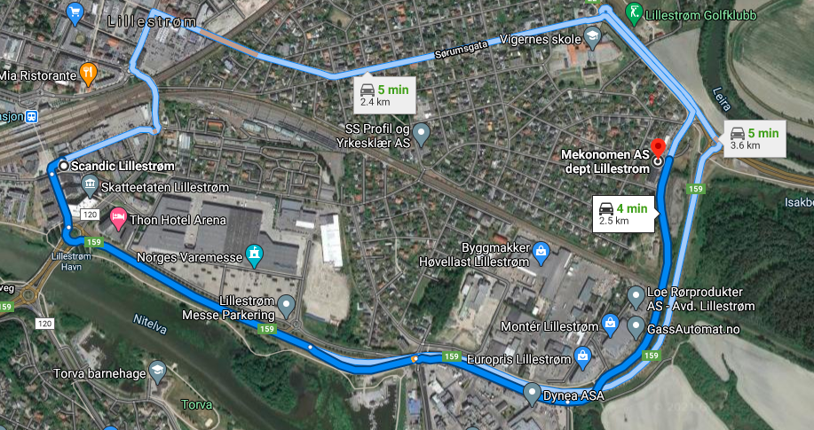
Airtel 4G VoLTE Band Handover B20 to B7
Route >> Scandic Lilestrom >> EUROPRIS LILLESTROM t0 Mekonomen AS

Slide 21
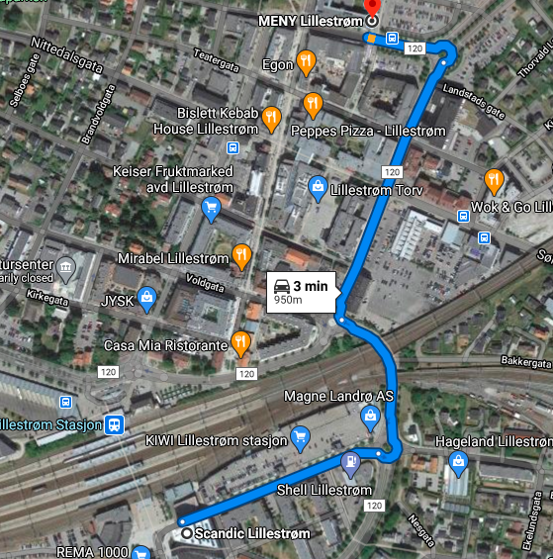
Telia 5G Volte operator CA (B3+B7) to Non CA B20
Route >> MENY LILLESTROM >> scandic lillestrom

Slide 22
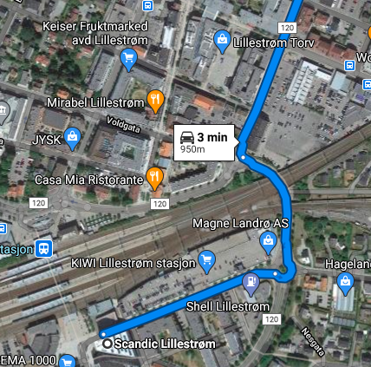
Telia 5G Volte operator CA to CA Handover(B3) to (B7)
Route >> Lillestrom torv to Scandic Lillestrom

Slide 23
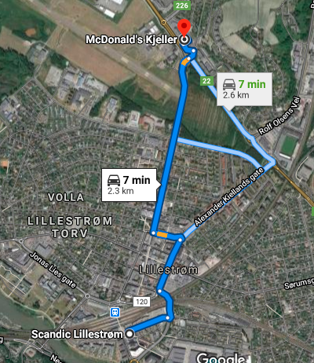
Telia 5g to 4G Volte operator SRVCC Location
Route >> Scandic Lillestrom to Macdonald Kjeller taking several roundabouts as 5g area is very limited

Slide 24
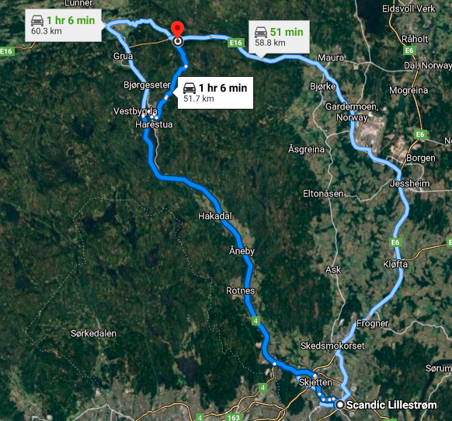
Telia 5g Volte operator 4G to 2G to 4G Handover
Very bleak possibility as 2g and 3g are phased out
Route >> Scandic Lillestrom to Brovoll Skistue

Slide 25
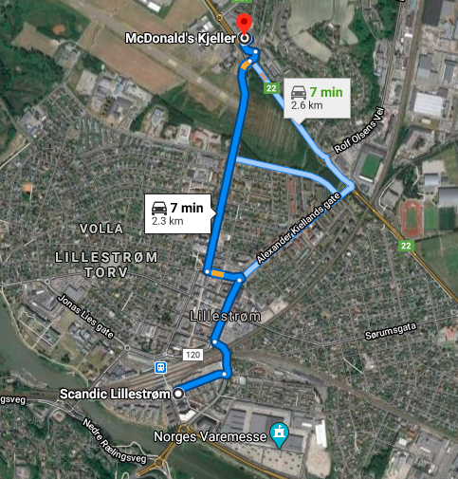
Telia 5G VOLTE Long Call Drive Route
Route >> Scandic Lillestrom to Macdonald Kjeller taking several roundabouts as 5g area is very limited

Slide 26
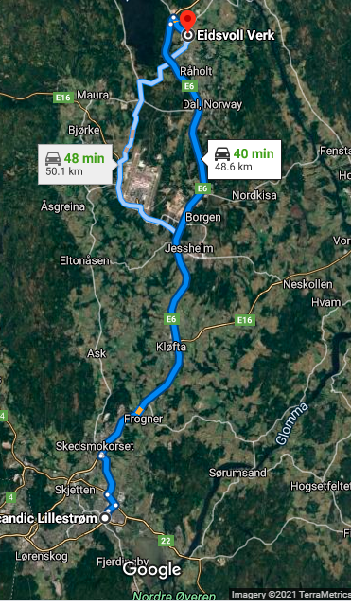
Telia 4g long calls
Lillestrom Scandic to Eidsvoll

Slide 27
Services Supported by Ice VoLTE Operator
Ice 4G/3G/2G | GSM-900MHz & 1800MHz, B1(2100 MHz), B3(1800MHz), B7(2600MHz), B20(800MHz)
OPERATOR | Features /Services | Supported(yes/No)
Ice (Major) | Reselection | Yes
 | Redirection | Yes
 | MMS /SMS | Yes
 | Volte | Yes
 | vowifi | Yes
 | PS Handover | Yes

Slide 28
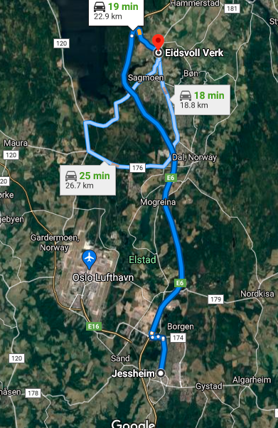
Ice Good coverage Band l3 and l7
Route >> Jessheim to Eidsvoll Verk

Slide 29
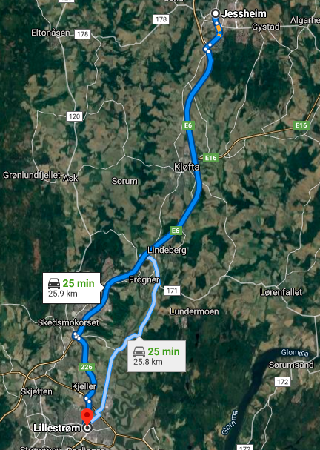
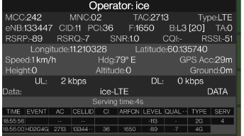
Ice Operator Mix Coverage band l3 and l20
Route >> Jessheim to Lillestrom Scandic

Slide 30
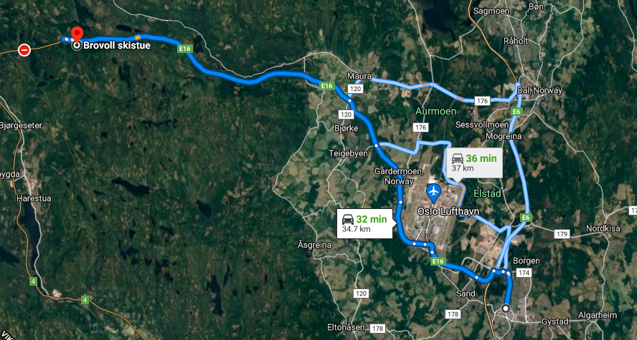
Ice Operator Weak coverage Band l3 and L7
Route >> Jessheim to Brovoll Skistue

Slide 31
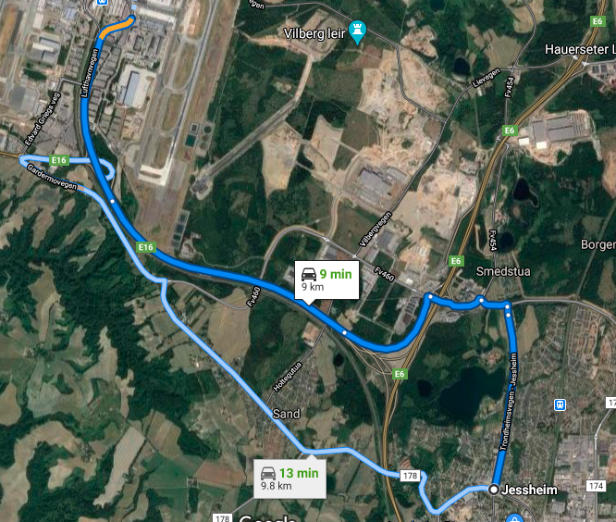
Ice Operator Band Ho from Band l3 to Band l7
Route >> Jessheim to OSLO Airport

Slide 32
Ice 4g long calls
Lillestrom Scandic to Eidsvoll

Slide 33
ICE 4g Volte operator 4G to 2G to 4G Handover
Very bleak possibility as 2g and 3g are phased out
Route >> Scandic Lillestrom to Brovoll Skistue

