Slide 1
MARQUIS TECHNOLOGIES
Drive Route

Slide 2
(Croatia)
Country | Croatia
Continent | Europe
City | Zagreb
Time Zone | GMT+2

Slide 3
Drive Route T-Mobile 5G
Near Cell :-Stationary: RSRP: -60dbm to -75dbm
Mixed :-Mobility: RSRP : -75dbm to -95dbm
Cell Edge :-Stationary: RSRP : -95dbm to -115dbm

Slide 4
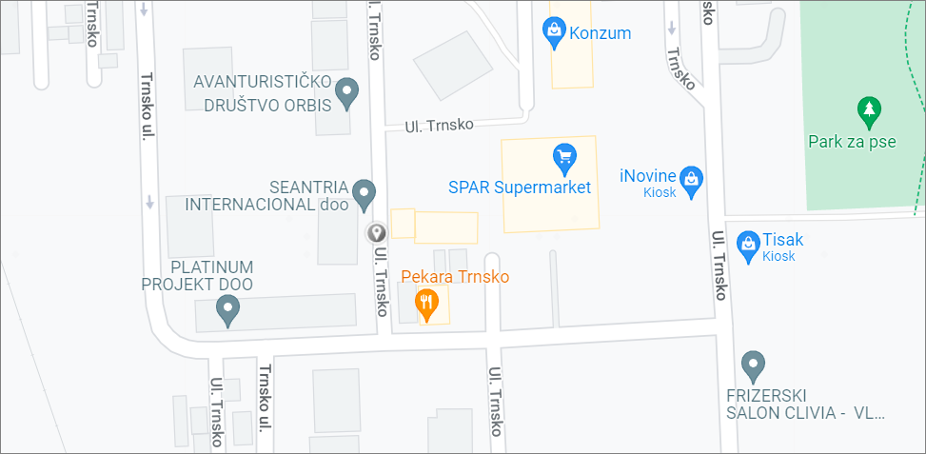

T-Mobile Band N77(Near Cell): Trnsko ul. 33 E, 10000, Zagreb, Croatia
Operator: T-Mobile
Band: N77
Cell ID: 8
E-ARFCN : 634080
RSRP: -60dBm to -75dBm

Slide 5
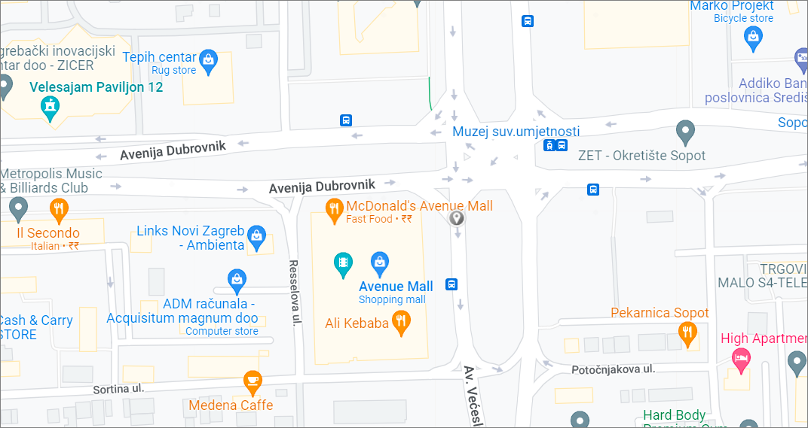

T-Mobile Band N77(Mixed Cell): Avenija Dubronvik, Zagreb
Operator: T-Mobile
Band: N77
Cell ID: 6
E-ARFCN : 634080
RSRP:-75dbm to -95dbm

Slide 6
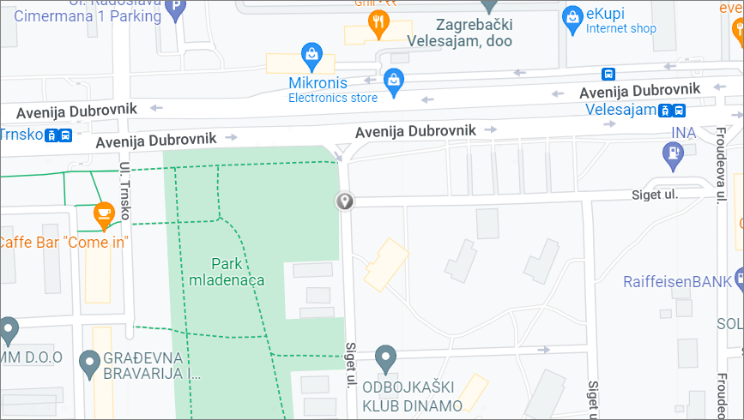

T-Mobile Band N77(Edge Cell): Siget, Zagreb
Operator: T-Mobile
Band: N77
Cell ID:8
E-ARFCN : 634080
RSRP: -95dbm to 115dbm

Slide 7
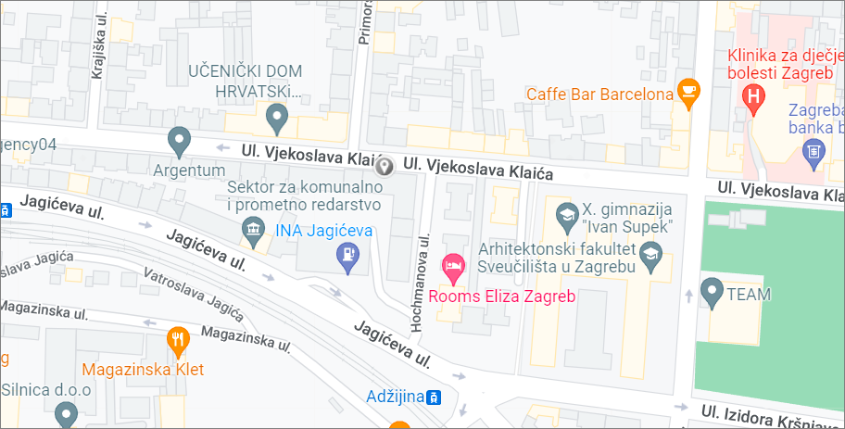

T-Mobile(5G to 4G Reselection): Ul vjekoslava Klaića 48, Zagreb
Operator: T-Mobile
5G to 4G Reselection

Slide 8
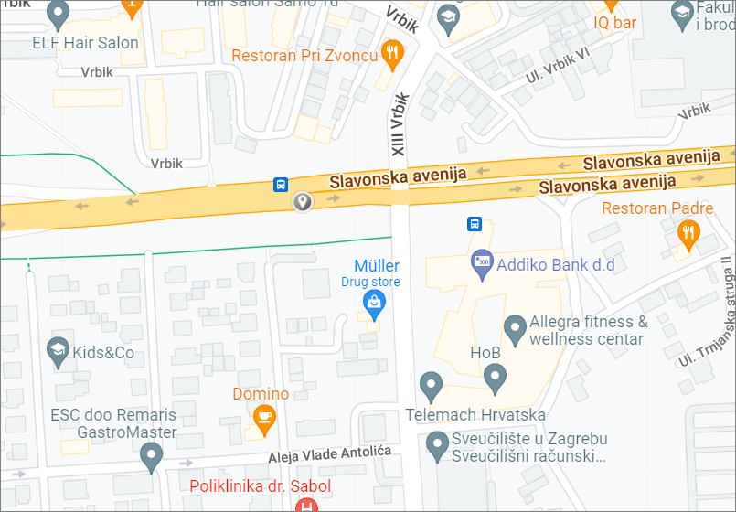

T-Mobile(4G to 5G Reselection): Slavonska avenija, Zagreb, Croatia
Operator: T-Mobile
5G to 4G Reselection

Slide 9
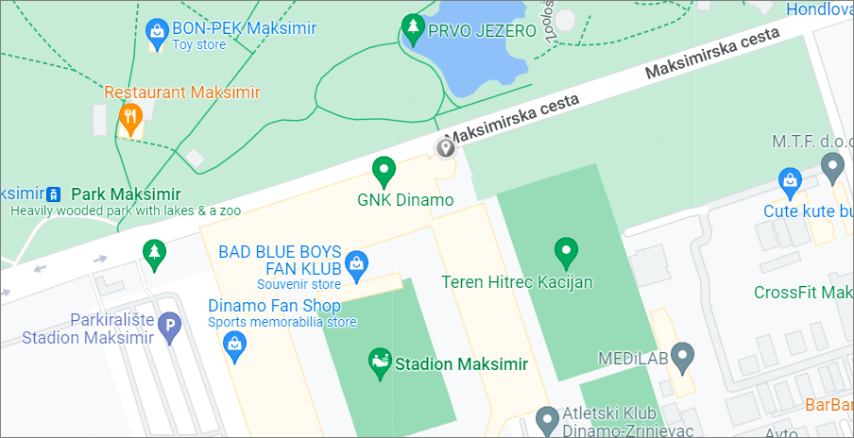

T-Mobile (Inter-frequency Band Handover): Maksimirska cesta 128, 10000, Zagreb
Operator: T-Mobile
Band Handover: N77-B20
E-ARFCN : 634080-6375

Slide 10
Drive Route Bonbon 4G
Near Cell :-Stationary: RSRP: -60dbm to -75dbm
Mixed :-Mobility: RSRP : -75dbm to -95dbm
Cell Edge :-Stationary: RSRP : -95dbm to -115dbm

Slide 11
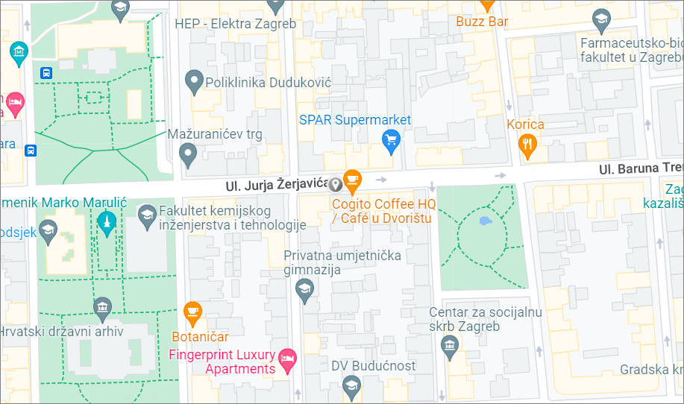

Bonbon Band L1( Near Cell):Ul. Jurja Žerjavića, 10000, Zagreb, Croatia
Operator: Bonbon
Band: L1
Cell ID: 11
E-ARFCN : 75
RSRP: -60dBm to -75dBm

Slide 12
Bonbon Band L20( Near Cell):Ul. Jurja Žerjavića, 10000, Zagreb, Croatia
Operator: Bonbon
Band: L20
Cell ID: 8
E-ARFCN : 6375
RSRP: -60dBm to -75dBm

Slide 13
Bonbon Band L3( Near Cell):Ul. Jurja Žerjavića, 10000, Zagreb, Croatia
Operator: Bonbon
Band: L3
Cell ID: 2
E-ARFCN : 1501
RSRP: -60dBm to -75dBm

Slide 14
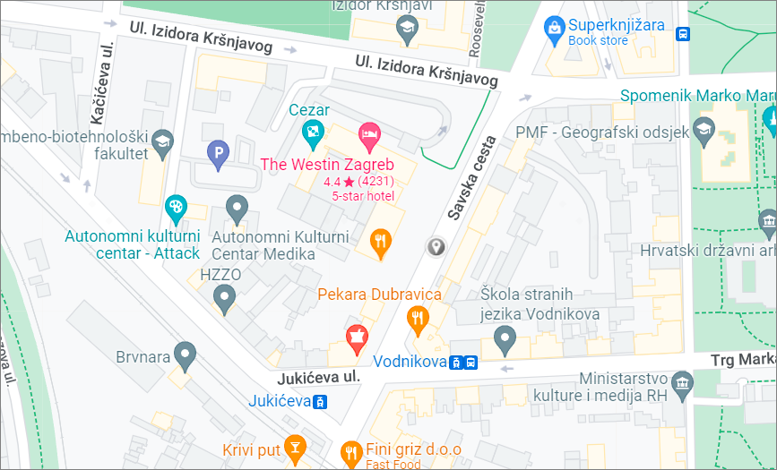

Bonbon Band L1( Mixed Cell): Savska cesta, Zagreb, Croatia
Operator: Bonbon
Band: L1
Cell ID: 9
E-ARFCN : 75
RSRP: -75dBm to -95dBm

Slide 15
Bonbon Band L20( Mixed Cell): Savska cesta, Zagreb, Croatia
Operator: Bonbon
Band: L20
Cell ID: 6
E-ARFCN : 6375
RSRP: -75dBm to -95dBm

Slide 16
Bonbon Band L3( Mixed Cell): Savska cesta, Zagreb, Croatia
Operator: Bonbon
Band: L3
Cell ID: 2
E-ARFCN : 1501
RSRP: -75dBm to -95dBm

Slide 17
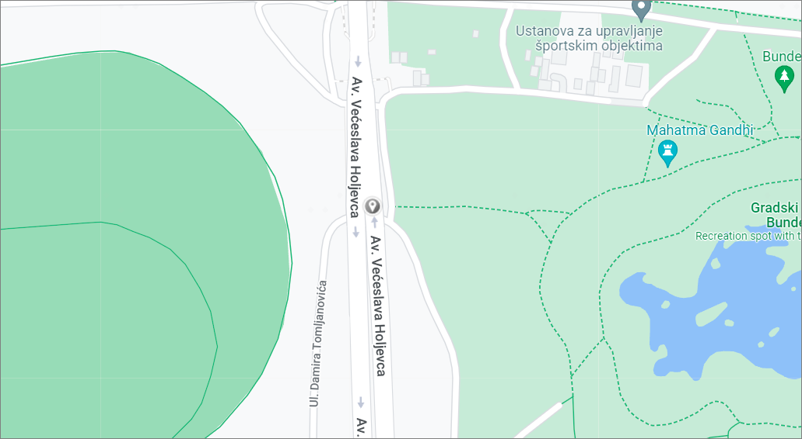

Bonbon Band L1( Edge Cell):Zagreb-Novi Zagreb 10000, Zagreb, Croatia
Operator: Bonbon
Band: L1
Cell ID: 10
E-ARFCN : 75
RSRP:-95dBm to -115dBm

Slide 18
Bonbon Band L20( Edge Cell):Zagreb-Novi Zagreb 10000, Zagreb, Croatia
Operator: Bonbon
Band: L1
Cell ID: 1
E-ARFCN : 6375
RSRP:-95dBm to -115dBm

Slide 19
Bonbon Band L3( Edge Cell):Zagreb-Novi Zagreb 10000, Zagreb, Croatia
Operator: Bonbon
Band: L3
Cell ID: 11
E-ARFCN : 1501
RSRP:-95dBm to -115dBm

Slide 20
THANK YOU
MARQUIS TECHNOLOGIES
www.marquistech.com

