Slide 1
MARQUIS TECHNOLOGIES
Drive Route –Airtel, Idea, VODAFONE & Reliance JIO (FDD/TDD) LTE

Slide 2
Operator Information:
Operator | JIO 4G
MCC | 405
MNC | 866
APN | jionet
Operator | Airtel 4G
MCC | 405
MNC | 53
APN | airtelgprs.com
Operator | VI
MCC | 405
MNC | 753
APN | www

Slide 3
Operator Information 1
Functionality | Airtel
Website: http://www.airtel.com/ WAP APN: airtelgprs.com
Customer care | 199
MNC | 53
Bands supported | Both FDD and TDD
 | LTE 2300 MHz – TDD(Band 40)
 | LTE 2100 MHz - FDD(Band 1)
 | LTE 1800 MHz – FDD(Band 3)
 | LTE 900 MHz – FDD(Band 8)
USSD | To check MDN: *282#
 | Balance check: *123#
 | Data Balance check: *121*114#
VoLTE | Supported
CSFB | Supported (CSFB to 2G)

Slide 4
Operator Information 2
Functionality | RELIANCE JIO
Website: http://www.jio.com WAP APN: jionet
Customer care | 198
MNC | 866
Bands supported | Both FDD and TDD
 | LTE 2300 MHz –TDD(Band 40)
 | LTE 850 MHz – FDD(Band 5)
 | LTE 1800 MHz –FDD(Band 3)
USSD | NA
 | NA
 | NA
VoLTE | Supported
CSFB | Not Supported

Slide 5
Operator Information 3
Functionality | VI
Website: http://www.vodafone.com WAP APN: www
Customer care | 198
MNC | 753
Bands supported | Both FDD
 | LTE 1800 MHz –FDD(Band 3)
USSD | To check MDN*199#
 | Balance check198
 | Data Balance check: 121
VoLTE | Supported
CSFB | Supported (CSFB to 3G)

Slide 6
Drive Route
Near Cell :- Stationary: RSRP : -65dbm to -75dbm
Cell Edge :- Stationary: RSRP : -95dbm to -110dbm
Mixed :- Mobility: RSRP : -65dbm to -110dbm

Slide 7
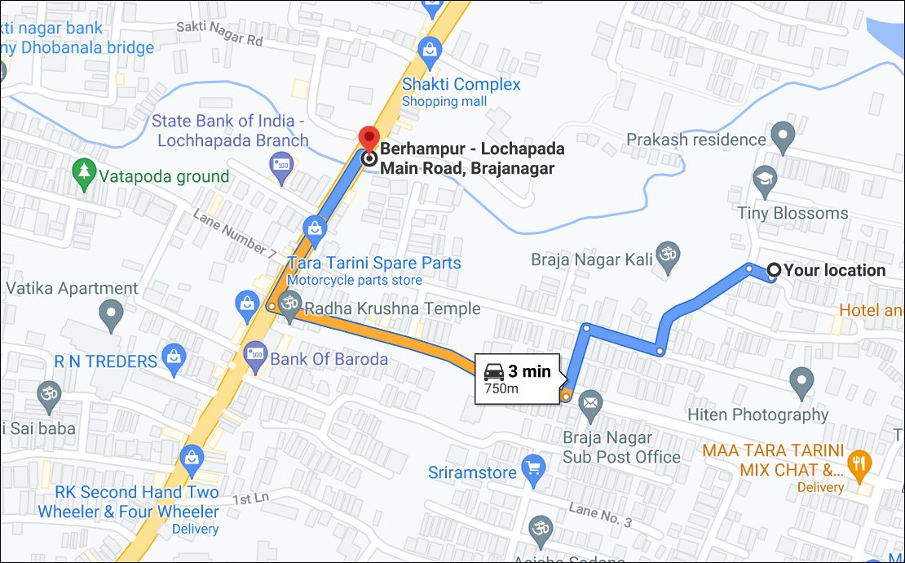
Near Cell (Airtel)
Berhampur - Lochapada Main Rd, Brajanagar, Brahmapur, Odisha 760001
RSRP:
-65dbm to 75dbm

Slide 8
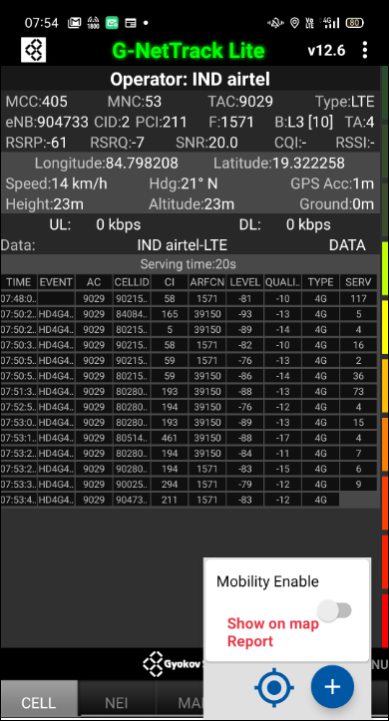
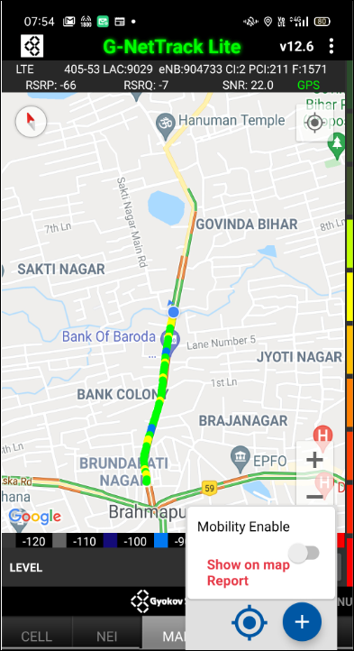
Near Cell Airtel G-Net Snap
Near cell(NC) | Longitude | latitude | RSRP | Cell id | FDD E-ARFCN
1 | 84.798208 | 19.322258 | 61 | 2 | 1571

Slide 9
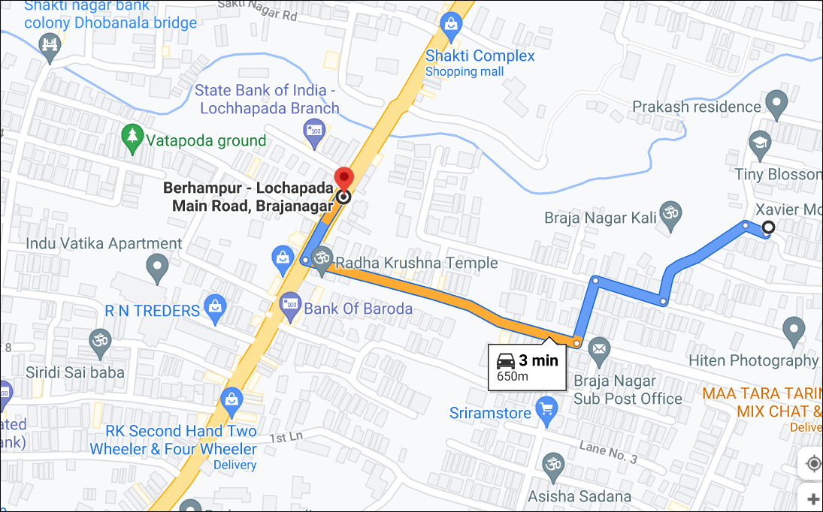
Edge Cell (Airtel)
Berhampur - Lochapada Main Rd, Brajanagar, Brahmapur, Odisha 760001
RSRP:
-95dbm to -110dbm

Slide 10
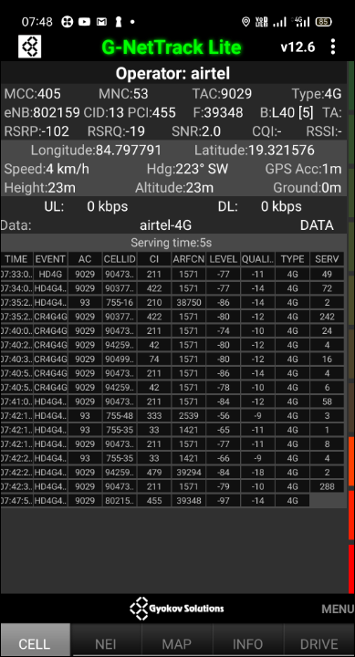
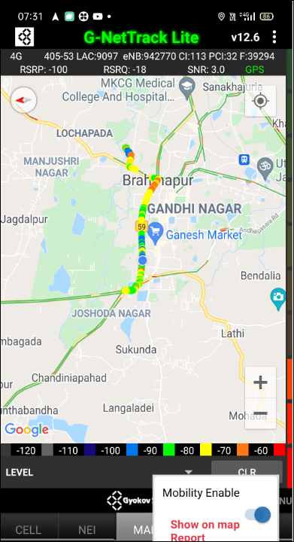
Edge Cell Airtel G-Net Snap
Edge cell(EC) | longitude | latitude | RSRP | Cell id | TDD E-ARFCN
1 | 84.797791 | 19.321576 | 102 | 13 | 39348

Slide 11
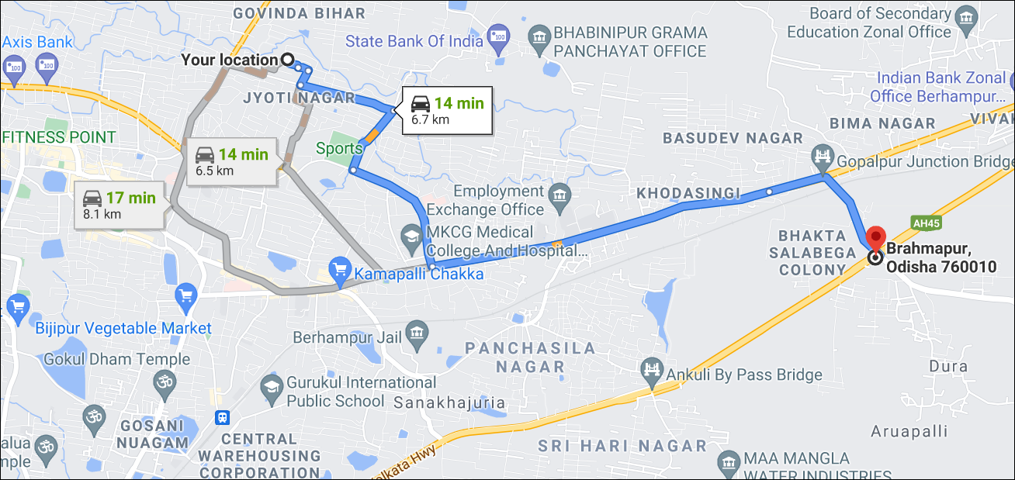
Mixed Mobility Airtel:-
Bhakta Salabega Colony
Brahmapur, Odisha 760010
RSRP:
-95dbm TO -110dbm

Slide 12
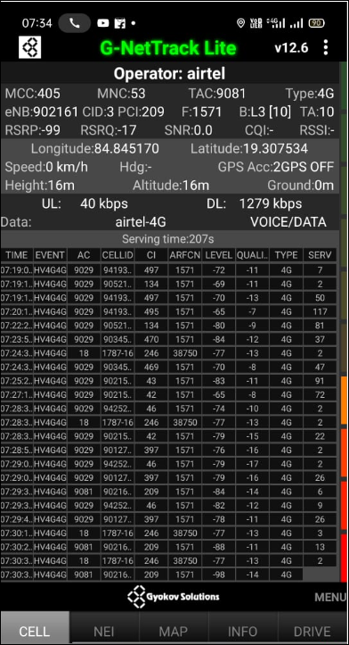
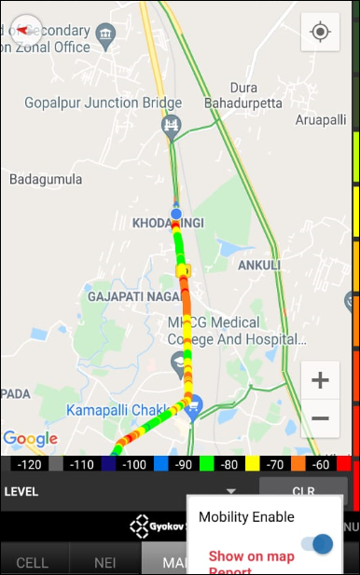
Mixed Mobility Airtel G-Net Snap

Slide 13
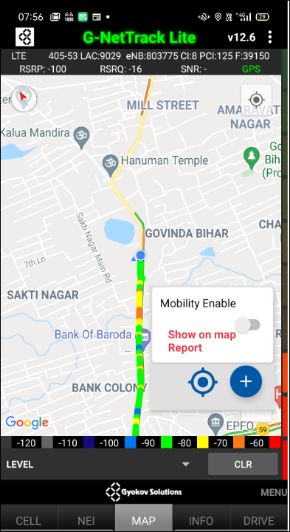
Inter Band Handover (FDD-TDD) Airtel
Band Hand Over | Longitude | Latitude | RSRP
1 | 84.794181 | 19.314950 | -85 to 105 dBM

Slide 14
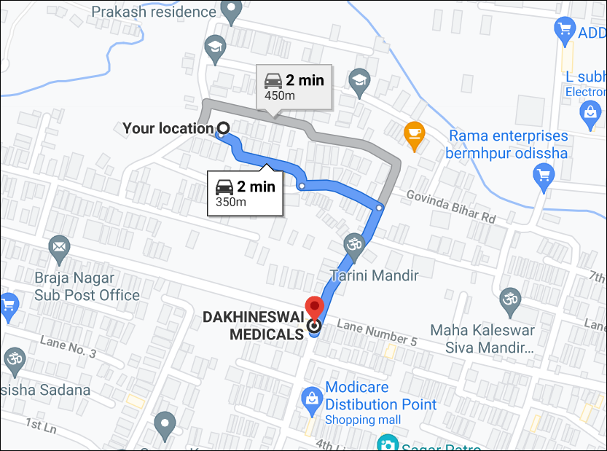
Near Cell (Reliance JIO)
Brajanagar, Brahmapur, Odisha 760001
RSRP:
-65dbm to -75dbm

Slide 15
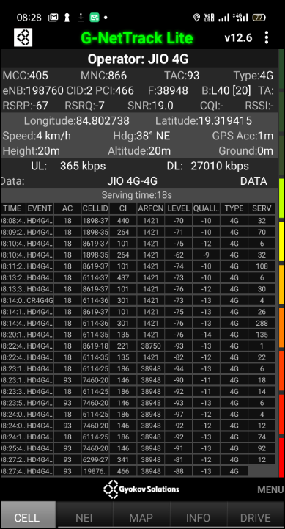
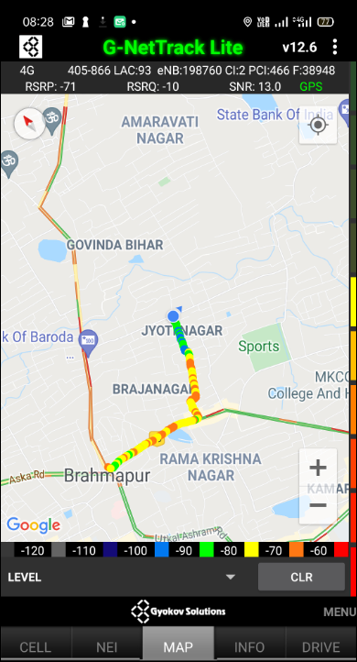
Near Cell Jio G-Net Snap
Near cell(NC) | longitude | latitude | RSRP | Cell id | TDD E-ARFCN
1 | 84.802738 | 19.319415 | 67 | 2 | 38948

Slide 16
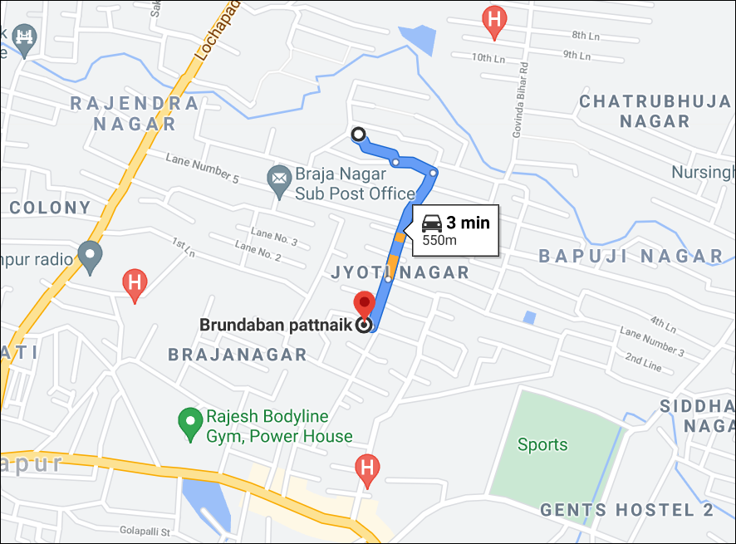
Edge Cell (Reliance JIO)
Bapuji Nagar 5th Lane, Medical Bank Colony, Jyoti Nagar, Brahmapur, Odisha 760004
RSRP:
-95dbm to -110dbm

Slide 17
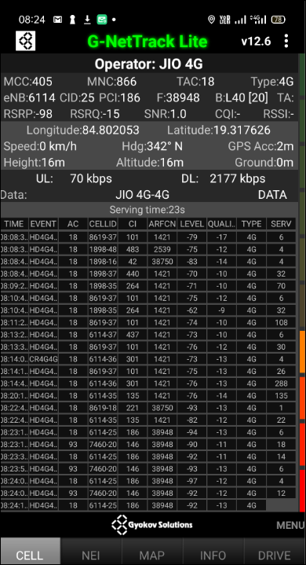
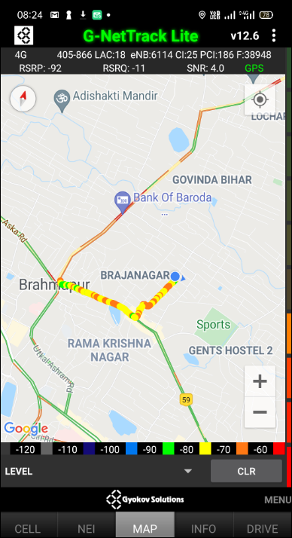
Edge Cell Jio G-Net Snap
Edge cell(NC) | longitude | latitude | RSRP | Cell id | TDD E-ARFCN
1 | 84.802053 | 19.317626 | 98 | 25 | 38948

Slide 18
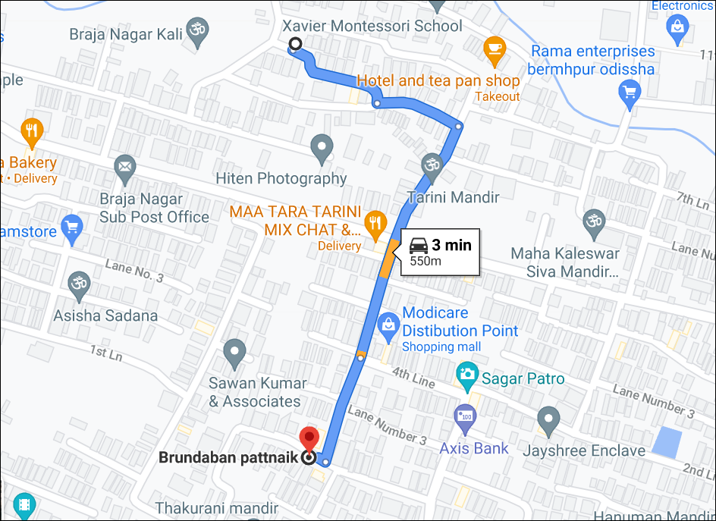
Mixed Mobility Jio:-

Slide 19
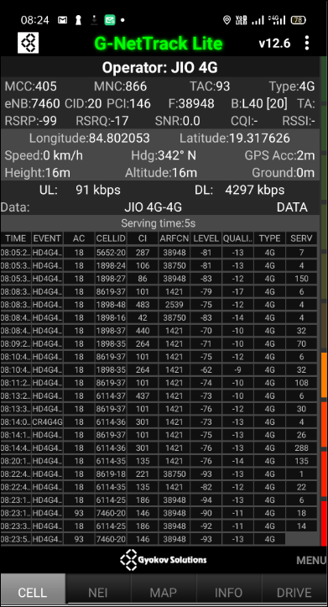

Mixed Mobility Jio G-net Snap

Slide 20
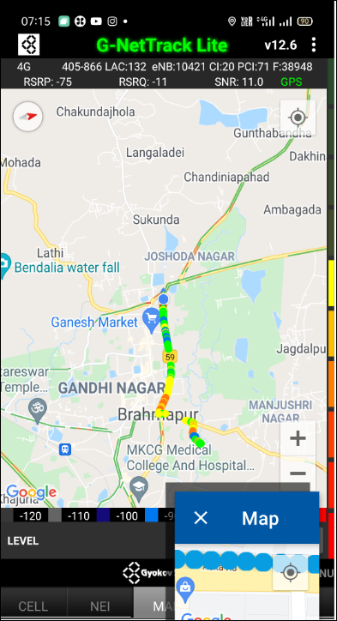
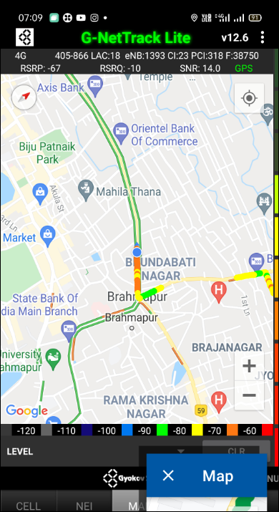
Inter Band Handover (FDD-TDD) JIO 4G
Band Handover | longitude | latitude | RSRP | PCI | TDD E-ARFCN
1 | 84.777108 | 19.319665 | 90 | 44 | 38948

Slide 21
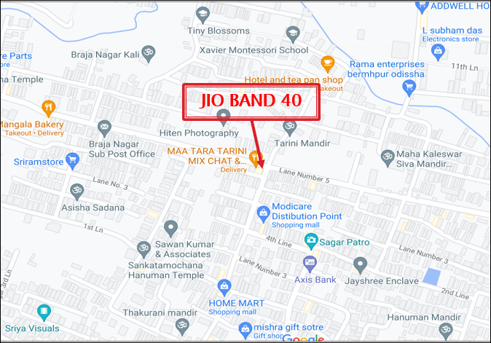
RJIO Band 40 Near Cell:-
Lat -19.319560 Long-84.802771

Slide 22
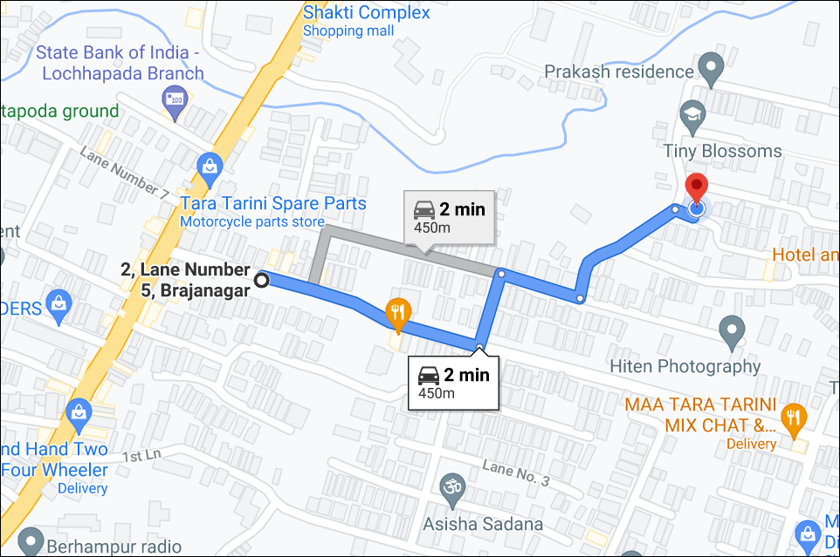
Near Cell VI:-
2nd Lane number-5, Brajanagar, Berhampur, odisha
RSRP:
-65dbm to -75dbm

Slide 23
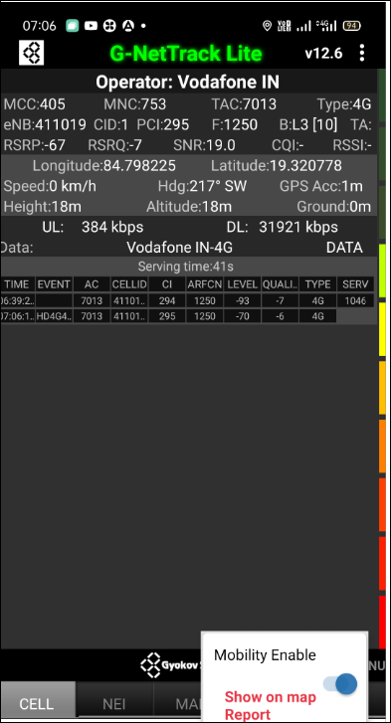
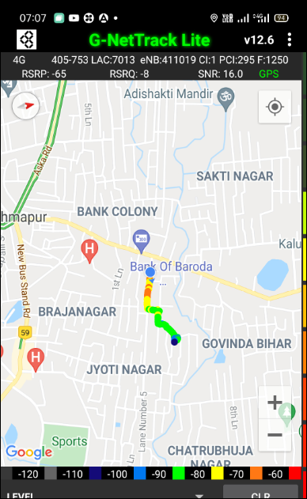
Near Cell VI G-Net Snap
Near cell(NC) | longitude | latitude | RSRP | Cell id | FDD E-ARFCN
1 | 84.798225 | 19.320778 | 67 | 1 | 1250

Slide 24
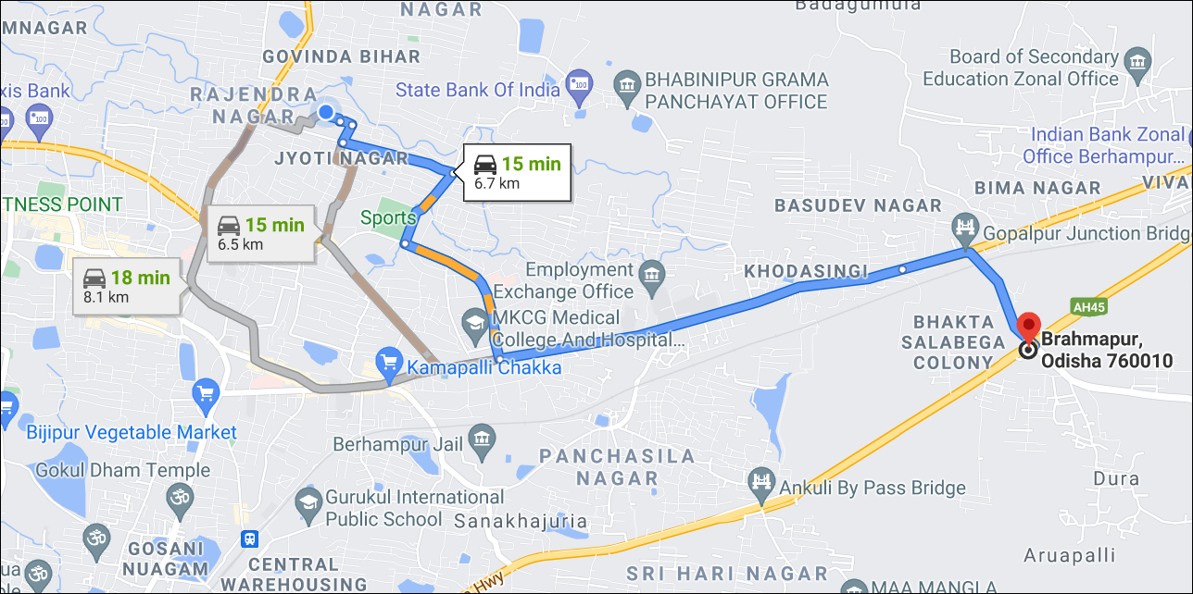
Cell Edge VI:-
Bhakta Salabega Colony
Brahmapur, Odisha 760010
RSRP:
-95dbm to -105dbm

Slide 25
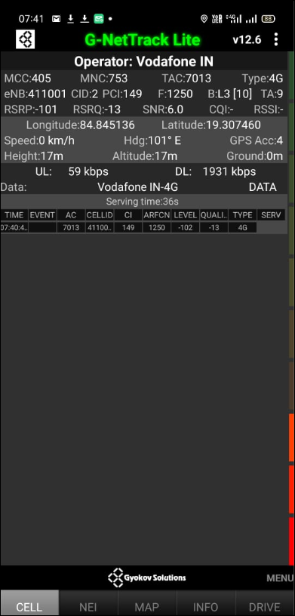
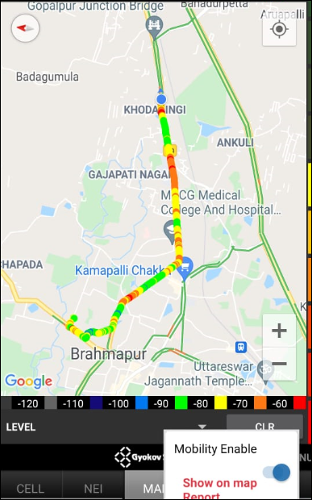
Cell Edge VI G-Net Snap
Edge cell(EC) | longitude | latitude | RSRP | Cell id | FDD E-ARFCN
1 | 84.845136 | 19.30746 | 101 | 2 | 1250

Slide 26
Mixed Mobility VI:-

Slide 27
Airtel & VI SRVCC UTRAN
SRVCC Point Not Found

Slide 28
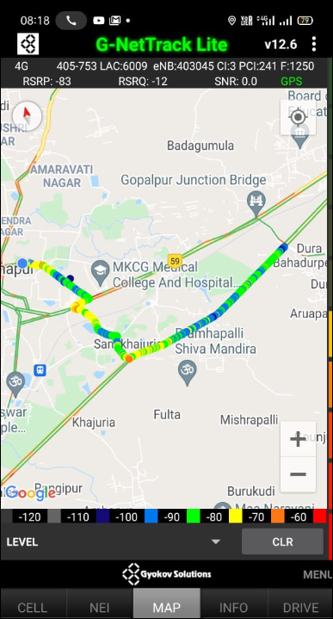
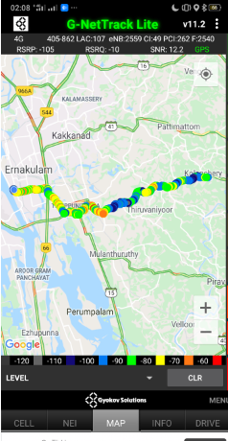
G-Net Tracker Drive Route

Slide 29
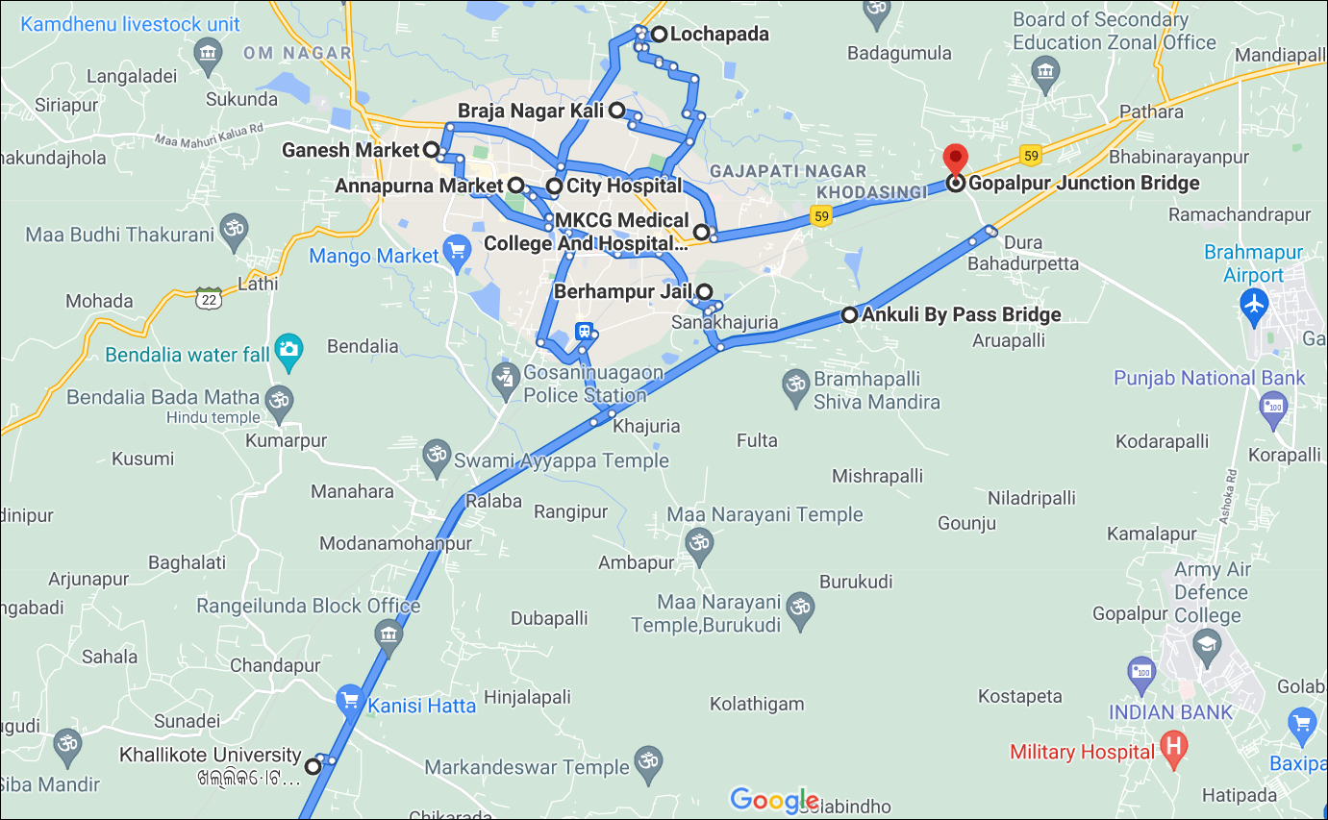
Berhampur Drive Route

Slide 30
THANK YOU
MARQUIS TECHNOLOGIES

