Slide 1
Trivandrum/ Kerala Network Information
Trivandrum
(Kerala)
S.NO | Operator Name | Service Supported | Band Supported | Band Tested | Endc Combination tested | CA Combination
1 | Airtel | 2G/4G/5G/VoLTE/VoWiFi | 4G BAND 1/3/8/40,5GBand N78 | B40,B3,N78 | N78+B1,N78+B8 | B3+B40
2 | RJIO | 4G/5G/VoLTE/VoWiFi | 4G BAND 3/5/40,5G Band N78/N28 | B40,B1,N78,N28 | NA | B40+B40
3 | VI | 2G/4G/VoLTE/VoWiFi | 4G BAND 1/3/8/41 | B3,41,8 | NA | B3+B41
4 | BSNL | 2G/3G | B1 | 2100MZH/900MHZ | NA | NA

Slide 2
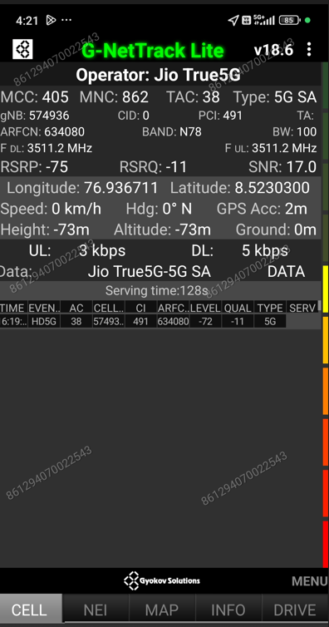
JIO 5G Good Coverage Location
Description | Operator | Band | Lat. | Long.
5G SA Throughput Location | JIO | N78 | 76.936711 | 8.523030

Slide 3
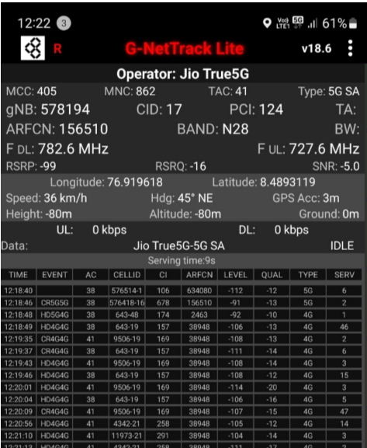
JIO 5G SA N28 Location
Discerption | Operator | Band | Lat. | Long.
5G SA N28 Location | JIO | N28 | 76.919618 | 8.489311

Slide 4
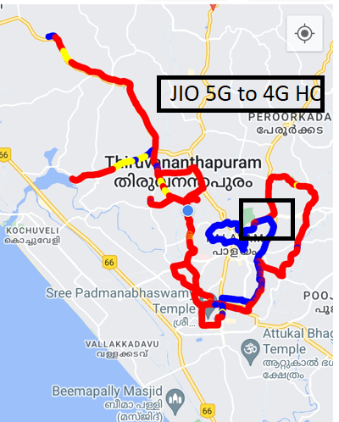
JIO 5G to 4G Handover Location
Discerption | Operator | Technology/ Band | Lat. | Long.
5G to 4G Handover Location | JIO | 5G>>4G>>5G | 76.93789 | 8.51342

Slide 5
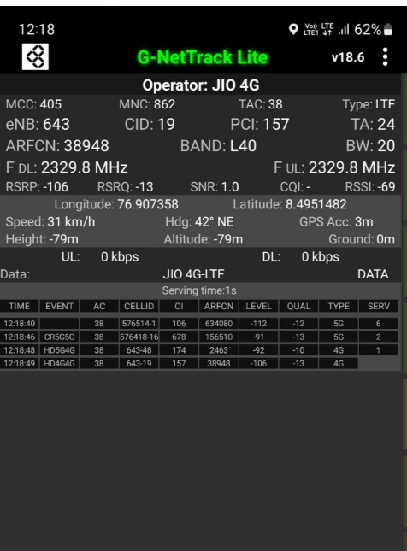
JIO LTE 2CA Location
Discrption | Operator | Band | Lat. | Long.
LTE CA Location | JIO | B40+B40 | 76.907358 | 8.49548

Slide 6
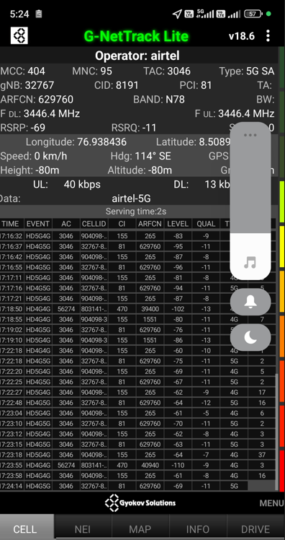
Airtel 5G good coverage Location
Discrption | Operator | Band | Lat. | Long.
5G SA Throughput Location | Airtel | N78+B3 | 76.7938 | 8.5089

Slide 7
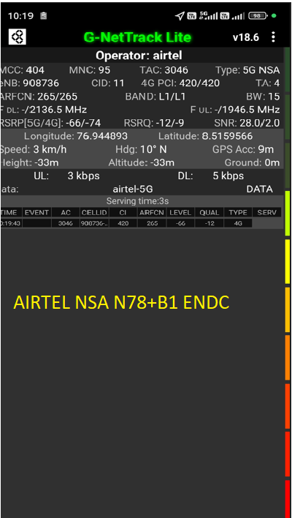
Airtel ENDC Combination
Discerption | Operator | Band | Lat | Long
Airtel ENDC Combination | Airtel | N78+B1 | 76.794489 | 8.515966
 |  | N78+B3 | 76.7938 | 8.5089

Slide 8
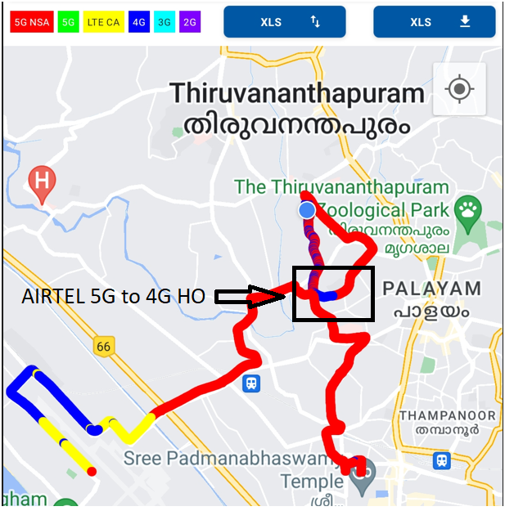
Airtel 5G to 4G Handover Location
Discerption | Operator | Technology | Lat. | Long.
5G to 4G Handover Location | Airtel | 5G>>4G>>5G | 76.644407 | 8.423993

Slide 9
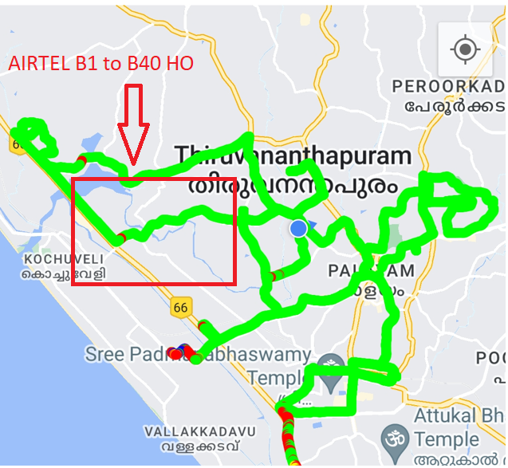
Airtel LTE BAND Handover
Discerption | Operator | Technology | Lat. | Long.
Airtel LTE Band Handover | Airtel | TDD>>FDD>>TDD | 76.736544 | 8.462064

Slide 10
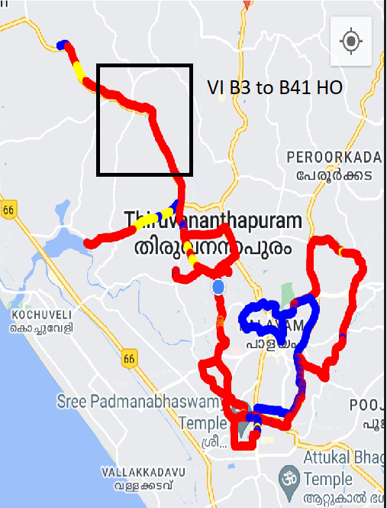
VI LTE BAND Handover
Discerption | Operator | Technology | Lat. | Long.
VI LTE Band Handover | VI | TDD>>FDD>>TDD | 76.764113 | 8.416126

Slide 11
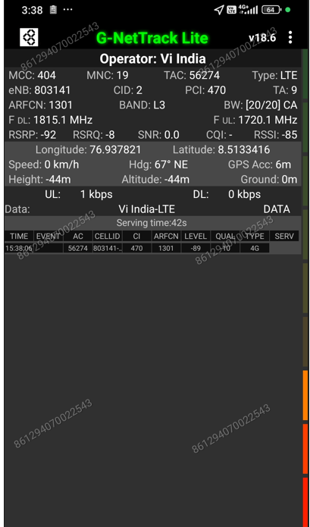
VI LTE 2CA Location
Discerption | Operator | Technology | Lat. | Long.
VI LTE CA Location | VI | B3+B8 | 76.937821 | 8.513316

Slide 12

THANK YOU

