Slide 1
MARQUIS TECHNOLOGIES
Drive Route
Luxembourg

Slide 2
(Location Name)
Country | Luxembourg
Continent | Europe
City | Luxembourg
Time Zone | (GMT+1)

Slide 3
Operators in Location
MCC | MNC | Operator
270 | 99 | POST
270 | 77 | Tango
270 | 99 | Orange
POST
RAT | Band | Comment
5G | 3500 MHz(N78)
4G | 800 MHz (Band 20), 1800 MHz (Band 3) & 2600 MHz (Band 7)
3G | -
2G | 900 MHz & 1800 MHz
Tango
RAT | Band | Comment
5G | 3500 MHz(N78)
4G | 800 MHz (Band 20), 1800 MHz (Band 3) & 2600 MHz (Band 7)
3G | 2100MHz
2G | 900 MHz & 1800 MHz
Orange
RAT | Band | Comment
5G | 3500 MHz(N78)
4G | 800 MHz (Band 20), 1800 MHz (Band 3) & 2600 MHz (Band 7)
3G | 2100MHz
2G | 1800 MHz

Slide 4
Drive Route operator
Near Cell :-Stationary: RSRP: -60dbm to -75dbm
Mixed :-Mobility: RSRP : -75dbm to -95dbm
Cell Edge :-Stationary: RSRP : -95dbm to -115dbm

Slide 5
POST

Slide 6
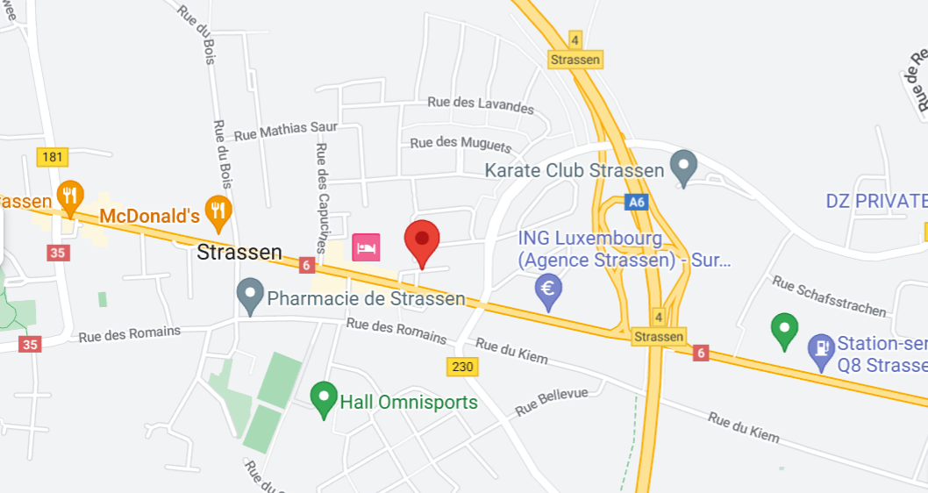
Near Cell screenshots of all band with Network INFO. Which include 5G also.
Operator: POST
Band: N78
RSRP: -60dBm to -75dBm

Slide 7
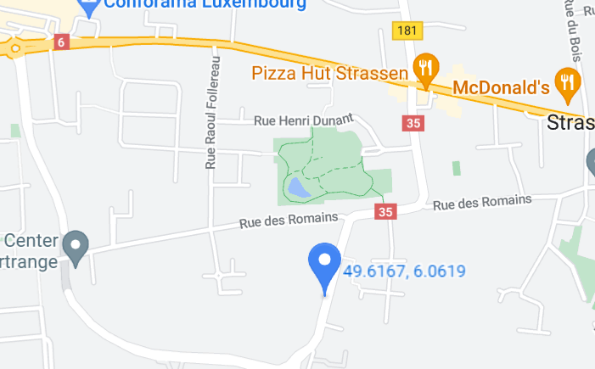
Edge Cell screenshots of all band with Network INFO. Which includes 5G also
Operator: POST
Band: N78
RSRP: -95dbm to 115dbm

Slide 8
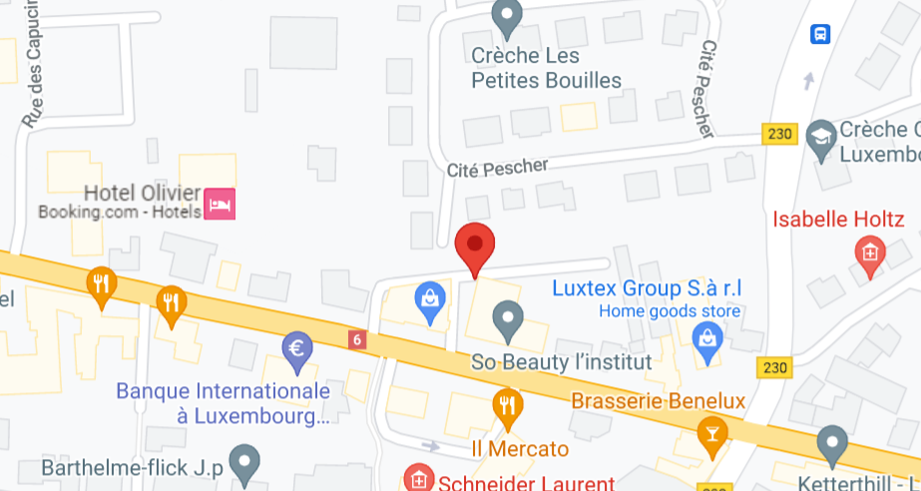
( Mixed Mobility Area) screenshots

Slide 9
Tango

Slide 10
Near Cell screenshots of all band with Network INFO. Which include 5G also.
Operator: Tango
Band: N78
RSRP: -60dBm to -75dBm

Slide 11
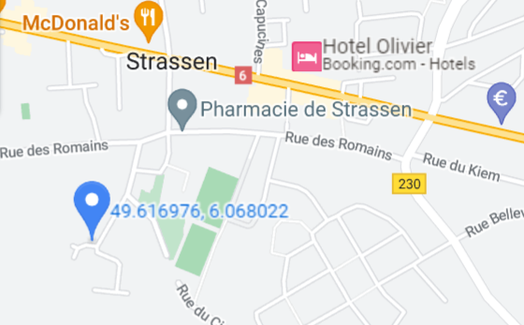
Edge Cell screenshots of all band with Network INFO. Which includes 5G also
Operator: Tango
Band: N78
RSRP: -95dbm to 115dbm

Slide 12
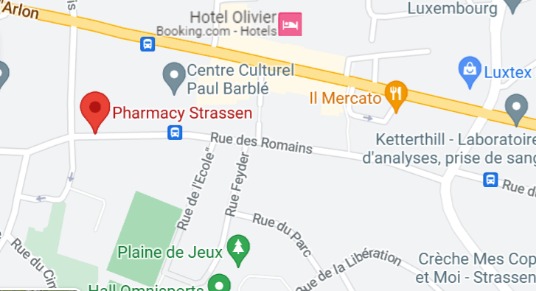
( Mixed Mobility Area) screenshots

Slide 13
Orange

Slide 14
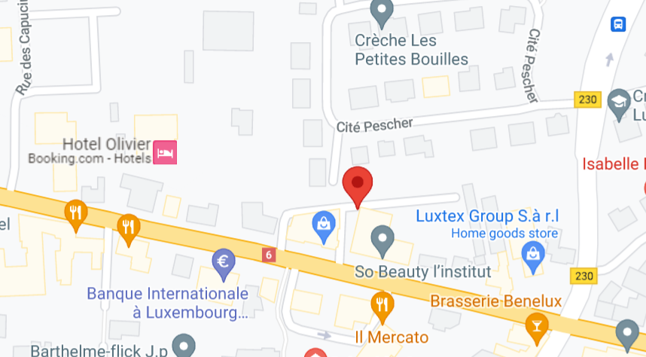
Near Cell screenshots of all band with Network INFO. Which include 5G also.
Operator: Orange
Band: N78
RSRP: -60dBm to -75dBm

Slide 15
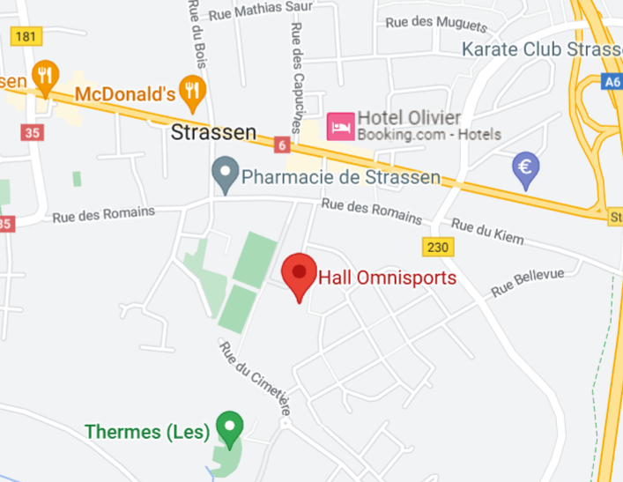
Edge Cell screenshots of all band with Network INFO. Which includes 5G also
Operator : Orange
Band: N78
RSRP: -95dbm to 115dbm

Slide 16
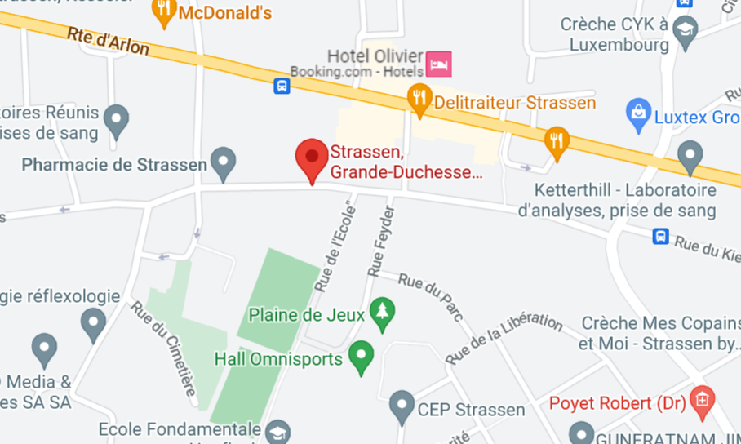
( Mixed Mobility Area) screenshots

Slide 17
THANK YOU
MARQUIS TECHNOLOGIES
www.marquistech.com

