Slide 1
MARQUIS TECHNOLOGIES
Drive Route

Slide 2
Lucknow/India
Operator Details:
S. No. | Operator |  | Supported Bands | Supported Features by Network
1 | Major | Airtel | LTE FDD B1/B3/B8 & TDD B40/N78 | VoWiFi/VoLTE/4G/2G/5G
2 |  | JIO | LTE FDD B3/B5 & TDD B40/N78/N28 | VoWiFi/VoLTE/4G/5G
3 |  | VI | LTE FDD B3/B8 & TDD B41/N78 | VoWiFi/VoLTE/4G/3G/2G
4 | Minor | BSNL | LTE FDD B1 | Volte/4G/3G/2G

Slide 3
Operator Information 1
Functionality | Airtel
Website: http://www.airtel.com/ WAP APN: airtelgprs.com
Customer care | 121
MNC | 54
Bands supported | Both FDD and TDD
 | LTE 2300 MHz – TDD(Band 40)
 | LTE 1800, 2100 MHz – FDD(Band 3 & 1)
USSD | To check MDN: *282#
 | Balance check: *123#
 | Data Balance check: *121*2#
VoLTE | Supported
CSFB | Supported (4G to 2G)

Slide 4
Operator Information 2
Functionality | RELIANCE JIO
Website: http://www.jio.com WAP APN: jionet
Customer care | 198
MNC | 8
Bands supported | Both FDD and TDD
 | LTE 2300 MHz –TDD(Band 40)
 | LTE 850 MHz – FDD(Band 5)
 | LTE 1800 MHz –FDD(Band 3)
USSD | NA
 | NA
 | NA
VoLTE | Supported
CSFB | Not Supported

Slide 5
Operator Information 3
Functionality | VI
Website: http://www.vi.com WAP APN: www
Customer care | 121
MNC | 15
Bands supported | Both FDD and TDD
 | LTE 2300 MHz –TDD(Band 41)
 | LTE 850 MHz – FDD(Band 5)
 | LTE 1800 MHz –FDD(Band 3)
USSD | To check MDN*199#
 | Balance check 121
 | Data Balance check: 121
VoLTE | Supported
CSFB | Supported(4g to 2g/3g)

Slide 6
Operator Information 4
Functionality | Bsnl
Website: http://www.bsnl.com WAP APN: www.bsnlnet
Customer care | 121
MNC | 55
Bands supported | Both FDD and TDD not supported
 | UTMS 2100
 | GSM900
USSD | To check MDN*222#
 | Balance check: 123
 | Data Balance check: 123
VoLTE | not Supported
CSFB | not Supported

Slide 7
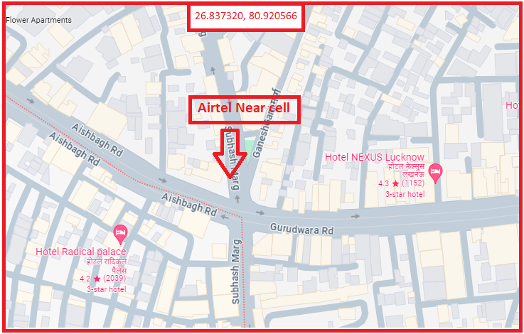
AIRTEL 5G Near Cell
Lat/Long -26.837320° N, 80.920566° E
Specification –Stable Airtel 5G NSA network

Slide 8
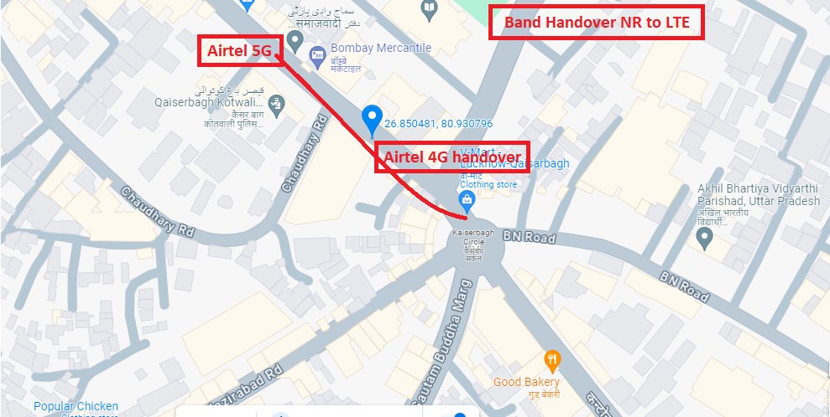
NR to LTE Handover Airtel
Lat. 26.850481 & Long. 80.930796 to Location –Kesar ganj Specification –Band Handover

Slide 9
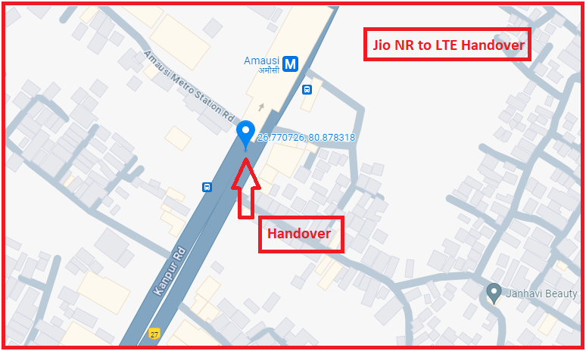
NR to LTE Handover JIO
Lat. 26.770726 & Long. 80.878318 Location –Near Amausi Metro Station

Slide 10
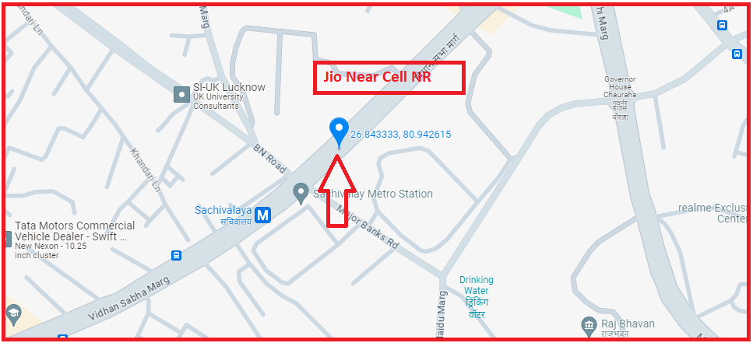
JIO Near Cell NR
Lat. 26.843333 & Long. 80.942615

Slide 11
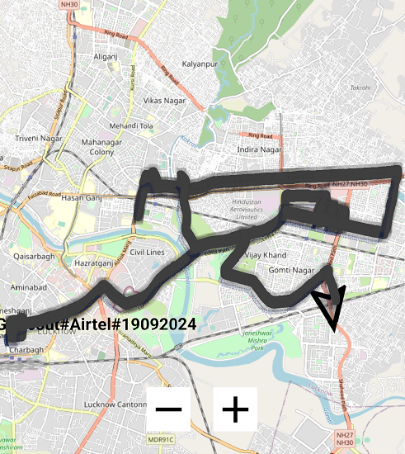
5G NSA Airtel

Slide 12
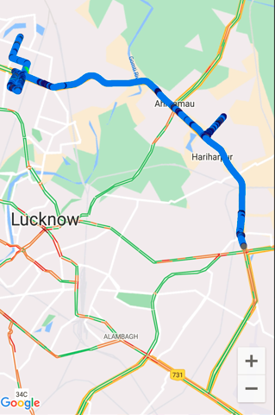
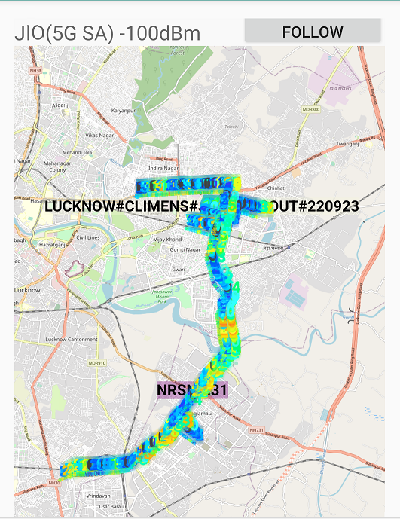
5G SA Rjio
Loc: T/G-6/6 DLF City Centre, Vibhuti Khand, Gomti Nagar, Lucknow, Uttar Pradesh 226010

Slide 13
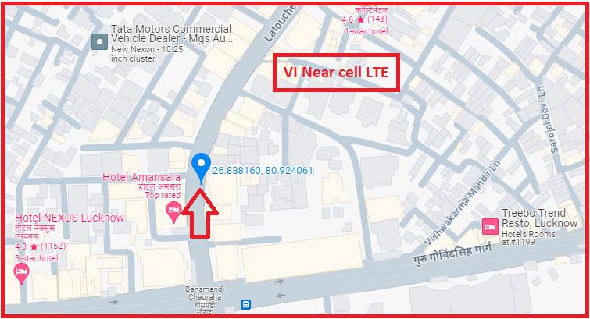
VI LTE Near Cell
Lat. 26.838160° N, Long 80.924061° E Location – Near BansMandi Chauraha

Slide 14
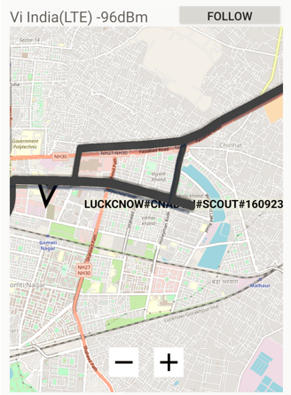
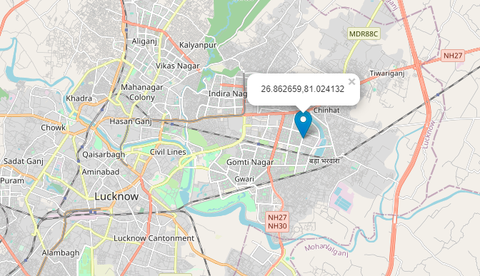
VI LTE Loc: Lat:26.862659 Long.:81.024132

Slide 15
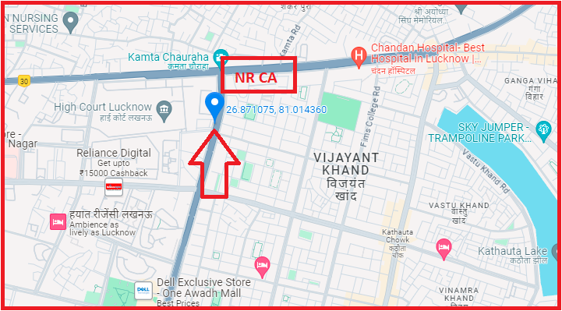
NR CA Jio
Lat. 26.871075 & Long. 81.014360 to
Vibhuti Khand

Slide 16
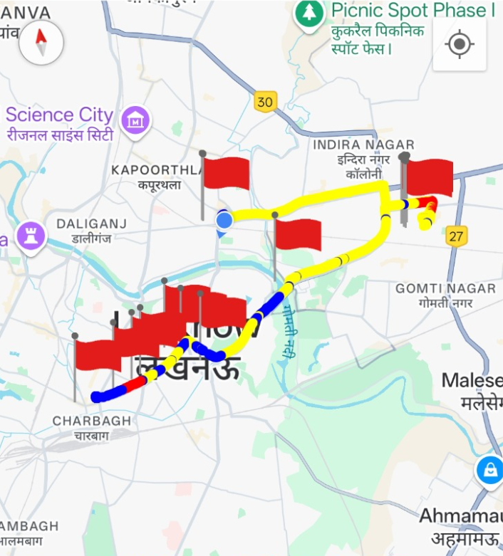
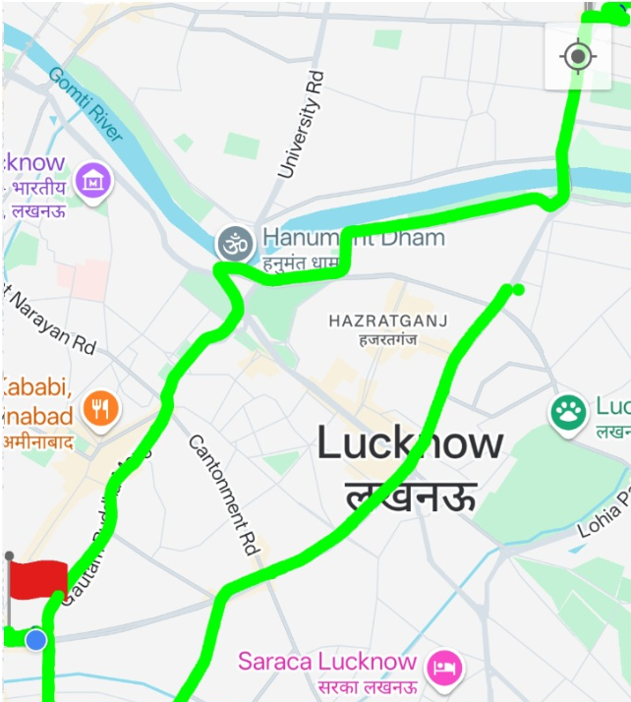
DRIVE ROUTE

Slide 17


Slide 18
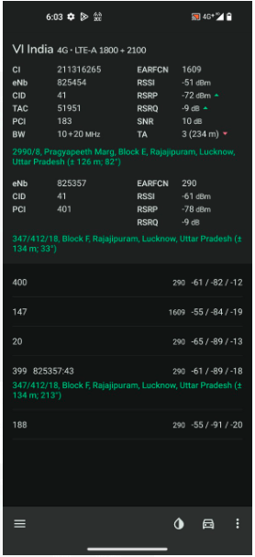
Near Cell screenshots of all band with Network INFO.
Operator: VI
Band: 3
Cell ID: 41
E-ARFCN : 1609
RSRP: -60dBm to -75dBm

Slide 19
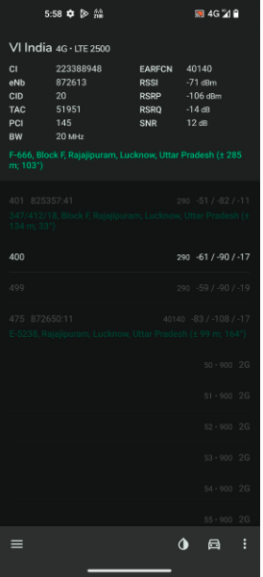
Edge Cell screenshots of all band with Network INFO. Which includes 5G also
Operator: VI
Band: 41
Cell ID: 20
E-ARFCN : 40140
RSRP: -95dbm to 115dbm

Slide 20
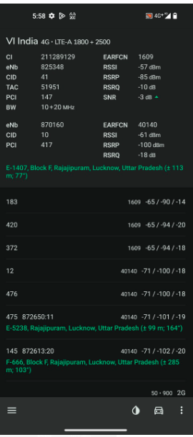
( Mixed Mobility Area) screenshots

Slide 21
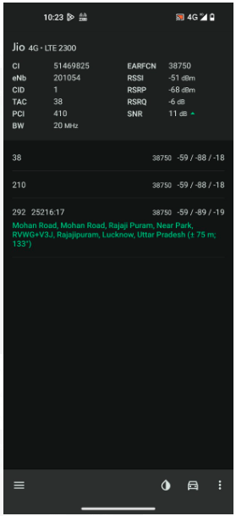
Near Cell screenshots of all band with Network INFO.
Operator: JIO
Band: 40
Cell ID: 1
E-ARFCN : 38750
RSRP: -60dBm to -75dBm

Slide 22
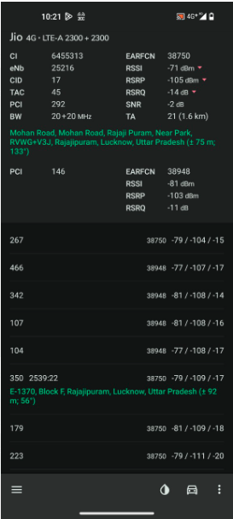
Edge Cell screenshots of all band with Network INFO.
Operator: JIO
Band: 40
Cell ID: 17
E-ARFCN : 38750
RSRP: -95dbm to 115dbm

Slide 23
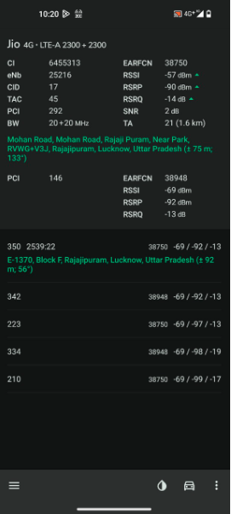
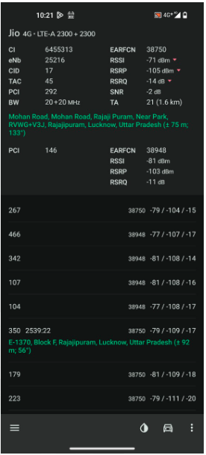
( Mixed Mobility Area) screenshots

Slide 24
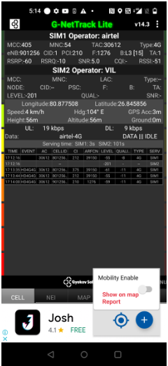
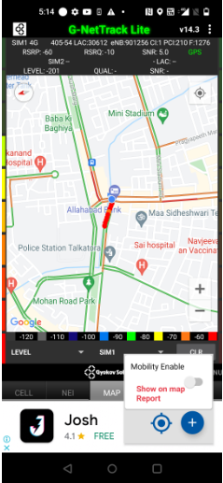
Near Cell (Airtel)
Near cell(NC) | longitude | latitude | RSRP | Cell id | TDD/FDD E-ARFCN
1 | 80.877508 | 26.845856 | 60 | 1 | 1276
Rajajipuram
RSRP:
-55dbm to 7dbm

Slide 25
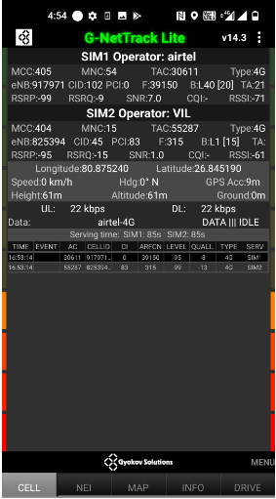
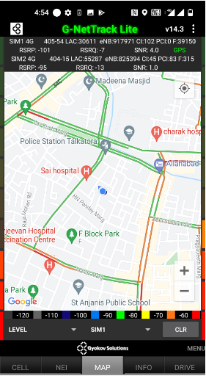
Edge Cell (Airtel)
Near cell(NC) | longitude | latitude | RSRP | Cell id | TDD E-ARFCN
1 | 80.875240 | 26.845190 | 100 | 102 | 39150
Rajajipuram
RSRP:
-95dbm to -110dbm

Slide 26
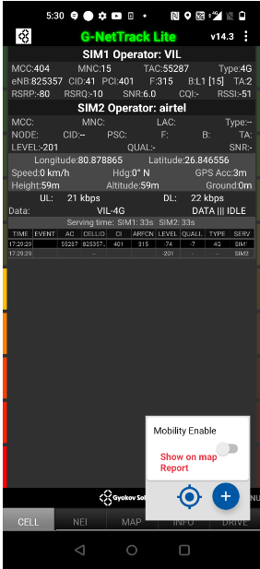
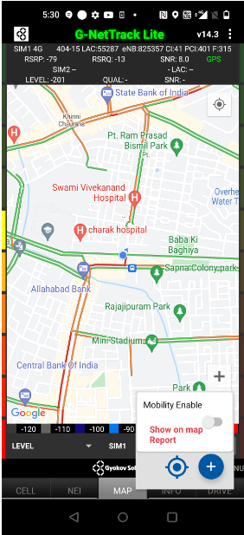
Mixed Mobility:- Lucknow
Rajajipuram
RSRP: -75dbm to -100dbm

Slide 27
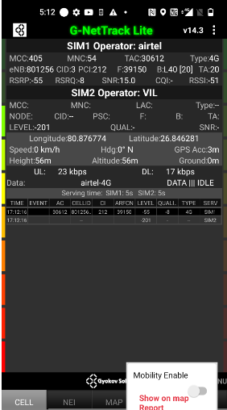
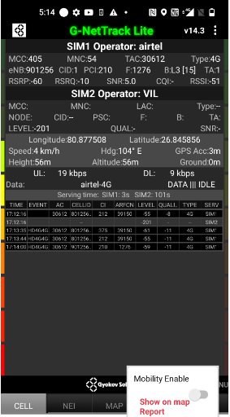
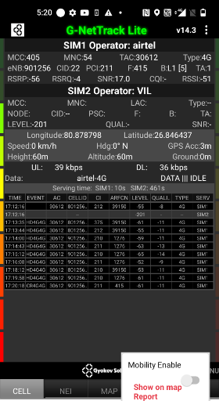
Airtel inter Band HO (TDD-FDD)
Band Hand Over | Longitude | Latitude | RSRP
1 & 3 & 40 | 80.876774 | 26.846281 | -55 to 75 dBM
Rajajipuram Talkatora police station to Meenabakery Chauraha drive root

Slide 28
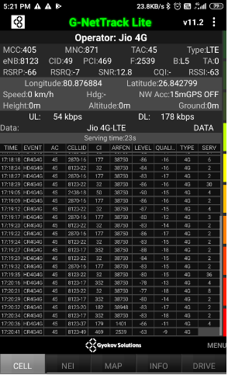
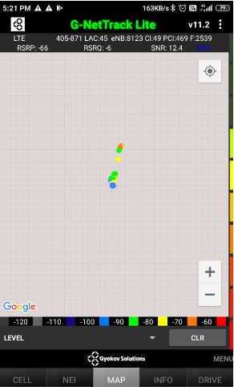
Near Cell (Reliance JIO)
Near cell(NC) | longitude | latitude | RSRP | Cell id | TDD/FDD E-ARFCN
1 | 80.876884 | 26.842779 | 66 | 49 | 2539
Rajajipuram
RSRP:
-65dbm to -75dbm

Slide 29
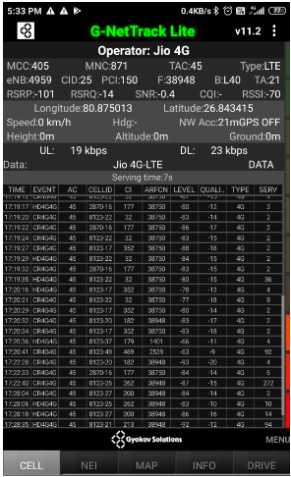
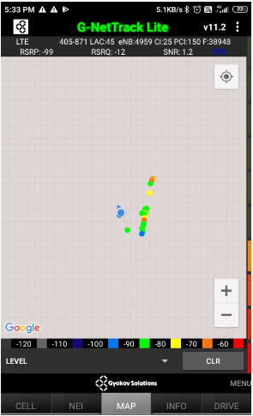
Edge Cell (Reliance JIO)
Edge cell(NC) | longitude | latitude | RSRP | Cell id | TDD E-ARFCN
1 | 80.875013 | 26.843415 | 101 | 25 | 38948
Rajajipuram
RSRP:
-95dbm to -110dbm

Slide 30
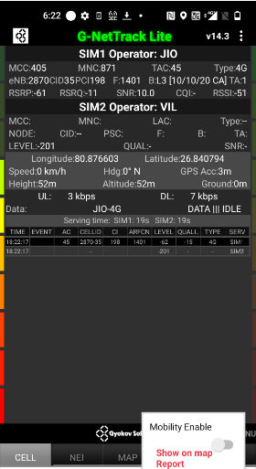
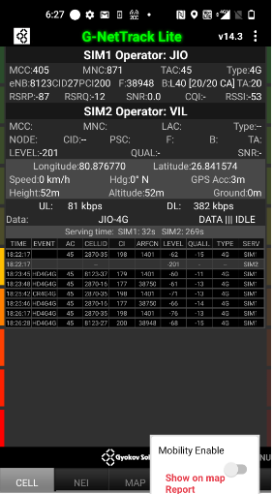
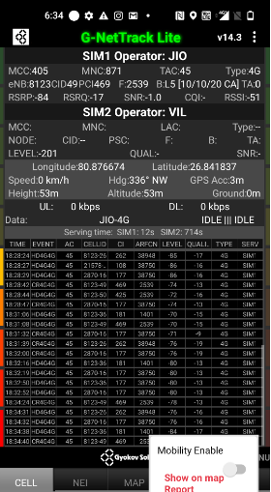
Inter Band Handover (FDD-TDD), JIO 4G
Band Handover | longitude | latitude | RSRP
3 & 5 & 40 | 80.876603 | 26.840794 | -60 to -90
Rajajipuram F_block market to
Talkatota police station

Slide 31
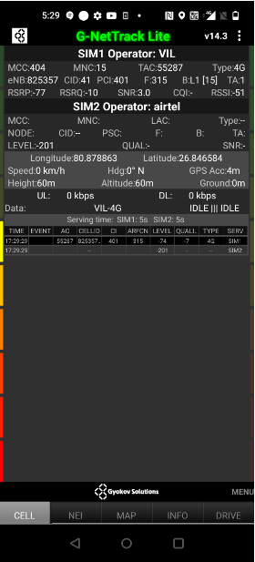
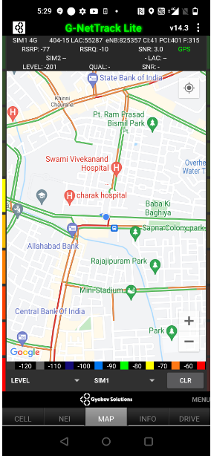
Near Cell VI:
Near cell(NC) | longitude | latitude | RSRP | Cell id | TDD/FDD E-ARFCN
1 | 80.878863 | 26.846584 | 77 | 41 | 315
Rajajipuram
RSRP:
-60dbm to -75dbm

Slide 32
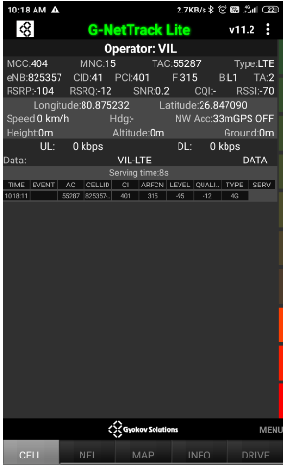
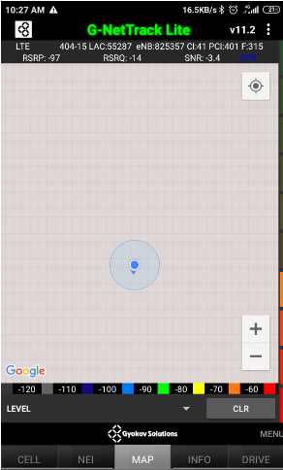
Cell Edge VI:
Edge cell(EC) | longitude | latitude | RSRP | Cell id | TDD/FDD E-ARFCN
1 | 80.875232 | 26.847090 | 98 | 41 | 315
Rajajipuram
RSRP:
-95dbm to -105dbm

Slide 33
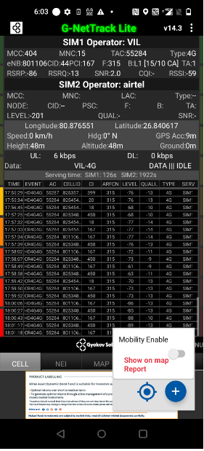
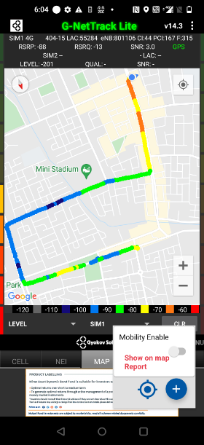
Mixed coverage area Vodafone:
Rajajipuram
RSRP:
-70dbm to -105dbm

Slide 34
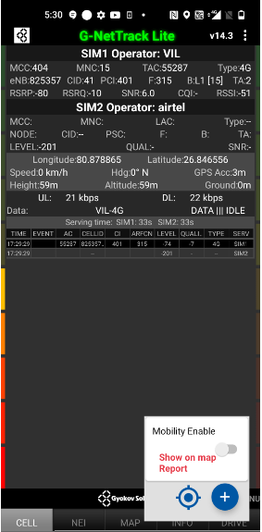
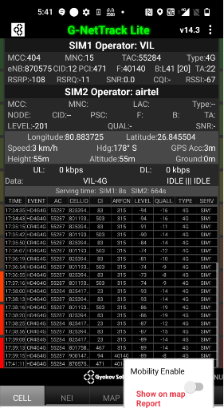
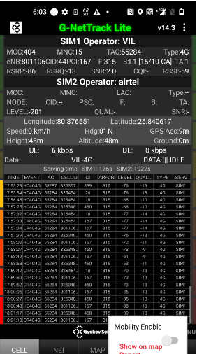
VI Inter Band Handover (TDD/FDD)
Band Hand Over | Longitude | Latitude | RSRP
1 & 3 & 40 | 80.878865 | 26.846556 | -75 to 105 dBM
Rajajipuram to Charbagh
Drive rout for Band HO
RSRP:
-90dbm to -105dbm

Slide 35
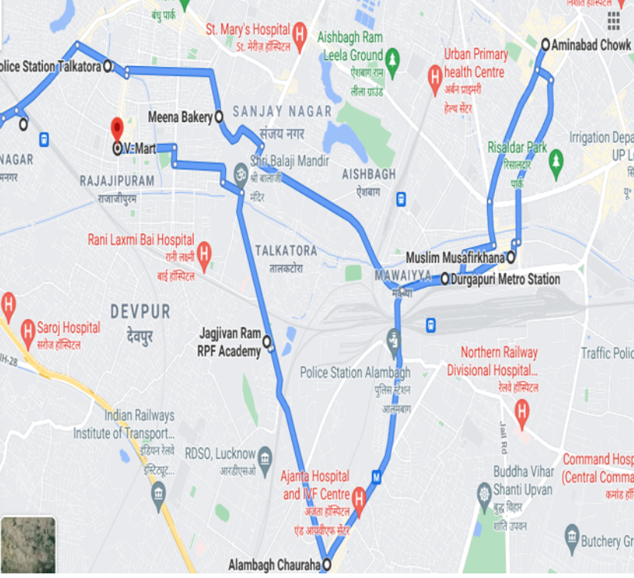
Drive root Tracking map :

Slide 36
THANK YOU
MARQUIS TECHNOLOGIES
www.marquistech.com

