Slide 1
MARQUIS TECHNOLOGIES
Drive Route –Airtel, VI & Reliance JIO (FDD/TDD) LTE
Location : Indore

Slide 2
Operator Information:
Operator | JIO 4G
MCC | 405
MNC | 863
APN | jionet
Operator | Airtel 4G
MCC | 404
MNC | 93
APN | airtelgprs.com
Operator | VI
MCC | 404
MNC | 78
APN | internet
Operator | BSNL
MCC | 404
MNC | 58
APN | Bsnlnet

Slide 3
Operator Information 1
Functionality | Airtel
Website: https://www.airtel.in/ WAP APN: airtelgprs.com
Customer care | 121
MNC | 93
Bands supported | Both FDD and TDD
 | LTE 2300 MHz – TDD(Band 40)
 | LTE 1800 – FDD(Band 3) LTE 2100 – FDD (Band 1)
USSD | To check MDN: *282#
 | Balance check: *123#
 | To check all services: *121#
VoLTE | Supported
VoWiFi | Supported
CSFB | Supported (CSFB to 2G)

Slide 4
Operator Information 2
Functionality | RELIANCE JIO
Website: https://www.jio.com WAP APN: jionet
Customer care | 198
MNC | 863
Bands supported | Both FDD and TDD
 | LTE 2300 MHz –TDD(Band 40)
 | LTE 850 MHz – FDD(Band 5)
 | LTE 1800 MHz –FDD(Band 3)
USSD | NA
 | NA
 | NA
VoLTE | Supported
VoWiFi | Supported
CSFB | Not Supported

Slide 5
Operator Information 3
Functionality | VI
Website: https://www.myvi.in WAP APN: internet
Customer care | 198
MNC | 78
Bands supported | Both FDD and TDD
 | LTE 2300 MHz –TDD(Band 40)
 | LTE 2500 MHz –TDD(Band 41)
 | LTE 1800 MHz –FDD(Band 3)
USSD | To check MSISDN :*199#
 | Recharge : *199*5#
 | Balance check : *199*2#
VoLTE | Supported
VoWiFi | Not Supported
CSFB | Supported (CSFB to 2G/3G)

Slide 6
Drive Route
Near Cell : Stationary: RSRP : -65dbm to -75dbm
Edge Cell : Stationary: RSRP : -95dbm to -110dbm
Mixed : Mobility: RSRP : -65dbm to -110dbm

Slide 7
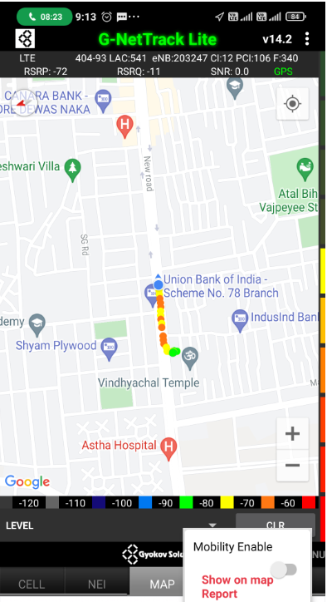
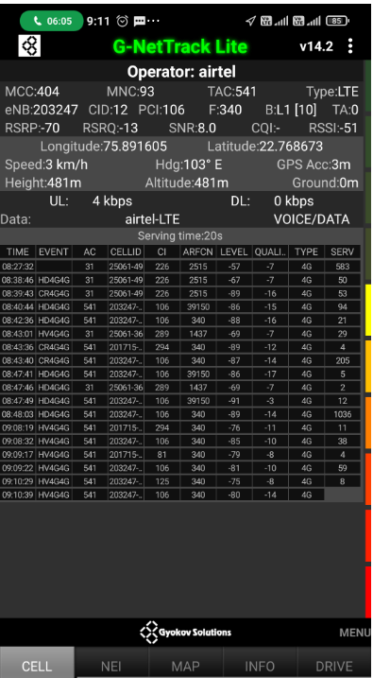
Near Cell (Airtel)
Near cell | longitude | latitude | RSRP (dbm) | Cell id | E-ARFCN
1 | 75.891605 | 22.768673 | -70 | 12 | 340
RSRP Range for Near Cell :
-65dbm to -75dbm
Sector- B,
Scheme No. 78,
Vijay Nagar,
Indore

Slide 8
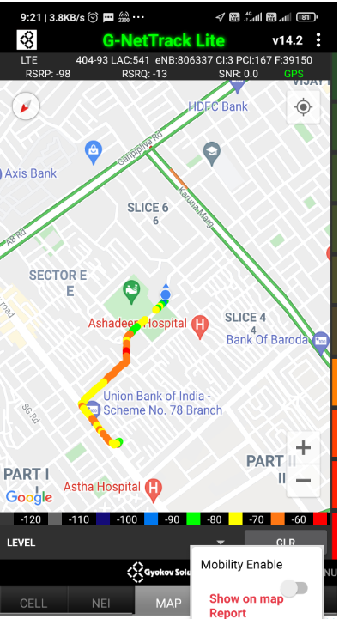
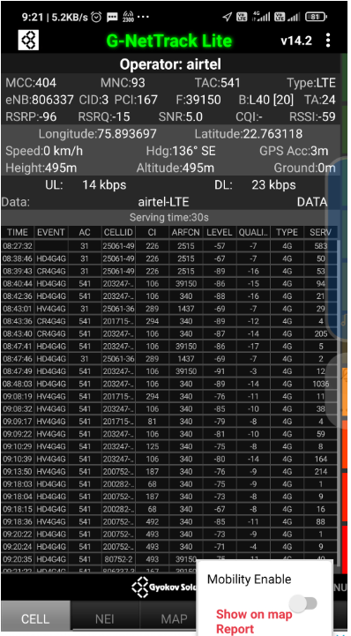
Edge Cell (Airtel)
Edge cell | longitude | latitude | RSRP (dbm) | Cell id | E-ARFCN
1 | 75.893697 | 22.763118 | -96 | 3 | 39150
RSRP Range for Edge Cell :
-95dbm to -110dbm
Scheme No. 74,
Vijay Nagar,
Indore

Slide 9
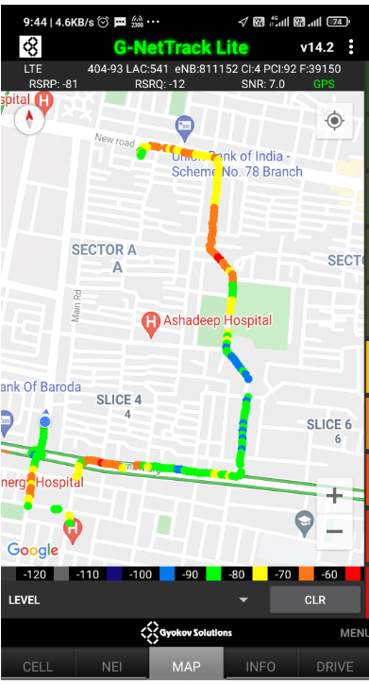
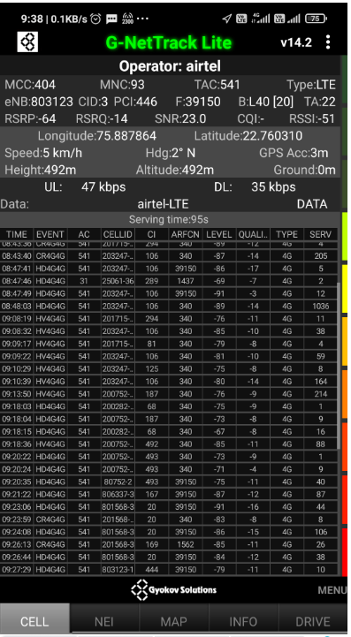
Mixed Coverage Area for Airtel

Slide 10
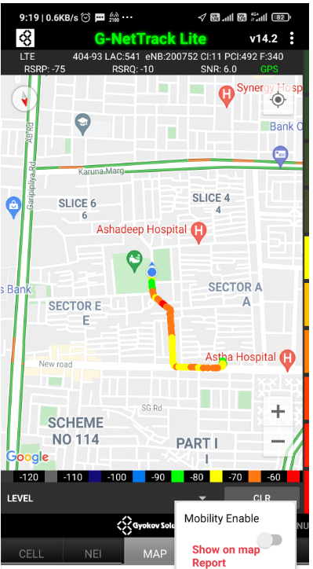
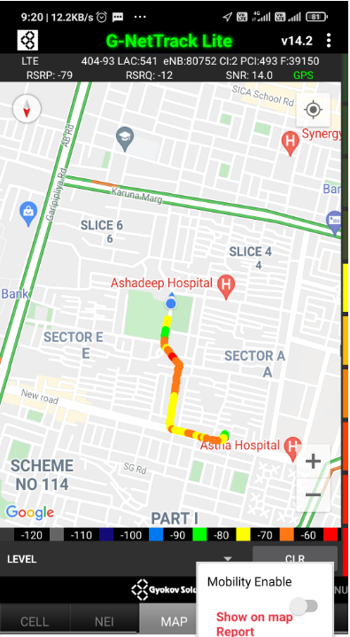
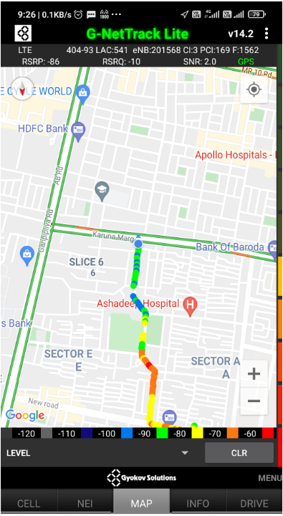
Airtel Inter Band HO
Band 1 BAND 40 BAND 3

Slide 11
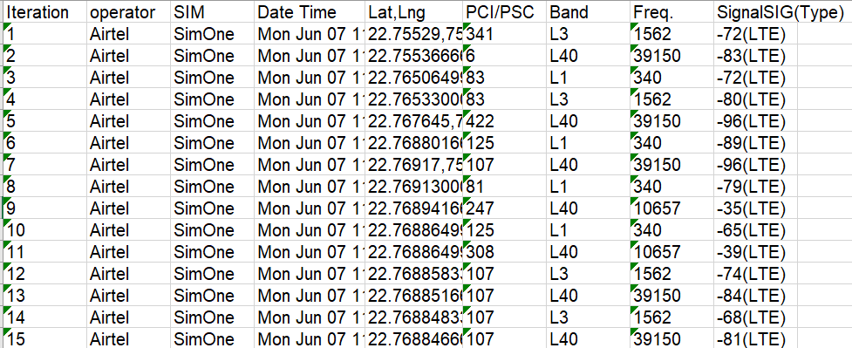
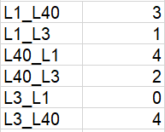
MATT Tool InterBand Handover Results for Airtel

Slide 12
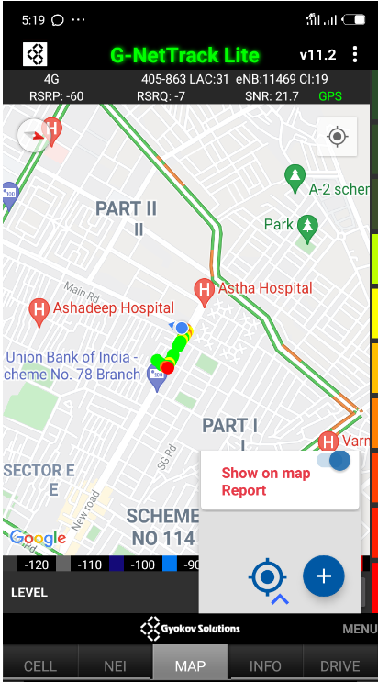
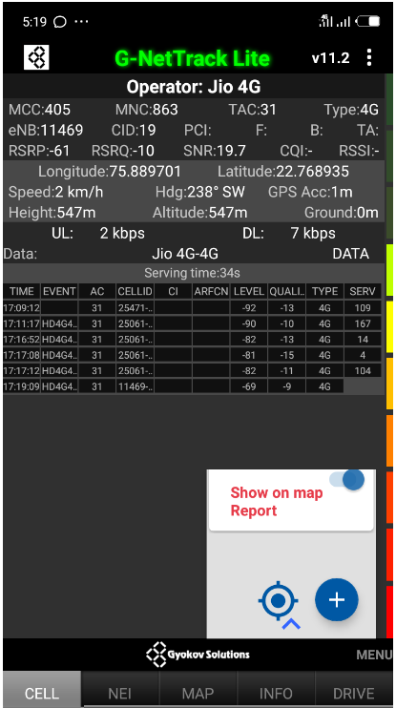
Near Cell (Reliance JIO)
Near cell | longitude | latitude | RSRP (dbm) | Cell id | E-ARFCN
1 | 75.889701 | 22.768935 | -61 | 19 | 38948
RSRP Range for Near Cell : -65dbm to -75dbm
Sector- B,
Scheme No. 78,
Vijay Nagar,
Indore

Slide 13
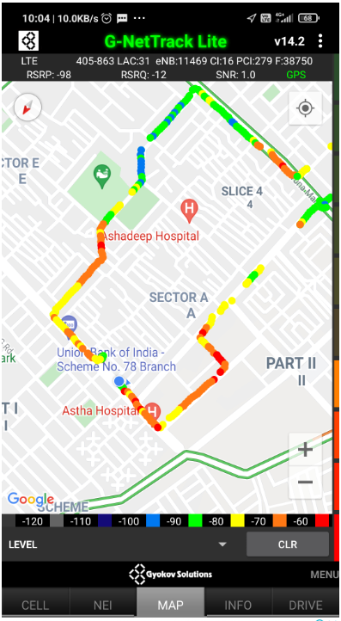
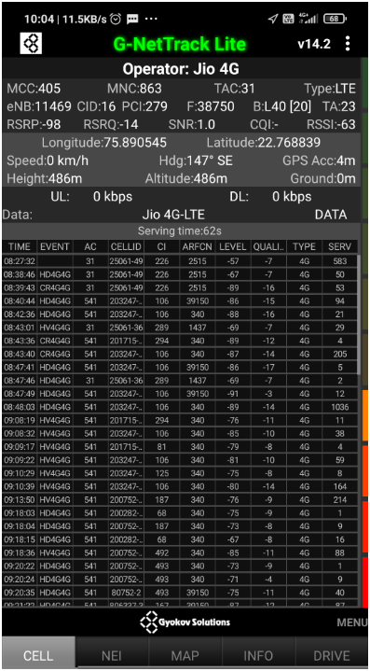
Edge Cell (Reliance JIO)
Edge Cell | longitude | latitude | RSRP (dbm) | Cell id | E-ARFCN
1 | 75.890545 | 22.768839 | -98 | 16 | 38750
RSRP Range for Edge Cell :
-95dbm to -110dbm
Scheme No. 78,
Vijay Nagar,
Indore

Slide 14
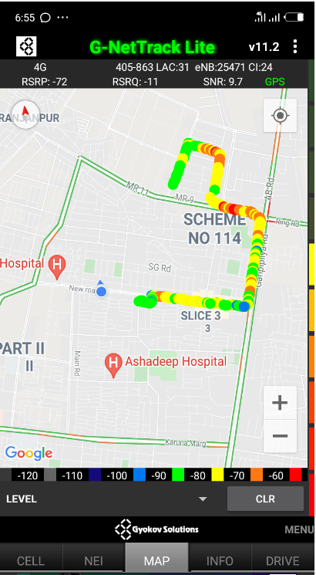
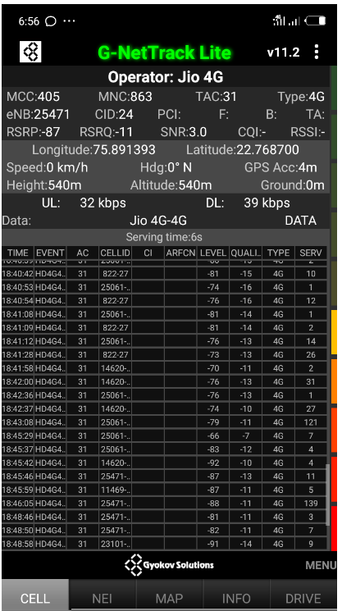
Mixed Coverage Area for Reliance JIO

Slide 15
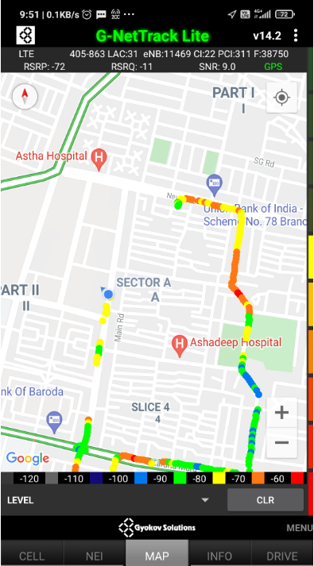
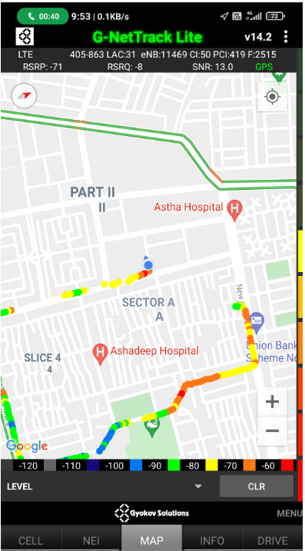
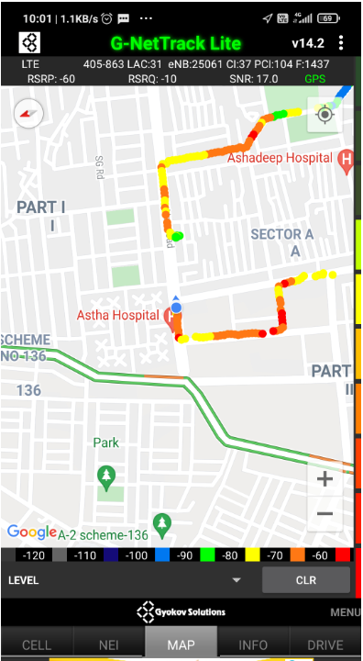
Inter Band Handover (FDD-TDD) for JIO 4G
Band 40 Band 5 Band 3

Slide 16
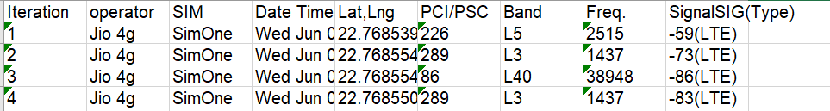
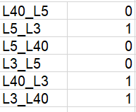
MATT Tool InterBand Handover Results for Jio

Slide 17
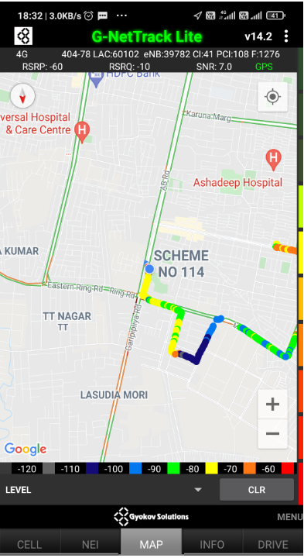
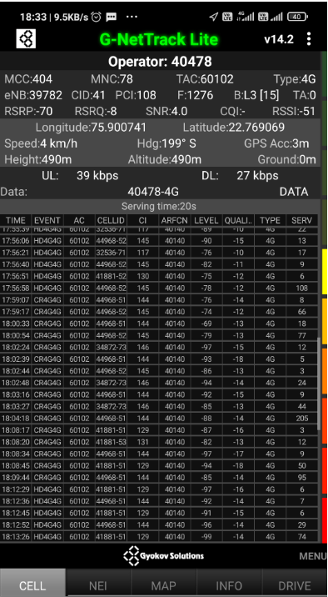
Near Cell for VI:
Near Cell | longitude | latitude | RSRP (dbm) | Cell id | E-ARFCN
1 | 75.900741 | 22.769069 | -70 | 41 | 1276
RSRP Range for Near Cell :
-65dbm to -75dbm
Scheme No. 114,
Vijay Nagar,
Indore

Slide 18
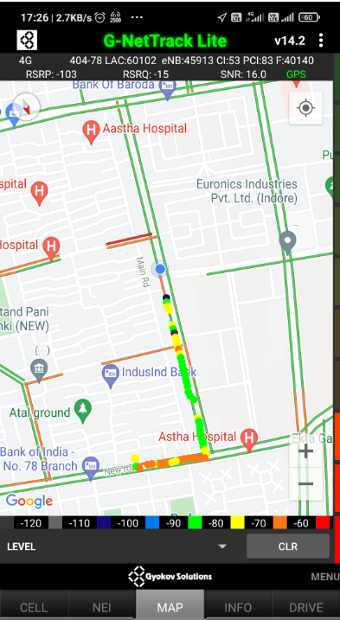
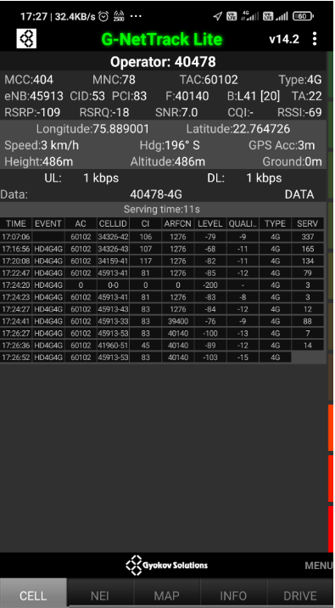
Edge Cell for VI:
Edge cell(EC) | longitude | latitude | RSRP (dbm) | Cell id | E-ARFCN
1 | 75.889001 | 22.764726 | -103 | 53 | 40140
RSRP Range for Edge Cell :
-95dbm to -110dbm
Scheme No. 78,
Vijay Nagar, Indore

Slide 19
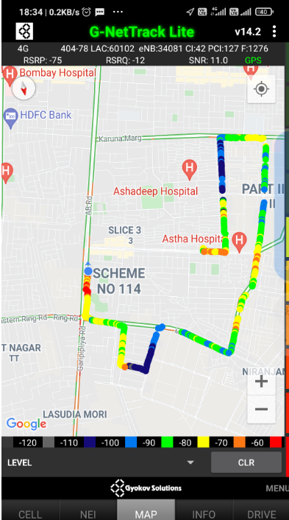
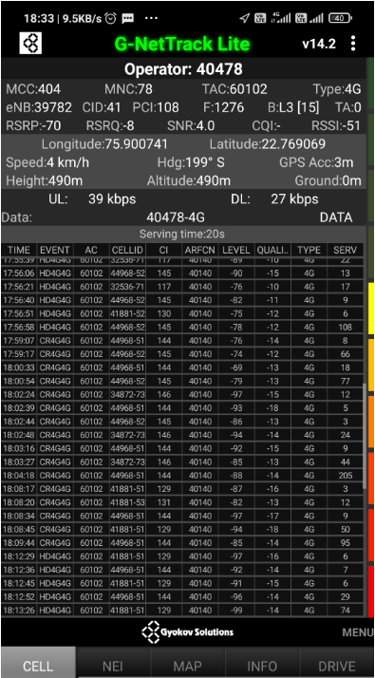
Mixed Coverage Area for VI:

Slide 20
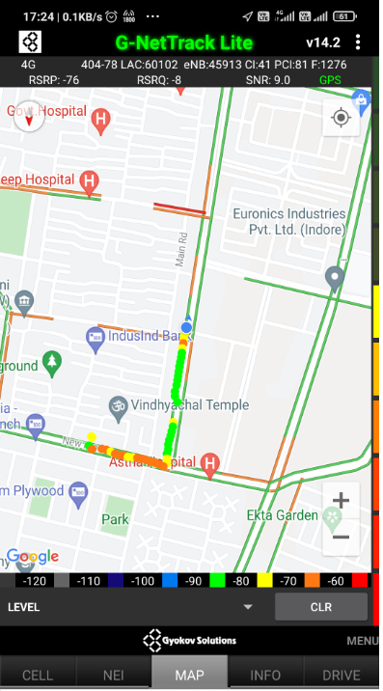
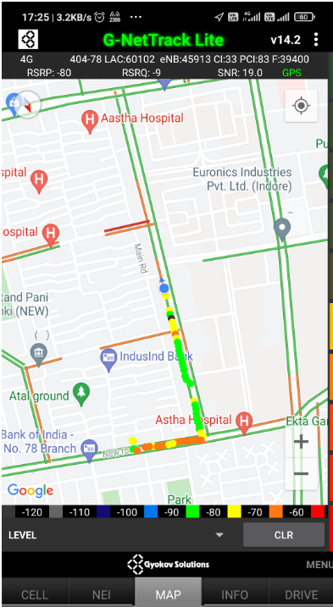
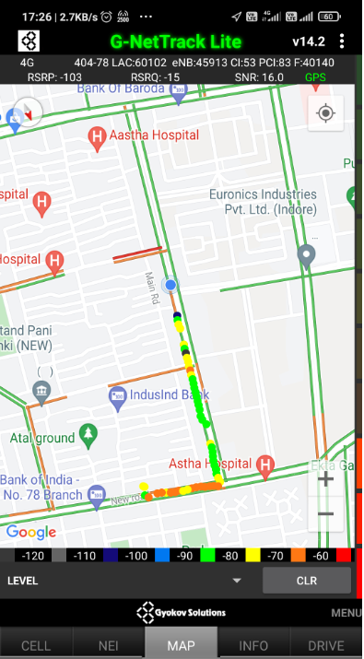
VI Band Handover
Band 3 Band 40 Band 41

Slide 21
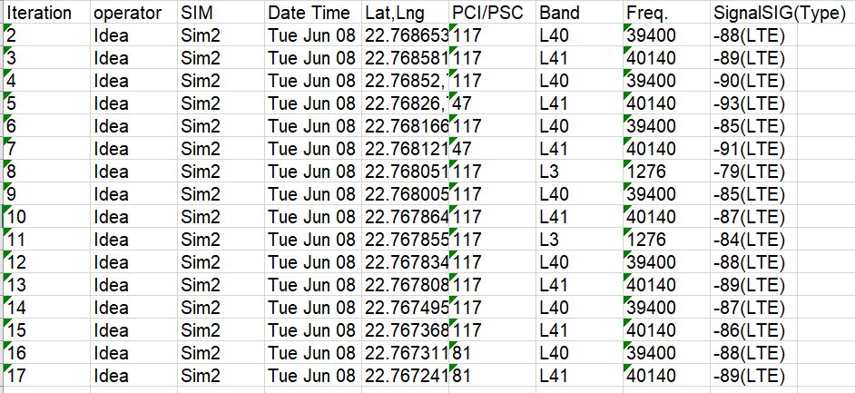
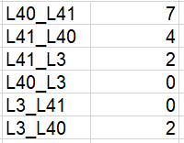
MATT Tool InterBand Handover Results for VI

Slide 22
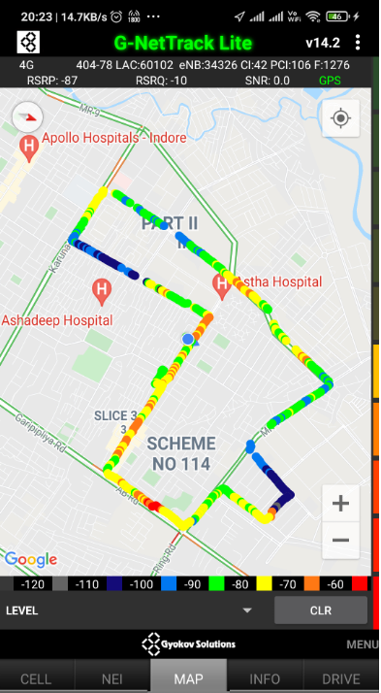
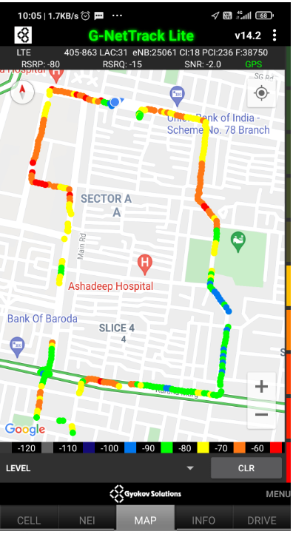
G-net Tracker Drive Route

Slide 23
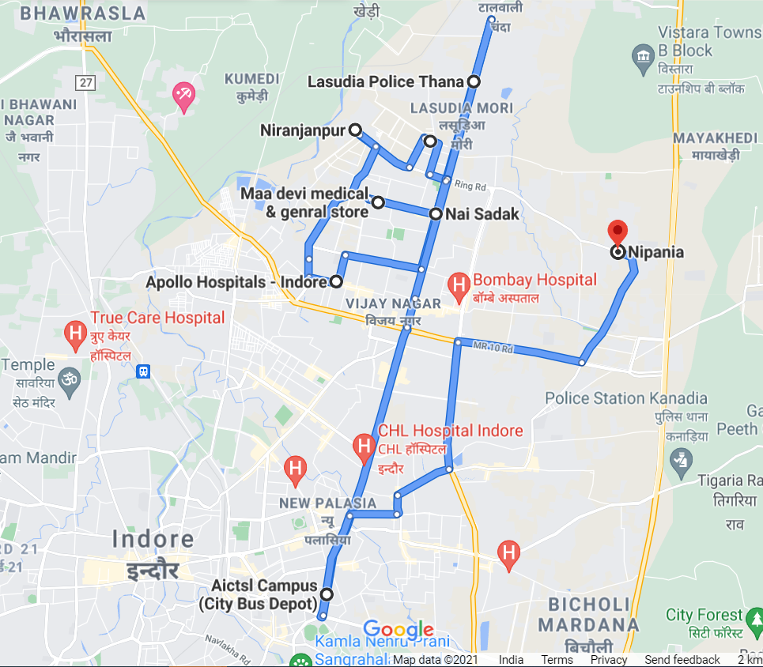
Drive Route

Slide 24
THANK YOU
MARQUIS TECHNOLOGIES

