Slide 1
MARQUIS TECHNOLOGIES
Drive Route & Features tested
In Bern,switzerland.

Slide 2
Operator Details:
S. No. | Operator |  | Supported Bands | Supported Features by Network
1 | Major | Swisscomm | N78,N28,N1 | VoWiFi/VoLTE/4G/3G/2G/5G

Slide 3
IMPORTANT FEATURES TESTED - Swisscomm OPERATOR
Performance test cases related to data and data+Call for SC OPERATOR for N78_N28_N1 – SA .
The testing Area is Bern Beaumont - Weissensteinstr. 88 3007 Bern, where the Main antenna has been installed.
Infra-Vendor used is Ericsson .
Maximum speed attained was 1200/140 in RSRP< -69.

Slide 4
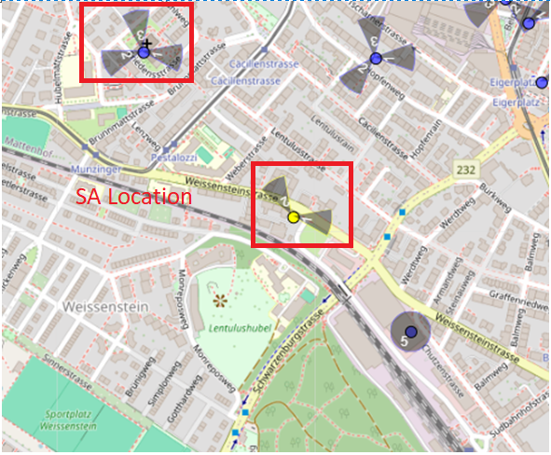
SA Near cell location with features available -
Bern Beaumont - Weissensteinstr. 88 3007 Bern
Notes:
MOBILITY SITES ARE THESE

Slide 5
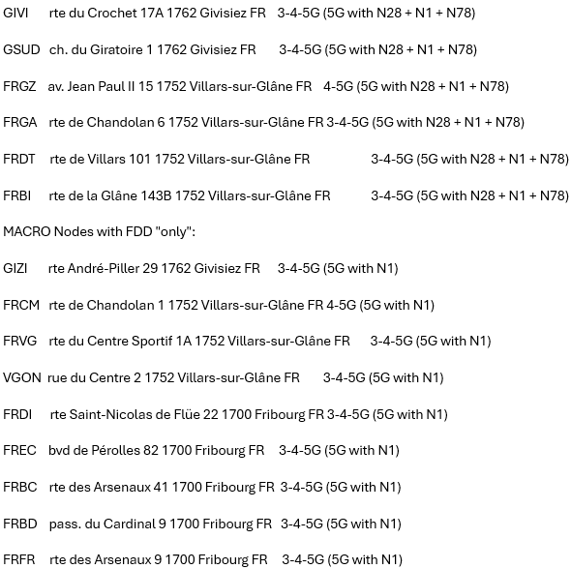
SA Near cell Address Details with Band Combo

Slide 6
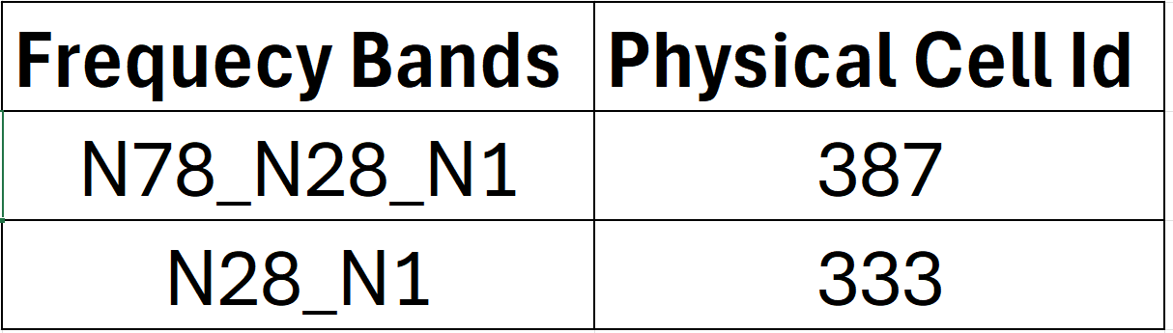
Information of PCI with supported Bands-

Slide 7
Testing Details – TEF Operator
The band combination present at N78+N28+N1 – SA COMBINATION.
We tested Performance Bidirectional, DL,UL,Ping,Speedtest Data related test cases.
We tested SM8850 Kaanapali devices for SSIM and MSIM Session on the same test location.

Slide 8
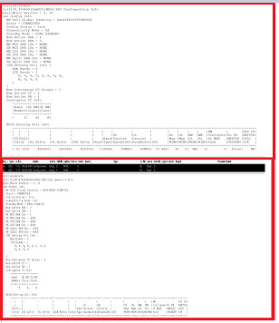
Band Details during Testing

Slide 9
THANK YOU
MARQUIS TECHNOLOGIES
www.marquistech.com

