Slide 1
DRIVE ROUTE- JAPAN

Slide 2
KDDI
MCC | 440
MNC | 51
APN | Uad5gn.au-net.ne.jp
Country/City | Japan/Tokyo
Country Code | +81
Currency | Japanese yen
Time Zone | GMT+9

Slide 3
DOCOMO
MCC | 440
MNC | 10
APN | spmode
Country/City | Japan/Tokyo
Country Code | +81
Currency | Japanese yen
Time Zone | GMT+9

Slide 4
RAKUTEN
MCC | 440
MNC | 11
APN | rakuten.jp
Country/City | Japan/Tokyo
Country Code | +81
Currency | Japanese yen
Time Zone | GMT+9

Slide 5
SoftBank
MCC | 440
MNC | 20
APN | Plus.4g
Country/City | Japan/Tokyo
Country Code | +81
Currency | Japanese yen
Time Zone | GMT+9

Slide 6
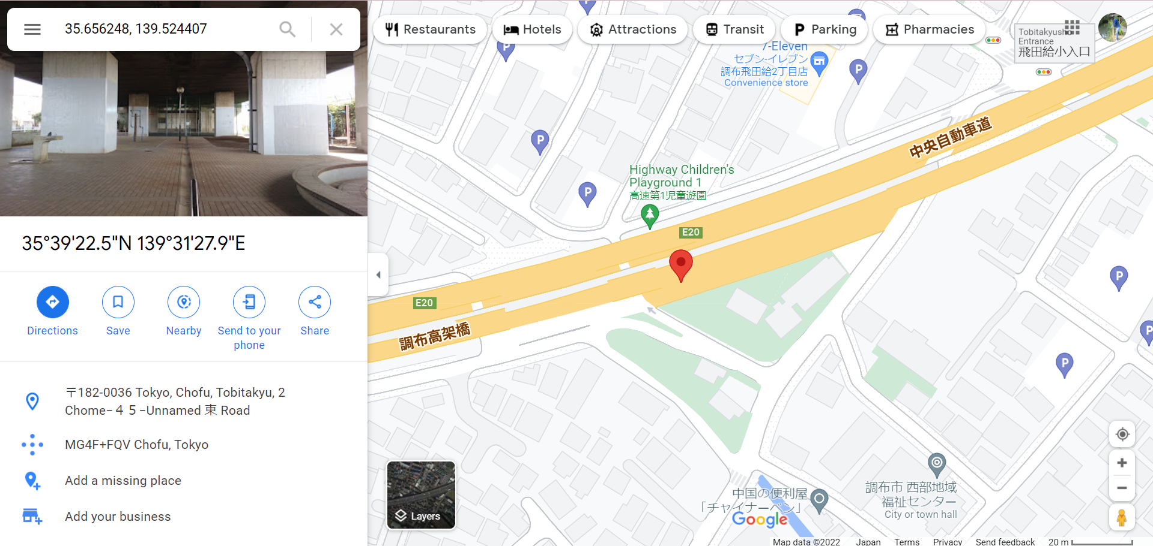
KDDI 5G location :

Slide 7
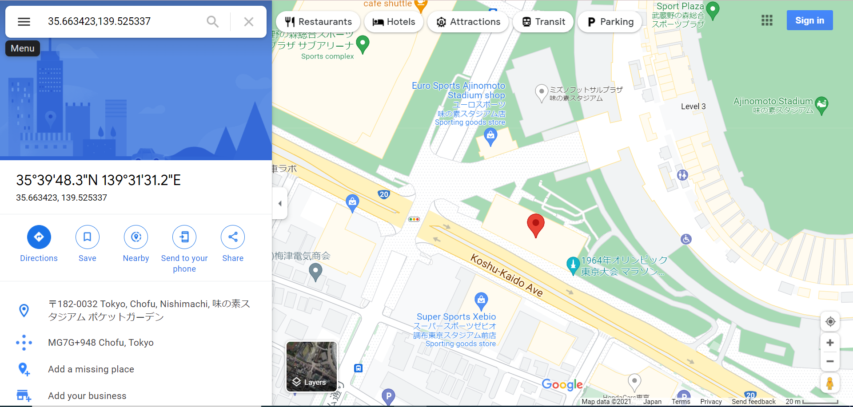
Docomo 5G location :

Slide 8
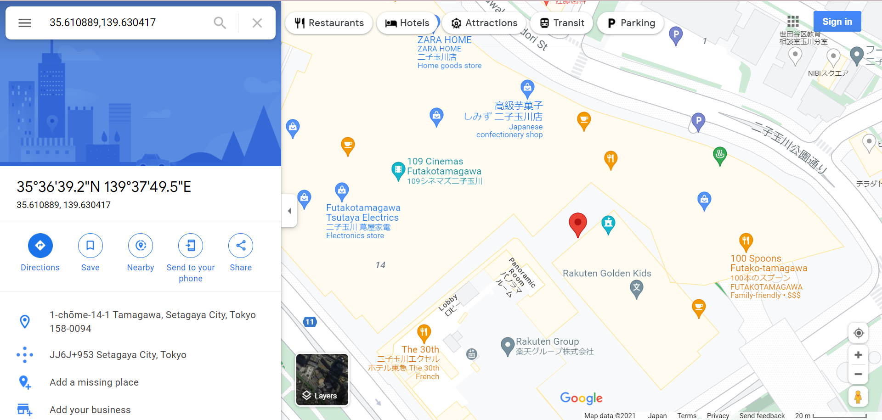
Rakuten 5G Location:

Slide 9
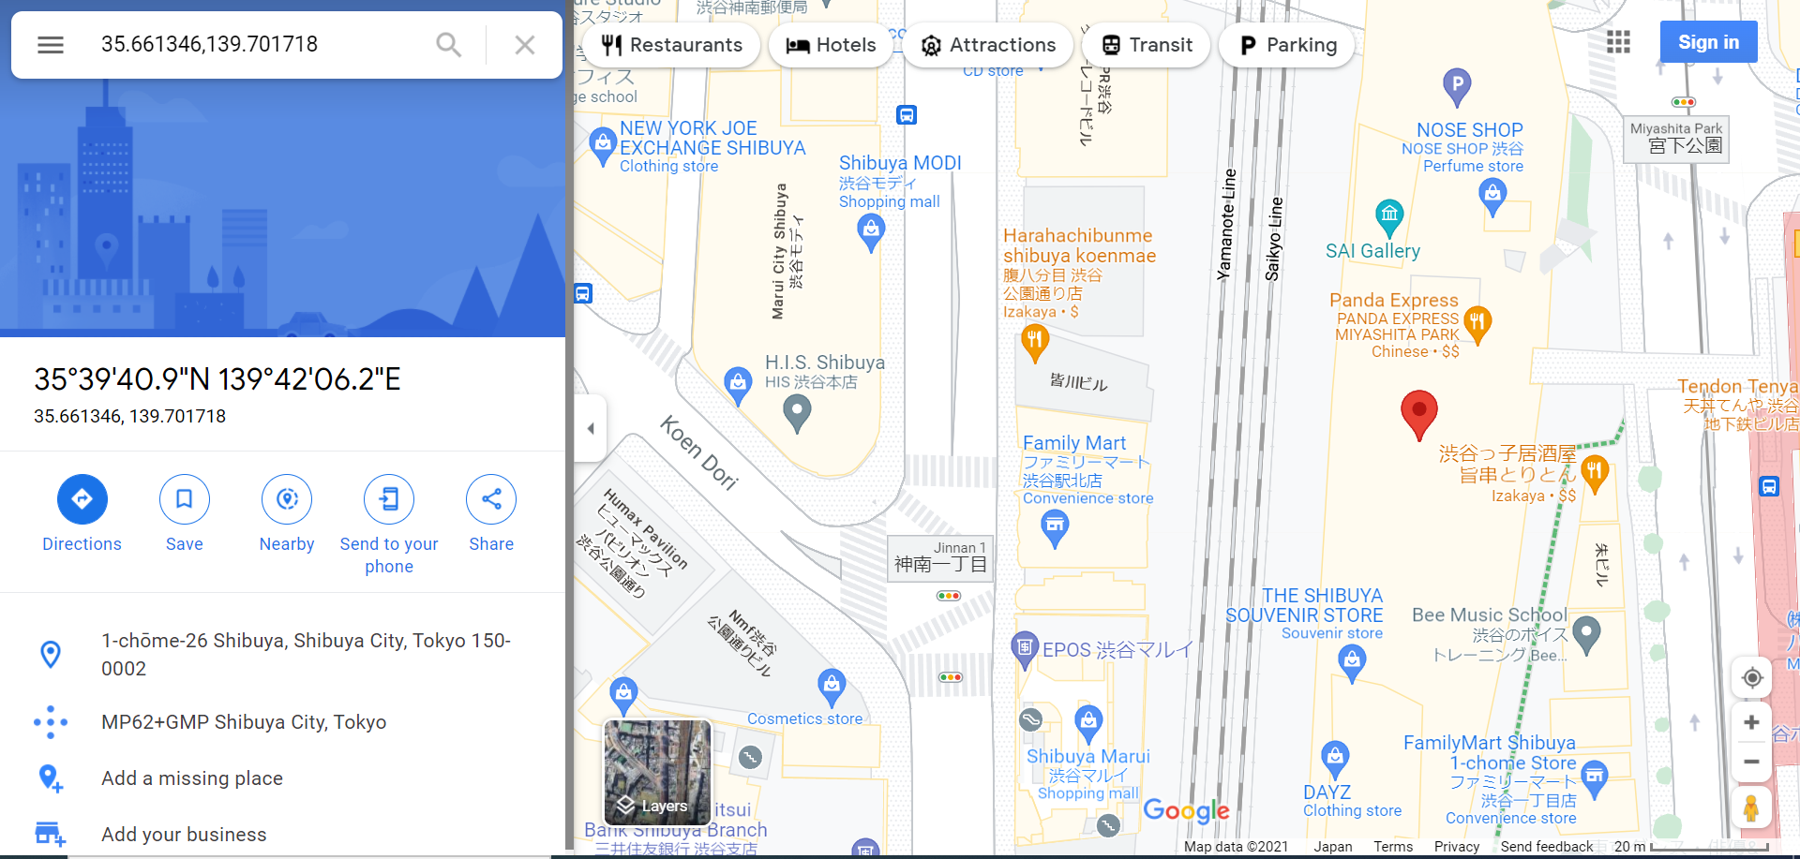
Softbank 5G location:

Slide 10
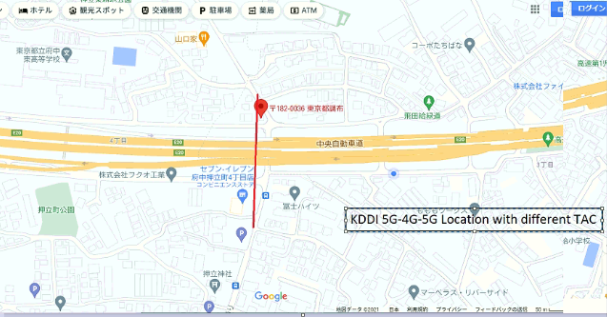
KDDI 5G-4G with different TAC location:

Slide 11
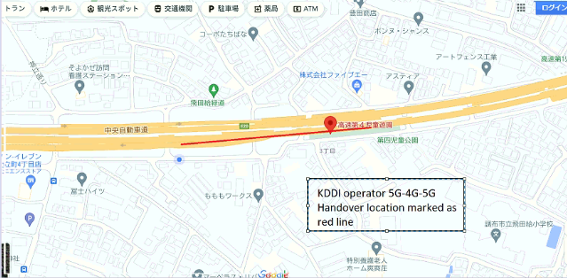
KDDI 5G-4G-5G handover location:

Slide 12
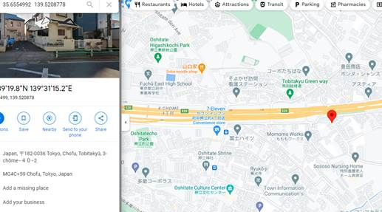
KDDI 5G with LTE B3+ NR B78 combination location:

Slide 13
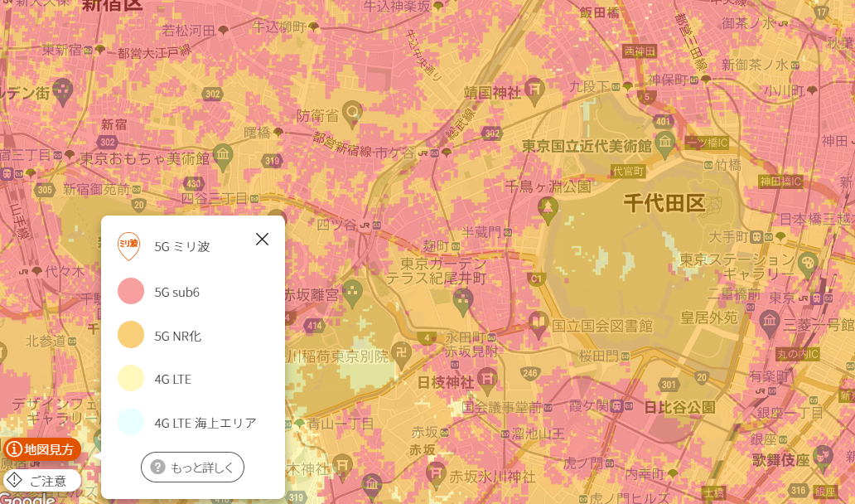
KDDI
https://www.au.com/mobile/area/map/
DSS area
(Orange colored area)
700MHz (n28)
1.7GHz (n3)
Note: outdoor cell only

Slide 14
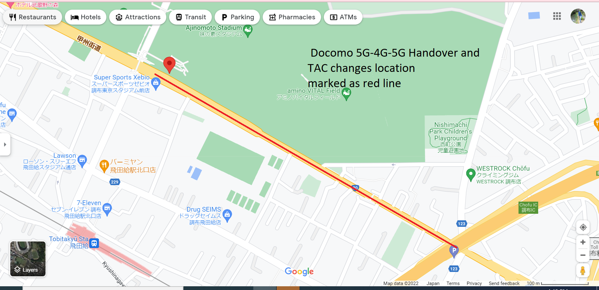
Docomo 5G-4G with different TAC location: Docomo 5G-4G-5G handover location:

Slide 15
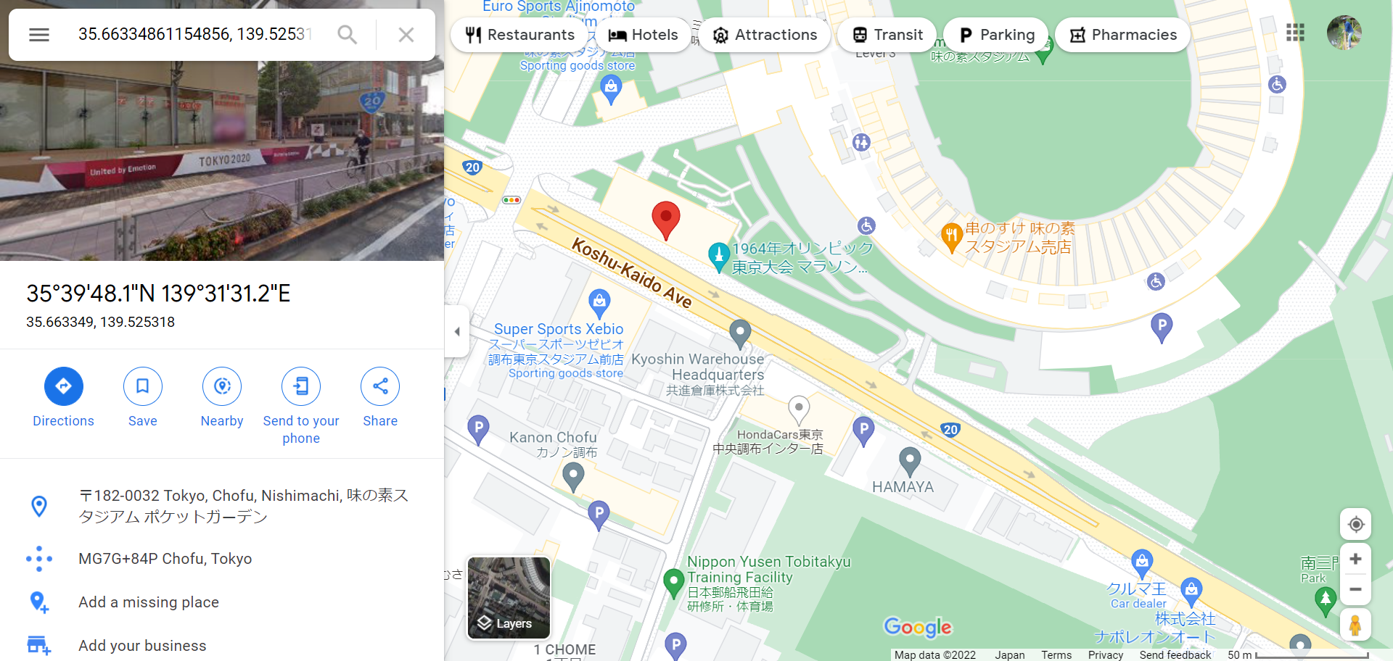
Docomo 5G with LTE B19 + NR B78 combination location:

Slide 16
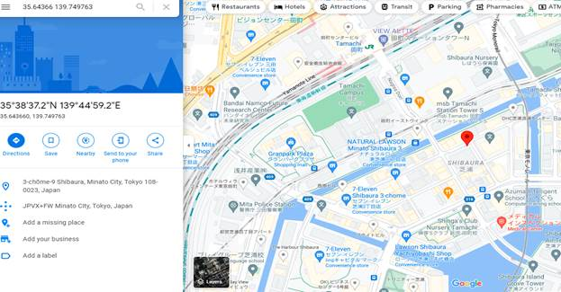
Docomo 5G with LTE B3+ NR B78 static location:

Slide 17
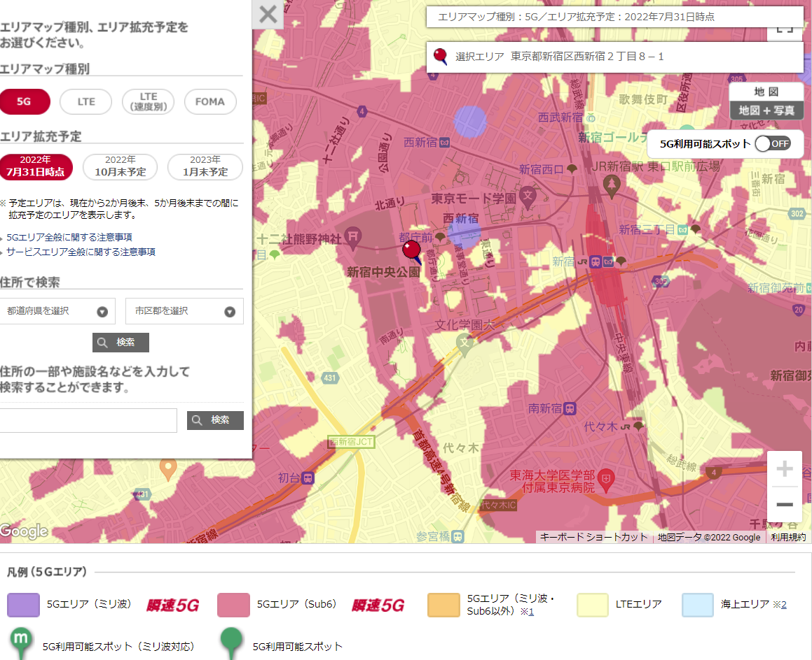
NTT docomo
https://www.docomo.ne.jp/area/servicearea/?rgcd=03&cmcd=5G&scale=128000&lat=35.686254&lot=139.694936
DSS area
(Orange colored area)
2GHz(n1)
700Mz (n28)
Note: Area is very limited.
Akiabara Station seems to be the area

Slide 18
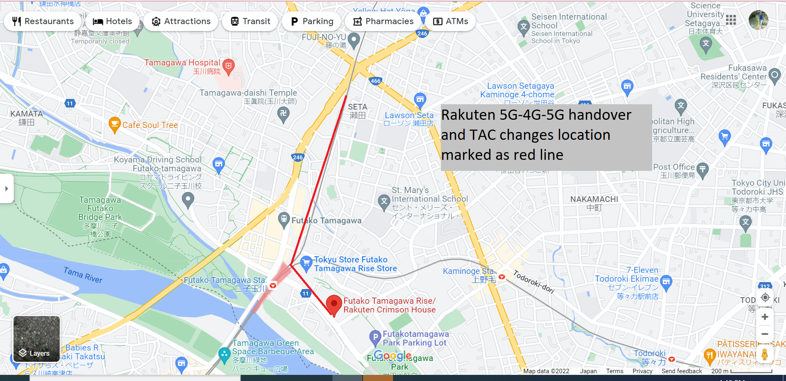
Rakuten 5G-4G with different TAC location: Rakuten 5G-4G-5G handover location:

Slide 19
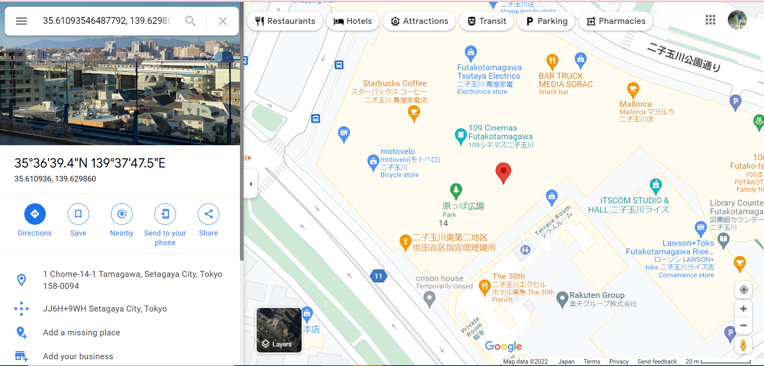
Rakuten 5G with LTE B3+ NR B77 static location:

Slide 20
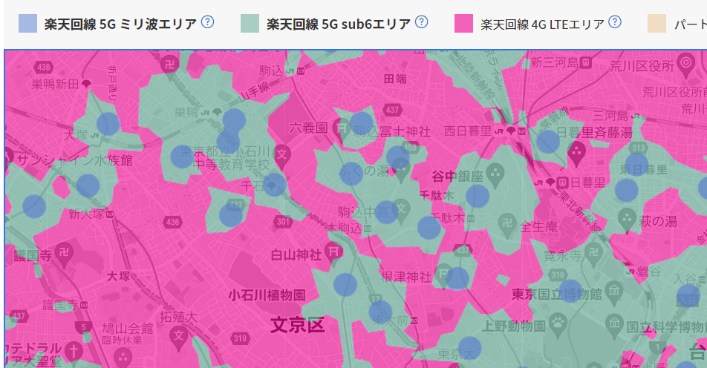
Rakuten
https://network.mobile.rakuten.co.jp/area/?map=conversion-current5g
DSS area
(Green colored area)
1.7GHz (n3)
3.4GHz (n77)

Slide 21
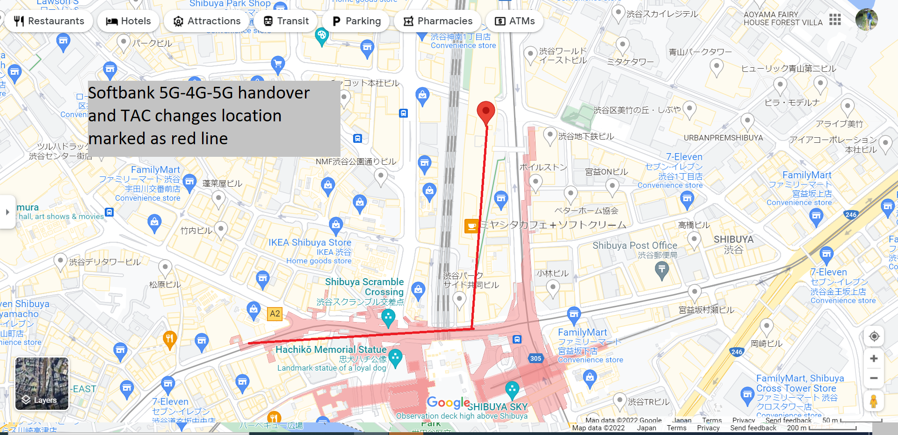
Softbank 5G-4G with different TAC location: Softbank 5G-4G-5G handover location:

Slide 22
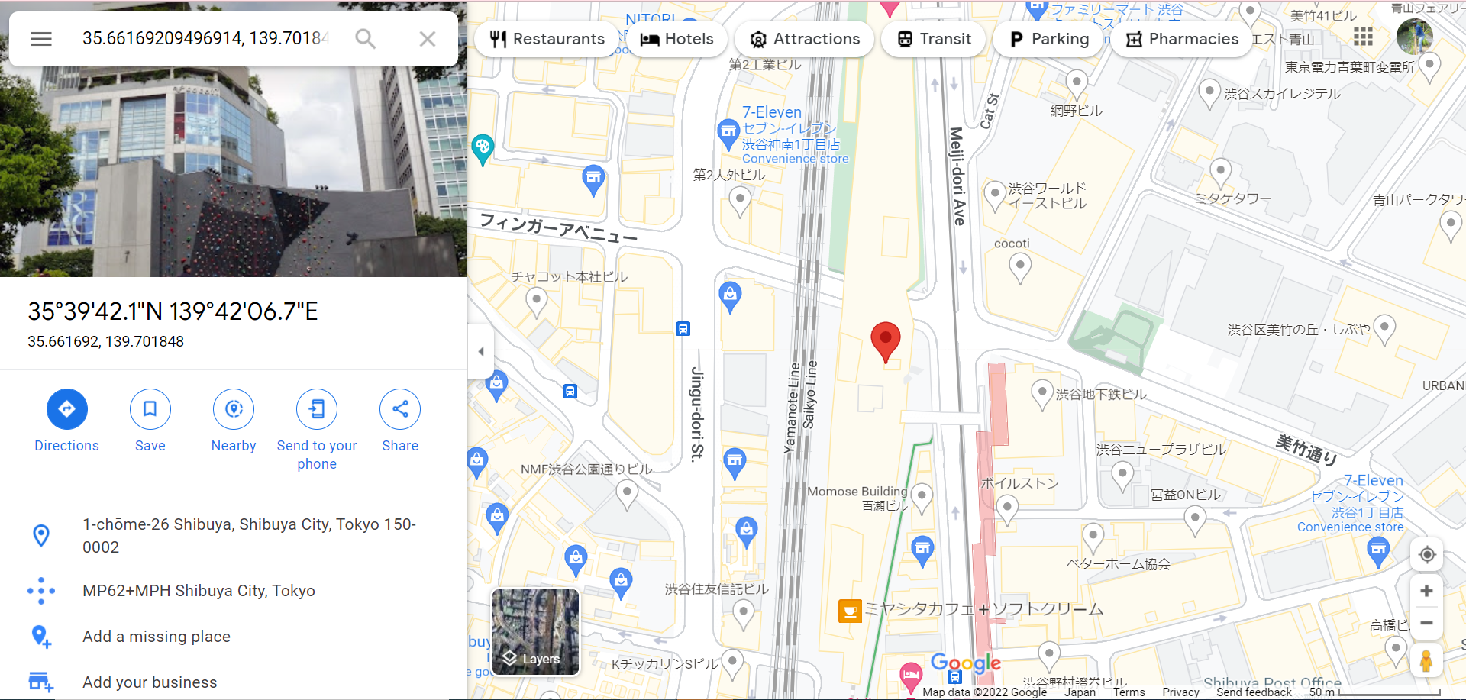
Softbank 5G with LTE B3+ NR B77 static location:

Slide 23
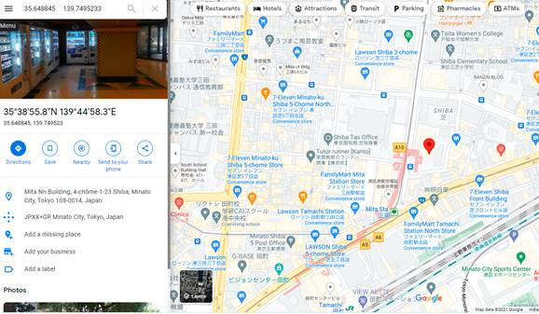
Softbank 5G with LTE B3+ NR B78 static location:

Slide 24
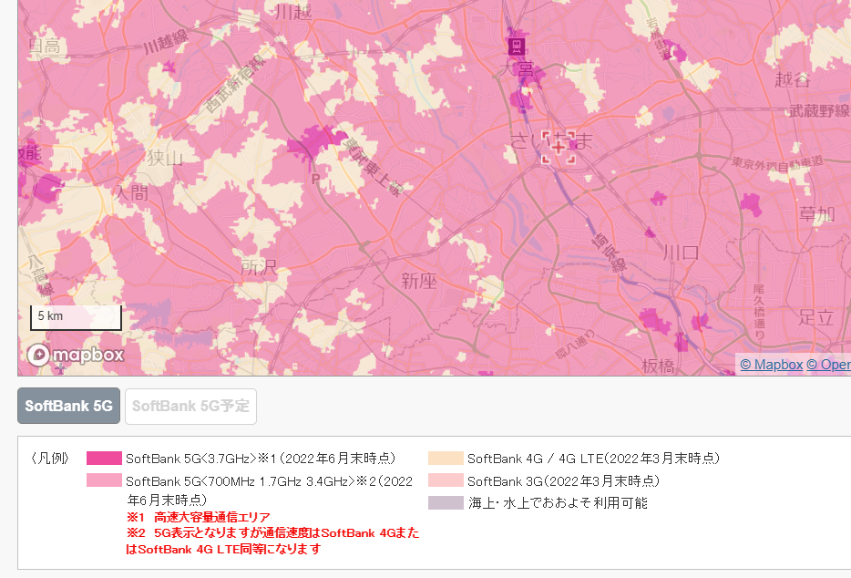
Softbank
https://www.softbank.jp/mobile/network/area/map/?pref=11&device_type=razr-5g
DSS area
(pink colored area)
700MHz (n28)
1.7GHz (n3)
3.4GHz (n77)
Note: outdoor cell only

Slide 25
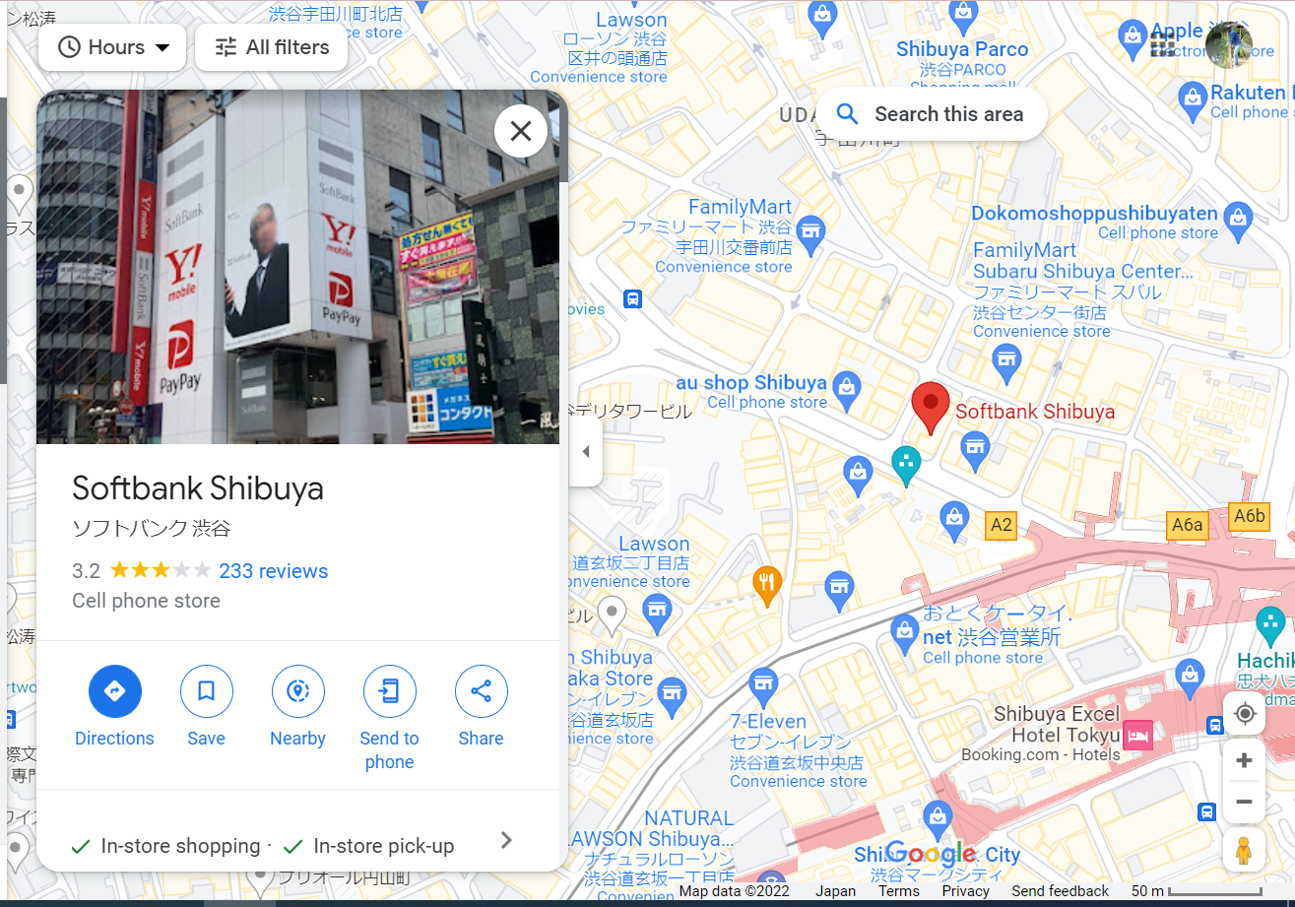
Softbank EAP-SIM

Slide 26
Thank You

