Slide 1

Drive route - Bulgaria
Operators in Bulgaria:
1. Vivacom
2. Yettel
3. A1

Slide 2
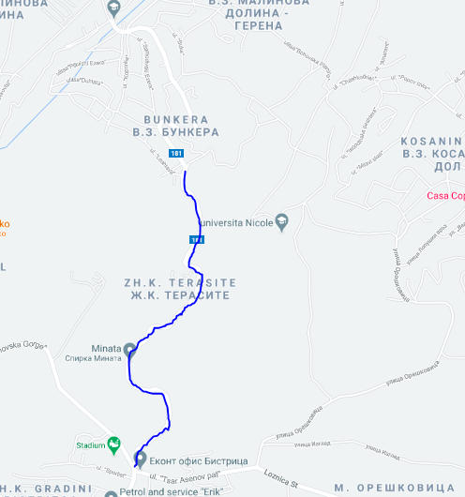
SRVCC Location for Vivacom
SRVCC location: ZH.K Terasite, 42.598924, 23.368546

Slide 3
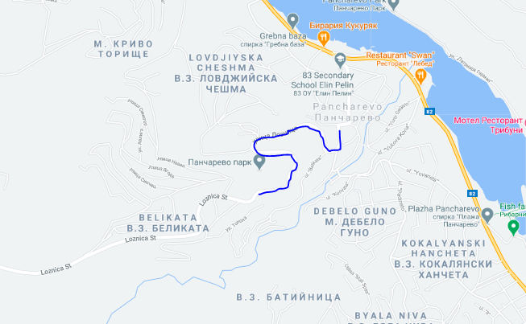
SRVCC Location for Yettel And A1
SRVCC location: Loznica St, 1137 Pancharevo

Slide 4
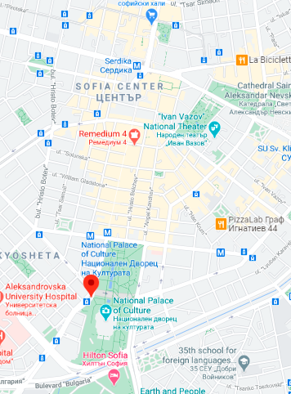
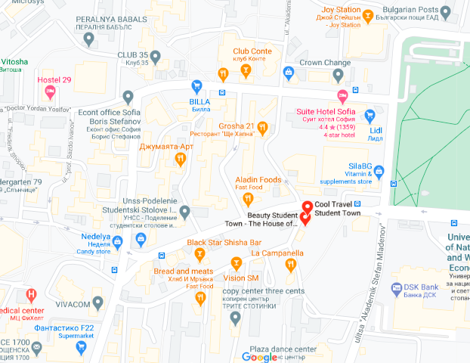
CA location for All operators
CA Location for all the operators: Can be found around National Palace of Culture and Blvd. Vitosha. Also can be found at Student Town, Sofia.

Slide 5
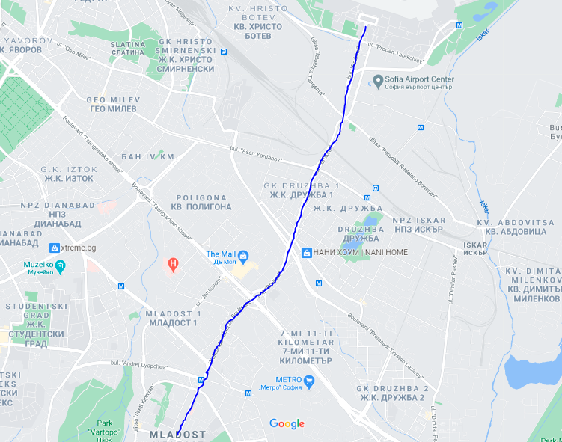
Vivacom 4G TAC CHANGE
TAC change Location: Blvd. Bruksel

Slide 6
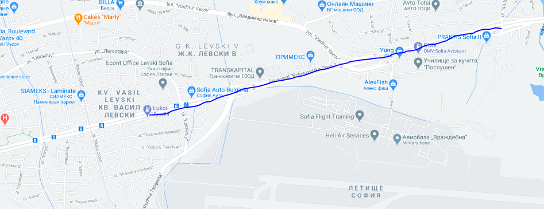
Yettel and A1 4G TAC CHANGE
Location: Blvd. Botevgradsko shose from Petrol Station Lukoil to Shoping mall Jumbo Plasa

Slide 7
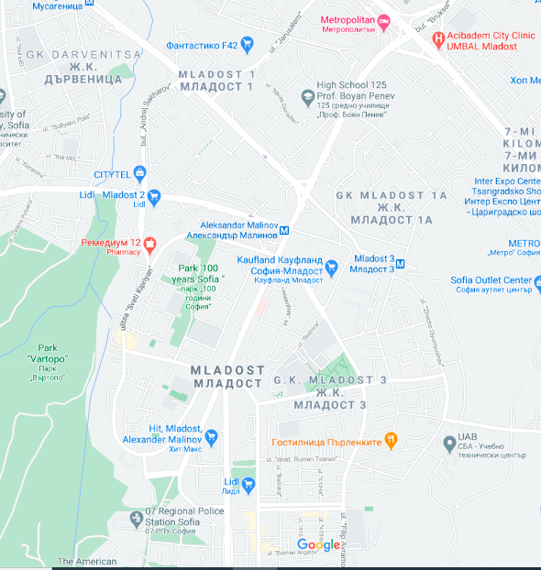
Vivacom 5G NR Largest Location in Sofia
5G NR largest Location(Main Test location): At Mladost 1,2 and 3 can be found 5G coverage.

Slide 8
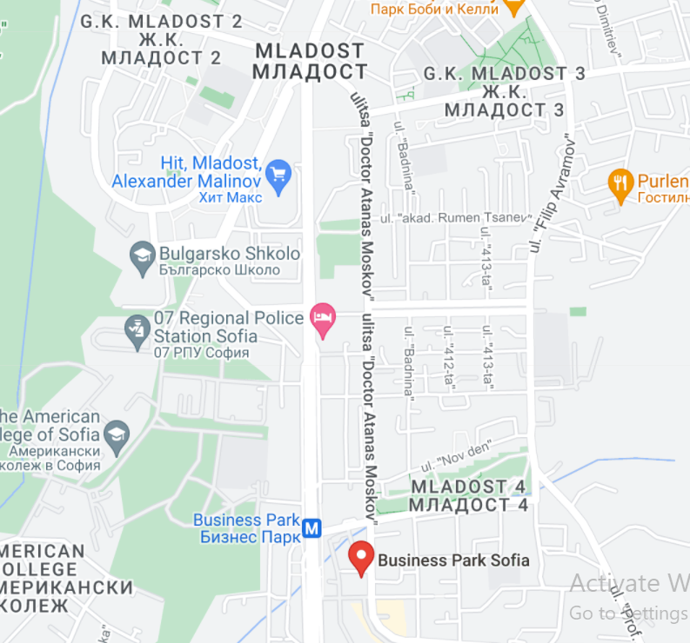
Yettel5G NR Largest Location in Sofia
There are two Large locations
2. Around Buisness Park Mladost

Slide 9
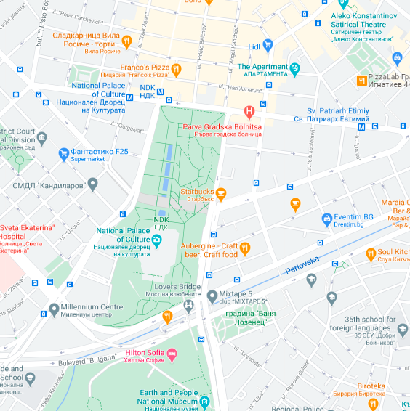
A1 5G NR Largest Location in Sofia
Location: A1 5G can be found on Blvd. Bulgaria and around National Palace of Culture at city center.

Slide 10
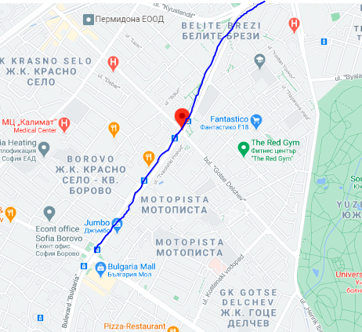
A1 NR TAC CHANGE
TAC change location: Blvd. Bulgaria

Slide 11
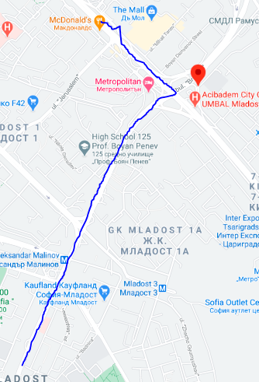
Vivacom NR Tac Change
TAC change location: Blvd. Aleksandar Malinov, Drive from HIT Aleksandar Malinov to The mall on Bul. Carigradsko shose

Slide 12
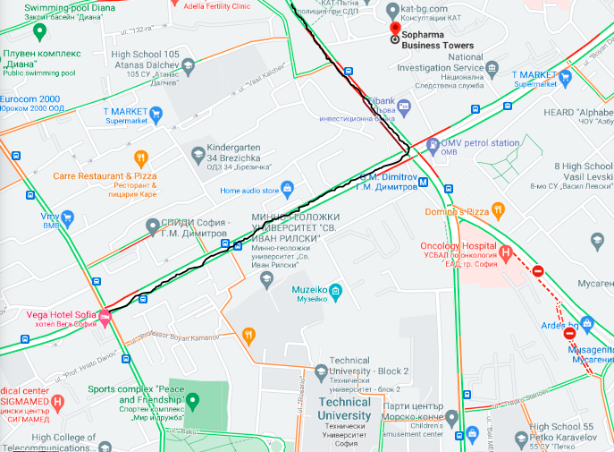
Yettel NR TAC Change
Between Vega Hotel Sofia and Sopharma Business Towers

Slide 13
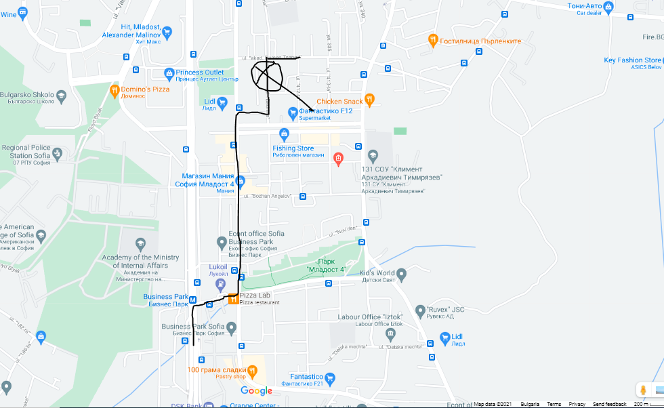
5G NR HANDOVER TEST LOCATION FOR Yettel LOCATION (LTE only -> 5G NR)
NR handover location: ul. Badnina 35A2 (can be observed sometimes)

Slide 14
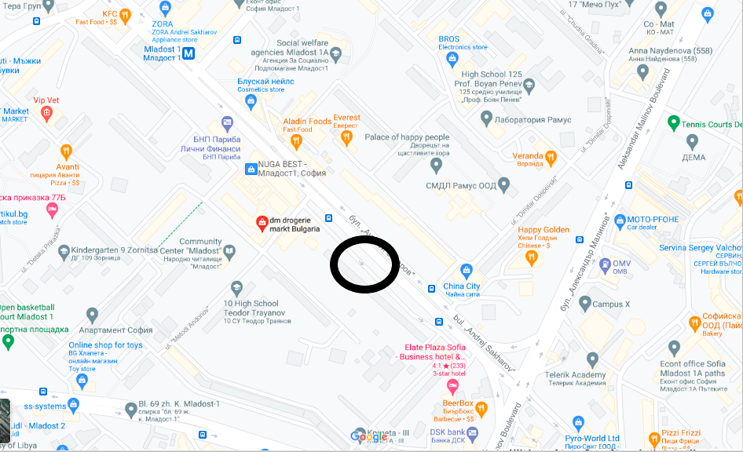
Vivacom TP Location Bul. Andrej Saharov 66

Slide 15
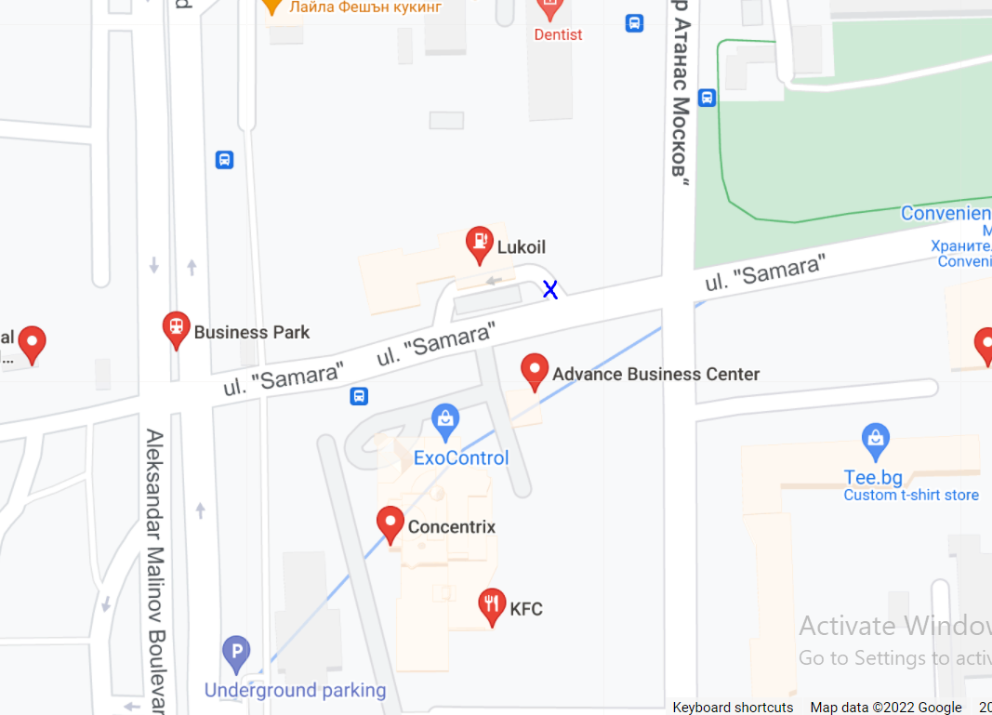
Yettel TP Location: ul. "Samara" 1, 1715 g.k. Mladost 4, Sofia

Slide 16
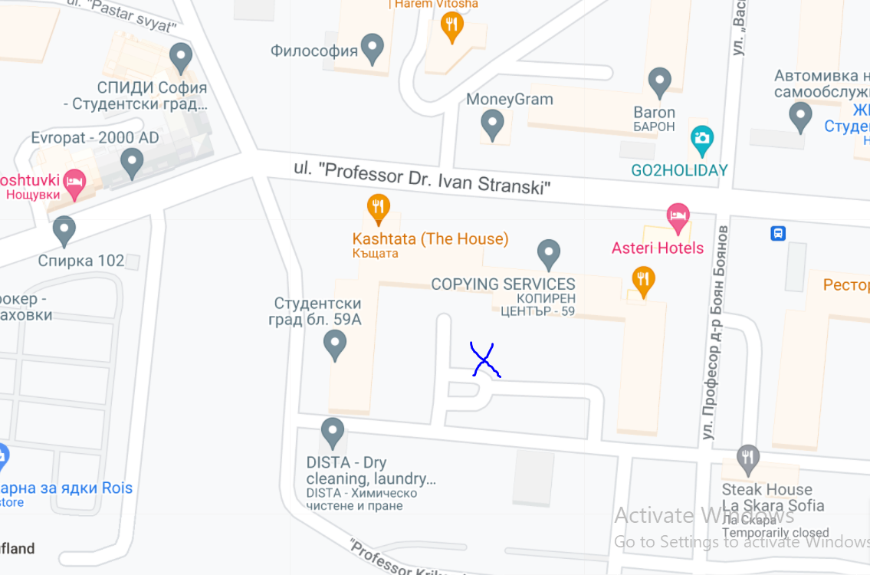
A1 TP Location: ul. "Professor Dr. Ivan Stranski” 59

Slide 17
Thank you!

