Slide 1
MARQUIS TECHNOLOGIES
Drive Route –Airtel, VODAFONE/IDEA & Reliance JIO (FDD/TDD) LTE

Slide 2
Operator Information:
Operator | JIO 4G
MCC | 405
MNC | 858
APN | Jionet
Operator | Airtel 4G
MCC | 404
MNC | 96
APN | Airtelgprs.com
Operator | VI
MCC | 404
MNC | 01
APN | Idea internet

Slide 3
Operator Information 1
Functionality | Airtel
Website: http://www.airtel.com/
WAP APN: airtelgprs.com
Customer care | 198
MNC | 96
Bands supported | Both FDD and TDD
 | LTE 2300 MHz – TDD(Band 40)
 | LTE 2100 MHz -- FDD(Band 1)
 | LTE 850 MHz – FDD(Band 3)
USSD | To check MDN: *282#
 | Balance check: *123#
 | Data Balance check: *121*114#
VoLTE | Supported
CSFB | Supported (CSFB to 2G)

Slide 4
Operator Information 2
Functionality | RELIANCE JIO
Website: http://www.jio.com
WAP APN: jionet
Customer care | 198
MNC | 858
Bands supported | Both FDD and TDD
 | LTE 2300 MHz –TDD(Band 40)
 | LTE 850 MHz – FDD(Band 5)
 | LTE 1800 MHz –FDD(Band 3)
USSD | NA
 | NA
 | NA
VoLTE | Supported
CSFB | Not Supported

Slide 5
Operator Information 3
Functionality | VI
Website:
WAP APN: Idea internet
Customer care | 198
MNC | 01
Bands supported | FDD
 | LTE 850 MHz – FDD(Band 5)
 | LTE 1800 MHz –FDD(Band 3)
USSD | To check MDN*199#
 | Balance check198
 | Data Balance check: 121
VoLTE | Not Supported
CSFB | Supported (3G)

Slide 6
Drive Route
Near Cell :- Stationary: RSRP : -60dbm to -75dbm
Cell Edge :- Stationary: RSRP : -95dbm to -110dbm
Mixed :- Mobility: RSRP : -60dbm to -110dbm

Slide 7
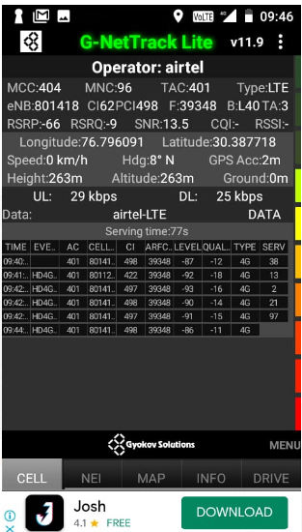
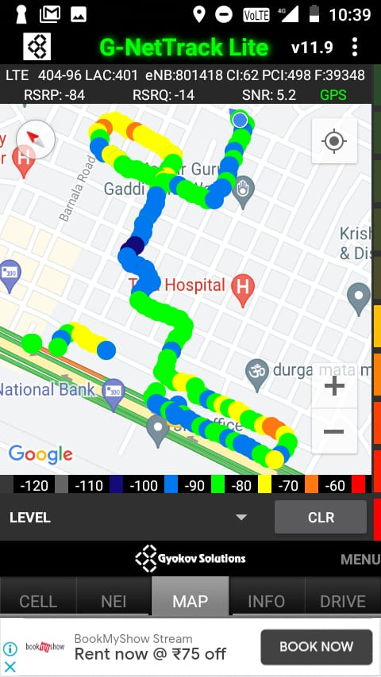
Near Cell (Airtel)
Near cell(NC) | longitude | latitude | RSRP | Cell id | FDD E-ARFCN
1 | 76.796091 | 30.387718 | -66 | 62 | 39348
RSRP:
-60dbm to 75dbm

Slide 8
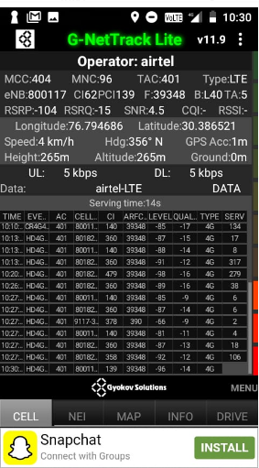
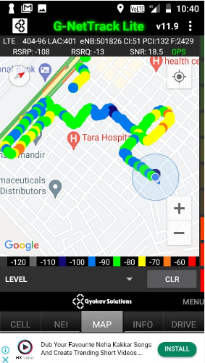
Edge Cell (Airtel)
Edge cell(EC) | longitude | latitude | RSRP | Cell id | TDD E-ARFCN
1 | 76.794686 | 30.386521 | -104 | 62 | 39348
RSRP:
-95dbm to -110dbm

Slide 9
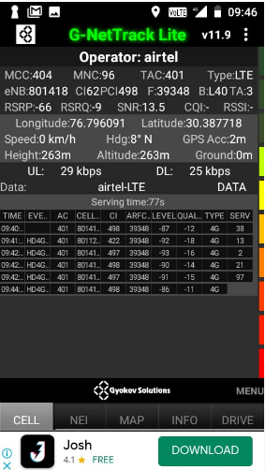
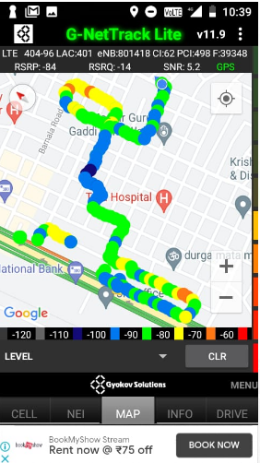
Mixed Mobility Airtel:- Ambala, Haryana

Slide 10
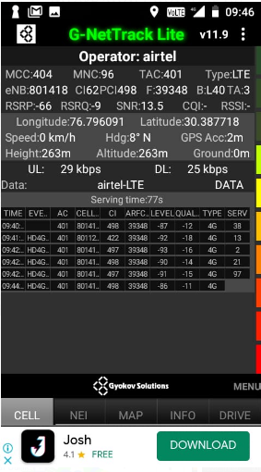
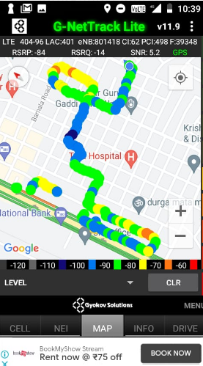
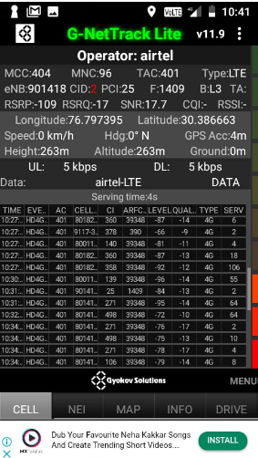
Airtel Band HO – B 40 TO B 3

Slide 11
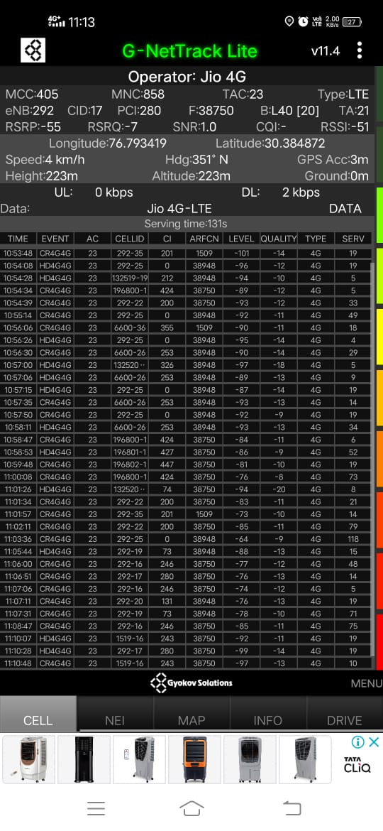
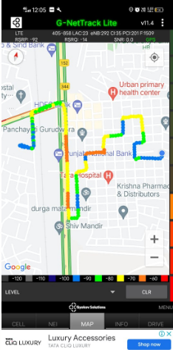
Near Cell (Reliance JIO)
Near cell(NC) | longitude | latitude | RSRP | Cell id | TDD E-ARFCN
1 | 76.793419 | 30.384872 | -55 | 17 | 38750
RSRP:
-60dbm to -75dbm

Slide 12
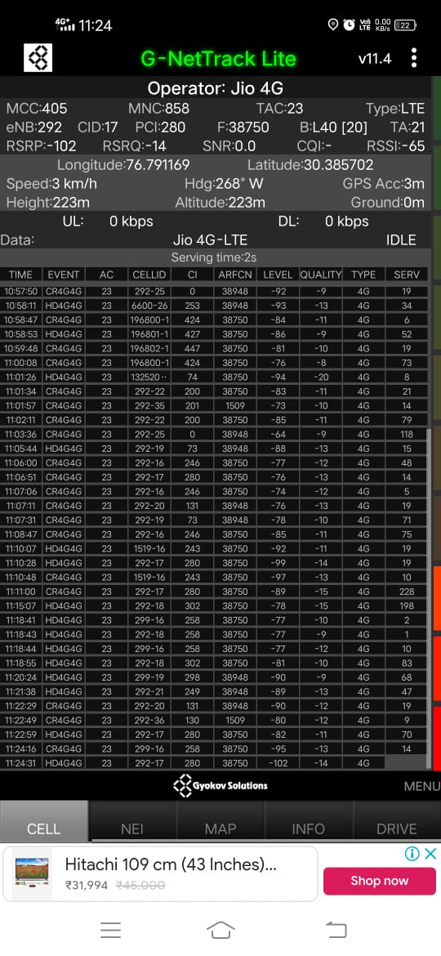
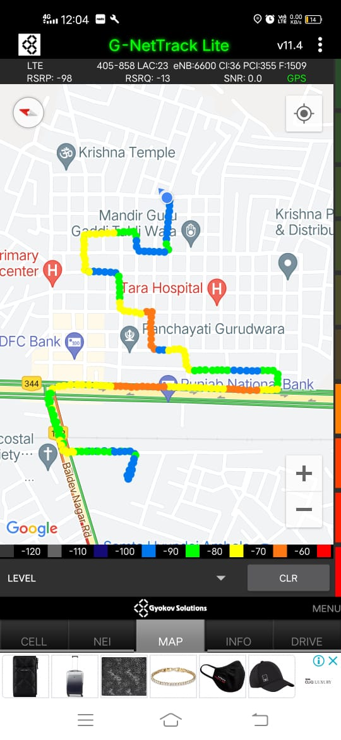
Edge Cell (Reliance JIO)
Edge cell(NC) | longitude | latitude | RSRP | Cell id | TDD E-ARFCN
1 | 76.791169 | 30.385702 | -102 | 17 | 38750
RSRP:
-95dbm to -110dbm

Slide 13
Mixed Mobility Jio:- Ambala , Haryana

Slide 14
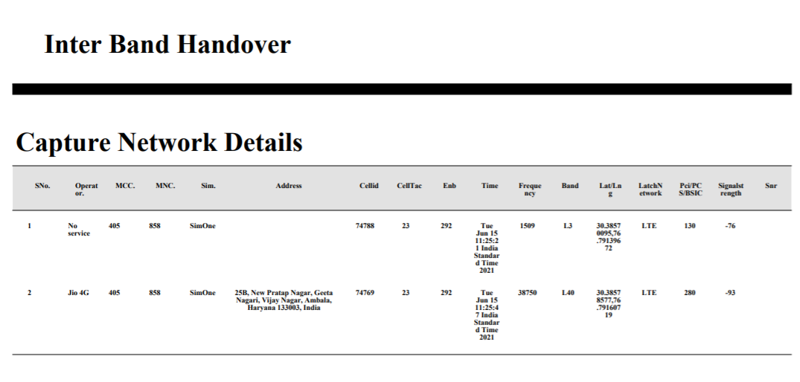
Inter Band Handover (FDD-TDD), JIO 4G

Slide 15
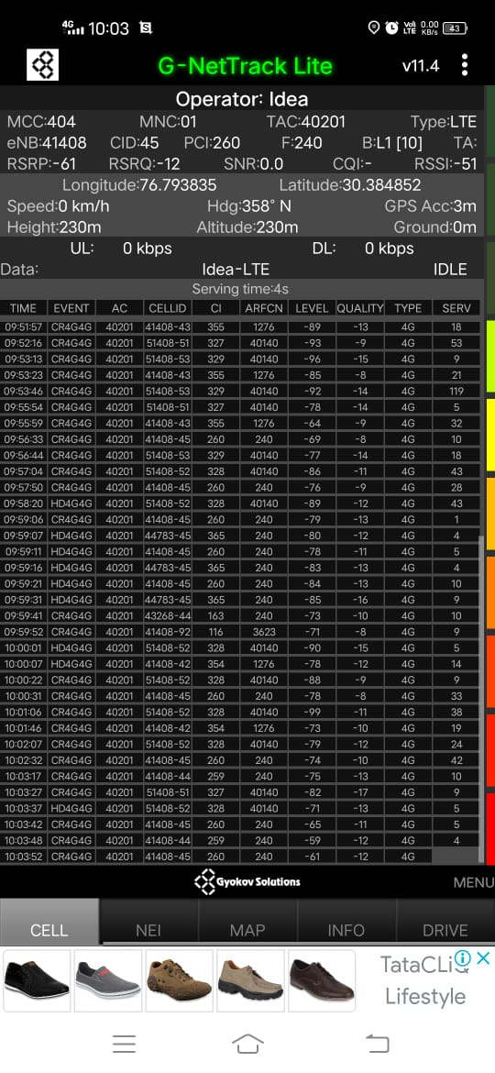
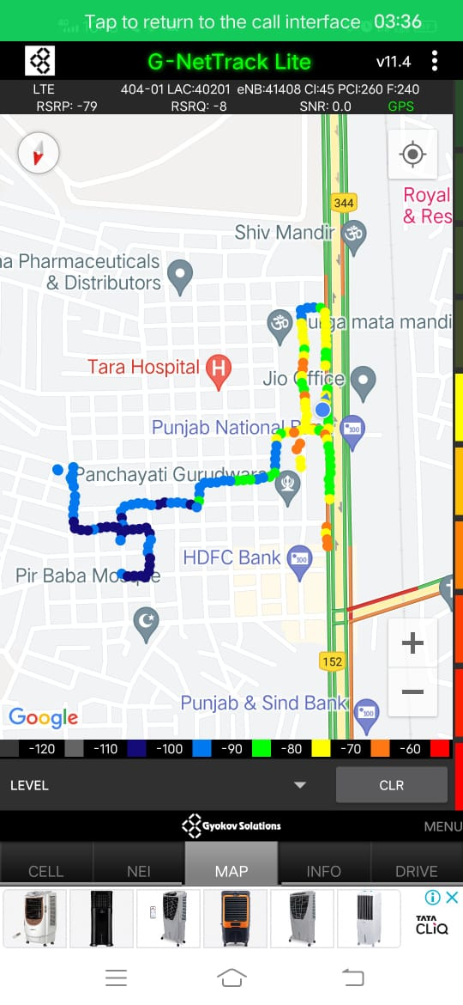
Near Cell VI:
Near cell(NC) | longitude | latitude | RSRP | Cell id | FDD E-ARFCN
1 | 76.793835 | 30.384852 | -61 | 45 | 240
RSRP:
-65dbm to -75dbm

Slide 16
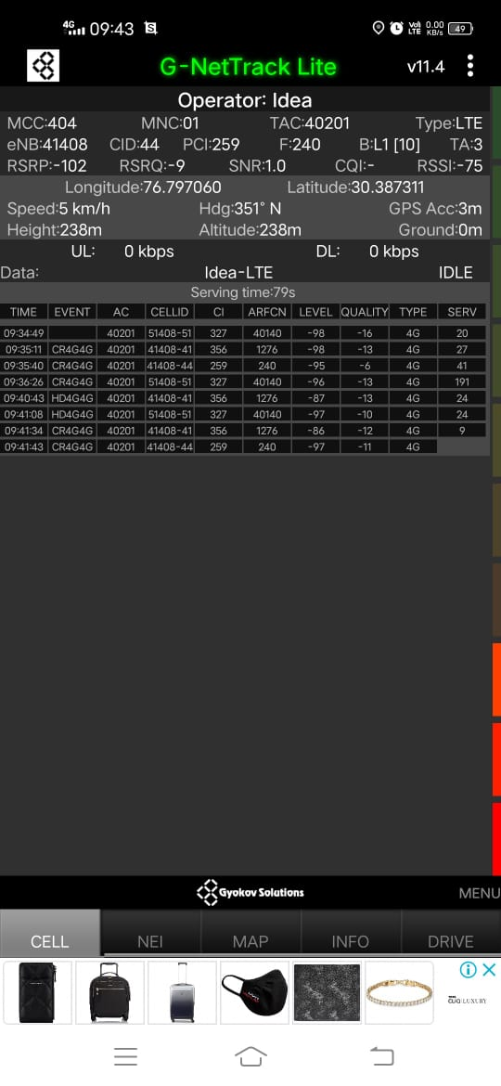
Cell Edge VI:
Edge cell(EC) | longitude | latitude | RSRP | Cell id | TDD E-ARFCN
1 | 76.797060 | 30.387311 | -102 | 44 | 240
RSRP:
-95dbm to -105dbm

Slide 17
Mixed coverage area Vodafone:

Slide 18
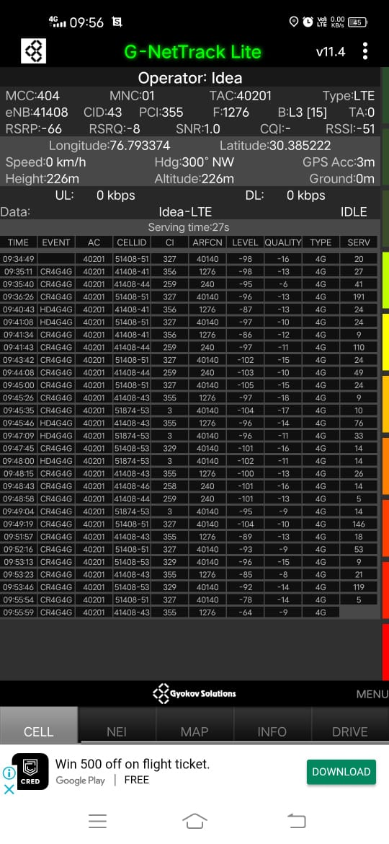
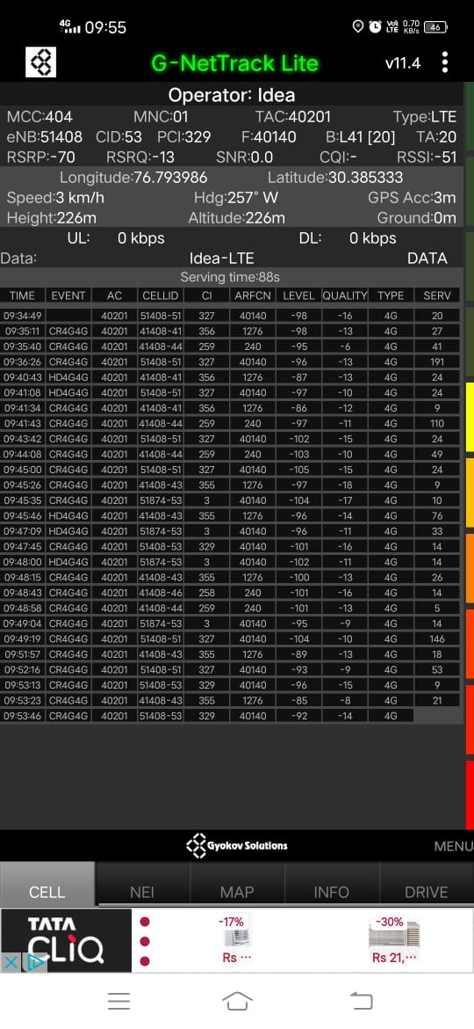
VI Band Handover – B3 , B41,B1

Slide 19
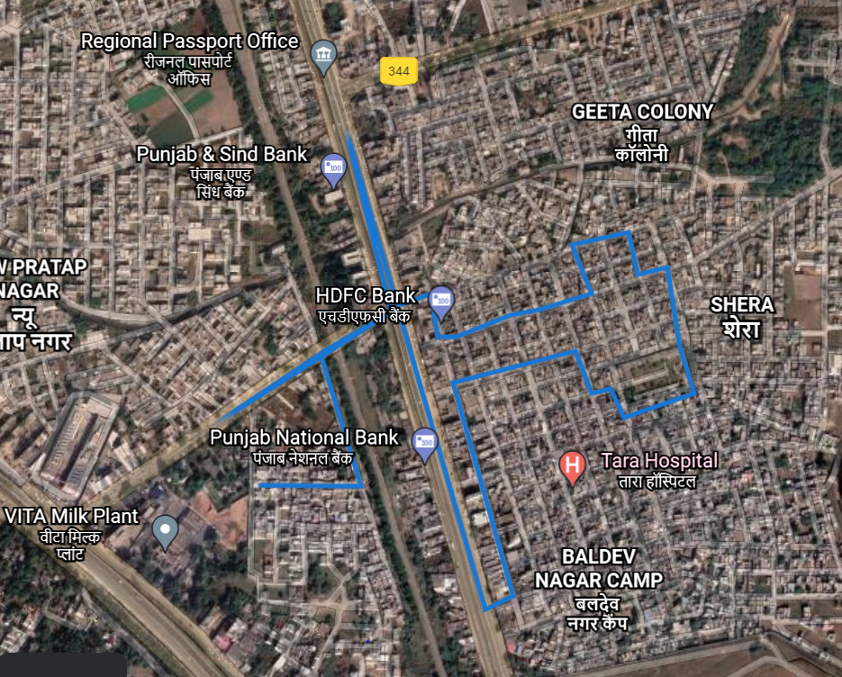
Overall DTROUTE

Slide 20
THANK YOU
MARQUIS TECHNOLOGIES

