Slide 1
MARQUIS TECHNOLOGIES
Drive Route BANGALORE

Slide 2
Drive Route
Near Cell :-Stationary: RSRP: -60dbm to -75dbm
Mixed :-Mobility: RSRP : -75dbm to -95dbm
Cell Edge :-Stationary: RSRP : -95dbm to -115dbm

Slide 3
Operators in Location
MCC | MNC | Operator
405 | 874 | Jio
404 | 45 | Airtel
404 | 44 | VI
JIO operator Network Info
RAT | Band | Comment
5G | n78, n28
4G | 3, 5, 40
3G | NA | Not Supported
2G | NA | Not Supported
AIRTEL operator Network Info
RAT | Band | Comment
5G | n77
4G | 1, 3, 8, 40
3G | NA | not Supported
2G | 3, 8
VI operator Network Info
RAT | Band | Comment
5G | NA
4G | 1, 3, 8
3G | NA | not Supported
2G | 3, 8

Slide 4
Services Supported by Vi VoLTE Operator
Operator | Supported Feature By Network | Supported Bands | Infra | MCC | MNC
Vi | VoLTE/4G/2G | B1, B3 & B8 | Nokia & Huawei | 404 | 86
Operator | Feature/Services | Supports(Yes/No)
Vi | Reselection | Yes
 | Redirection | Yes
 | MMS | Yes
 | Volte | Yes
 | CSFB | Yes(2G)
 | PS Handover | Yes

Slide 5
Operator Information 1
Functionality | Airtel
Website: https://www.airtel.in/ WAP APN: airtelgprs.com
Customer care | 198
MNC | 45
Bands supported | Both FDD and TDD
 | LTE 2300 MHz – TDD(Band 40)
 | LTE 1800 – FDD(Band 3) LTE 900 – FDD(Band 8) LTE 2100 – FDD (Band 1)
USSD | To check MDN: *282#
 | Balance check: *123#
 | To check all services: *121#
VoLTE | Supported
VoWiFi | Supported
CSFB | Supported (CSFB to 2G)

Slide 6
Operator Information 2
Functionality | RELIANCE JIO
Website: https://www.jio.com WAP APN: jionet
Customer care | 198
MNC | 861
Bands supported | Both FDD and TDD
 | LTE 2300 MHz –TDD(Band 40)
 | LTE 850 MHz – FDD(Band 5)
 | LTE 1800 MHz –FDD(Band 3)
USSD | NA
 | NA
 | NA
VoLTE | Supported
VoWiFi | Supported
CSFB | Not Supported

Slide 7
Operator Information 3
Functionality | VI
Website: https://www.myvi.in WAP APN: internet
Customer care | 198
MNC | 86
Bands supported | FDD
 | LTE 900 MHz – (Band 8)
 | LTE 2100 MHz – (Band 1)
 | LTE 1800 MHz – (Band 3)
USSD | To check MSISDN :*199#
 | Recharge : *199*5#
 | Balance check : *199*2#
VoLTE | Supported
VoWiFi | Not Supported
CSFB | Supported (CSFB to 2G/3G)

Slide 8
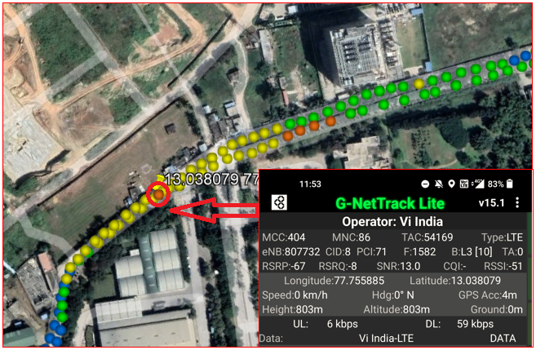
Vi operator Good Coverage Area Band3 Route >> Safal market

Slide 9
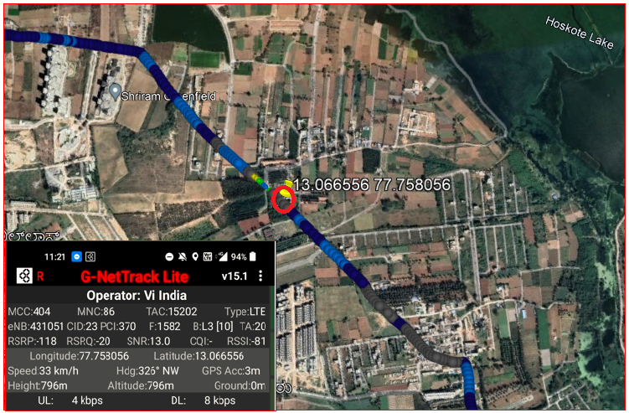
Vi operator Weak Coverage Area Band 3 Route >> huskur road>>raghuvanahall-hoskote rd>>3m farm-mani’s mythri manasa_biowise _

Slide 10
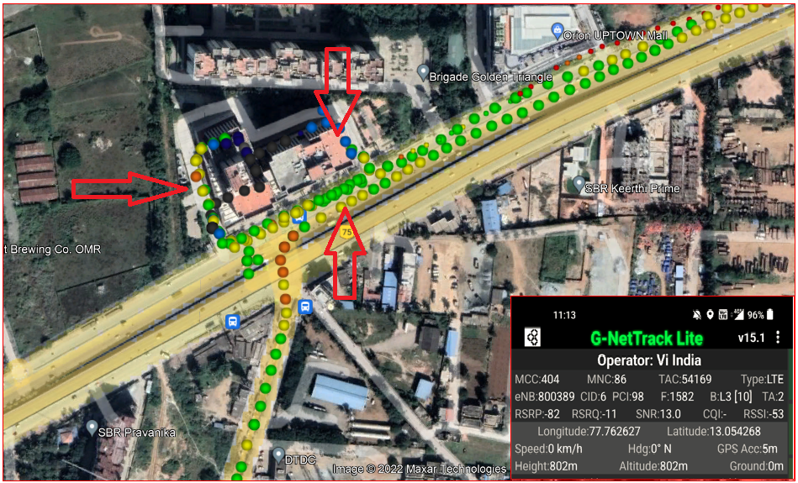
Vi operator Mix Coverage Area Route >> kattamanallur>>brigade signature tower

Slide 11
Crowded area for Vi operator route>>kattamanallur>>brigade signature tower>>orion uptown mall

Slide 12
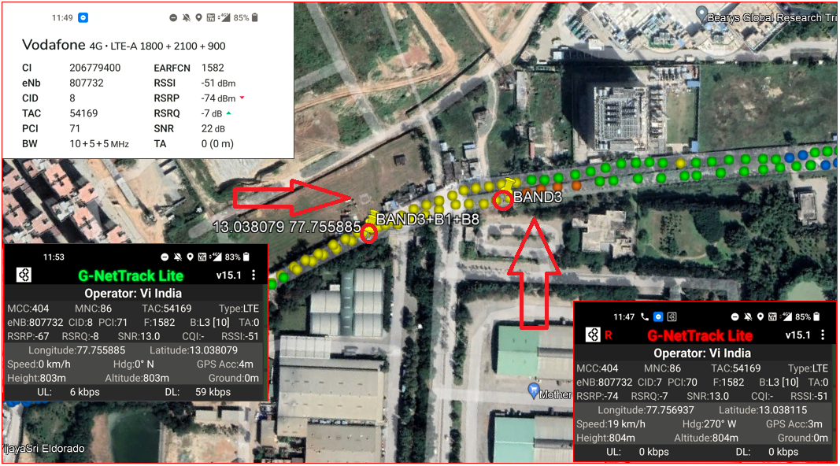
Vi operator non CA to CA_HO(B3_non CA to B3+B1+B8_CA) Route>>whitle fileld road>>Safal market>>mother dairy>>Bandapura road

Slide 13
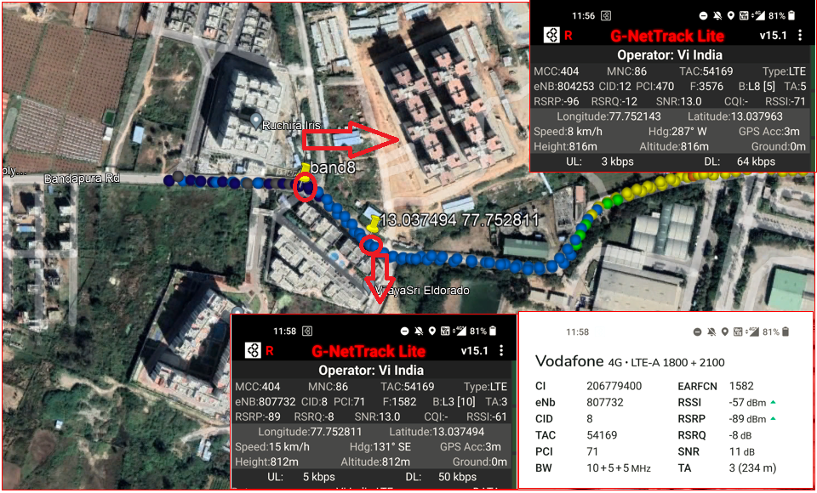
Vi operator non CA to CA HO (B8_to B3+B1_CA) Route>>bandapura road >> mother dairy>>Safal market

Slide 14
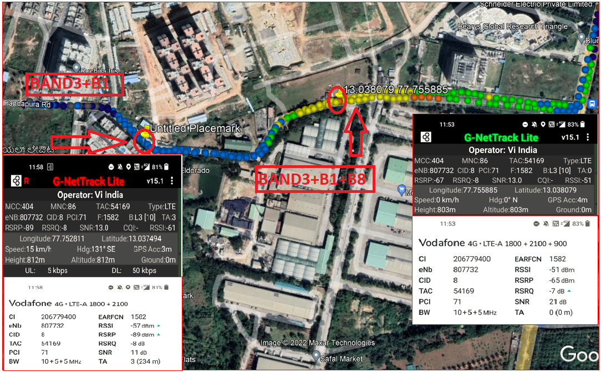
HO from 3CA (B3+B1+B8) cell to another 2CA(B3+B1) cell for Vi operator Route>>safal market >>Bandapura raod

Slide 15
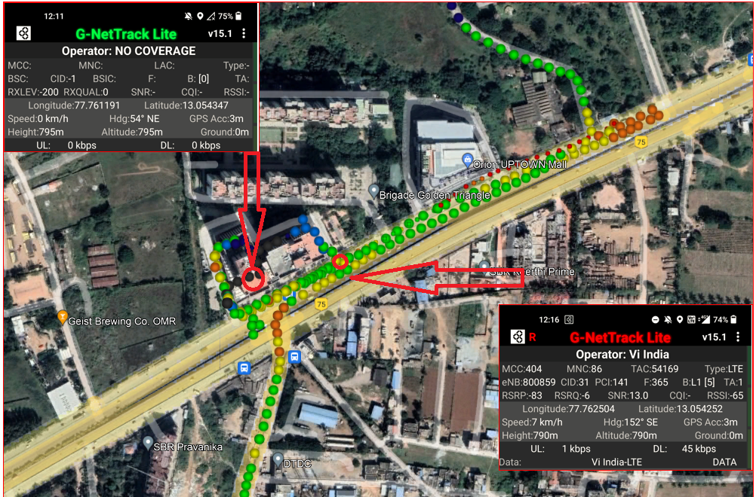
Vi Operator for OOS to in service route>>brigade signature tower base ment >>exit gate

Slide 16
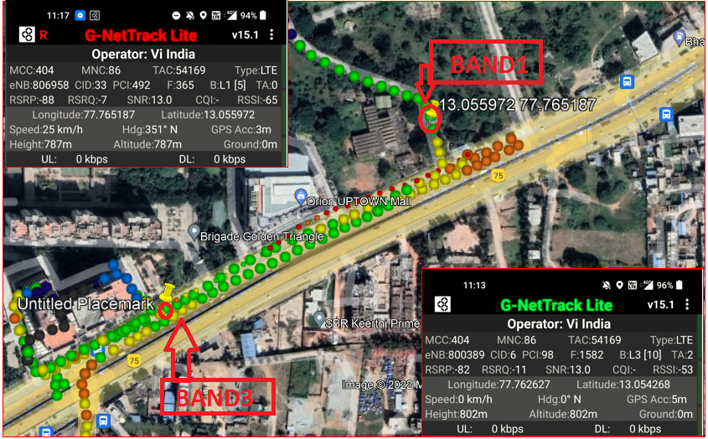
Band HO from B3 to B1 during ongoing MO call for Vi operator Route>>brigade signature tower>>orion uptown mall>>Huskur road

Slide 17
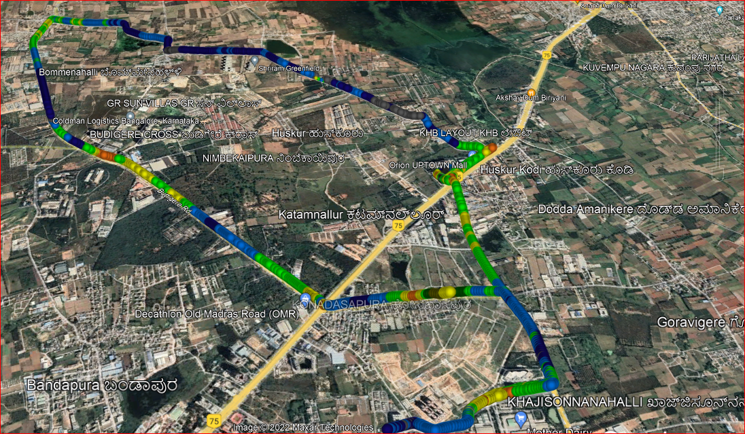
Mix Coverage & Different band Route for long call for Vi operator Started from kattamanallur>>Huskur>>nimbekapura road>bommenahalli>>budigiri cross>>budigiri road>>sufal market>>brigade signature tower.

Slide 18
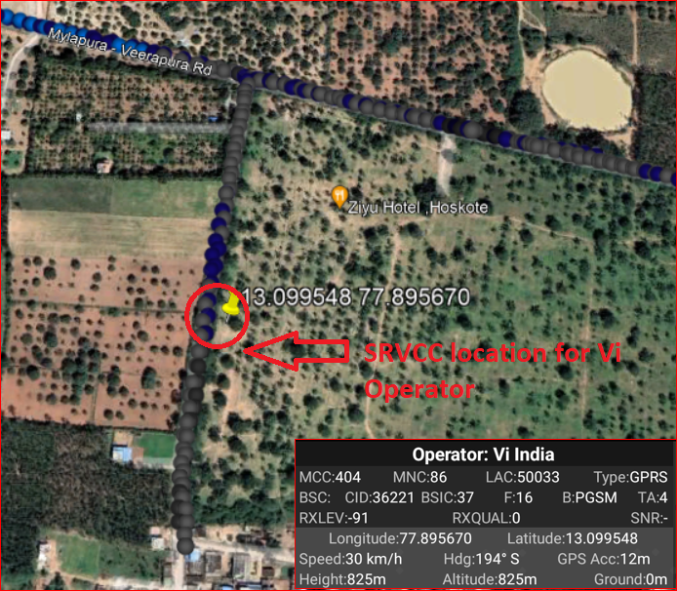
SRVCC Vi 4G Operator to Vi 2G RAT during ongoing MO call Mylapura-Veerapura road to Chikkanallala

Slide 19
Services Supported by Airtel VoLTE Operator
Features/Services | Description | Support(Yes/NO) | Location
Bands of Operator | Band-1,3,8, Band-40 | Yes | Bengaluru
Bandwidth of Bands | Band-1: 2100 MHz(FDD) | yes
 | Band-3: 1800 MHz(FDD) | Yes
 | Band-8: 900 MHz(FDD) | Yes
 | Band-40: 2300 MHz(TDD) | Yes
EARFCN for All Bands | Band-1:240 | Yes
 | Band-3:1301 | Yes
 | Band-8:3646 | Yes
 | Band-40:39125 | Yes
Band Handover | Band 1,3,8->Band 40-> & Vice-versa | YES
Infra | Ericsson
Reselection(L<-->W) | In Idle Mode | NO
Redirection(L-->W) | In Dedicated Mode | NO
PS Handover(L-->>W) | In Dedicated Mode | NO
CSFB(L-->W) | Circuit Switch Fall back | NO
Inter frequency Reselection | FDD to TDD & TDD to FDD | YES
Inter frequency Redirection | FDD to TDD & TDD to FDD | YES
Volte | Voice Over LTE | YES
SMS |  | YES
MMS |  | NO

Slide 20
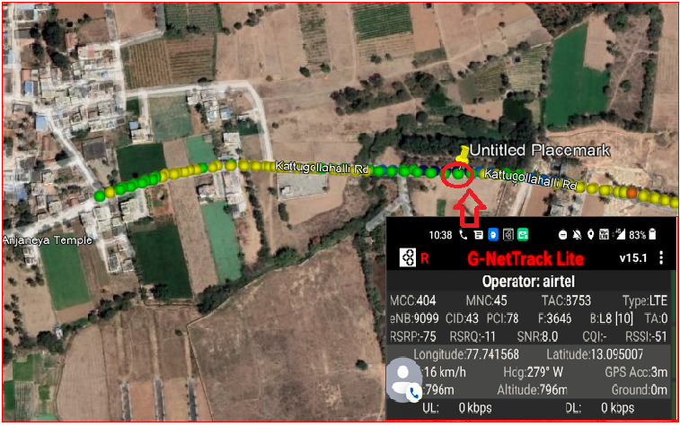
Airtel 4G VoLTE Good Coverage Area Band8 Route >> Budigere Road >> Patalmma Temple

Slide 21
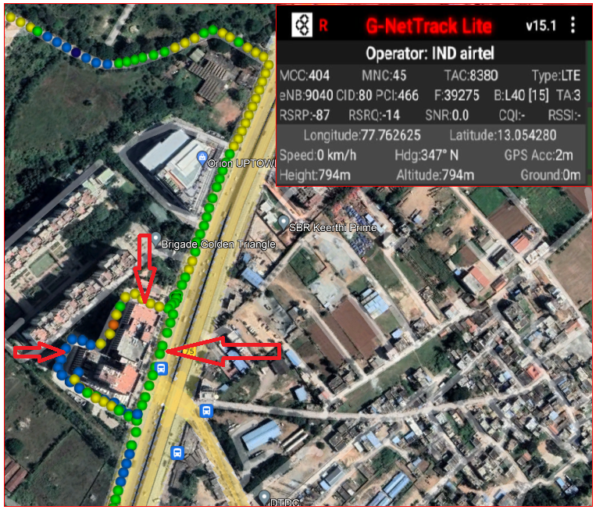
Airtel 4G VoLTE Mix Coverage Area Route >> kattamanallur>>brigade signature tower

Slide 22
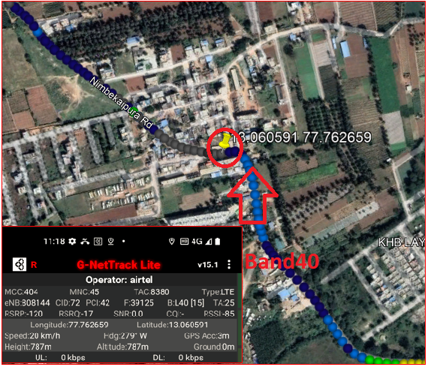
Airtel 4G Volte operator Weak Coverage Area Band 40 Route >> orion uptown mall>>Nimbekaipura road>>jodi huskuru.

Slide 23
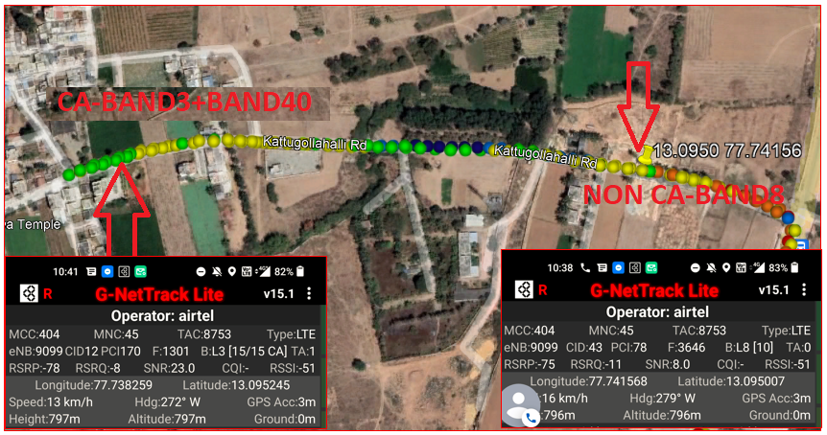
Airtel 4G Volte operator CA (B3+B40) to Non CA B3 Route >>Kattugollahalli road >>patalamma temple >>mandur road

Slide 24
Airtel 4G Volte Operator Non CA B8 to CA (B3 + B40) Handover Route >> mandur road >>pattalamma temple >>kattugollahalli road.

Slide 25
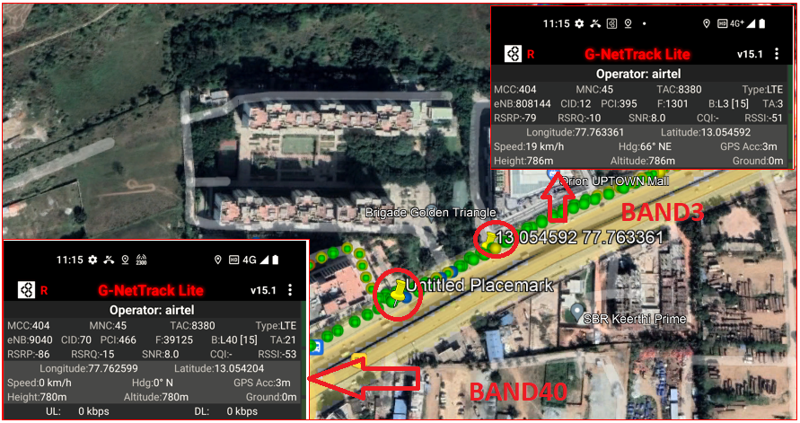
Airtel 4G Volte Operator Band Handover (B3 – B40) during ongoing call Route >>Brigade signature tower >>orion uptown mall

Slide 26
Airtel 4G Volte Operator Band Handover (B40 – B3) during ongoing call Route >>Brigade signature tower >>orion uptown mall

Slide 27
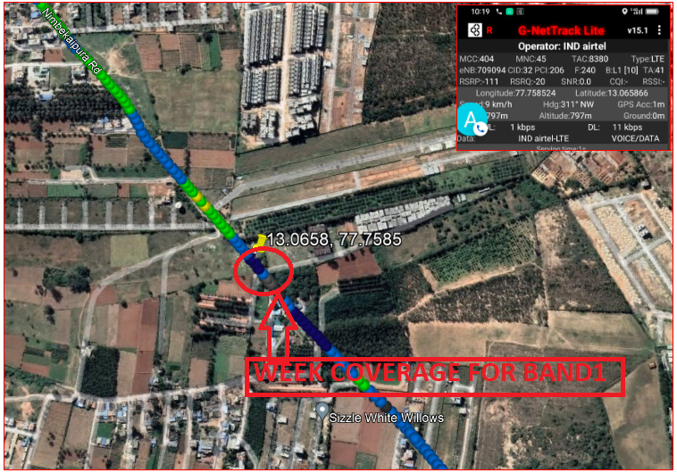
Airtel 4G Volte operator Weak Coverage Area Band 1 Route >> orion uptown mall>>Nimbekaipura road>>farm greenery pvt.

Slide 28
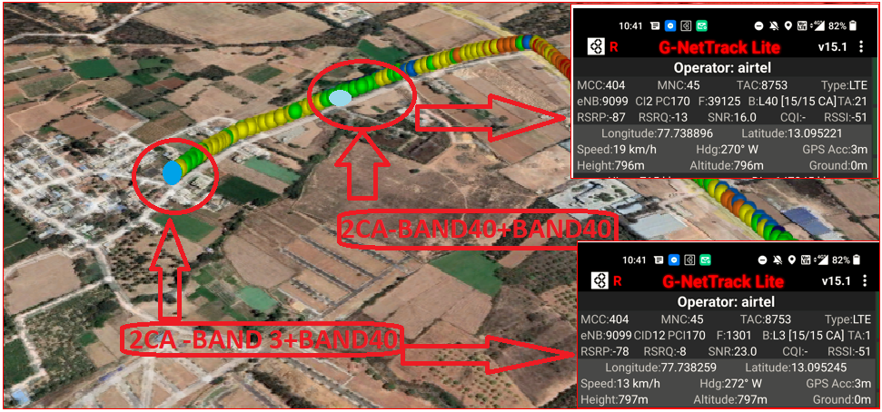
Airtel 4G Volte operator CA to CA Handover(B3+B40) to (B40+B40) Route >>Kodigehalli>>kattugollahalli road>>Patalamma Temple.

Slide 29
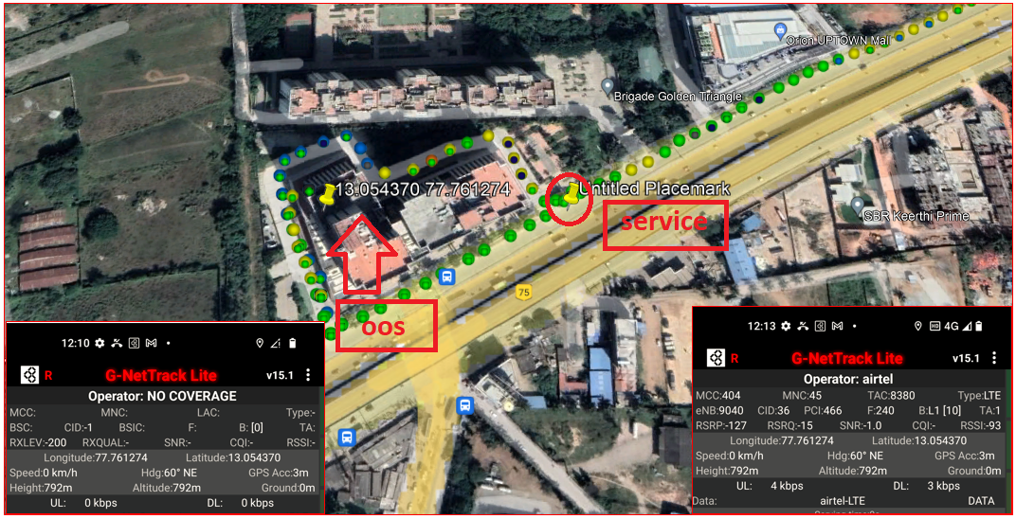
Airtel 4G VoLTE OOS to IN Service Route >>brigade signature tower base ment >> brigade signature exit gate

Slide 30
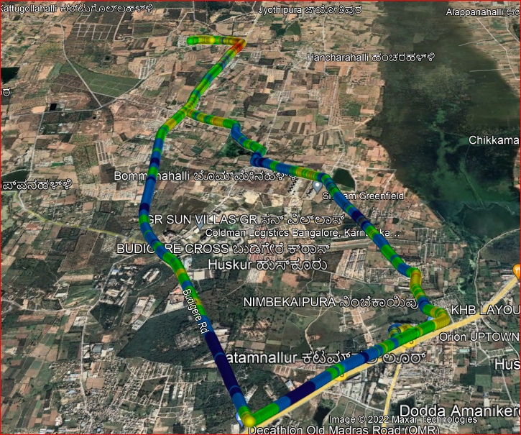
Airtel 4G VOLTE Long Call Drive Route Route >> Brigade signature towers>>Shriram Green field>>lagumenahalli>>mandur>>kodigehalli>>budigire cross>>kattamanallur.

Slide 31
Services Supported by JIO Operator
Features/Services | Description | Support(Yes/NO) | Location
Bands of Operator | Band-3, Band-5, Band-40 | Yes | Bangalore
Bandwidth of Bands | Band-3: 1800 MHz(FDD) | yes
 | Band-5: 850 MHz(FDD) | Yes
 | Band-40: 2300 MHz(TDD) | Yes
EARFCN for All Bands | Band-3: 1451 | Yes
 | Band-5: 2515 | Yes
 | Band-40: 38948,38750 | Yes
Band Handover | Band 3->Band 5->Band 40-> & Vice-versa | YES
Infra | Samsung & Mavenir
Reselection(L<-->W) | In Idle Mode | NO
Redirection(L-->W) | In Dedicated Mode | NO
PS Handover(L-->>W) | In Dedicated Mode | NO
CSFB(L-->W) | Circuit Switch Fall back | NO
Inter frequency Reselection | FDD to TDD & TDD to FDD | YES
Inter frequency Redirection | FDD to TDD & TDD to FDD | YES
Volte | Voice Over LTE | YES
SMS |  | YES
MMS |  | NO

Slide 32
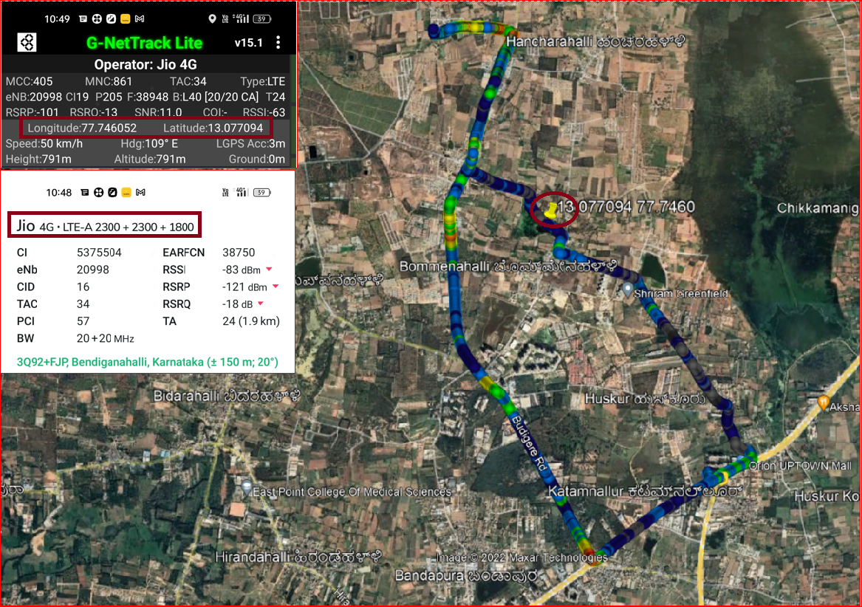
JIO Operator 3CA location Route >> Lagumenahalli>>Raghuvanahalli Hoskothe Road

Slide 33
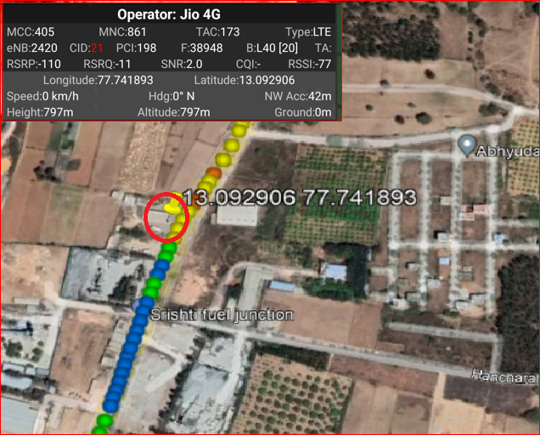
JIO Operator Mix Coverage Route >> Mandur >> Kodigehalli >> Jyothipura

Slide 34
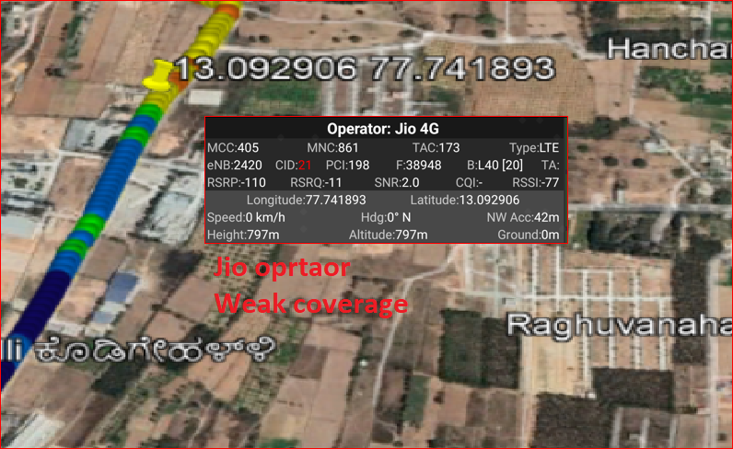
JIO Operator Weak coverage Band 40 Route >> jyothipura >>Abhiyudya star city >> Sristi fuel junction

Slide 35
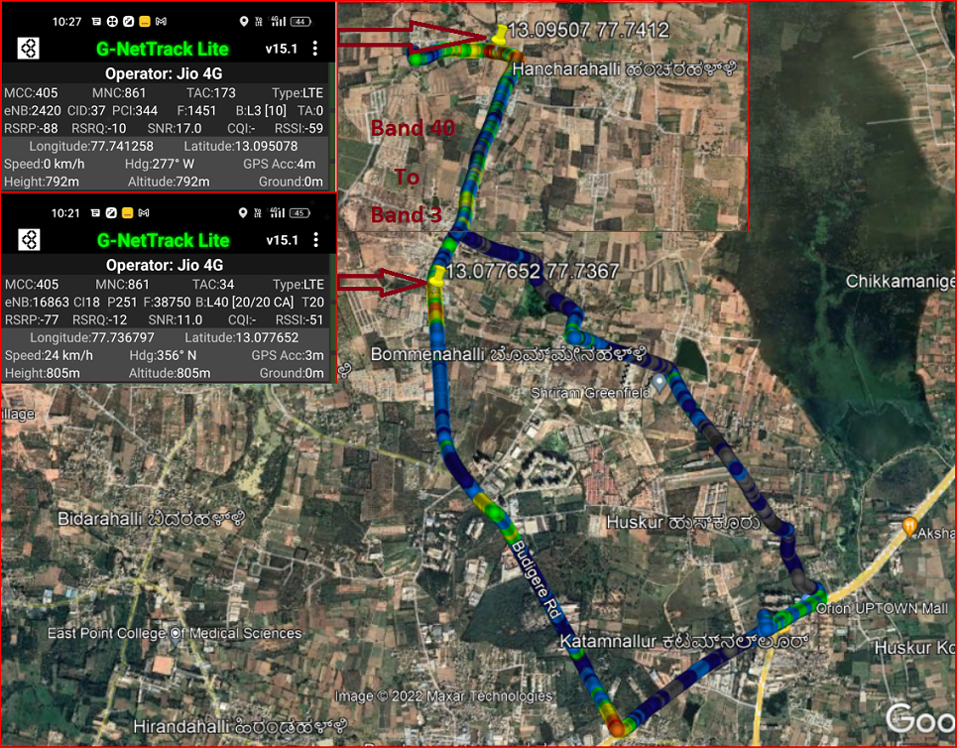
JIO Operator Band Ho from Band 40 to Band 3 Route >> Near Mandur Gram Panchayat>> Kottugollahalli Road

Slide 36
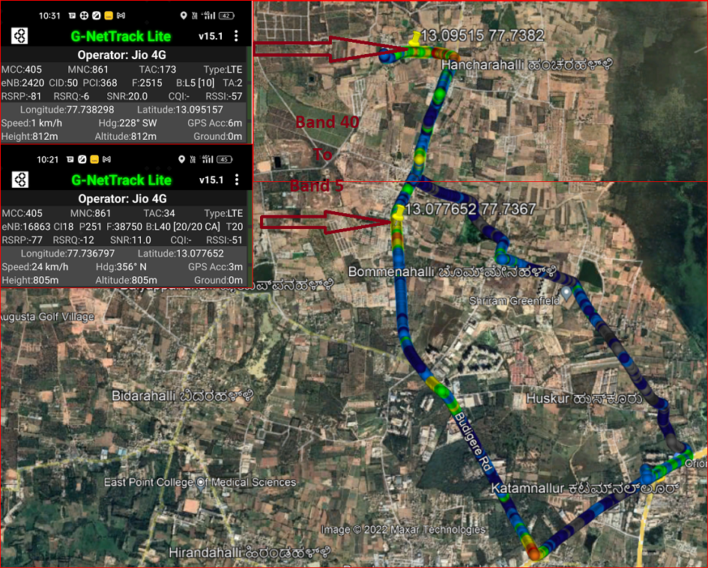
JIO Operator Band HO from Band 3 to band 5 Route >> Mandur>>Kattugollahalli road

Slide 37
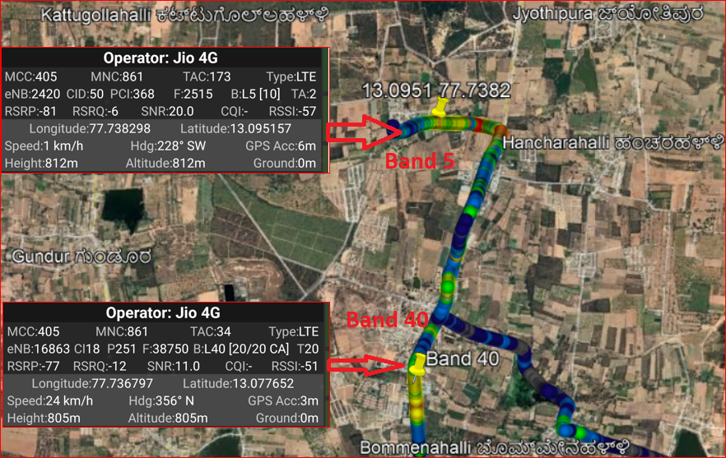
JIO Operator Band HO from Band 5 to Band 40 Route >> Budigere road

Slide 38
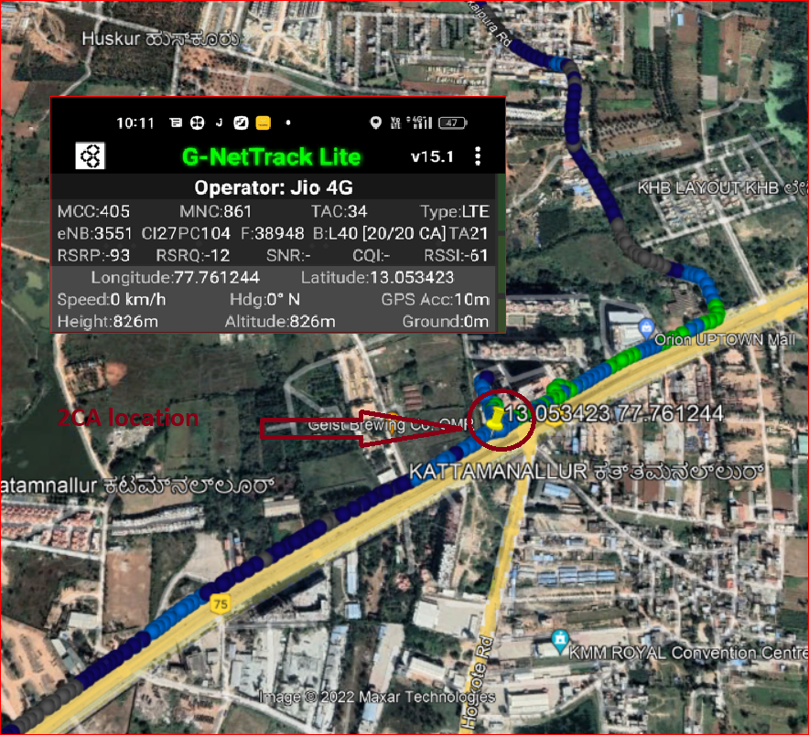
JIO Operator 2CA Location Route >> Kattamanallur>>Orion mall

Slide 39
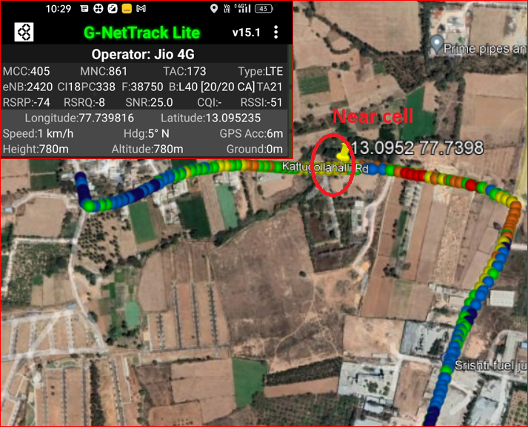
JIO Near cell Location >> Kattugollahalli road

Slide 40
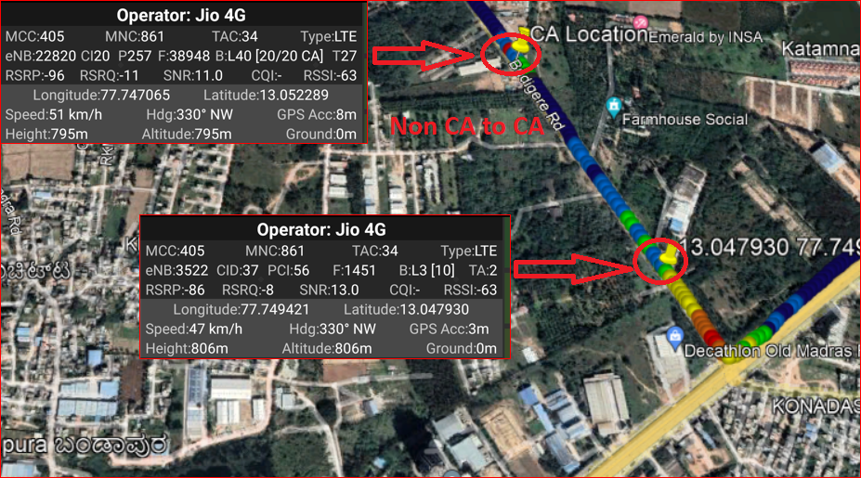
JIO Operator: Non CA cell to CA cell : B3 to B(40+40) Route >> Budigere road

Slide 41
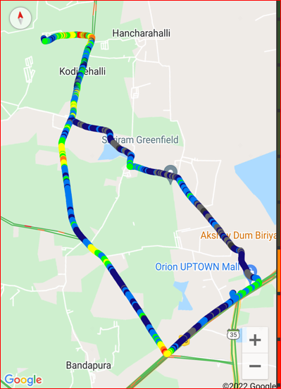
JIO Long call Route>>Started at Kattamanllur to Kattugollahalli road

Slide 42
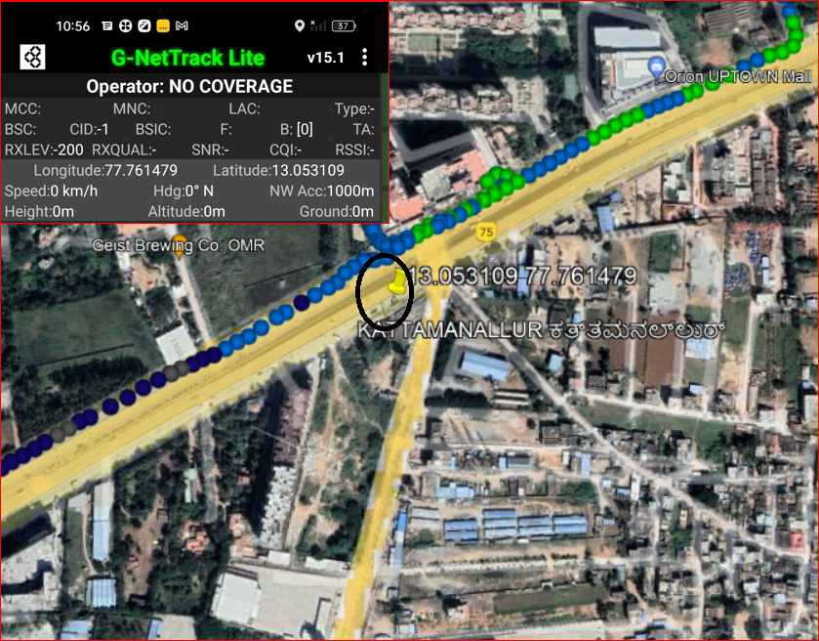
Out Of Service Location for JIO operator Route >> Brigade signature tower (Basaement) Near Kattamnallur gate

Slide 43
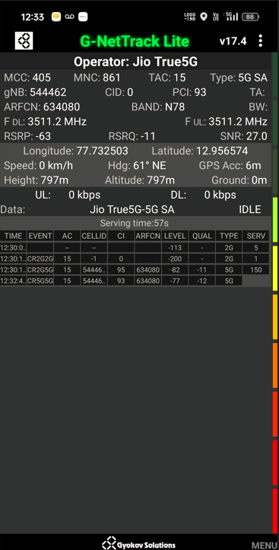
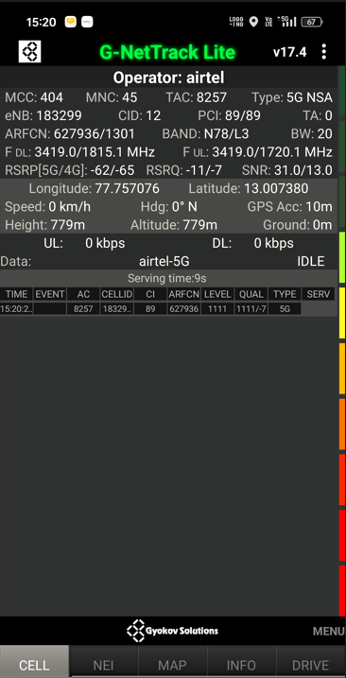
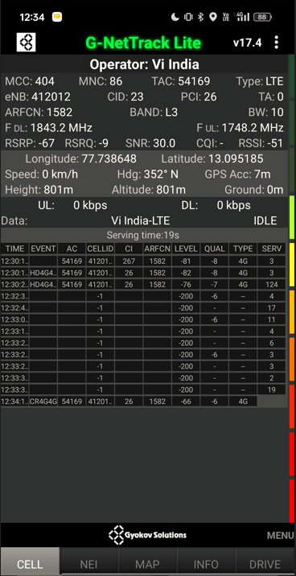
Near cell screenshots of all band with Network INFO. Which includes 5G also
Operator: JIO
Band: N78
Cell ID: 0
E-ARFCN : 634080
RSRP: -60dbm to 75dbm
Operator: AIRTEL
Band: N78 , L3
Cell ID: 12 ,12
E-ARFCN : 627936, 1301
RSRP: -60dbm to 75dbm
Operator: VI
Band: L3
Cell ID: 23
E-ARFCN : 1582
RSRP: -60dbm to 75dbm

Slide 44
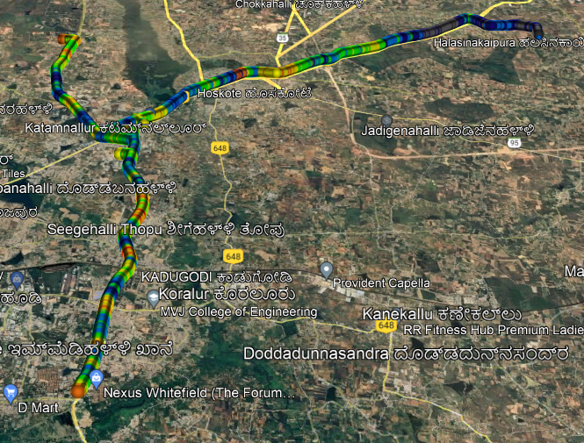
( Mixed Mobility Area) screenshots

Slide 45
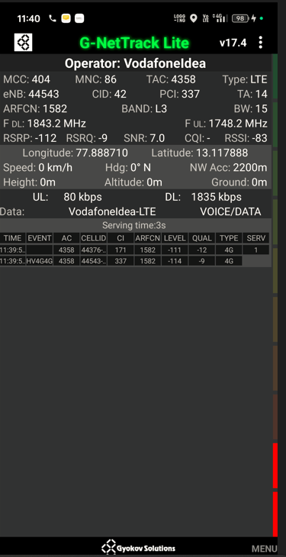
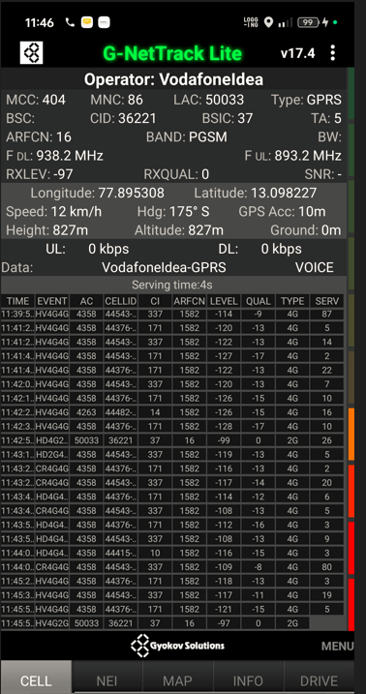
SRVCC screenshots of all band with Network INFO.
Operator: VI
Band: L3
Cell ID: 42
E-ARFCN : 1582
RSRP: -99dbm

Slide 46
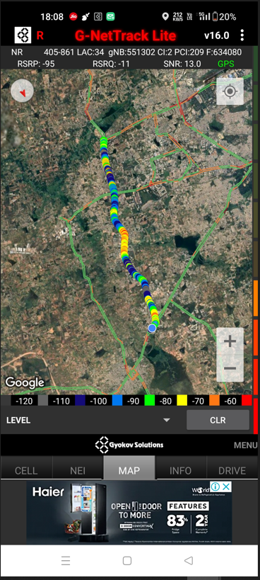
Band Handover – It will include all 5G to 4G
Operator: JIO
Band Handover: N77—B3
E-ARFCN : 39025-1800

Slide 47
(Reselection)
Operator: JIO
Band reselection: N77-N28-B5-B8
E-ARFCN : 551302-1800

Slide 48
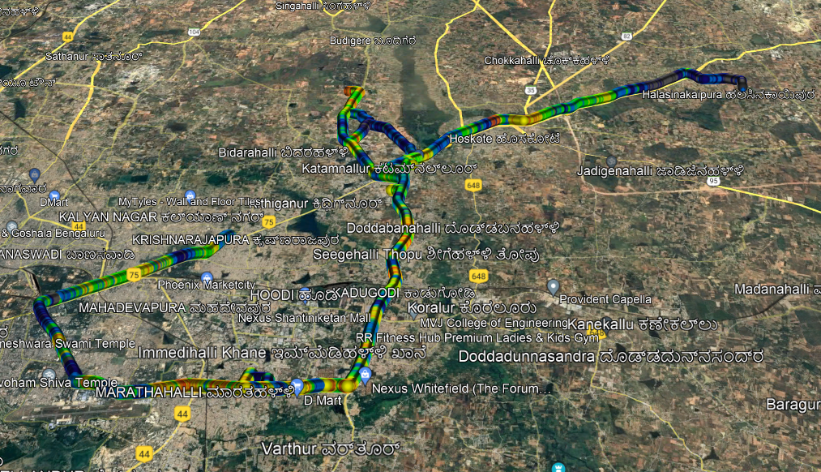
( Drive Route covered during mobility. )

Slide 49
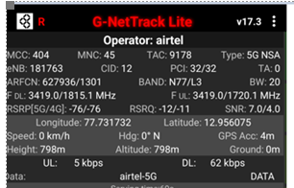
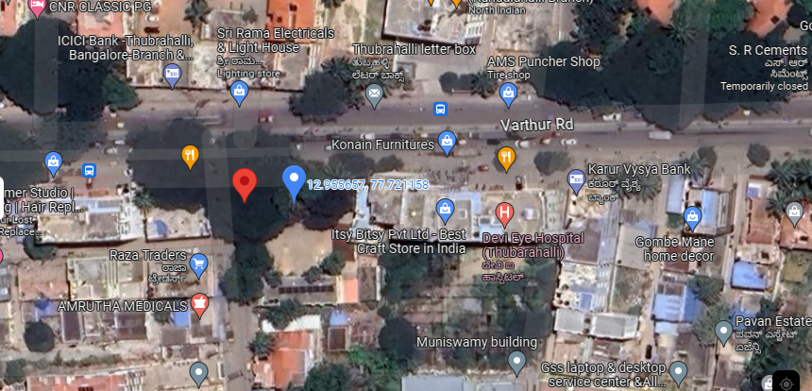
5G Near Cell, Airtel
Lat/Long –12.956075/77.731732
Location:- Siddapura Primary Health Centre PHC
Specification –Stable Airtel 5G NSA network

Slide 50
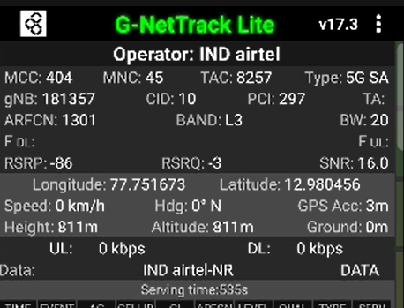
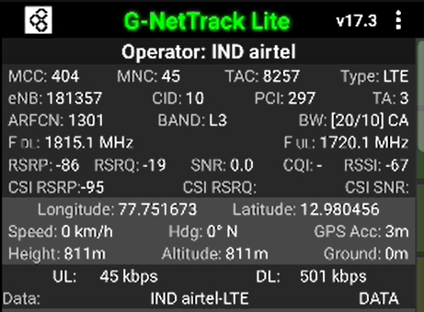
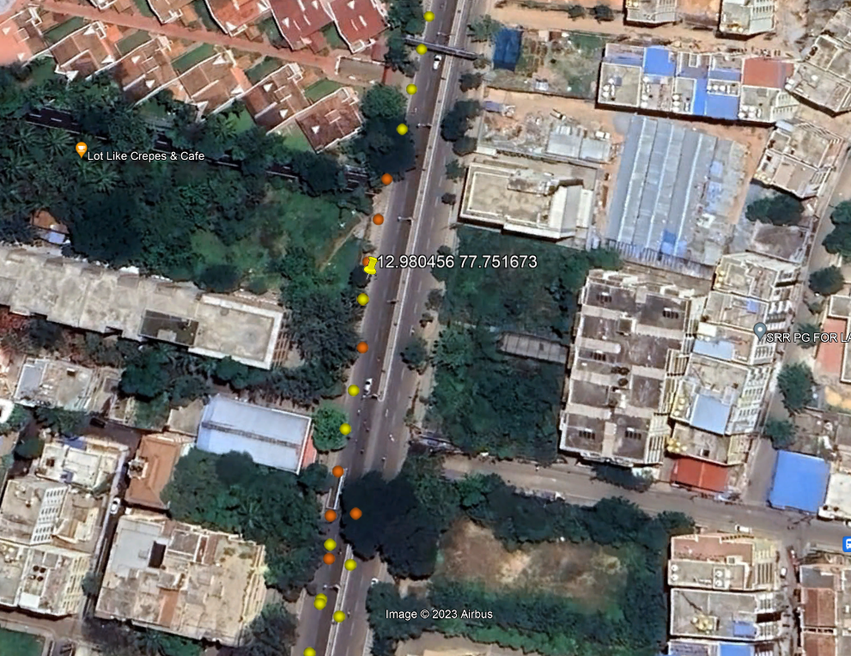
NR to LTE Handover ,Airtel
Lat/Long. 12.976339, 77.750847
Lat/Long. 12.982287, 77.752124 Location – Near Hope Farm Jn. Specification –NR to LTE Handover
NR2L HO

Slide 51
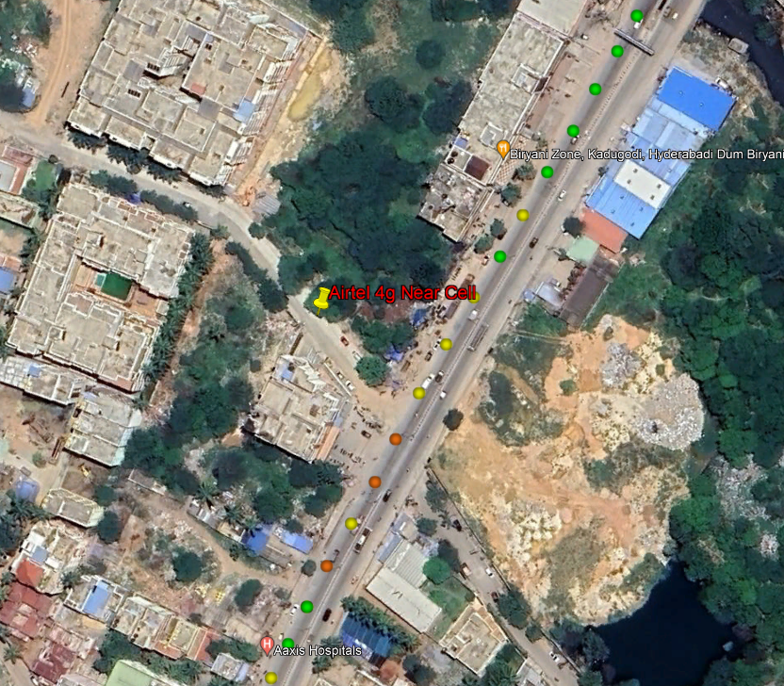
Airtel 4G VoLTE Good Coverage Area
Lat/Long 13.007293, 77.757333
Location – Belathur

Slide 52
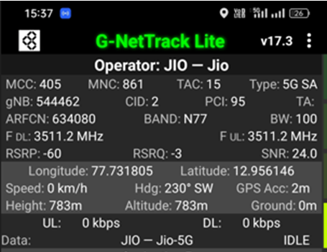
5G Near Cell,JIO
Lat/Long –12.956075/77.731732
Location:- Siddapura Primary Health Centre PHC
Specification –Stable JIO 5G SA network

Slide 53
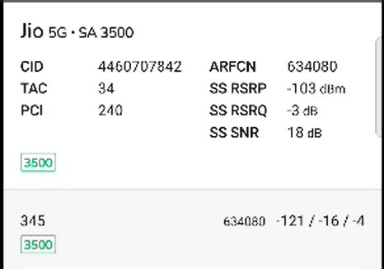
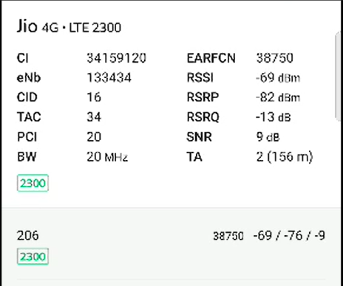
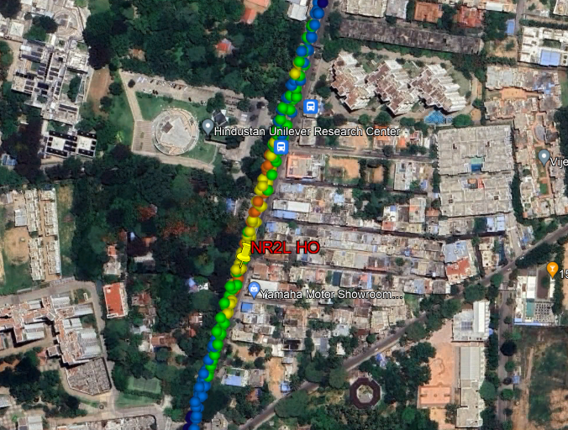
NR To LTE Handover, Jio
Lat/Long 12.958508, 77.746125 Lat/Long. 12.965942, 77.749075
Location – Hindustan Unilever Research Center Specification –NR to LTE Handover

Slide 54
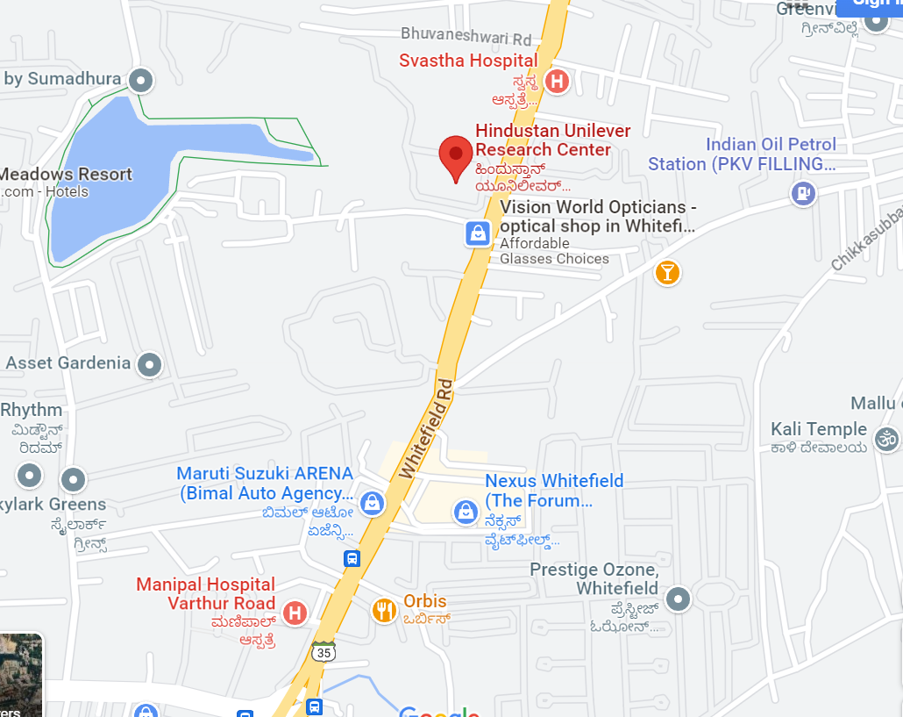
Inter-freq HO on NR ,JIO (n78-n28-n78)
Lat/Long. 12.959805, 77.746854 to
Lat/Long. 12.964071, 77.748442
Location: Hindustan Unilever Research Center
N78-N28-N78 HO

Slide 55
JIO 4G VoLTE Good Coverage Area Lat/Long –12.956075/77.731732 Location:- Siddapura Primary Health Centre PHC

Slide 56
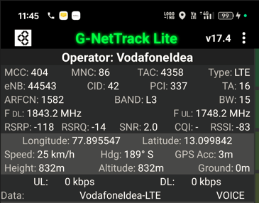


SRVCC VI Operator
Lat Long- . 13.099430 77.895475 Location- Mylapura Gate Specification –SRVCC

Slide 57
DRIVE ROUTE

Slide 58

Near Cell (Airtel)
Near cell | longitude | Latitude | RSRP (dbm)
1 | 13.068945305972239 | 77.78497641252783 | -71
RSRP Range for Near Cell :
-65dbm to -75dbm
Near Safal market,
Bangalore

Slide 59

Edge Cell (Airtel)
Edge cell | longitude | latitude | RSRP (dbm)
1 | 13.053365634511652 | 77.76178095703837 7 | -102
RSRP Range for Edge Cell :
-95dbm to -110dbm
Near
Kattamanallur,
Bangalore

Slide 60



Airtel Inter Band HO
Band 8 BAND 40 BAND 3

Slide 61
Near Cell (Reliance JIO)
Near cell | longitude | Latitude | RSRP (dbm)
1 | 13.068945305972239 | 77.78497641252783 | -71
RSRP Range for Near Cell : -65dbm to -75dbm
Near Safal Market, Bangalore

Slide 62


Edge Cell (Reliance JIO)
Edge cell | longitude | latitude | RSRP (dbm)
1 | 13.053365634511652 | 77.76178095703837 7 | -102
RSRP Range for Edge Cell :
-95dbm to -110dbm
Near
Kattamanallur,
Bangalore

Slide 63



Inter Band Handover (FDD-TDD) for JIO 4G
Band 40 Band 5 Band 3

Slide 64
Near Cell for VI:
Near cell | longitude | Latitude | RSRP (dbm)
1 | 13.068945305972239 | 77.78497641252783 | -71
RSRP Range for Near Cell :
-65dbm to -75dbm
Near Safal Market,
Bangalore

Slide 65
Edge Cell for VI:
Edge cell | longitude | latitude | RSRP (dbm)
1 | 13.053365634511652 | 77.76178095703837 7 | -102
RSRP Range for Edge Cell :
-95dbm to -110dbm
Near
Kattamanallur,
Bangalore

Slide 66



VI Band Handover
Band 1 Band 3 Band 8

Slide 67
THANK YOU
MARQUIS TECHNOLOGIES
www.marquistech.com

