Slide 1

MARQUIS TECHNOLOGIES
NR(5G) LOCATION: Budapest, Hungary
Notes:
CONFIDENTIAL

Slide 2
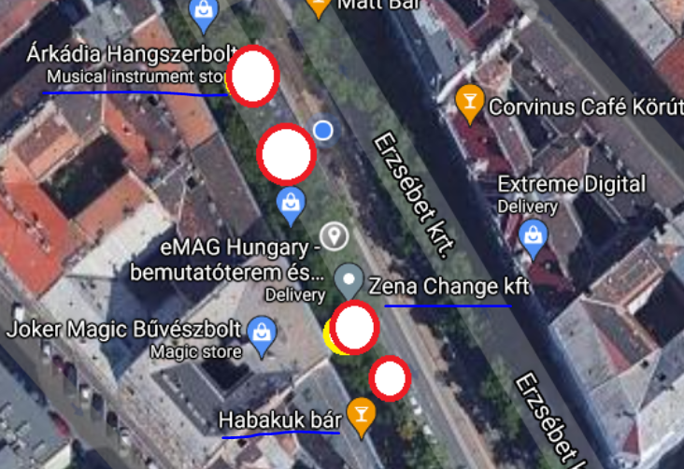
5G Location for VDF Operator (Good Coverage) Location- Zena Change Kft, Habakuk bar, Arkadia Hangszerbol

Slide 3
Thank You Marquis Technologies Pvt Ltd

