Slide 1
MARQUIS TECHNOLOGIES
Drive Route – Mexico City(Mexico)

Slide 2
Testing Place – Mexico City (Mexico)
Country | Mexico
Continent | North America(LATAM)
City | Mexico City
Time Zone | UTC-6 (CST)
International Dialing Code | +52

Slide 3
RSRP Criteria
Near Cell :-Stationary: RSRP : -55dbm to -85dbm
Cell Edge :-Stationary: RSRP : -95dbm to -110dbm
Mixed :-Mobility: RSRP : -55dbm to -120dbm

Slide 4
Operator Information
MCC | MNC | Operator | Bands (MHz)
334 | 20 | Telcel (VoLTE commercial available) 4G/3G/2G .VoWiFi not commercially available | LTE-1700MHz, UMTS- 850/1900 MHz, GSM-1900MHz
334 | 30 | Movistar (VoLTE not commercially available) 4G/3G/2G | LTE- 1900 MHz, UMTS-850/1900 MHz, GSM-1900MHz
334 | 40/50 | AT&T(VoLTE commercially available) 4G/3G. VoWiFi not commercially available. | LTE-1700 MHz, UMTS- 1700MHz , 2G discontinued

Slide 5
Telcel Operator
Drive Route – Mexico City(Mexico)

Slide 6
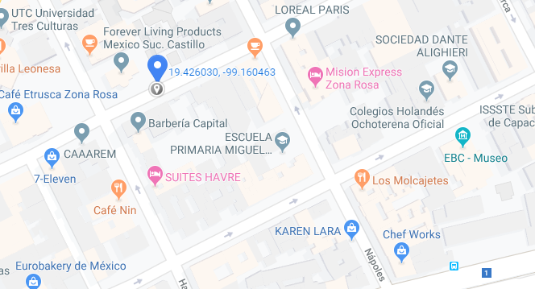
CA Cell Havre 64, Juarez, CDMX Operator: Telcel
Telcel-Slide : 1

Slide 7
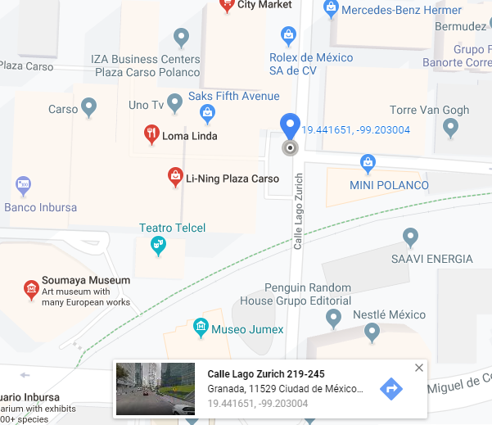
IRAT to 3G Location (Move from Sanborns to Nearby Escalator(Ice Cream Shop) in Plaza Carso Mall) Operator: Telcel
Telcel-Slide : 2

Slide 8
SRVCC to 3G (Move from Sanborns to Nearby Escalator in Plaza Carso)
Telcel-Slide: 3

Slide 9
Movistar Operator
Drive Route – Mexico City( Mexico)

Slide 10
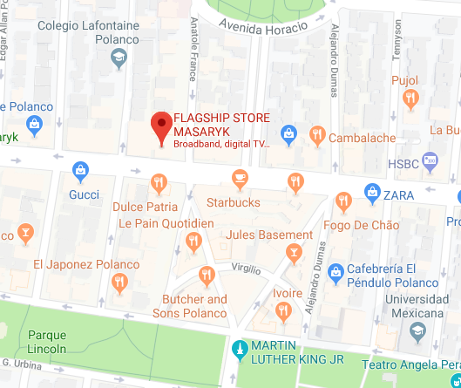
CA Location Movistar Flagship Store, Anatole France 114, Polanco III Secc, CDMX Operator: Movistar
Movistar-Slide-1

Slide 11
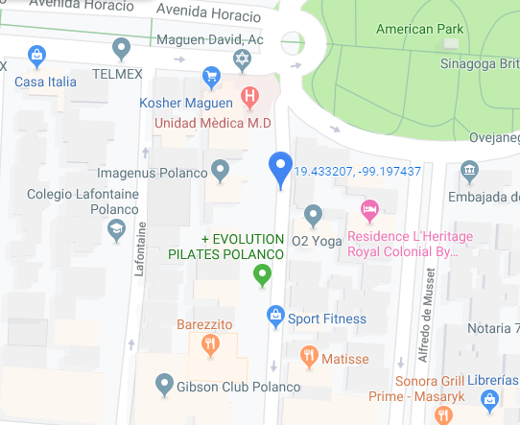
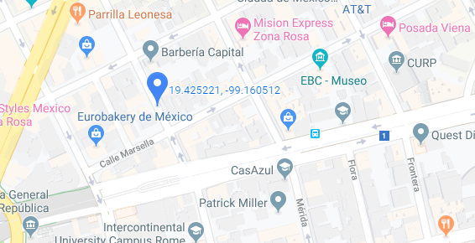
IRAT to 3G Location 1. Anatole France 150-114, Polanco, Polanco III Secc, 11550, CDMX 2. Havre 78-60, Juarez, 06600, CDMX Operator: Movistar
Movistar-Slide :2

Slide 12
SRVCC to 3G 1. Havre 78-60, Juarez, 06600, CDMX Operator: Movistar
Movistar-Slide: 3

Slide 13
AT&T Operator
Drive Route – Mexico City(Mexico)

Slide 14
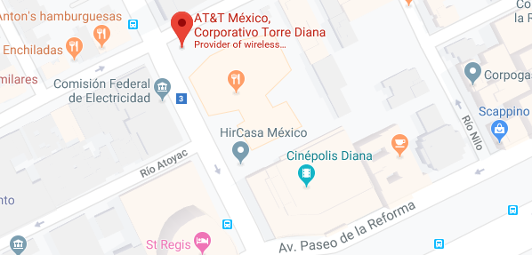
CA Location AT&T Mexico, Corporativo Torre Diana(Entrance Gate) Operator: AT&T
AT&T-Slide : 1

Slide 15
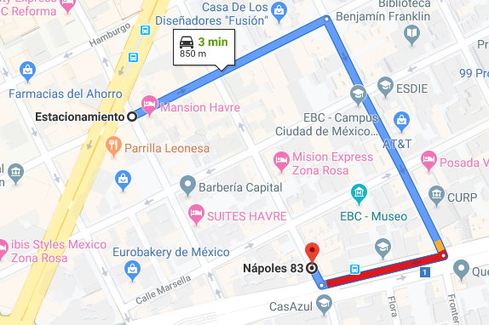
IRAT Location Route: Estacionamiento>Plaza Washington>Calle Dinamarca 85>Napoles 83>Calle Marsella 73 Operator: AT&T
AT&T-Slide : 2

Slide 16
SRVCC Location Route: Estacionamiento>Plaza Washington>Calle Dinamarca 85>Napoles 83>Calle Marsella 73 Operator: AT&T
AT&T-Slide: 3

Slide 17
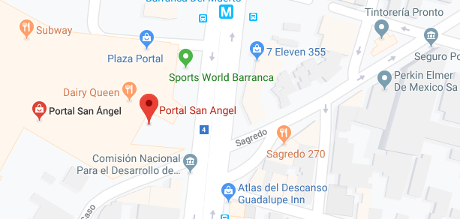
Domestic Roaming Route: Portal San Angel Mall Entrance>Sams Club Cafeteria>Wait for No Service and Network Reject 12 from Telcel>>Move back to Portal San Angel Mall Entrance. Operator: AT&T
AT&T-Slide: 4

Slide 18
THANK YOU
MARQUIS TECHNOLOGIES
www.marquistech.com

