Slide 1
MARQUIS TECHNOLOGIES
Drive Route –Airtel, VI & Reliance JIO (FDD/TDD) LTE

Slide 2
Operator Information:
Operator | JIO 4G
MCC | 405
MNC | 840
APN | Jionet
Operator | Airtel 4G
MCC | 405
MNC | 51
APN | Airtelgprs.com
Operator | VI
MCC | 405
MNC | 67
APN | www
Operator | BSNL
MCC | 404
MNC | 74
APN | Bsnl

Slide 3
Operator Information 1
Functionality | Airtel
Website: http://www.airtel.com/ WAP APN: airtelgprs.com
Customer care | 199
MNC | 51
Bands supported | Both FDD and TDD
 | LTE 2300 MHz – TDD(Band 40)
 | LTE 1800,2100 MHz – FDD(Band 3 ,Band 1)
USSD | To check MDN: *282#
 | Balance check: *123#
 | Data Balance check: *121*114#
VoLTE | Supported
CSFB | Supported (CSFB to 2G)

Slide 4
Operator Information 2
Functionality | RELIANCE JIO
Website: http://www.jio.com WAP APN: jionet
Customer care | 198
MNC | 840
Bands supported | Both FDD and TDD
 | LTE 2300 MHz –TDD(Band 40)
 | LTE 850 MHz – FDD(Band 5)
 | LTE 1800 MHz –FDD(Band 3)
USSD | NA
 | NA
 | NA
VoLTE | Supported
CSFB | Not Supported

Slide 5
Operator Information 3
Functionality | VI
Website: http://www.my.vi.in WAP APN: www
Customer care | 198
MNC | 67
Bands supported | Both FDD and TDD
 | LTE 2500 MHz –TDD(Band 41)
 | LTE 1800 MHz – FDD(Band 3)
USSD | To check MDN*199#
 | Balance check198
 | Data Balance check: 121
VoLTE | Supported
CSFB | Supported (swithed to 2G)

Slide 6
Operator Information 4
Functionality | BSNL
Website: https://portal.bsnl.in WAP APN: bsnlnet
Customer care | 198
MNC | 74
Bands supported
 | 3G 2100 MHz (Band 1)
 | 2G 900 MHz (Band 8)
USSD | To check MDN *222#
 | Balance check *123*1#
 | Data Balance check: *124*1#
VoLTE | NA
CSFB | NA

Slide 7
Drive Route
Near Cell :- Stationary: RSRP : -65dbm to -75dbm
Cell Edge :- Stationary: RSRP : -95dbm to -110dbm
Mixed :- Mobility: RSRP : -65dbm to -110dbm

Slide 8
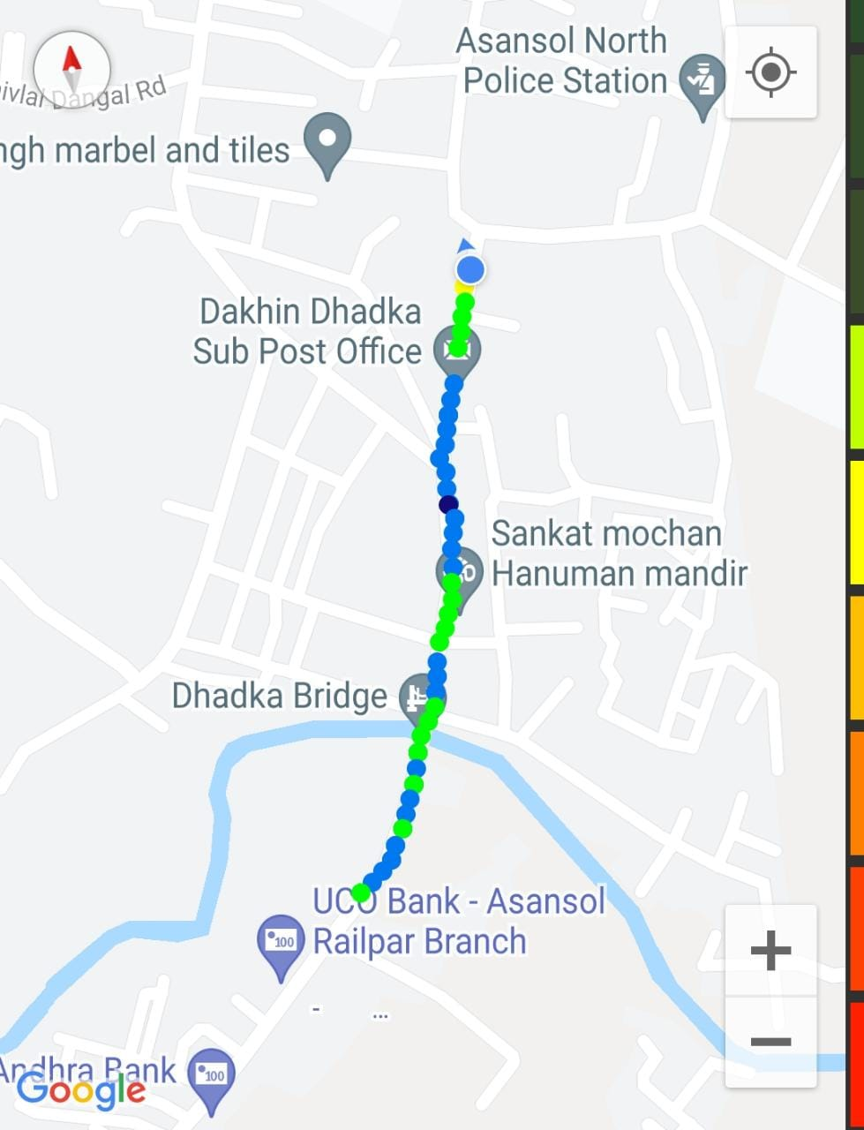
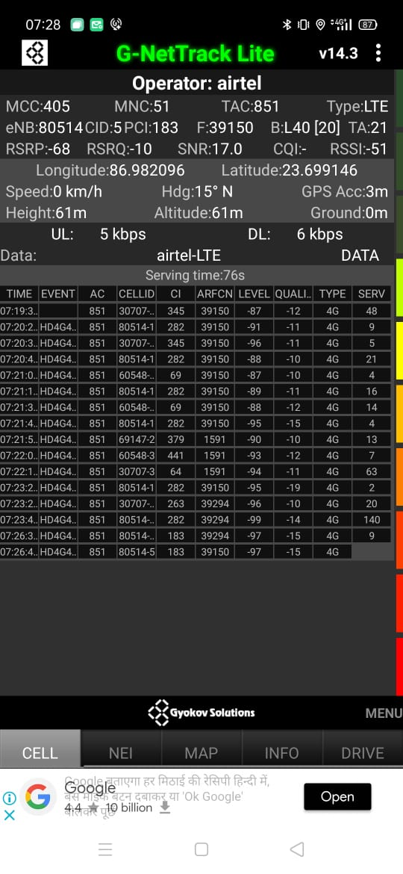
Near Cell (Airtel)
Near cell(NC) | longitude | latitude | RSRP | Cell id | TDD E-ARFCN
1 | 86.982096 | 23.699146 | -68 | 5 | 39150
Dakhin Dhadka Sub Post Office
RSRP:
-65dbm to 75dbm

Slide 9
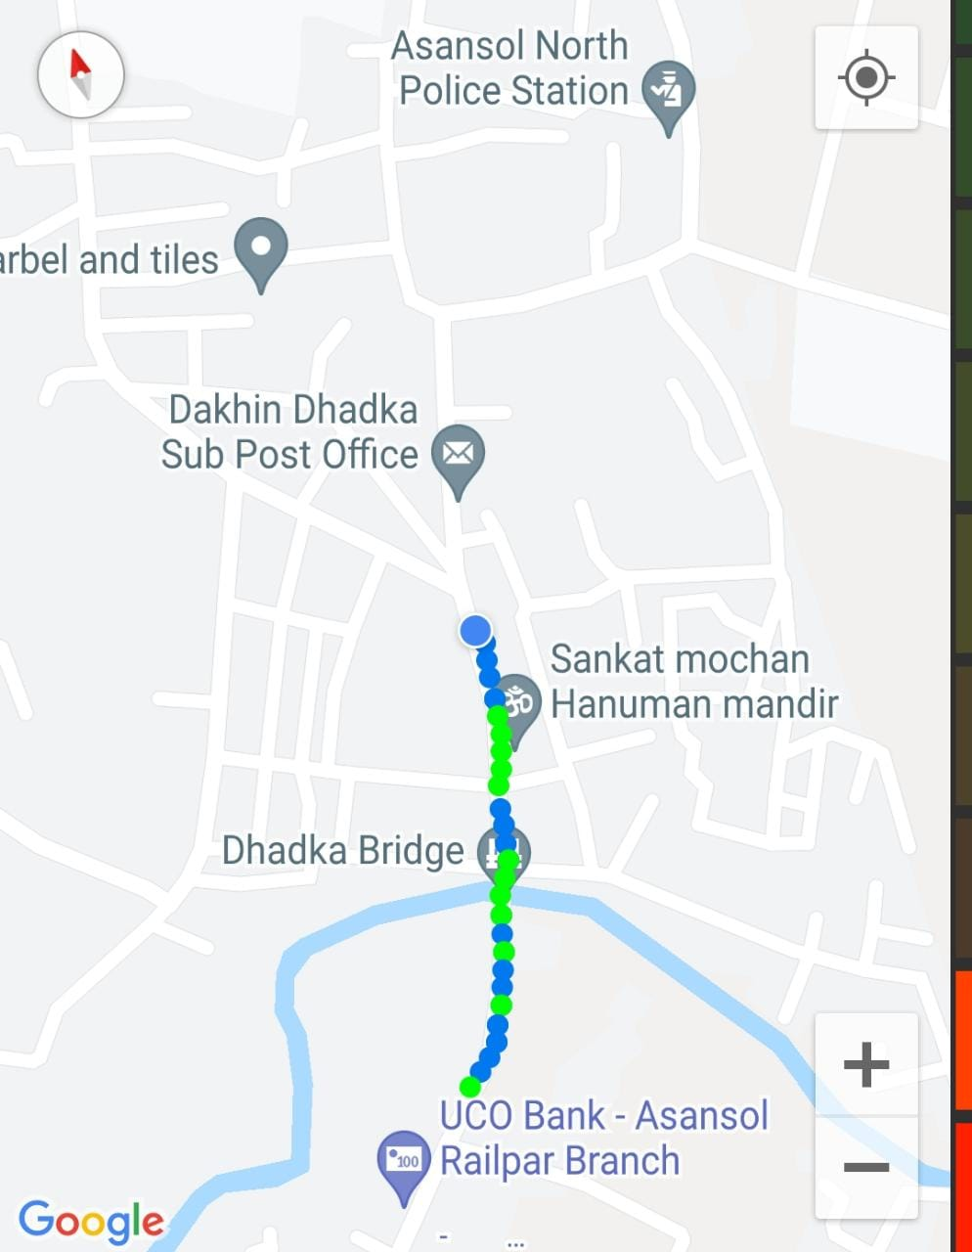
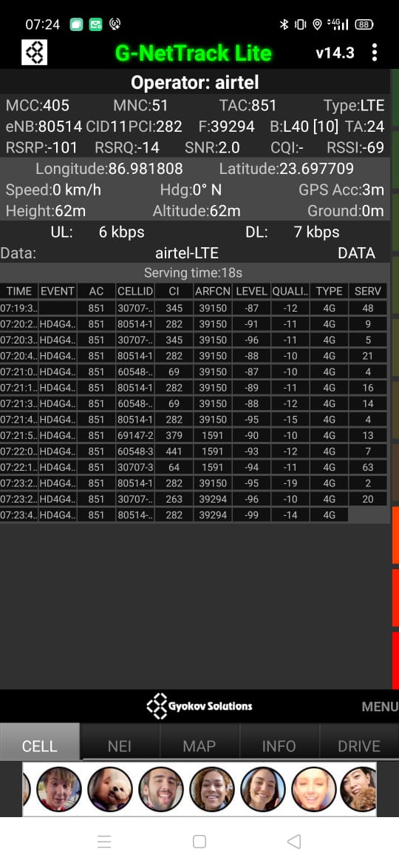
Edge Cell (Airtel)
Edge cell(EC) | longitude | latitude | RSRP | Cell id | TDD E-ARFCN
1 | 86.981808 | 23.697709 | -101 | 11 | 39294
Sankat Mochan Hnauman Mamdir
RSRP:
-95dbm to -110dbm

Slide 10
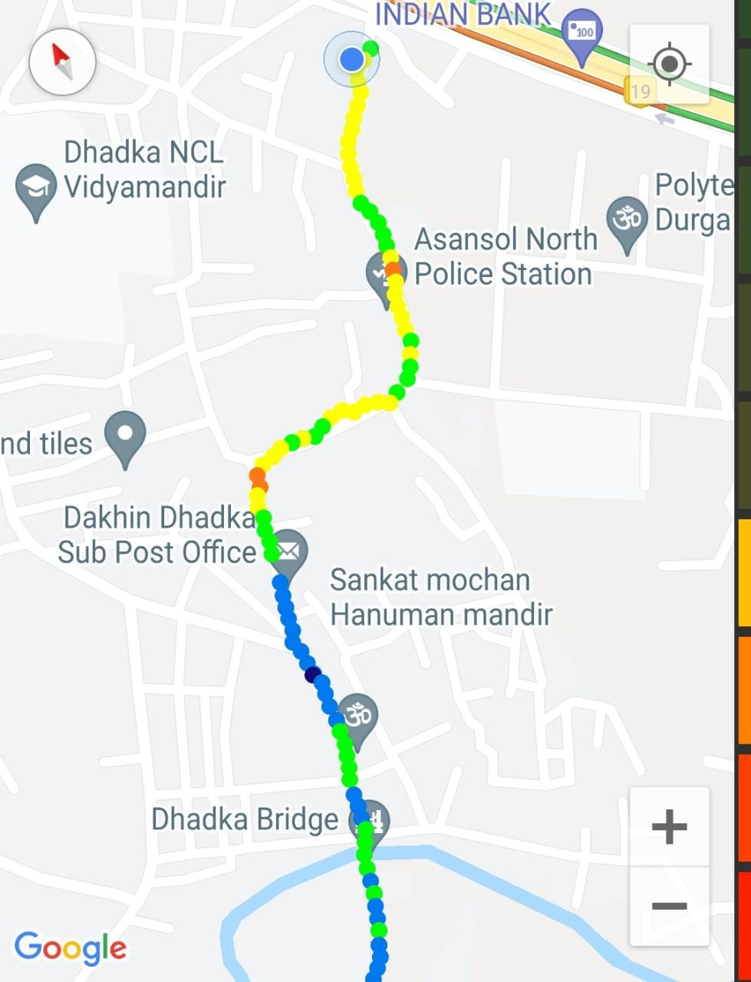
Mixed Mobility:- Dhadka Asansol
Dhadka Road Asansol, WB
RSRP: -65dbm to -110dbm

Slide 11
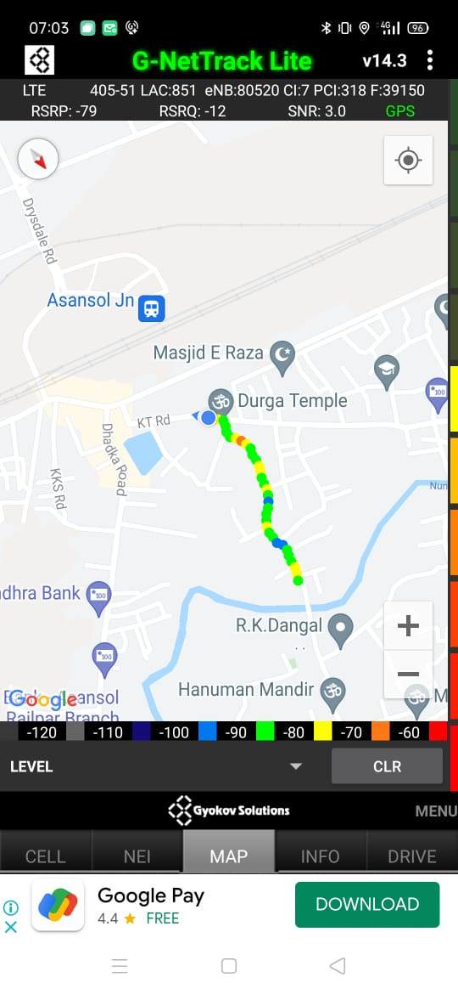
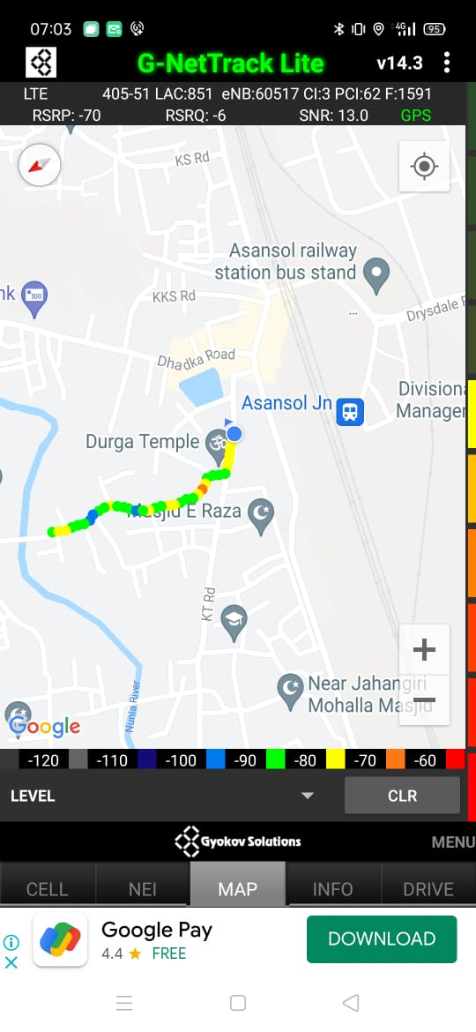
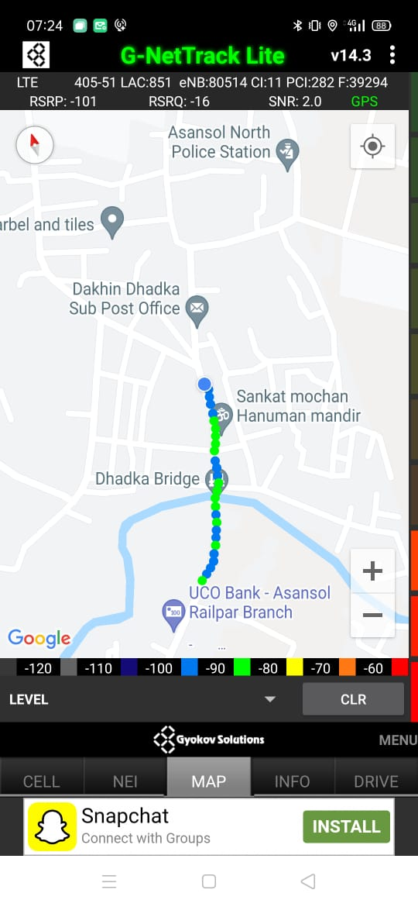
Airtel Band HO
Band Hand Over | longitude | Latitude | RSRP
1 | 86.97686819 | 23.69223254 | -70 to -95 dBM

Slide 12
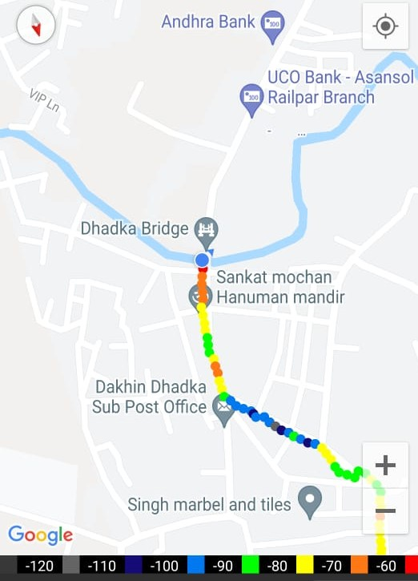
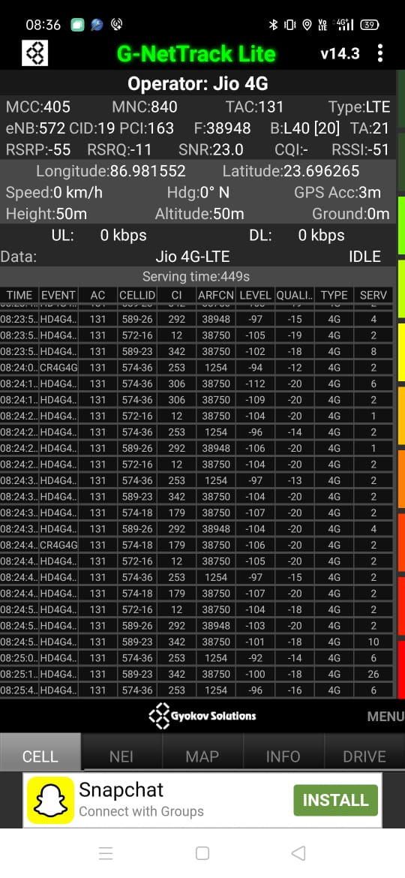
Near Cell (Reliance JIO)
Near cell(NC) | longitude | latitude | RSRP | Cell id | TDD E-ARFCN
1 | 86.981552 | 23.696265 | -55 | 19 | 38948
Dhadka Bridge
RSRP:
-55dbm to -75dbm

Slide 13
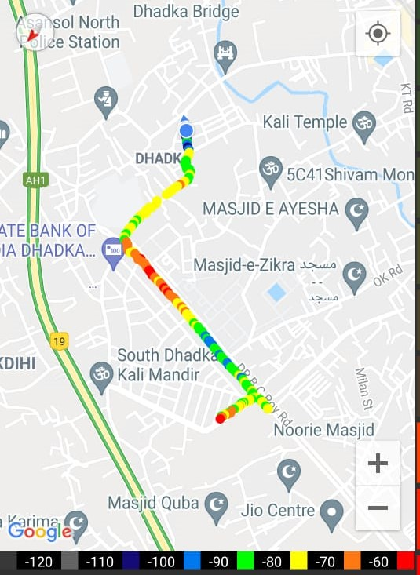
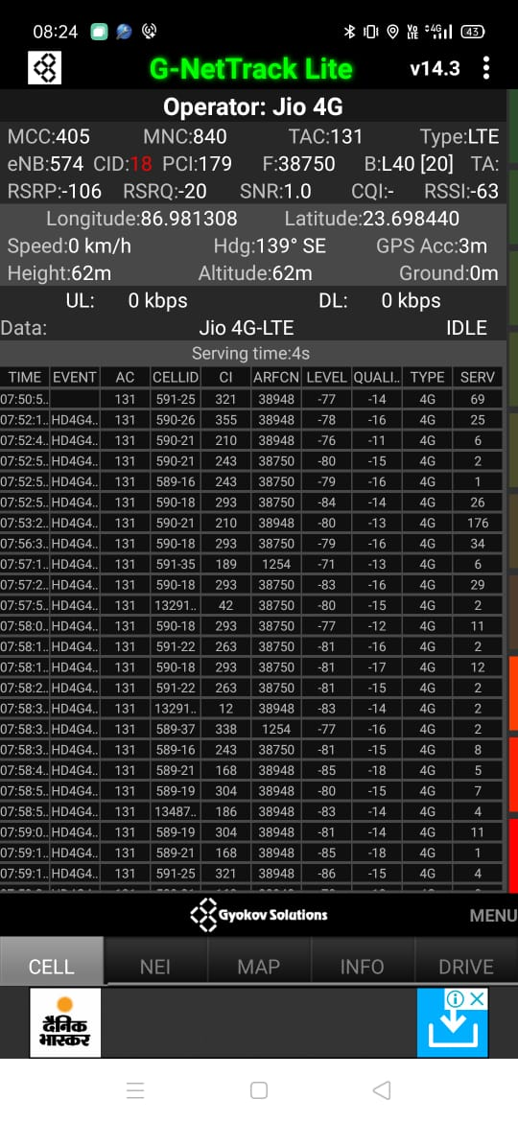
Edge Cell (Reliance JIO)
Edge cell(NC) | longitude | latitude | RSRP | Cell id | TDD E-ARFCN
1 | 96.981308 | 23.698440 | -106 | 18 | 38948
Dhadka Asansol
RSRP:
-95dbm to -110dbm

Slide 14
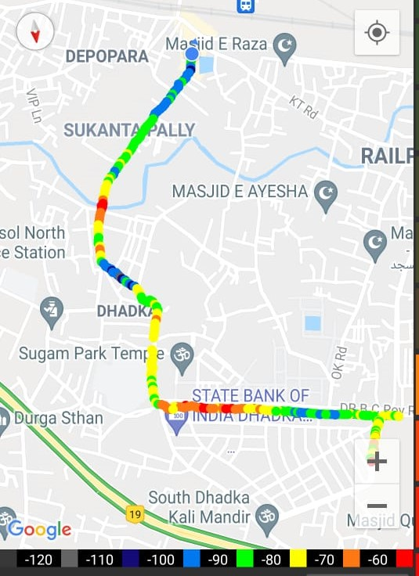
Mixed Mobility JIO:- Dhadka Asansol
RSRP: -95dbm to -110dbm
RSRP: -65dbm to -110dbm

Slide 15
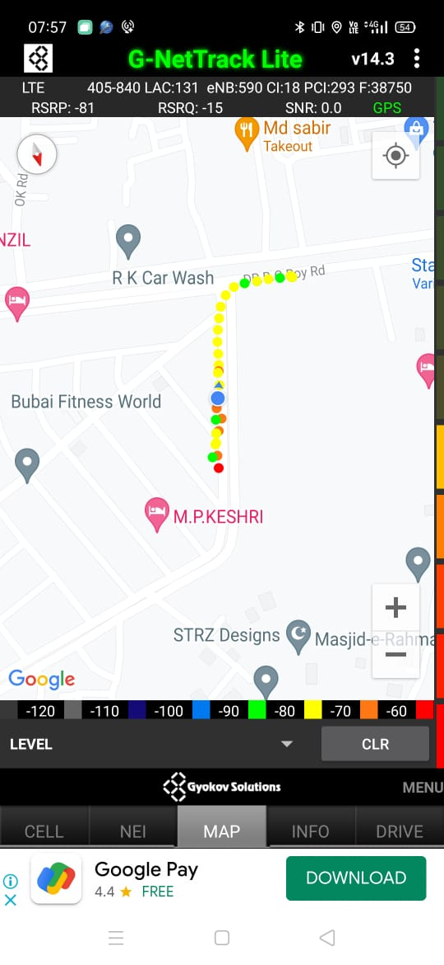
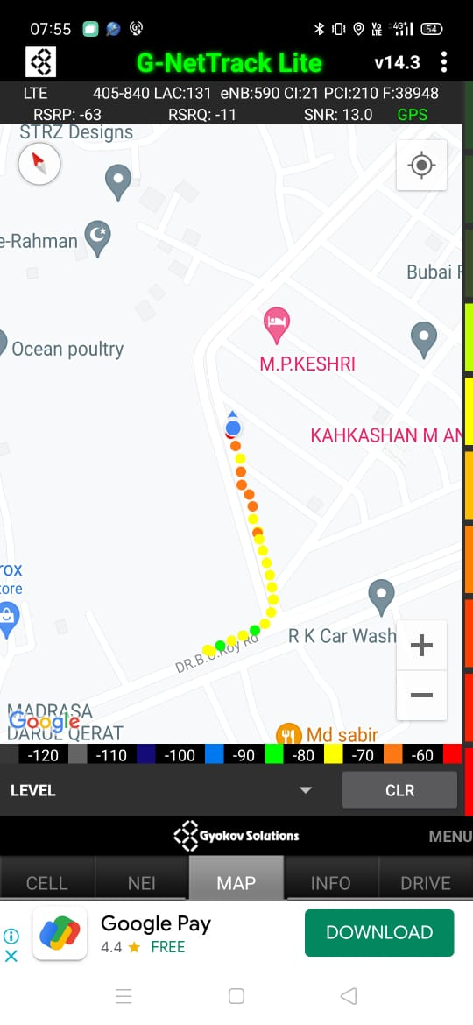
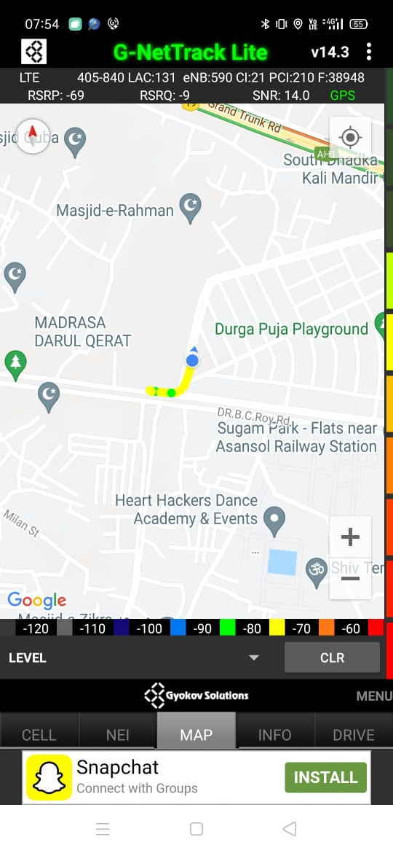
Inter Band Handover (FDD-TDD), JIO 4G
Band Handover | longitude | latitude | RSRP | PCI | FDD E-ARFCN
1 | 86.97348732 | 23.70446979 | -71 | 189 | 1254

Slide 16
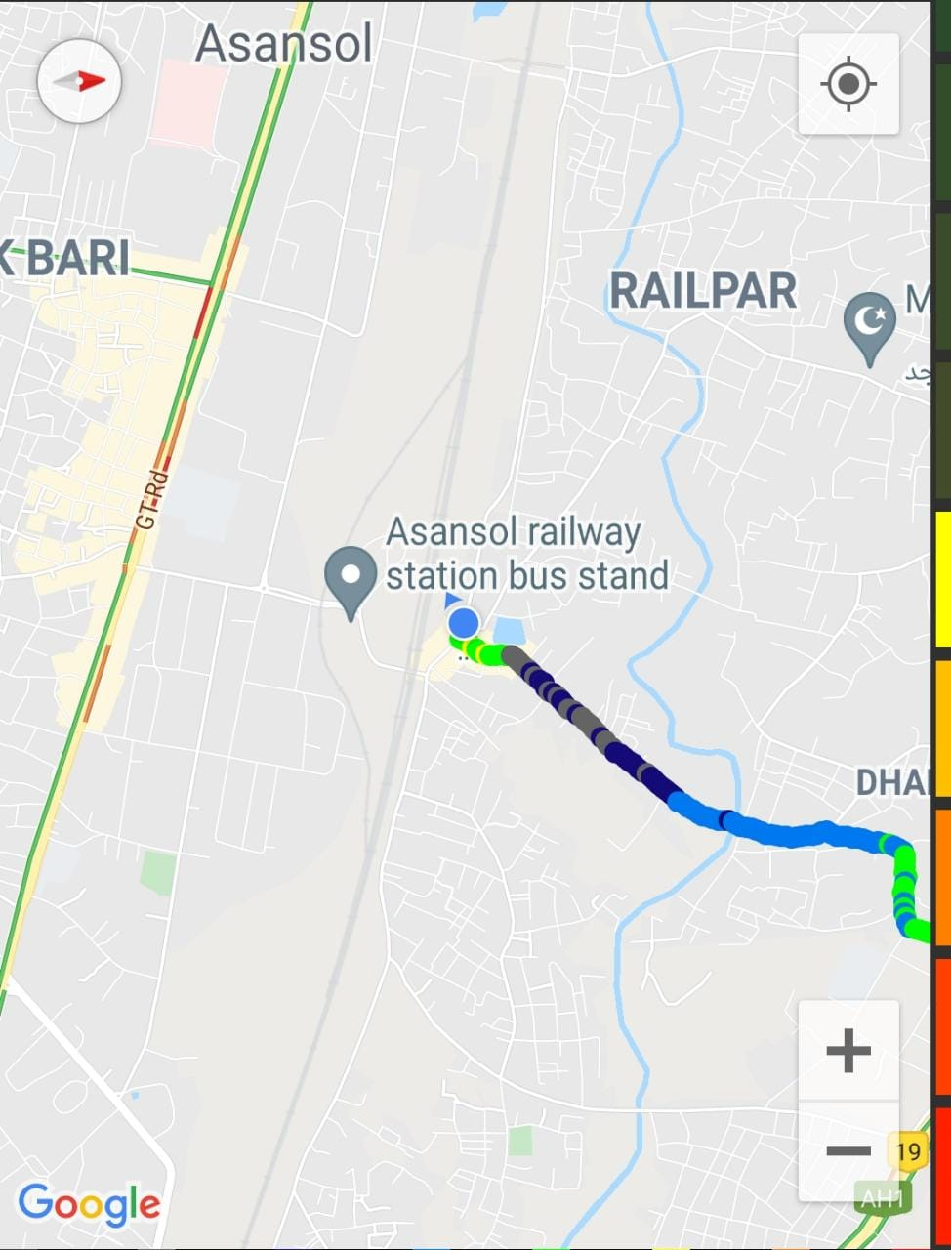
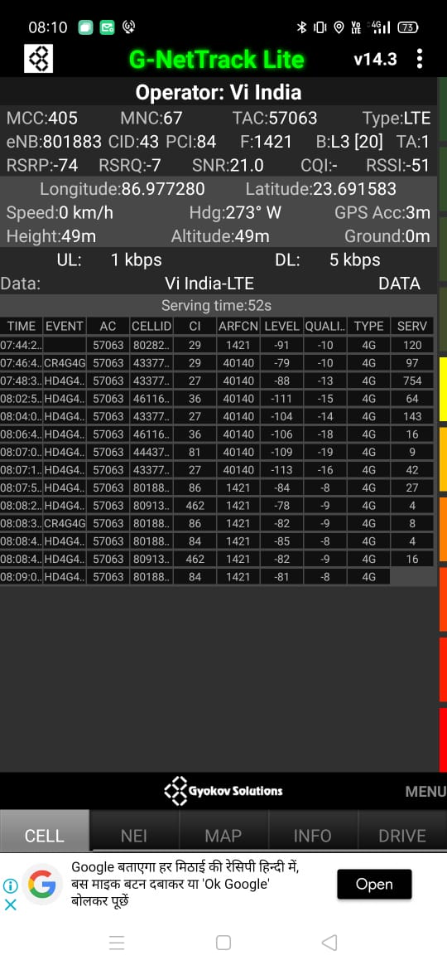
Near Cell VI:
Near cell(NC) | longitude | latitude | RSRP | Cell id | FDD E-ARFCN
1 | 86.977280 | 23.691583 | -74 | 43 | 1421
Asansol Railway Station
RSRP:
-65dbm to -75dbm

Slide 17
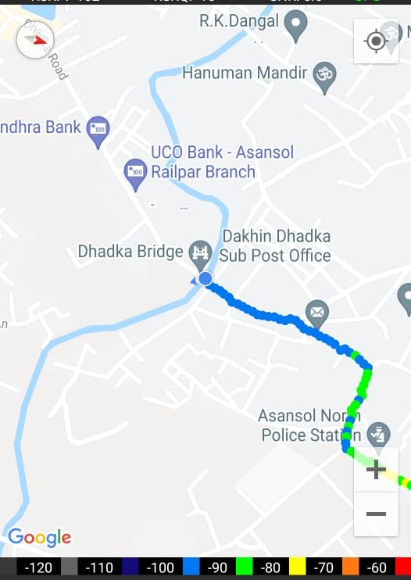
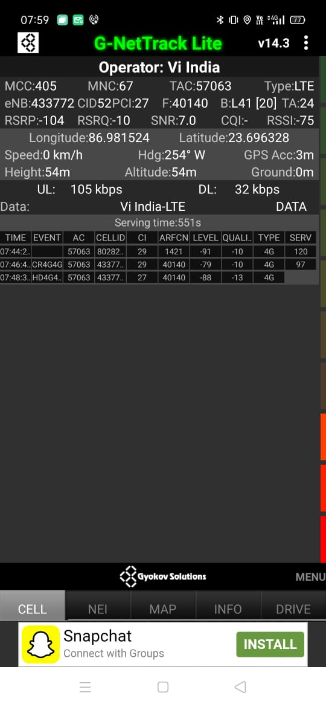
Cell Edge VI:
Edge cell(EC) | longitude | latitude | RSRP | Cell id | TDD E-ARFCN
1 | 86.981524 | 23.696328 | -104 | 52 | 40140
Dhadka Bridge
RSRP:
-95dbm to -105dbm

Slide 18
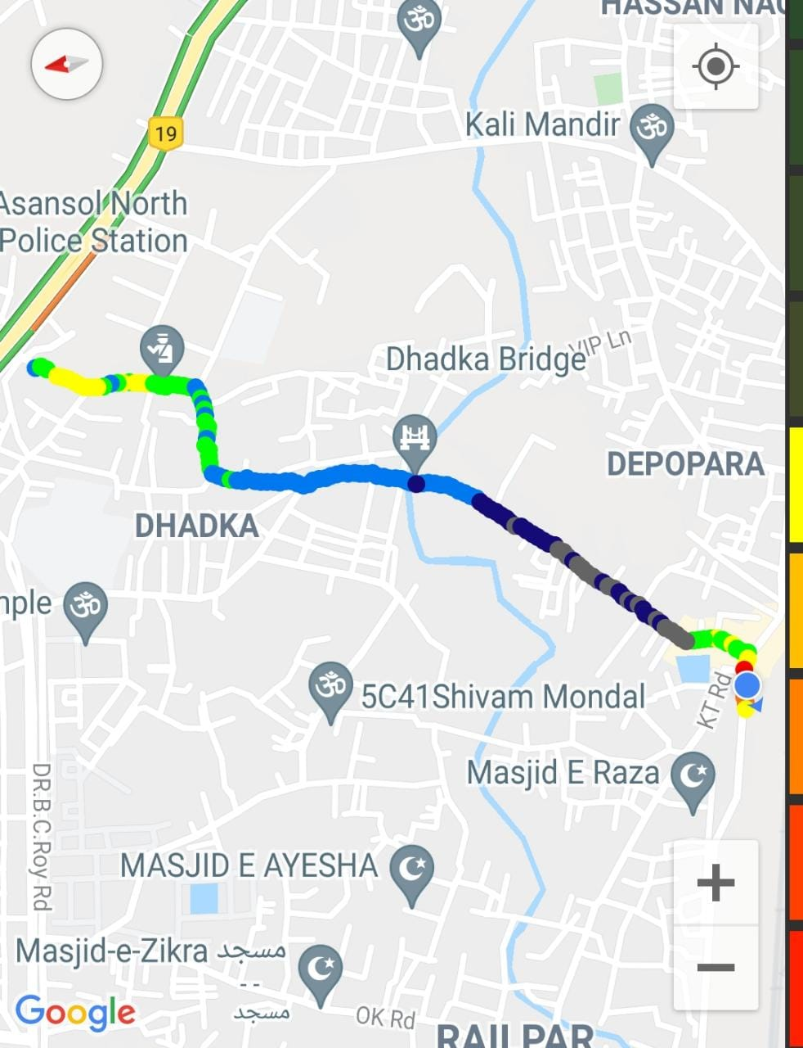
Mixed coverage area Vodafone:
RSRP: -65dbm to -110dbm

Slide 19
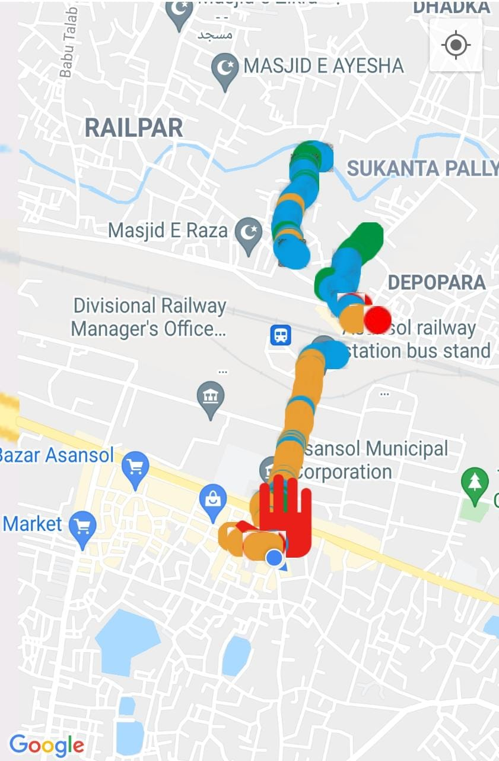
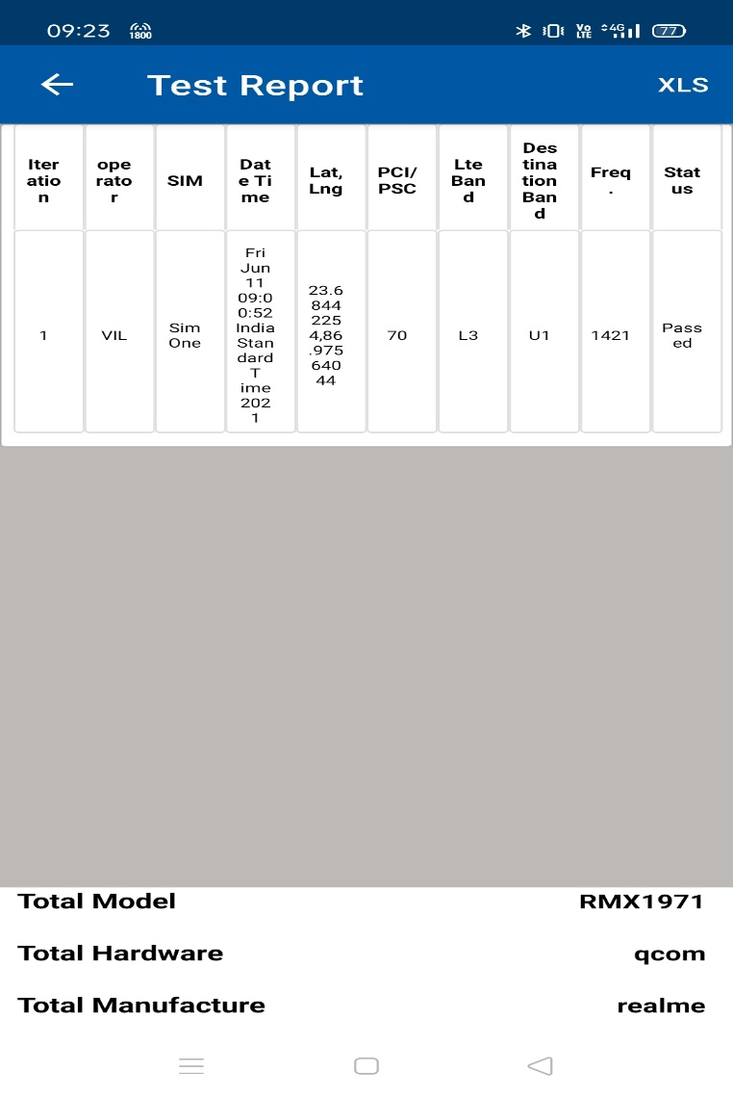
VI SRVCC to UTRAN:

Slide 20
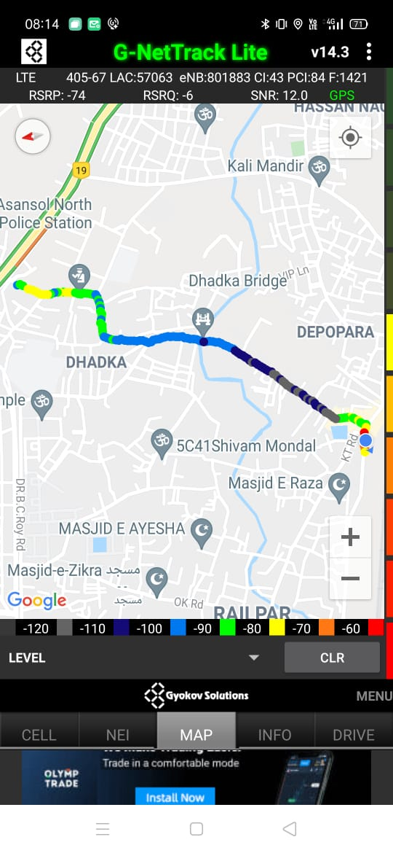
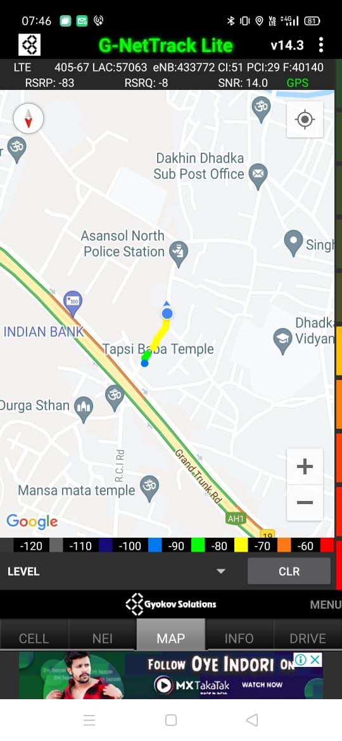
VIBand Handover

Slide 21
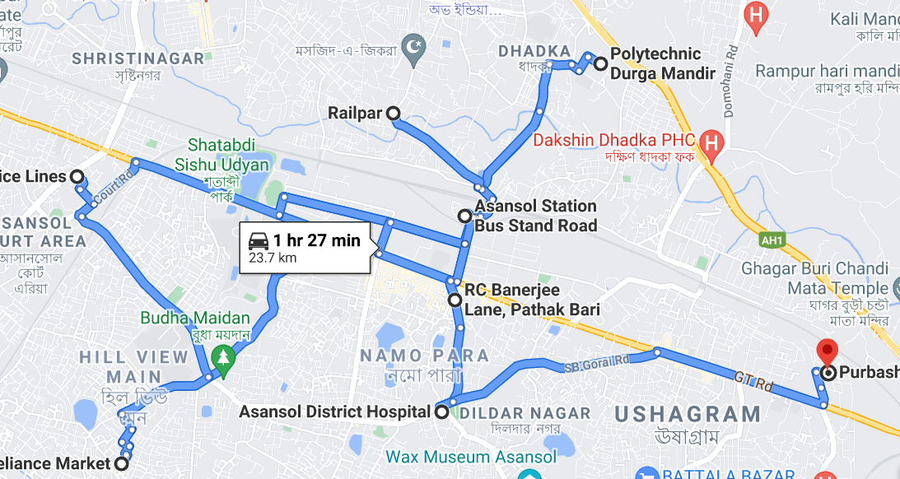
Overall Drive Route During Mobility Asansol

Slide 22
THANK YOU
MARQUIS TECHNOLOGIES

