Slide 1
MARQUIS TECHNOLOGIES
Drive Route & Features tested
In dRESDEN,germany.

Slide 2
Operator Details:
S. No. | Operator |  | Supported Bands | Supported Features by Network
1 | Major | Vodafone | N78,N28,N3 | VoWiFi/VoLTE/4G/2G/5G

Slide 3
Operator Details:
S. No. | Operator |  | Supported Bands | Supported Features by Network
1 | Major | TMO | N78,N28,N1 | VoWiFi/VoLTE/4G/2G/5G

Slide 4
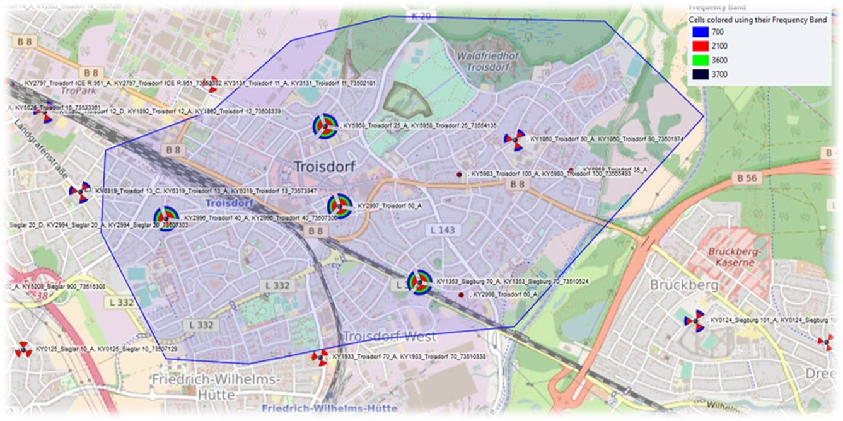
SA Near cell location with features available -

Slide 5
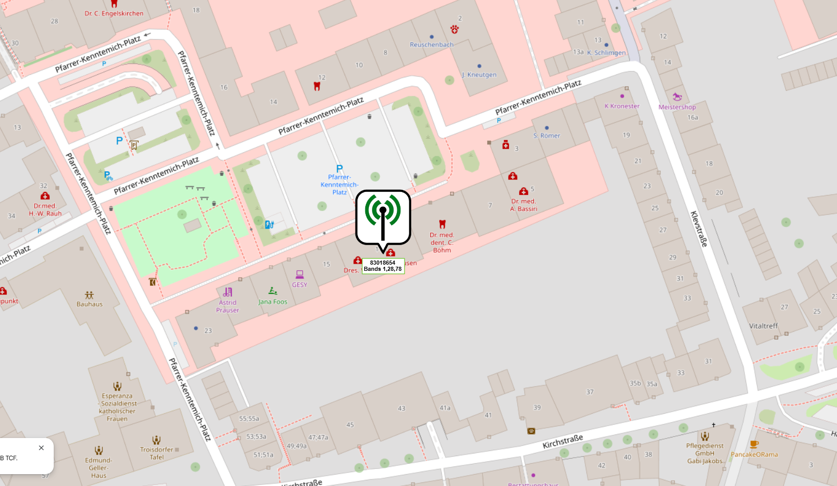
SA Near cell location with features available -

Slide 6
IMPORTANT FEATURES TESTED - Vodafone OPERATOR
Performance test cases related to data and data+Call for VDF OPERATOR for N78_N28_N3 – SA .
The testing Area is Dresden-Winterbergstrasse, Germany, where the Main antenna has been installed.
Infra-Vendor used is Huawei .
Maximum speed attained was 1400/210 in RSRP< -56.

Slide 7
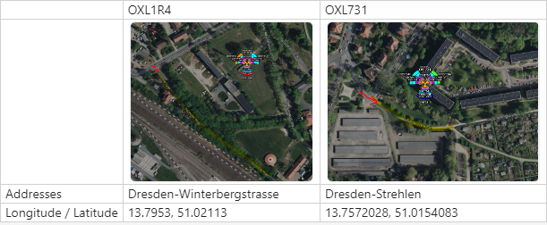
SA Near cell location with features available -
Winterbergstrasse Dreden, Germany
Notes:
MOBILITY SITES ARE THESE

Slide 8

Information of PCI with supported Bands-

Slide 9
Testing Details – VDF Operator
The band combination present at N78+N28+N3 – SA COMBINATION.
We tested Performance Bidirectional, DL,UL,Ping,Speedtest,Vonr call during Data related test cases.
We tested SM8850 and our main focus was on Rel 17 SwuL.

Slide 10
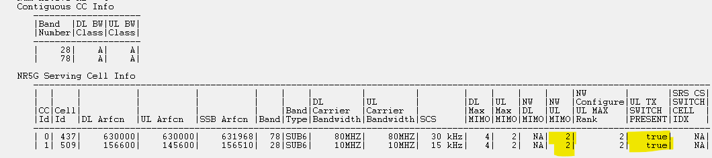
Band Details during Testing_N78+N28 for REL 17 SwUL

Slide 11
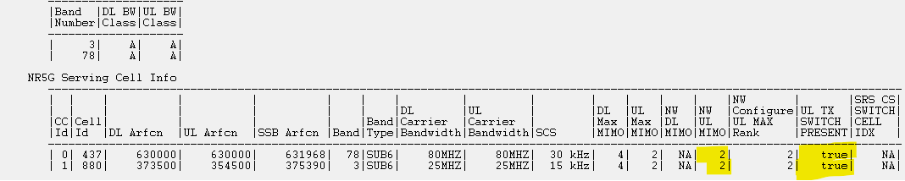
Band Details during Testing_N78+N3 for REL 17 SwUL

Slide 12
THANK YOU
MARQUIS TECHNOLOGIES
www.marquistech.com

