Slide 1
MARQUIS TECHNOLOGIES
5G_Drive Route - Hongkong/China

Slide 2
Operators and Related Information
All the operators are having FDD LTE implementation
Smartone- Supports NR5G, VoLTE, VoWifi, ViLTE, LTE, WCDMA and 2G
3HK- Supports NR5G, VoLTE, VoWifi, ViLTE, LTE, WCDMA and 2G
CMHK- Supports NR5G, VoLTE, VoWifi, ViLTE, LTE, WCDMA and 2G
CSL- Supports NR5G, VoLTE, VoWifi, ViLTE, LTE, WCDMA and 2G
MMS over Vo-WiFi is supported by all three operators.

Slide 3
EN-DC Band Combination:-
Smartone: B1_n78
CMHK: B7_n78
3HK: B3_n78
CSL: B3_n78

Slide 4
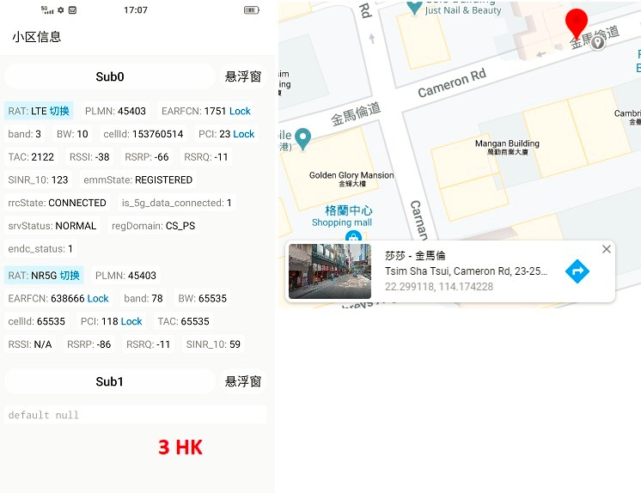
Band 3 n78 Good Coverage for 3HK Operator

Slide 5
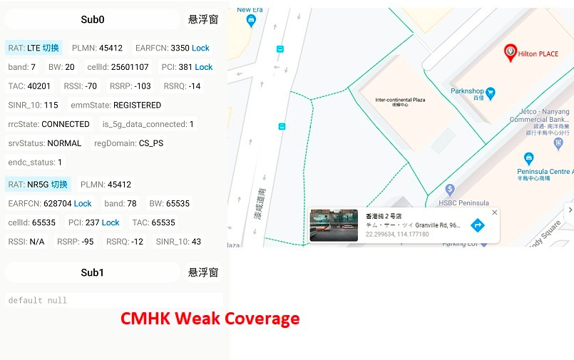
Band 7 n78 Weak Coverage for CMHK Operator

Slide 6
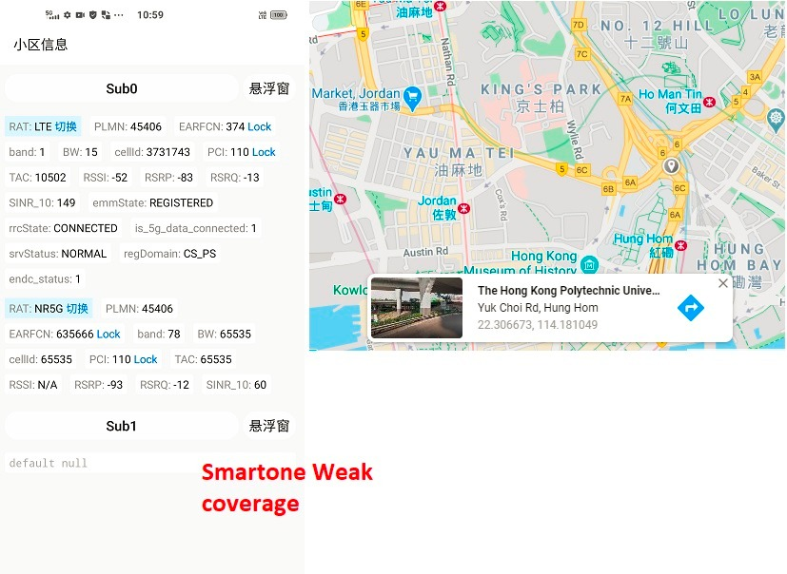
Band 1 n78 Weak Coverage for Smartone Operator

Slide 7
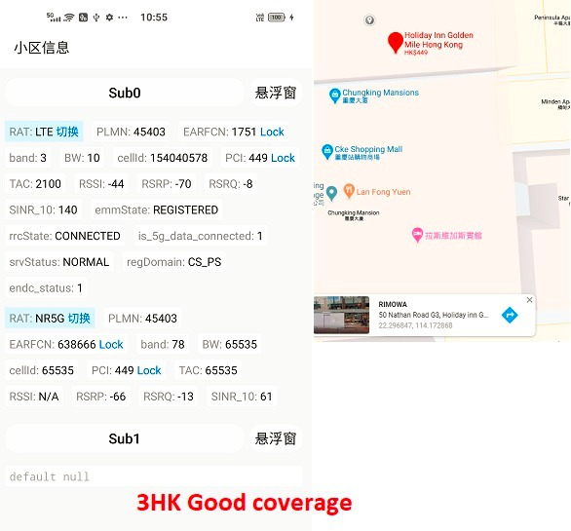
Band 3 n78 Weak Coverage for 3HK Operator

Slide 8
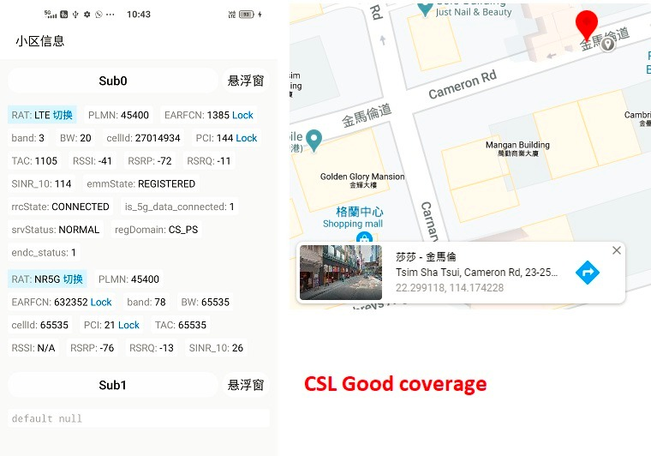
Band 3 n78 Good Coverage for CSL Operator

Slide 9
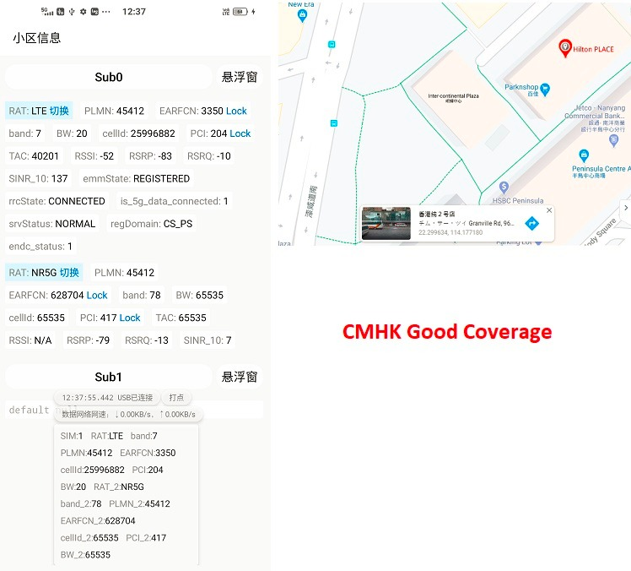
Band 7 n78 Good Coverage for CMHK Operator

Slide 10
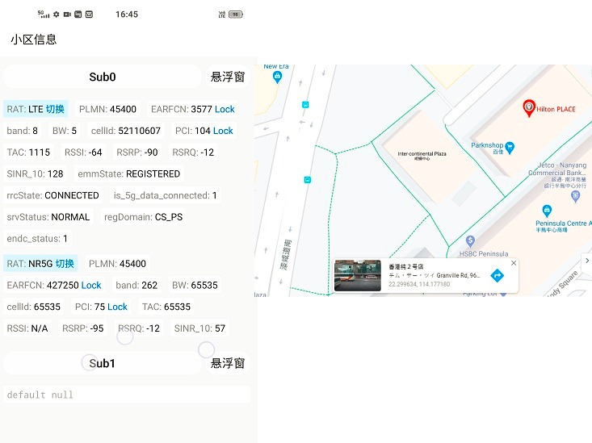
Band 8 n78 Good Coverage for Smartone Operator

Slide 11
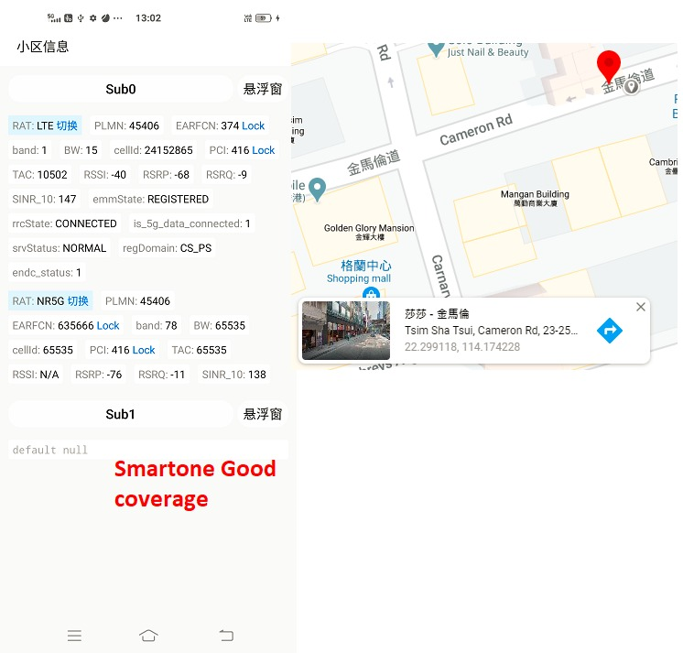
Band 1 n78 Good Coverage for Smartone Operator

Slide 12
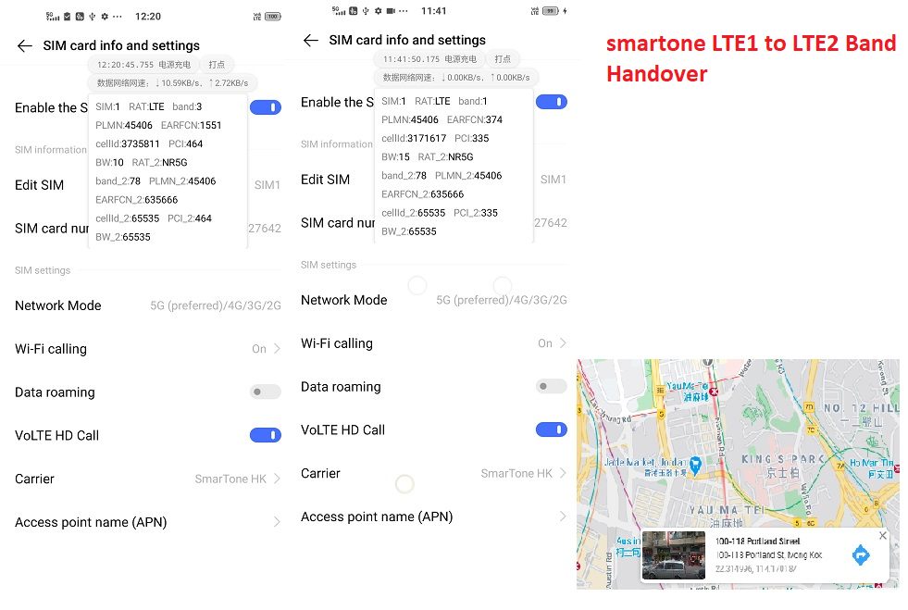
Smartone LTE1_LTE2 Band handover

Slide 13
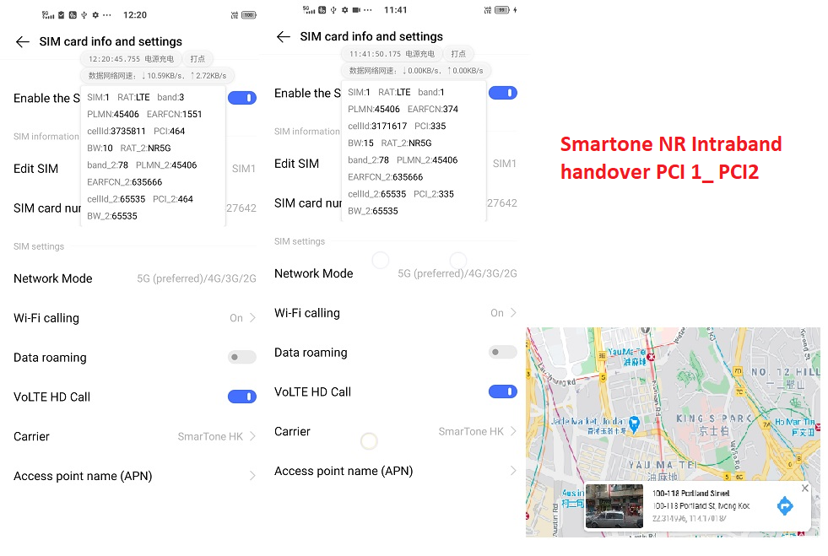
Smartone IntraBand Handover PCI 1_ PCI 2

Slide 14
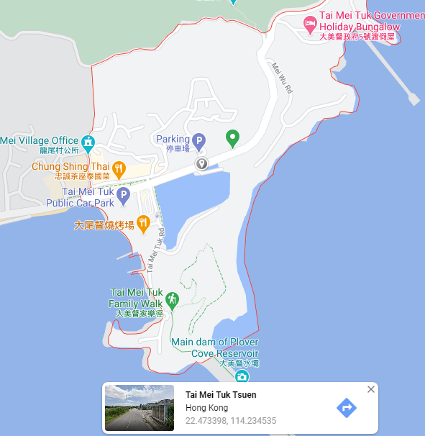
SRVCC Location for All Major Operator

Slide 15
Thank You

