Slide 1
MARQUIS TECHNOLOGIES
Drive Route

Slide 2
Aligarh/India
Operator Details:
S. No. | Operator |  | Supported Bands | Supported Features by Network
1 | Major | Airtel | LTE FDD B1/B3/B8 & TDD B40/N78 | VoWiFi/VoLTE/4G/2G/5G
2 |  | JIO | LTE FDD B3/B5 & TDD B40/N78/N28 | VoWiFi/VoLTE/4G/5G
3 |  | VI | LTE FDD B3/B8 & TDD B41/N78 | VoWiFi/VoLTE/4G/3G/2G/5G
4 | Minor | BSNL | LTE FDD B1 | VoLTE/4G/3G/2G

Slide 3
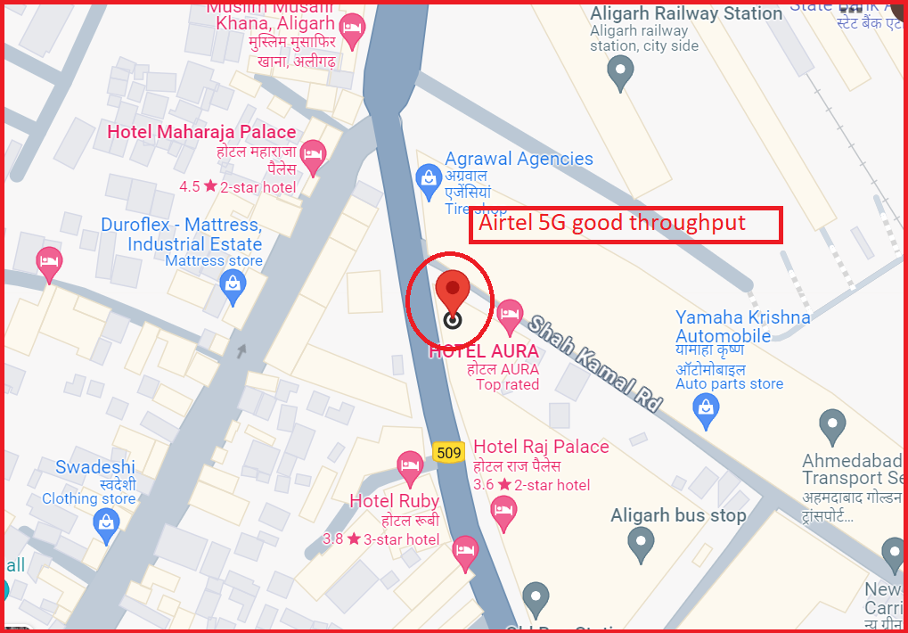
5G Near Cell,Airtel
Lat/Long -27.88754, 78.07354
Specification –Stable Airtel 5G NSA network Good Throughput

Slide 4
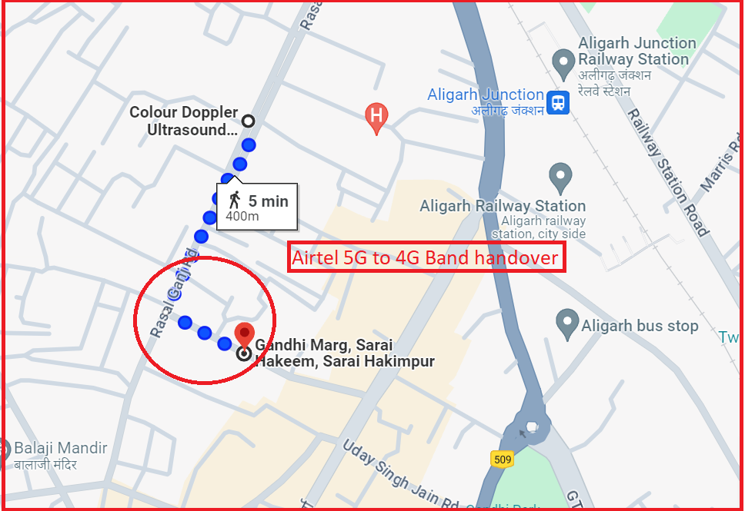
NR to LTE Handover ,Airtel
Lat/Long 27.88855, 78.06972to Specification –Band Handover ,Weak coverage

Slide 5
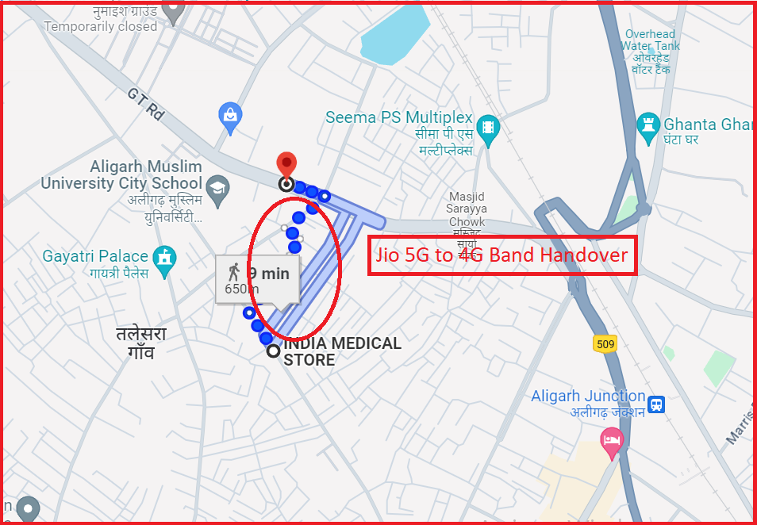
NR to LTE Handover ,JIO
Lat/Long 27.8933312, 78.0645856 Specification –Band Handover ,Weak coverage

Slide 6
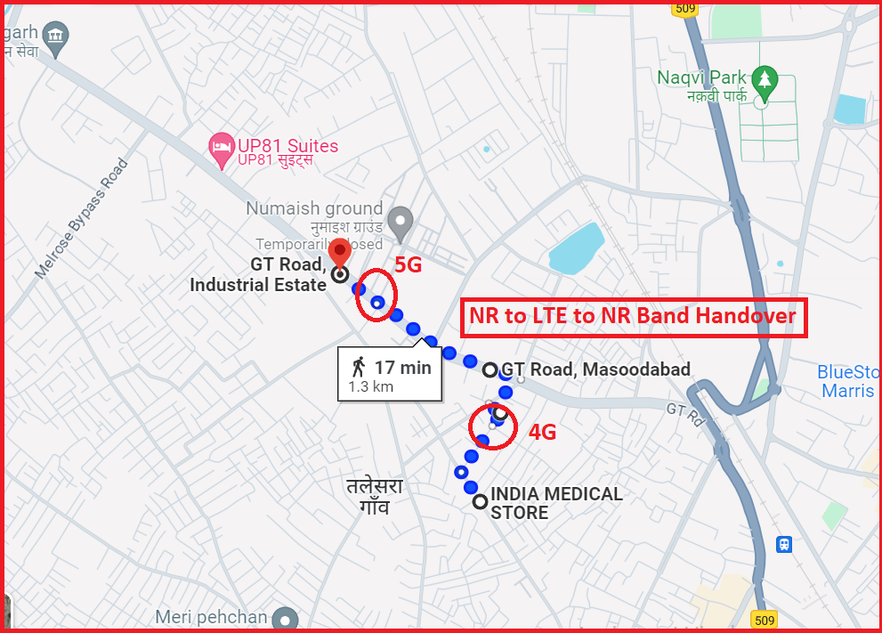
NR TO LTE TO NR Handover , Jio
Lat/Long 27.89606, 78.06111

Slide 7
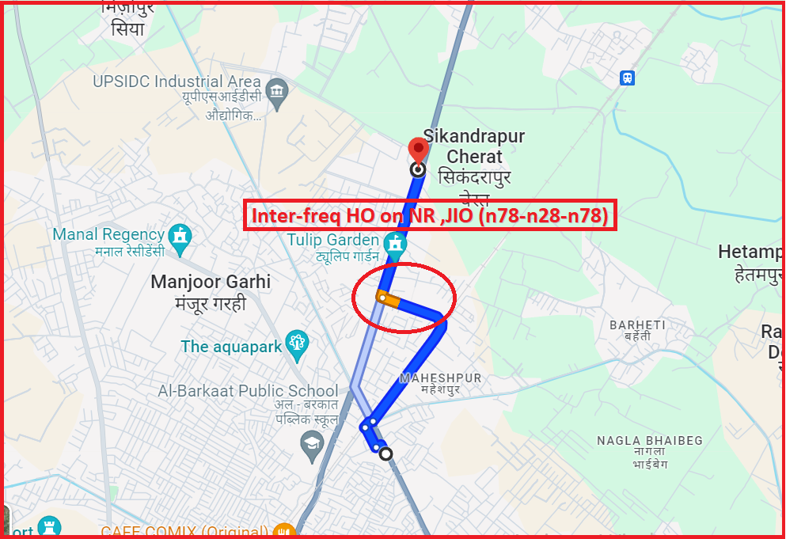
Inter-freq HO on NR ,JIO (n78-n28-n78)
Lat/Long 27.94444, 78.08624

Slide 8
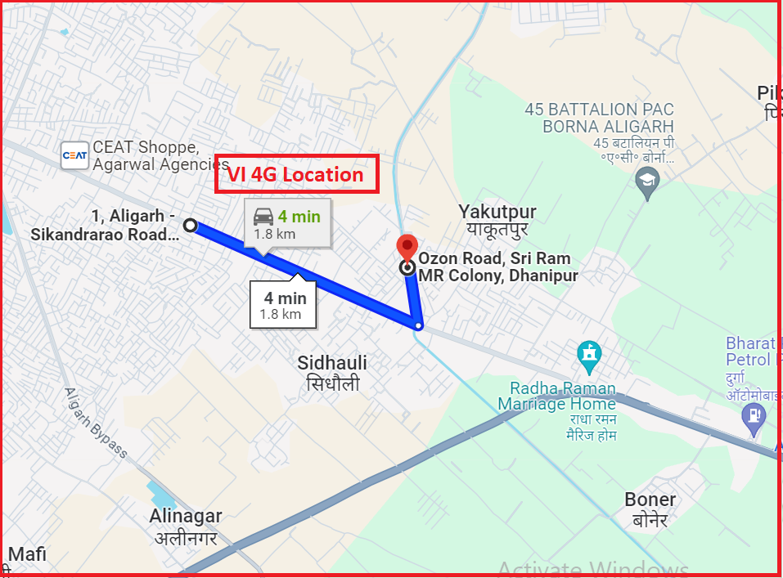
VI 4G
Lat long - Specification –VI 4G coverage

Slide 9
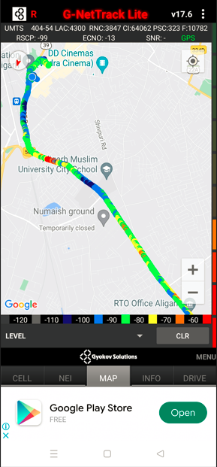
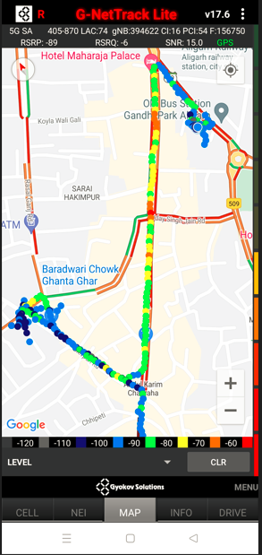
DRIVE ROUTE

Slide 10
THANK YOU
MARQUIS TECHNOLOGIES
www.marquistech.com

