Slide 1
MARQUIS TECHNOLOGIES
Drive Route

Slide 2
Kuala Lumpur/Malaysia
Operator Details:
Operator | 2G | 3G | 4G | 5G NSA
Celcom | E-GSM (900), DCS (1800) | No Support | B1 (2100 MHz), B3 (1800 MHz), B7 (2600 MHz), B8(900 MHz) | N78 (700 MHz) + B7 (2600MHz)
Digi | E-GSM (900), DCS (1800) | No Support | B1 (2100 MHz), B3 (1800 MHz), B7 (2600 MHz), B8(900 MHz) | N78 (700 MHz) + B7 (2600MHz)
Maxis | E-GSM (900), DCS (1800) | No Support | B1 (2100 MHz), B3 (1800 MHz), B7 (2600 MHz), B8(900 MHz) | N78 (700 MHz) + B7 (2600MHz)
Umobile | E-GSM (900), DCS (1800) | No Support | B1 (2100 MHz), B3 (1800 MHz), B7 (2600 MHz), B8(900 MHz) | N78 (700 MHz) + B7 (2600MHz)
Unifi | E-GSM (900), DCS (1800) | No Support | B5 (850 MHz), B38 (2600 MHz), B40 (2300 MHz) | N78 (700 MHz) + B38 (2600MHz) N78 (700 MHz) + B40 (2300MHz)
YTL | No Support | No Support | B20(800MHz), B28 (700 MHz). B40 (2300 MHz) | N78 (700 MHz) + B40 (2300MHz)

Slide 3
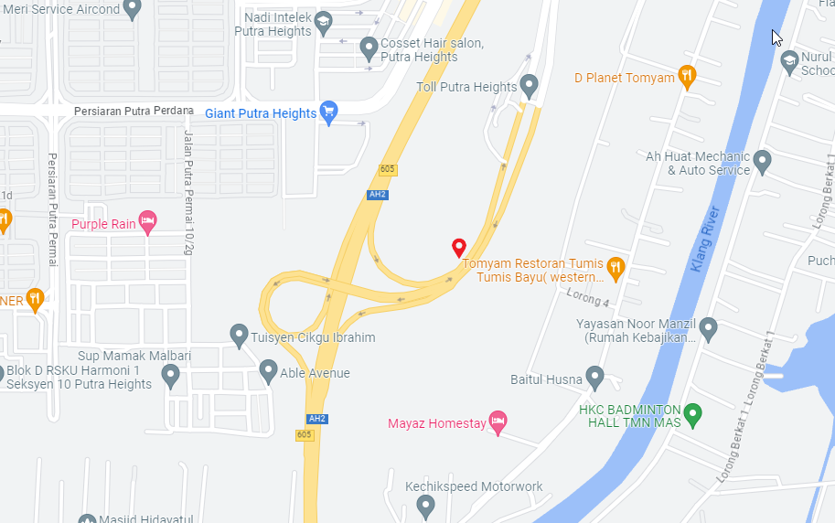
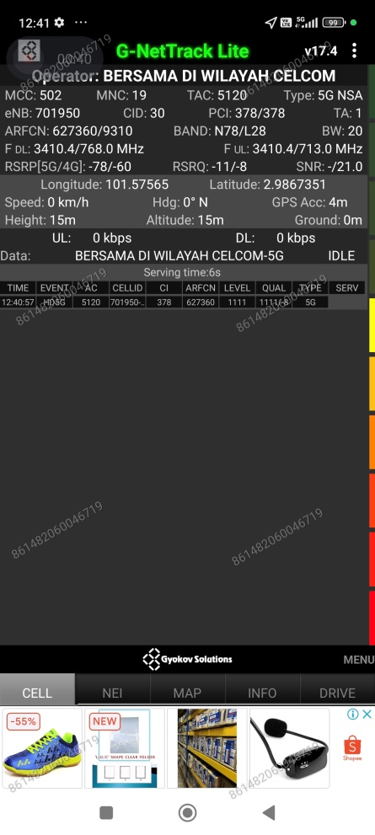
5G Near Cell - Celcom
Lat Long (2.9867351,101.57565)
Specification - Near field criteria (Good signal strength and signal quality)

Slide 4
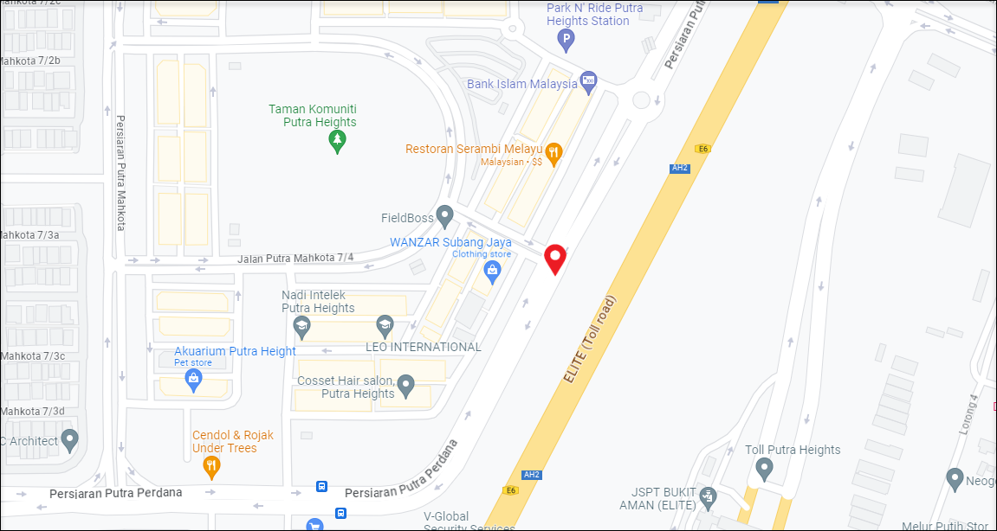
NSA to LTE Handover - Celcom
Lat/Long 2.992447, 101.574868 Specification – NSA Band Release

Slide 5
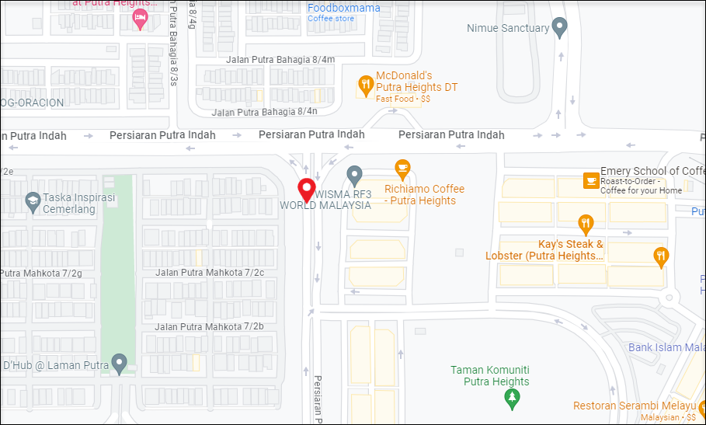
Lte to NSA Handover - Celcom
Lat Long (2.996160, 101.570168)
Specification - NSA Band Addition

Slide 6
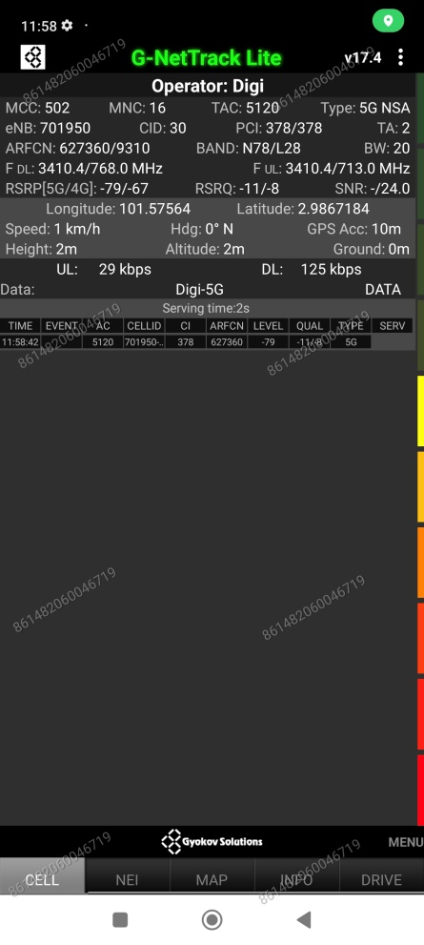
5G Near Cell - Digi
Lat Long (2.9867184,101.57564)
Specification - Near field criteria (Good signal strength and signal quality)

Slide 7
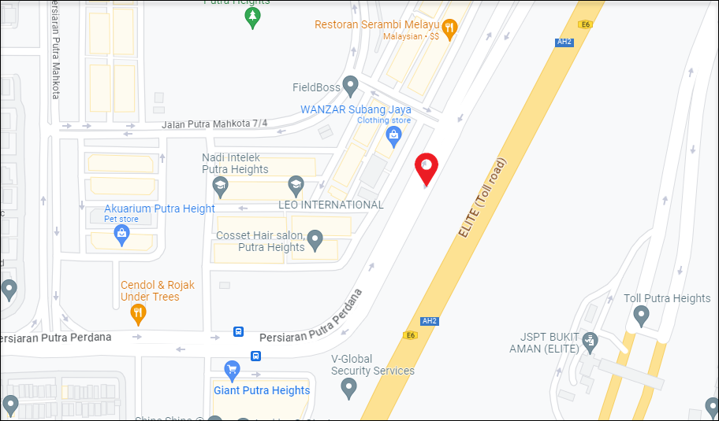
NSA to LTE Handover - Digi
Lat Long (2.991847, 101.574600) Specification – NSA Band Release

Slide 8
Lte to NSA Handover - Digi
Lat Long (2.996160, 101.570168)
Specification - NSA Band Addition

Slide 9
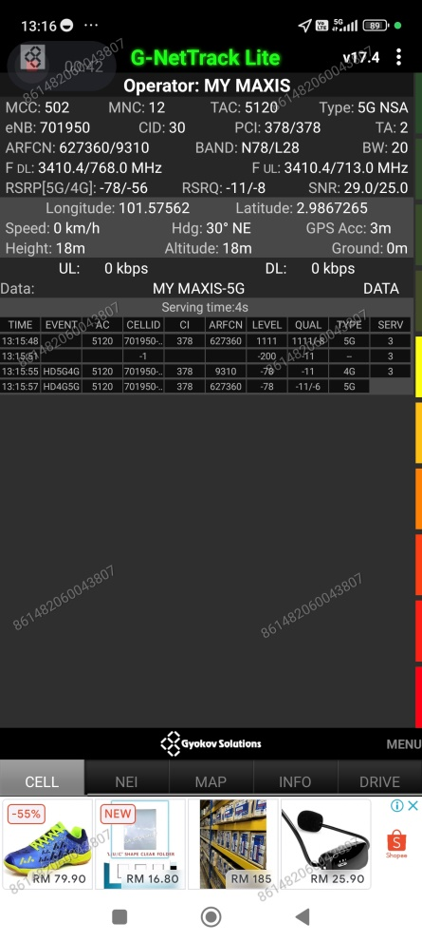
5G Near Cell - Maxis
Lat Long (2.9867351,101.57565)
Specification - Near field criteria (Good signal strength and signal quality)

Slide 10
NSA to LTE Handover - Maxis
Lat/Long 2.992447, 101.574868 Specification – NSA Band Release

Slide 11
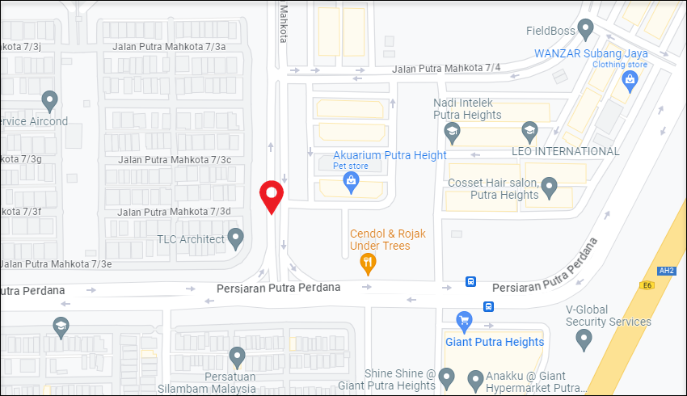
Lte to NSA Handover - Maxis
Lat Long (2.991081, 101.570210)
Specification - NSA Band Addition

Slide 12
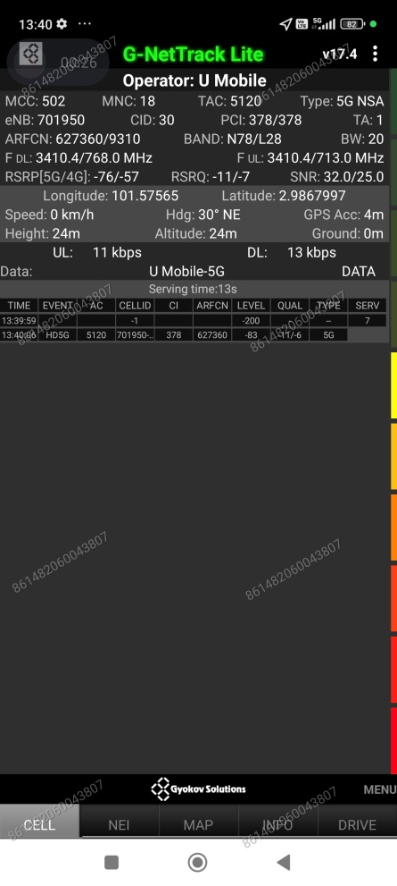
5G Near Cell - Umobile
Lat Long (2.9867997,101.57565)
Specification - Near field criteria (Good signal strength and signal quality)

Slide 13
NSA to LTE Handover - Umobile
Lat Long (2.991847, 101.574600) Specification – NSA Band Release

Slide 14
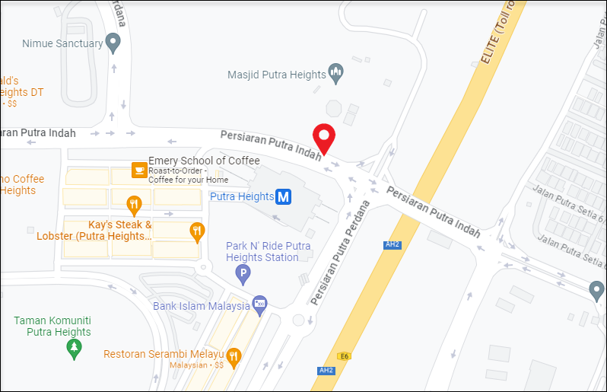
Lte to NSA Handover - Umobile
Lat Long (2.996642, 101.575978)
Specification - NSA Band Addition

Slide 15
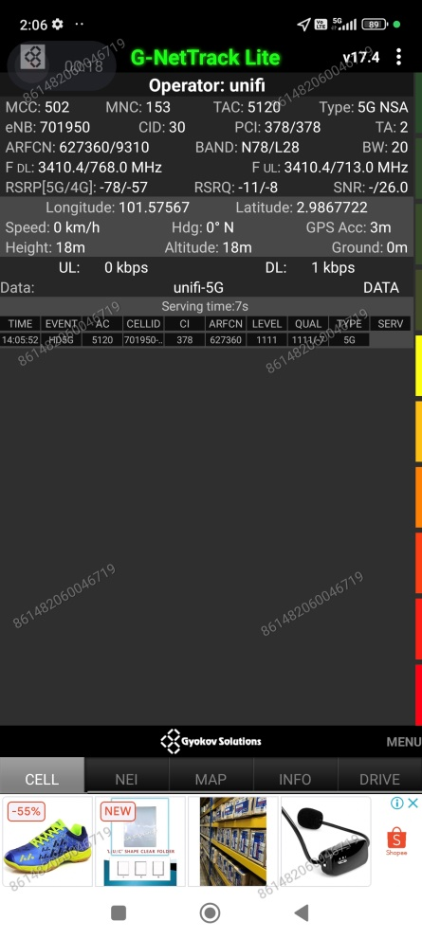
5G Near Cell - Unifi
Lat Long (2.9867222,101.57567)
Specification - Near field criteria (Good signal strength and signal quality)

Slide 16
NSA to LTE Handover - Unifi
Lat/Long 2.992447, 101.574868 Specification – NSA Band Release

Slide 17
Lte to NSA Handover - Unifi
Lat Long (2.991081, 101.570210)
Specification - NSA Band Addition

Slide 18
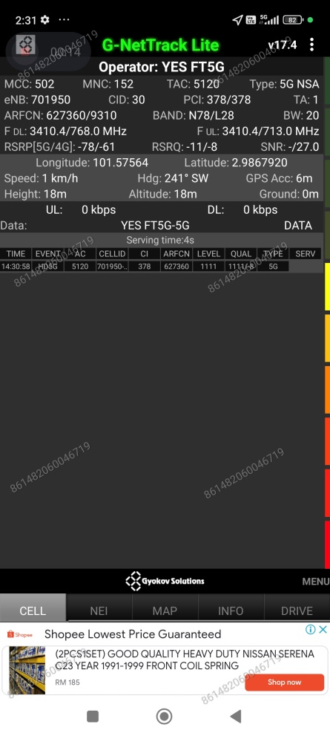
5G Near Cell - YES
Lat Long (2.9867920,101.57564)
Specification - Near field criteria (Good signal strength and signal quality)

Slide 19
NSA to LTE Handover - YES
Lat Long (2.991847, 101.574600) Specification – NSA Band Release

Slide 20
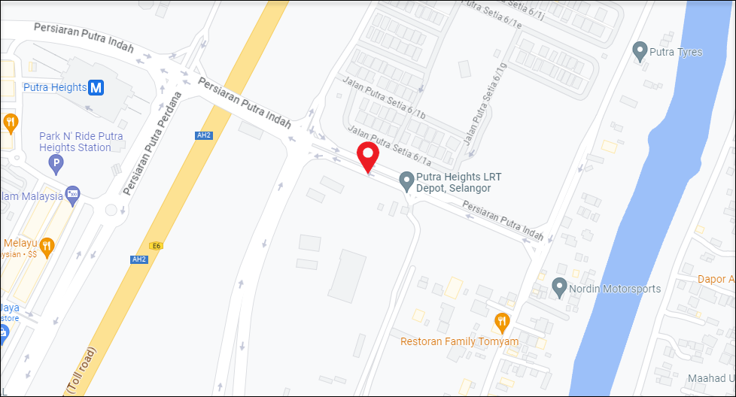
Lte to NSA Handover - YES
Lat Long (2.994831, 101.579262)
Specification - NSA Band Addition

Slide 21
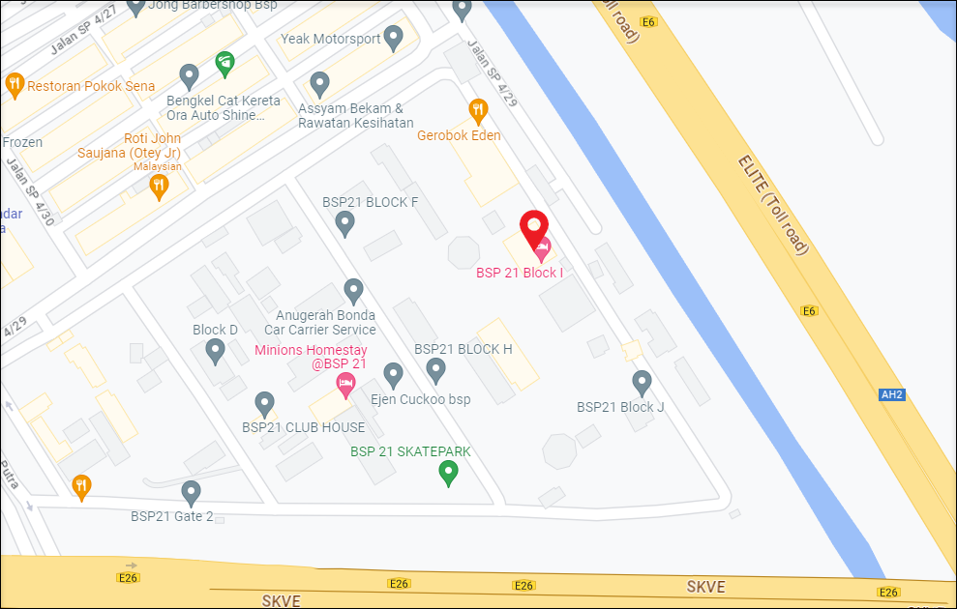
SRVCC (Celcom, Digi, Maxis, Umobile, Unifi)
Lat Long (2.944297, 101.591079)
Location - Parking area, fire exit, staircase area Specification - SRVCC

Slide 22
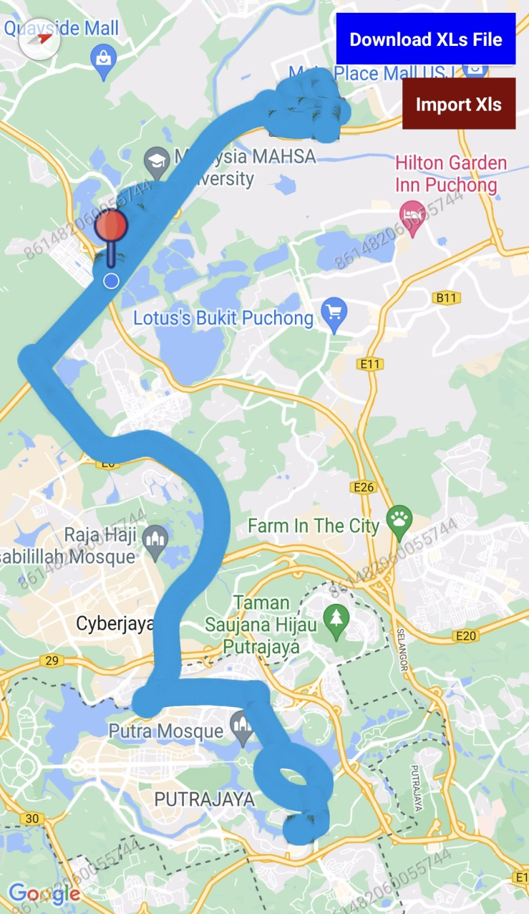
Drive Route

Slide 23
Thank You
Marquis Technologies
https://www.marquistech.com

