Slide 1
MARQUIS TECHNOLOGIES
Drive Route –Airtel, Idea, VODAFONE & Reliance JIO (FDD/TDD) LTE

Slide 2
Operator Information:
Operator | JIO 4G
MCC | 405
MNC | 855
APN | Jionet
Operator | Airtel 4G
MCC | 405
MNC | 56
APN | Airtelgprs.com
Operator | VI
MCC | 405
MNC | 751
APN | www
Operator | BSNL
MCC | 404
MNC | 38
APN | bsnlnet

Slide 3
Operator Information 1
Functionality | AIRTEL
Website: http://www.airtel.com/ WAP APN: airtelgprs.com
Customer care | 198
MNC | 56
Bands supported | Both FDD and TDD
 | LTE 2300 MHz – TDD(Band 40)
 | LTE 1800,850 MHz – FDD(Band 3&1)
USSD | To check MDN: *282#
 | Balance check: *123#
 | Data Balance check: *121*114#
VoLTE | Supported
CSFB | Supported (Switched to 2G)

Slide 4
Operator Information 2
Functionality | RELIANCE JIO
Website: http://www.jio.com WAP APN: jionet
Customer care | 198
MNC | 855
Bands supported | Both FDD and TDD
 | LTE 2300 MHz –TDD(Band 40)
 | LTE 850 MHz – FDD(Band 5)
 | LTE 1800 MHz –FDD(Band 3)
USSD | NA
 | NA
 | NA
VoLTE | Supported
CSFB | Not Supported

Slide 5
Operator Information 3
Functionality | VI
Website: https://www.myvi.in/ WAP APN: www
Customer care | 198
MNC | 751
Bands supported | FDD
 | -
 | LTE 1800 MHz –FDD(Band 3)
 | -
USSD | To check MDN*199#
 | Balance check 198
 | Data Balance check: *121#
VoLTE | Supported
CSFB | Supported(Switched to 3G)

Slide 6
Operator Information 4
Functionality | BSNL
Website: https://portal.bsnl.in/myportal/ WAP APN: bsnlnet
Customer care | 198
MNC | 38
Bands supported
 | WCDMA 2100 MHz-Band 1
 | GSM 900 MHz -Band 8
 | -
USSD | To check MDN*222#
 | Balance check *123*1#
 | Data Balance check:*124*1#
VoLTE | NA
CSFB | NA

Slide 7
Drive Route
Near Cell :- Stationary: RSRP : -65dbm to -75dbm
Cell Edge :- Stationary: RSRP : -95dbm to -110dbm
Mixed :- Mobility: RSRP : -65dbm to -110dbm

Slide 8
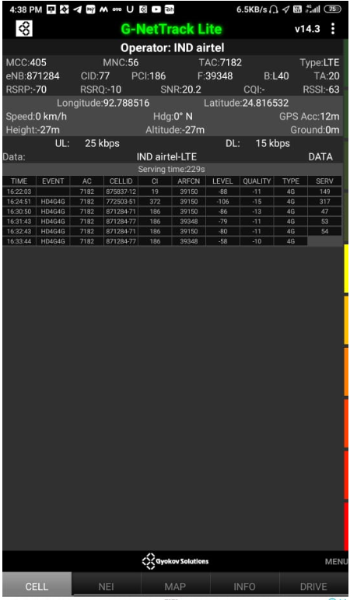
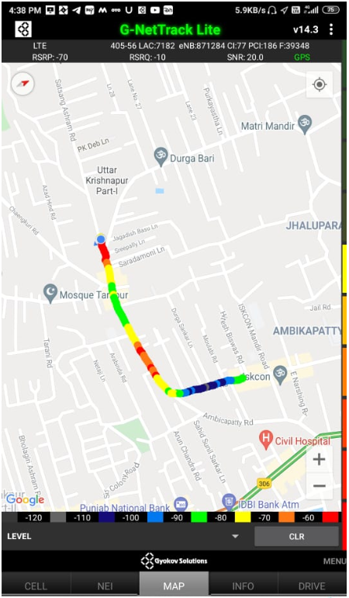
Near Cell (Airtel)
Near cell(NC) | longitude | latitude | RSRP | Cell id | FDD E-ARFCN
1 | 92.788516 | 24.816532 | -70 | 77 | 39348
Satsang Ashram road, near municipality bazar Silchar Assam.
RSRP:
-65dbm to 75dbm

Slide 9
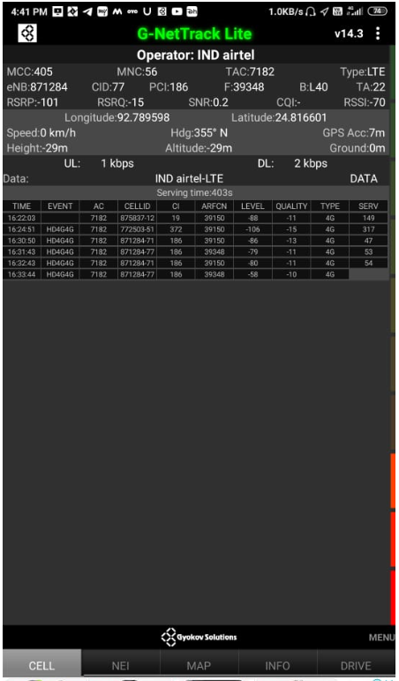
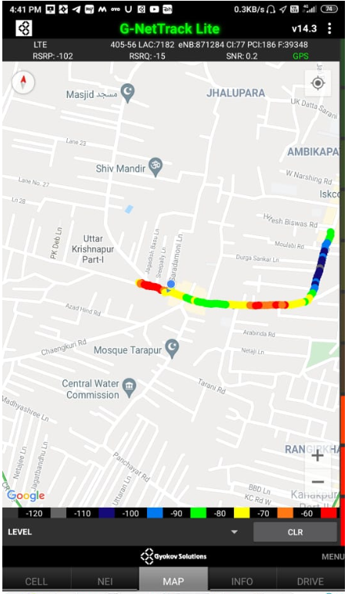
Edge Cell (Airtel)
Edge cell(EC) | longitude | latitude | RSRP | Cell id | TDD E-ARFCN
1 | 92.789598 | 24.816601 | -102 | 77 | 39348
Saradamoni ln, Silchar, Assam.
RSRP: -95dbm to -110dbm

Slide 10
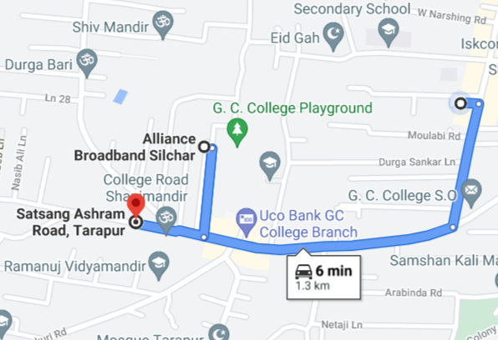
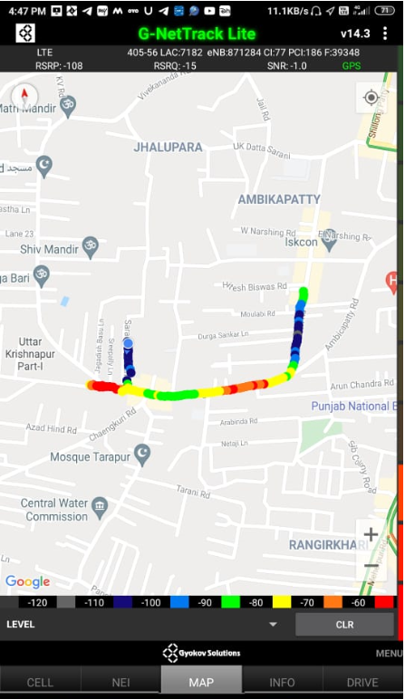
Mixed Mobility (Airtel)
Satsang Ashram road and Church road, Silchar, Assam.
RSRP: -65dbm to -110dbm

Slide 11
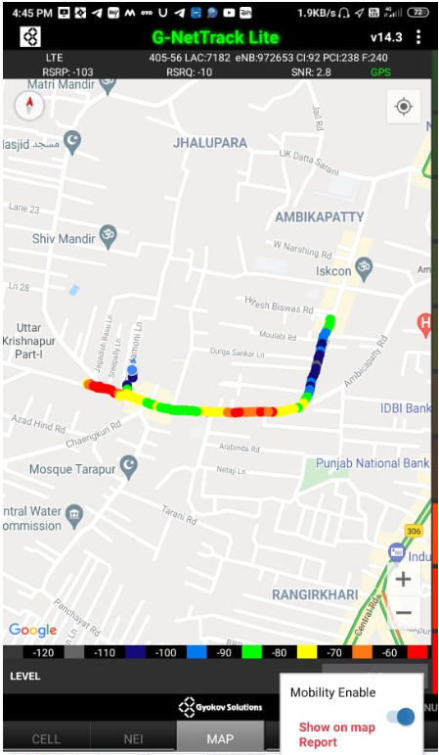
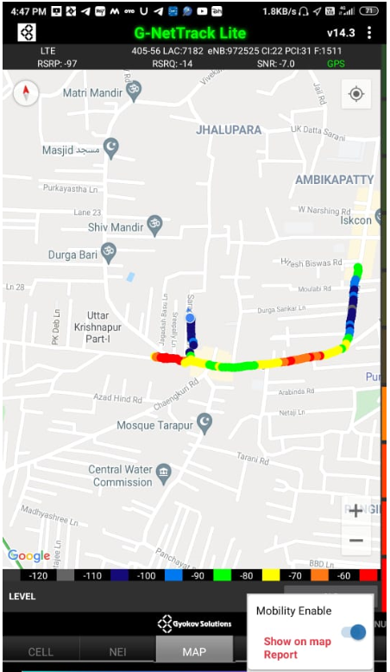
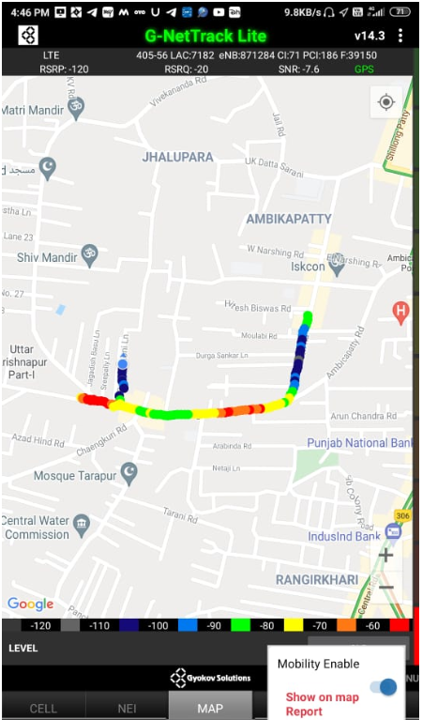
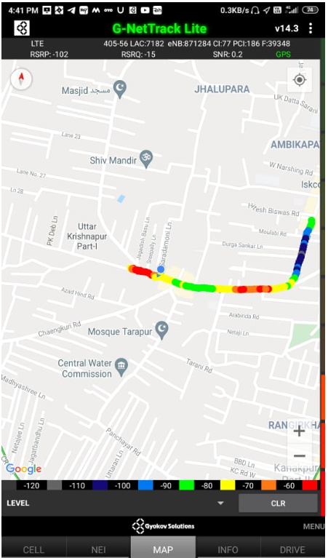
Airtel Band HO
Band Hand Over | Longitude | Latitude | RSRP
1 | 92.789689 | 24.817322 | -85 to -105dbm

Slide 12
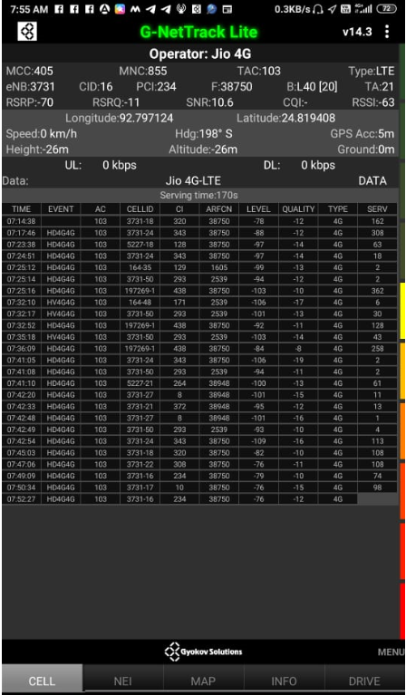
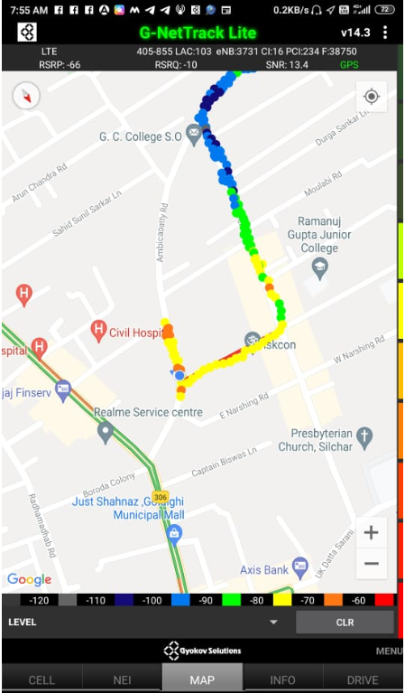
Near Cell (Reliance JIO)
Near cell(NC) | longitude | latitude | RSRP | Cell id | TDD E-ARFCN
1 | 92.797124 | 24.819408 | -70 | 16 | 38750
Ambicapatty road Silchar Assam.
RSRP: -65dbm to -75dbm

Slide 13
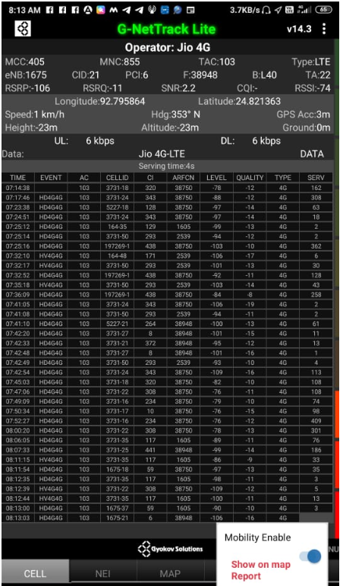
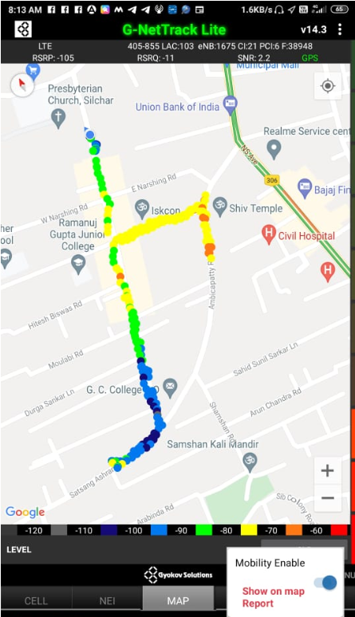
Edge Cell (Reliance JIO)
Edge cell(NC) | longitude | latitude | RSRP | Cell id | TDD E-ARFCN
1 | 92.795864 | 24.821363 | -106 | 21 | 38948
Church road Silchar Assam
RSRP: -95dbm to -110dbm

Slide 14
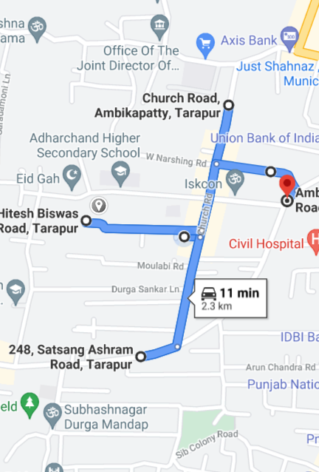
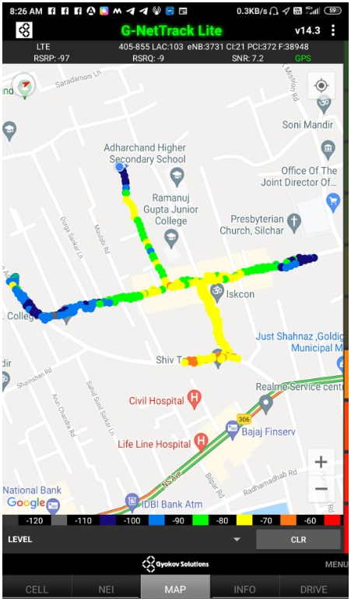
Mixed Mobility (Reliance JIO)
Ambikapatty, Silchar, Assam
RSRP: -65dbm to -110dbm

Slide 15
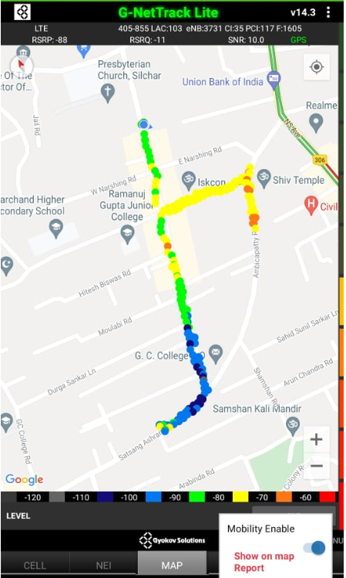
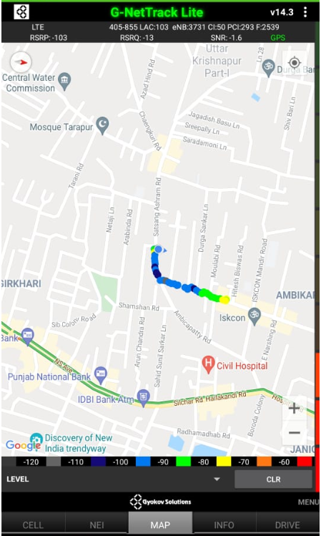
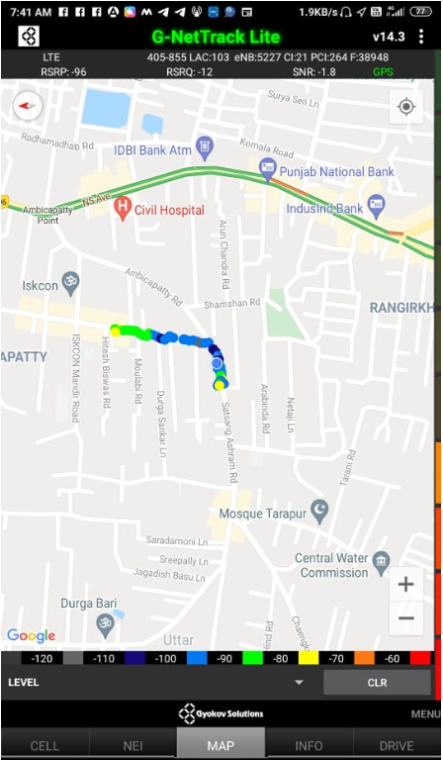
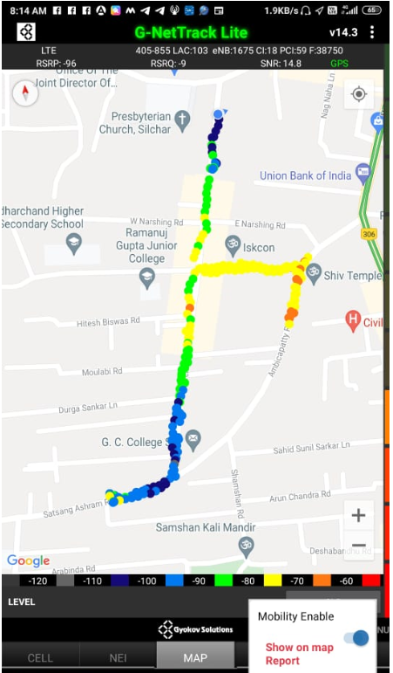
Inter Band Handover (FDD-TDD), JIO 4G
Band Handover | longitude | latitude | RSRP | PCI | TDD E-ARFCN
1 | 92.793673 | 24.816326 | -101 | 293 | 2539

Slide 16
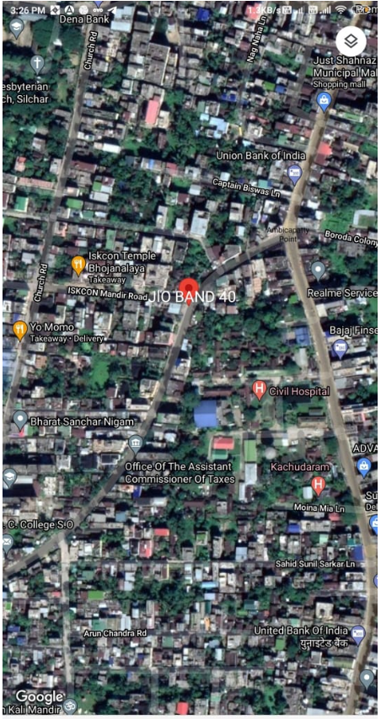
RJIO Band 40 Near Cell:
Lat-24.819408
Log-92.797124

Slide 17
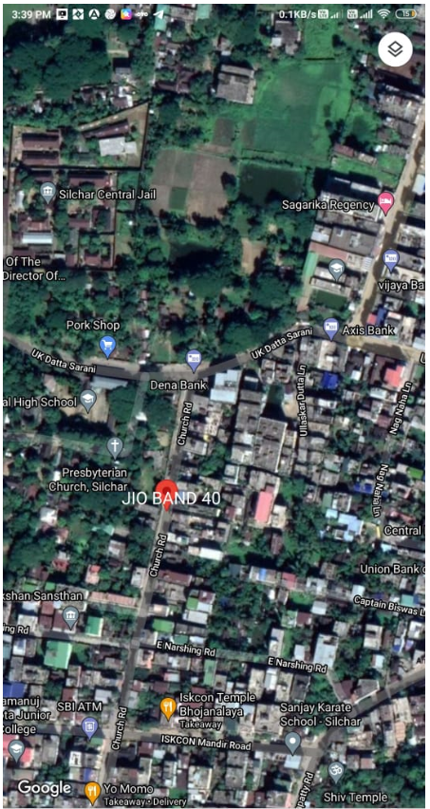
RJIO Band 40 Edge Cell:
Lat-24.821363
Log-92.795864

Slide 18
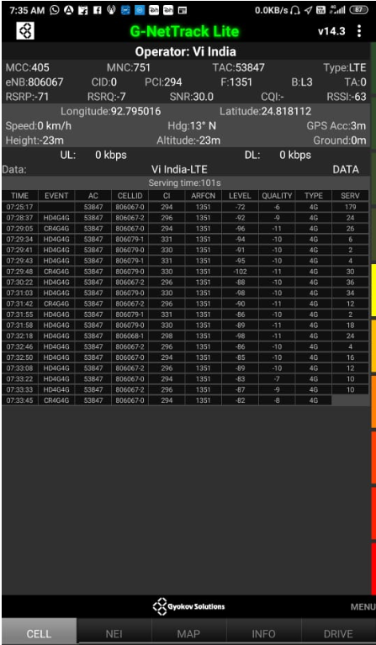
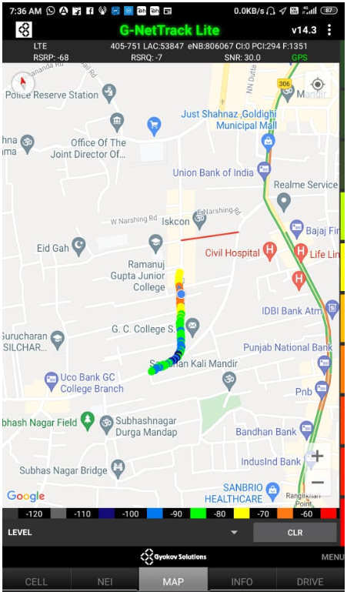
Near Cell VI
Near cell(NC) | Longitude | latitude | RSRP | Cell id | FDD E-ARFCN
1 | 92.795016 | 24.818112 | -71 | 0 | 1351
Church Road, Silchar, Assam.
RSRP: -65dbm
to -75dbm

Slide 19
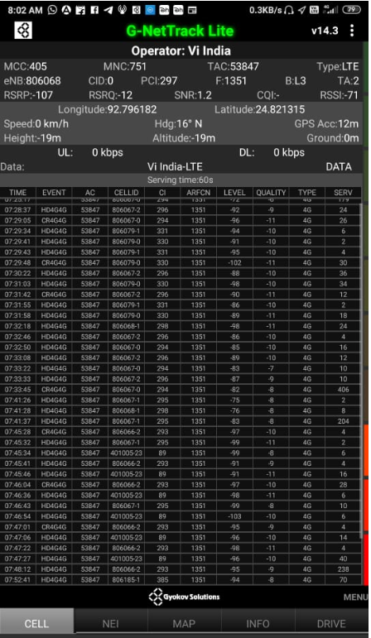
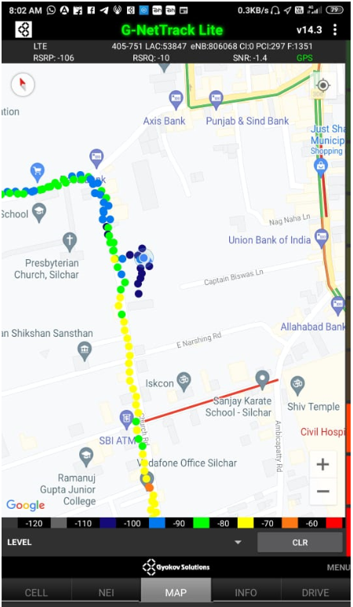
Cell Edge VI
Edge cell(EC) | longitude | latitude | RSRP | Cell id | TDD E-ARFCN
1 | 92.796182 | 24.821315 | -107 | 0 | 1351
Church road, Silchar, Assam
RSRP: -95dbm to -105dbm

Slide 20
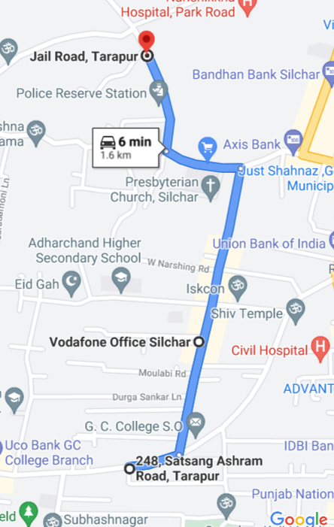
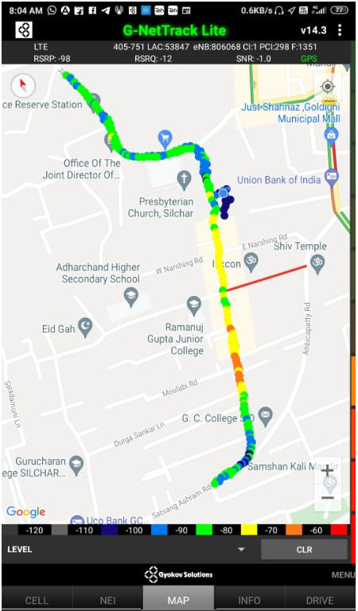
Mixed Mobility VI
Church Road, Ambikapatty, Silchar , Assam
RSRP—65dbm to-110dbm

Slide 21
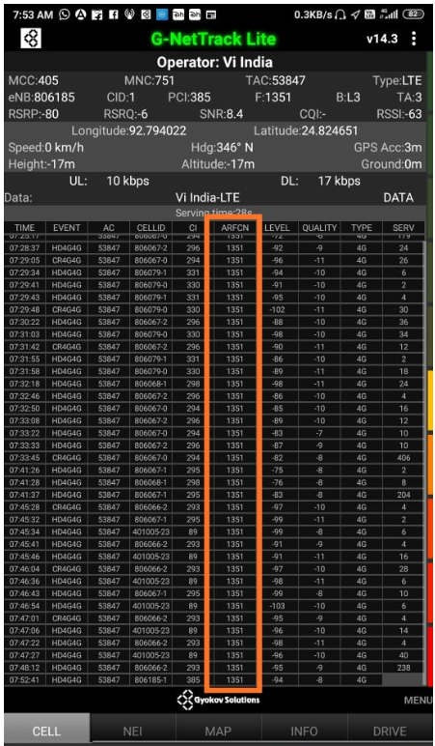
VI Band Handover- In this place only FDD(L3) band Available.

Slide 22
G net Tracker Drive Route

Slide 23
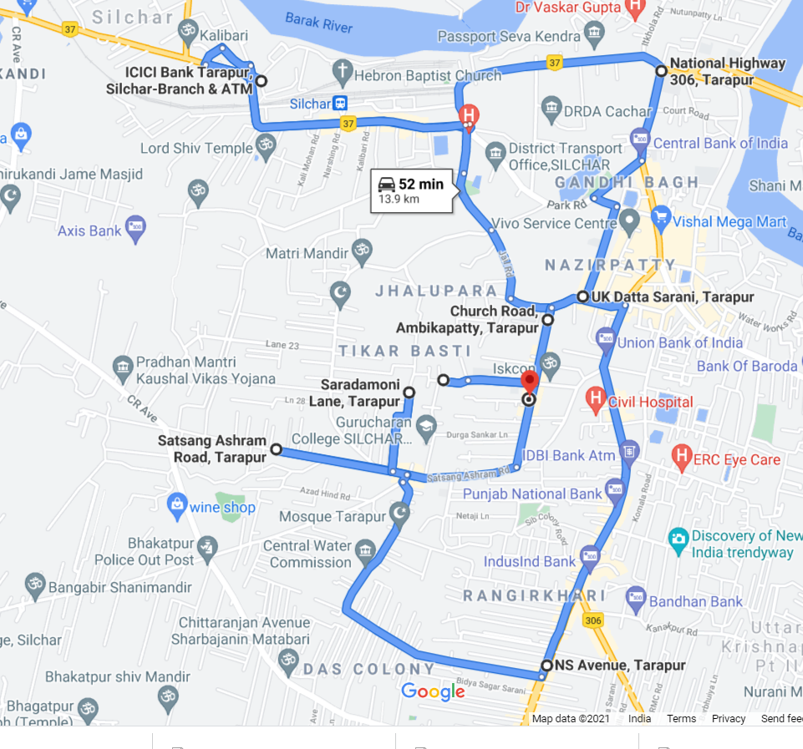
Overall Drive Route
Ambikapatty, Silchar, Assam
RSRP: -65dbm to -110dbm

Slide 24
THANK YOU
MARQUIS TECHNOLOGIES

