Slide 1
MARQUIS TECHNOLOGIES
Drive Route :- Bucharest, Romania
By
Karthigai Selvan

Slide 2
OPERATORS OVERVIEW:
Country | Romania
Infra | Huawei, Nokia , Ericsson
City | Bucharest
MCC | 226
Operator | Orange, DiGi Mobil, Vodafone, TMO
Near Cell | -65dbm to -80dBm
Edge Cell | -95dBm to -115dBm

Slide 3
OPERATOR DETAILS: [:
Location | Service Provider | Operator | RAT
Bucharest, Romania | Vodafone | Major | 5G/4G/3G/2G
Bucharest, Romania | Orange |  | 5G/4G/3G/2G
Bucharest, Romania | Digi Mobil |  | 5G/4G/3G/2G
Bucharest, Romania | Telekom |  | 4G/3G/2G

Slide 4
Major ROMANIA Operators : Locations for 5G /NR Field Test
Operator | PLMN | 5G Tested Locations | Longitude / Latitude | ENDC combination Tested
Vodafone | 226/1 | Piața Unirii, Bucharest, Romania | 44.42724360756836, 26.10244942624197 | LTE Band 3 + NR 78
 |  | Sala Palatului, Strada Ion Câmpineanu, Bucharest, Romania | 44.4392935665082, 26.09498979740737 | LTE Band 3 + NR 78
Orange | 226/10 | Piața Unirii, Bucharest, Romania | 44.42724360756836, 26.10244942624197 | LTE Band 3 + NR 78
 |  | Sala Palatului, Strada Ion Câmpineanu, Bucharest, Romania | 44.4392935665082, 26.09498979740737 | LTE Band 3 + NR 78
Digi Mobil | 226/5 | Biserica MAPN, Strada Izvor, Bucharest, Romania | 44.426989808067304, 26.078640141581918 | LTE Band 1 + NR 78 LTE Band 38 + NR78
 |  | Sala Palatului, Strada Ion Câmpineanu, Bucharest, Romania | 44.4392935665082, 26.09498979740737 | LTE Band 1 + NR 78 LTE Band 38 + NR78

Slide 5
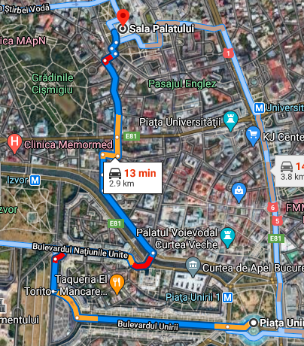
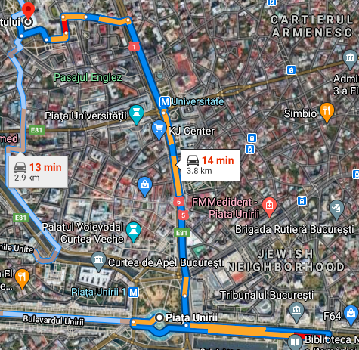
Bucharest, ROMANIA drive Routes for 5G Field Testing
Piața Unirii > Bulevardul Unirii > Strada Ion Brezoianu > Sala Palatului
Piața Unirii > E81 > Strada Demetru I. Dobrescu > Sala Palatului

Slide 6
Mobility Scenarios Execution Spots: (Bucharest, ROMANIA)
Operator | Mobility Scenario | Location Tested | Longitude / Latitude
Vodafone | 4G-3G-4G HO SPOT | Strada Vadul Moldovei, București 077190 (Baneasa Forest) | 44.524398288171554, 26.104729796192
 | SRVCC to 3G | Strada Vadul Moldovei, București 077190 (Baneasa Forest) | 44.524398288171554, 26.104729796192
 | IRAT | Piața Romană, Bucharest, Romania | 44.443576772532516, 26.098335282399805
 | Good Coverage for Testing | Sala Palatului, Sala Palatului, Strada Ion Câmpineanu, Bucharest, Romania | 44.43921696335525, 26.0949683397374
 | Poor Coverage for testing | Université Politehnica, Splaiul Independenței, Bucharest, Romania | 44.43813143235323, 26.049331564882657
 | OOS Area | NA | -
Orange | SRVCC to 2G | Strada Vadul Moldovei, București 077190 (Baneasa Forest) | 44.524398288171554, 26.104729796192
 | SRVCC to 3G | Strada Vadul Moldovei, București 077190 (Baneasa Forest) | 44.524398288171554, 26.104729796192
 | 4G-3G-4G HO SPOT | Strada Vadul Moldovei, București 077190 (Baneasa Forest) | 44.524398288171554, 26.104729796192
 | IRAT | Piața Romană, Bucharest, Romania | 44.443576772532516, 26.098335282399805
 | Good Coverage for Testing | Sala Palatului, Sala Palatului, Strada Ion Câmpineanu, Bucharest, Romania | 44.43921696335525, 26.0949683397374
 | Poor Coverage for testing | Université Politehnica, Splaiul Independenței, Bucharest, Romania | 44.43813143235323, 26.049331564882657
 | OOS Area | NA | -
Digi Mobil | SRVCC to 3G | Strada Vadul Moldovei, București 077190 (Baneasa Forest) | 44.524398288171554, 26.104729796192
 | SRVCC to 2G | Strada Vadul Moldovei, București 077190 (Baneasa Forest) | 44.524398288171554, 26.104729796192
 | 4G-3G-4G HO SPOT | Strada Vadul Moldovei, București 077190 (Baneasa Forest) | 44.524398288171554, 26.104729796192
 | IRAT | Piața Romană, Bucharest, Romania | 44.443576772532516, 26.098335282399805
 | Good Coverage for Testing | Sala Palatului, Sala Palatului, Strada Ion Câmpineanu, Bucharest, Romania | 44.43921696335525, 26.0949683397374
 | Poor Coverage for testing | Université Politehnica, Splaiul Independenței, Bucharest, Romania | 44.43813143235323, 26.049331564882657
 | OOS Area | NA | -

Slide 7
Services Supported by Orange VoLTE Operator
ORANGE: 5G/4G/3G/2G | GSM-900MHz & 1800MHz, B1(2100 MHz), B8(900MHz), B3(1800MHz), B7(2600MHz) , B20(800MHz), NR78 (3500 MHz),
OPERATOR | Features /Services | Supported(yes/No)
ORANGE (Major) | Reselection | Yes
 | Redirection | Yes
 | MMS /SMS | Yes
 | Volte | Yes
 | VoWifi | Yes

Slide 8
Services Supported by Vodafone VoLTE Operator
VODAFONE: 5G/4G/3G/2G | GSM-900MHz & 1800MHz, B1(2100 MHz), B8(900MHz), B3(1800MHz), B20(800MHz), NR78 (3500 MHz),
OPERATOR | Features /Services | Supported(yes/No)
VODAFONE (Major) | Reselection | Yes
 | Redirection | Yes
 | MMS /SMS | Yes
 | Volte | Yes
 | VoWifi | Yes

Slide 9
Services Supported by Digi Mobil VoLTE Operator
DIGI MOBIL: 5G/4G/3G/2G | GSM B8(900MHz), B1(2100 MHz), B1(2100MHz) B8(900MHz), B38(2600MHz), NR78 (3700 MHz),
OPERATOR | Features /Services | Supported(yes/No)
DIGI MOBIL (Major) | Reselection | Yes
 | Redirection | Yes
 | MMS /SMS | MMS not supported
 | Volte | Yes
 | VoWifi | Yes

Slide 10
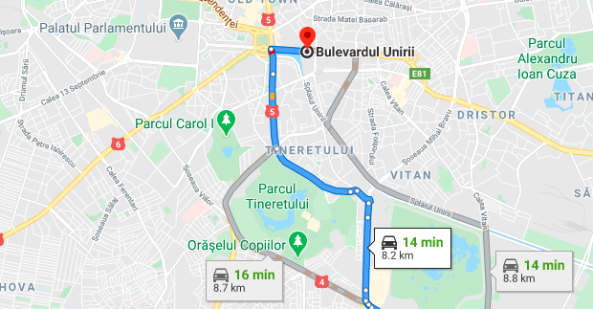
Near Cell (All Operators):
Location : Piata Uniri and Universitate
Map link: https://goo.gl/maps/YFMf85m18CsuguCk6

Slide 11
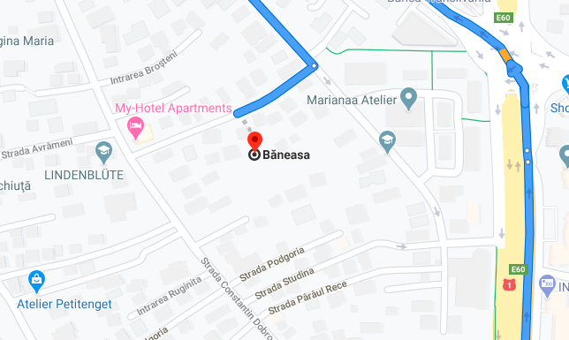
Edge Cell(All Operators)
Location : Baneasa Shopping Mall, Baneasa Forest
Map Link: https://goo.gl/maps/t3kxsiwMttnDGZTM6

Slide 12
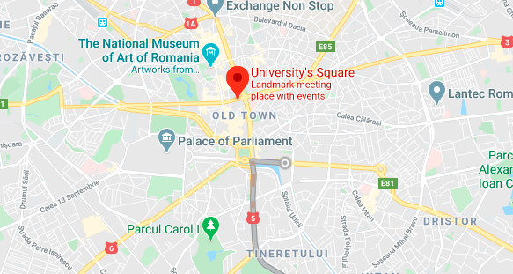
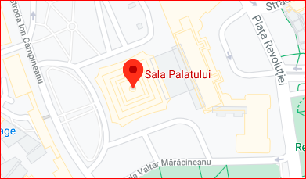
5G Coverage Orange:
Location : Piata Uniri
Location : Sala Palatului

Slide 13
5G Coverage Vodafone:
Location : Piata Uniri
Location : Sala Palatului

Slide 14
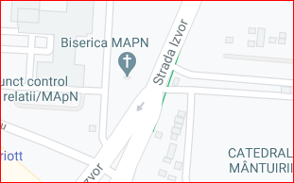
5G Coverage Digi Mobil:
Location : Sala Palatului
Location : Strada Izvor in front of Biserica MAPN

Slide 15
5G Location Map Link:
Orange : https://goo.gl/maps/YFMf85m18CsuguCk6
Vodafone: https://goo.gl/maps/mu1p2wuZVw1a8bkM9
Digi Mobil: https://goo.gl/maps/xAmhAbiDZ3dhYZE2A
Note :
All three Operator share one mutual location : SALA PALATULUI
https://goo.gl/maps/mu1p2wuZVw1a8bkM9

Slide 16
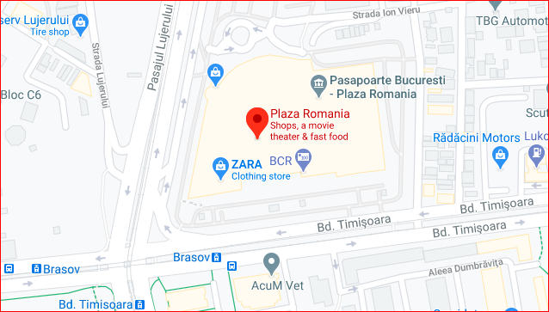
CA location for Orange and Vodafone:
Location: Near Plaza Romania
Map Link: https://goo.gl/maps/oafpTDe87mfn4HM47

Slide 17
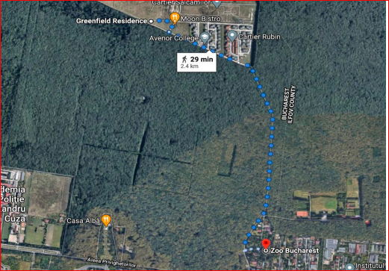
SRVCC Location for all operators:
Location : Baneasa Forest
Map Link: https://goo.gl/maps/VErUtBNbtus79iPD6

Slide 18
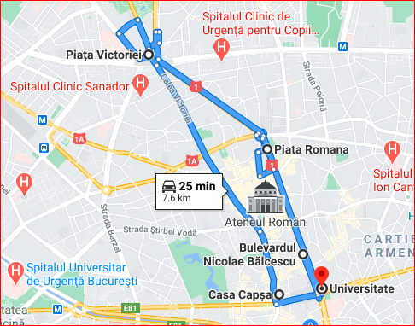
5G and 4G VoLTE Mix Coverage Area
UNIVERSITATE>>PIATA ROMANIA >> PIATA VICTORIEI>> UNIVERSITATE

Slide 19
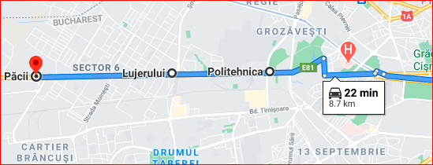
Weak 5G VoLTE Coverage Area: PIATA UNIRI >> POLITECHNICA>>LUJERULUI>>PACII GOOD COVERAGE>> WEAK COVERAGE >> NO 5G LOCATION
5G Ends
Weak 5G Signal
5G Coverage Start

Slide 20
Out of Service coverage:

Slide 21
THANK YOU
MARQUIS TECHNOLOGIES
www.marquistech.com

