Slide 1
MARQUIS TECHNOLOGIES
Drive Route – Warsaw( Poland)

Slide 2
Travel to WARSAW (POLAND)
Country | Poland
Continent | Europe
City | Warsaw
Time Zone | GMT +2 Hour
International Dialing Code | + 48
VISA Requirements | Need to provide 3 passport size photographs, 6 month bank statement
Yellow Fever Vaccination Certificate | Not Required

Slide 3
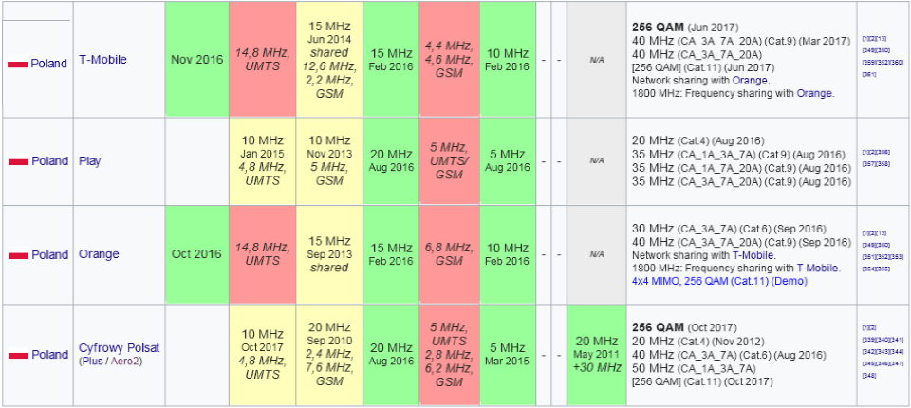
Operator Information

Slide 4
Operator Information
MCC | MNC | Operator | Bands (MHz)
260 | 02 | T-Mobile | GSM 900/1800, W-CDMA 2100, LTE 800/1800/2100/2600, NR n1-(5,10,15,20)MHz
260 | 05 | Orange | GSM 900/1800, W-CDMA 2100, LTE 800/1800/2100/2600, NR n1-(5,10,15,20)MHz
260 | 01 | Plus | CDMA-420, GSM 900/1800, UMTS-900/2100, LTE 800/900/1800/2100/2600, NR n1-(10,15,20)MHz
260 | 06 | Play | GSM 900/1800, UMTS-900/2100, LTE 800/1800/2100/2600, NR n41-(5,10,15,20)MHz

Slide 5
USSD Codes for operators
No. | Operator | Balance Check Code | Customer Care | Voice Mail No.
1 | T-Mobile | *101# | 9602 | 602950000
2 | Plus | *101# | 225777755 | NA
3 | ORANGE | *124# | 700 / 3970 | *501
4 | PLAY | *180# | *500 / *600 | *200

Slide 6
5G Band details of all operators
Operator | NR Band | 5 MHz | 10 MHz | 15 MHz | 20 MHz | EN-DC comb | FR1 (0.45~6GHz) Sub6
ORANGE | n1 | YES | YES | YES | YES | B7-n1 | n1(2110 MHz-2170 MHz)
T-MOBILE | n1 | YES | YES | YES | YES | B3-n1 | n1(2110 MHz-2170 MHz)
PLAY | n1 | YES | YES | YES | YES | B3-n1 | n1(2110 MHz-2170 MHz)
PLUS | n41 | NO | YES | YES | YES | B3-n41 | n41(2496 MHz-2690 MHz)

Slide 7
Manual APN Settings
Attached is a sheet which has Manual APN Settings for all operators in (POLAND)

Slide 8
Services Supported by Operators
Operator | Features/Services | Supports(Yes/No)
ORANGE | Reselection | Yes
 | Redirection | Yes
 | MMS | Yes
 | CSFB | Yes(3G)
 | VoLTE | Yes
 | PS Handover | Yes
 | CA | 30 MHz (CA_3A_7A) (Cat.6) 40 MHz (CA_3A_7A_20A) (Cat.9)
 | VoWiFi | Yes
PLAY | Reselection | Yes
 | Redirection | Yes
 | MMS | Yes
 | CSFB | Yes(3G)
 | VoLTE | Yes
 | PS Handover | Yes
 | CA | 20 MHz (Cat.4) 35 MHz (CA_1A_3A_7A) (Cat.9) 35 MHz (CA_1A_7A_20A) (Cat.9) 35 MHz (CA_3A_7A_20A) (Cat.9)
 | VoWiFi | Yes

Slide 9
Services Supported by Operators
Operator | Features/Services | Supports(Yes/No)
T-MOBILE | Reselection | Yes
 | Redirection | Yes
 | MMS | Yes
 | CSFB | Yes(3G)
 | VoLTE | Yes
 | PS Handover | Yes
 | CA | 256 QAM 40 MHz (CA_3A_7A_20A) (Cat.9) 40 MHz (CA_3A_7A_20A) [256 QAM] (Cat.11)
 | VoWiFi | Yes
PLUS | Reselection | Yes
 | Redirection | Yes
 | MMS | Yes
 | CSFB | Yes(3G)
 | VoLTE | No
 | PS Handover | Yes
 | CA | 256 QAM 20 MHz (Cat.4) 40 MHz (CA_3A_7A) (Cat.6) 50 MHz (CA_1A_3A_7A) [256 QAM] (Cat.11)
 | VoWiFi | No

Slide 10
RSRP Criteria
Near Cell :-Stationary: RSRP : -55dbm to -85dbm
Cell Edge :-Stationary: RSRP : -95dbm to -110dbm
Mixed :-Mobility: RSRP : -55dbm to -120dbm

Slide 11
Additional Information
Where to Get SIM cards?
Orange, Play & Plus can be procured from Warsaw Central Station Shopping Mall.
What Documents Required to Purchase SIM?
Only Passport ID
Best Recharge Option for 8 days Testing?
Depends on test cases but in general we procure 30 PLN recharge for each SIM
for 4~6 GB and Unlimited Calling Services. To activate this services please get
the details from online operator wise prepaid plan.

Slide 12
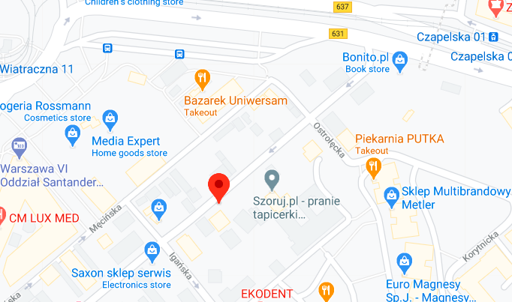
Orange 5G & T-Mobile 5G Edge Cell Location: Czapelska 39-33, 04-066 Warszawa, Poland 52.243506, 21.087792

Slide 13
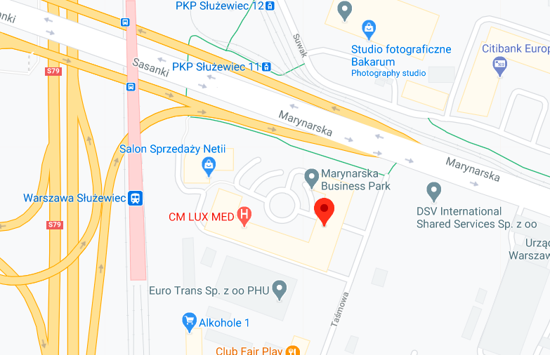
Play 5G & T-Mobile 5G Near Cell Location: Taśmowa 7, 02-677 Warszawa, Poland 52.179987, 20.989664

Slide 14
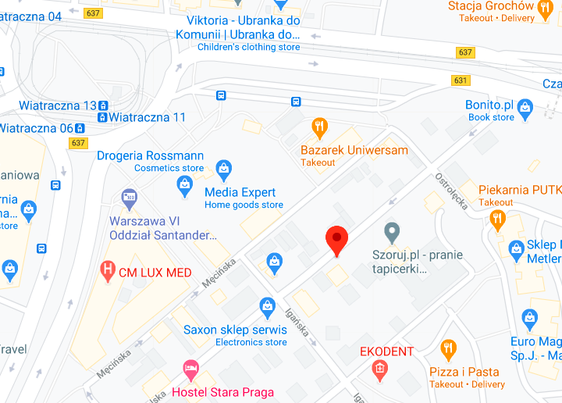
Play 5G & Plus 5G Edge Cell Location: Czapelska 39-33, 04-066 Warszawa, Poland 52.243506, 21.087792

Slide 15
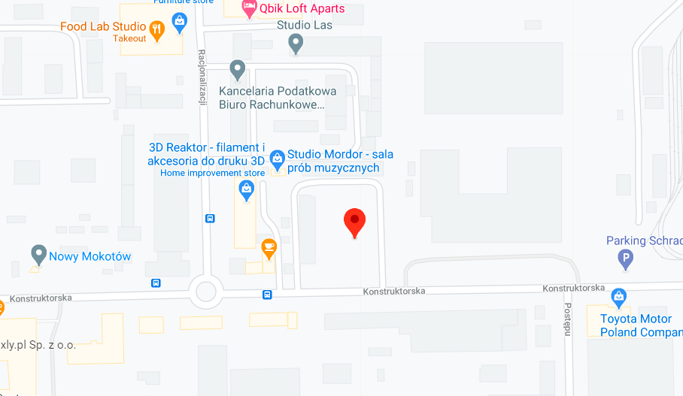
Plus 5G Near Cell Location: Konstruktorska 4, 02-673 Warszawa, Poland 52.185935, 20.994781

Slide 16
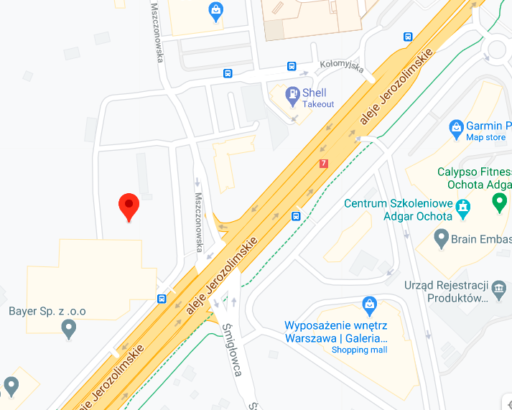
Orange 5G Near Cell Location: aleje Jerozolimskie 156, Warszawa, Poland 52.210355, 20.948026

Slide 17
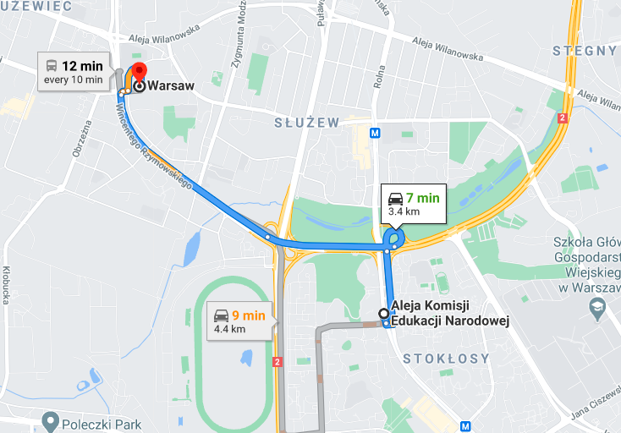
Orange 5G Drive Route Location: 5G to 4G & 4G to 5G (Aleja Komisji Edukacji Narodowej, 02-722 Warszawa, Poland) to (Służew, 02-695 Warsaw, Poland

Slide 18
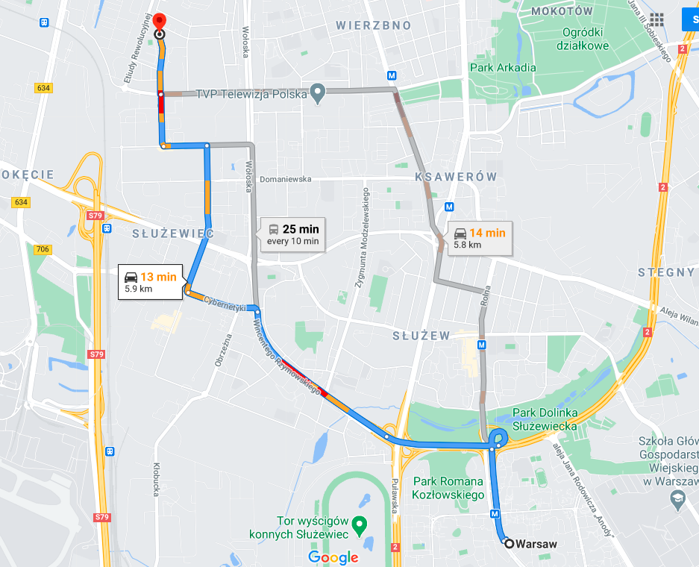
Play 5G Drive Route Location: 5G to 4G & 4G to 5G (Stokłosy, Warsaw, Poland) to (Jana Maklakiewicza 12, 02-642 Warszawa, Poland)

Slide 19
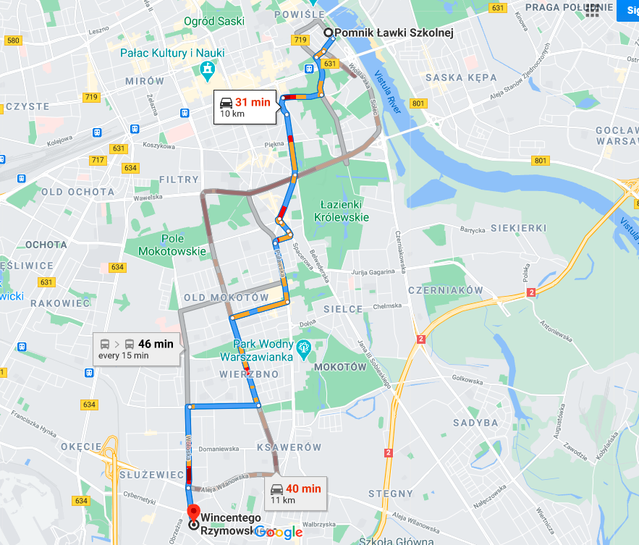
Plus 5G Drive Route Location: 5G to 4G & 4G to 5G (Pomnik Ławki Szkolnej, Wybrzeże Kościuszkowskie 35, 00-379 Warszawa, Poland) to (Wincentego Rzymowskiego, 02-697 Warszawa, Poland)

Slide 20
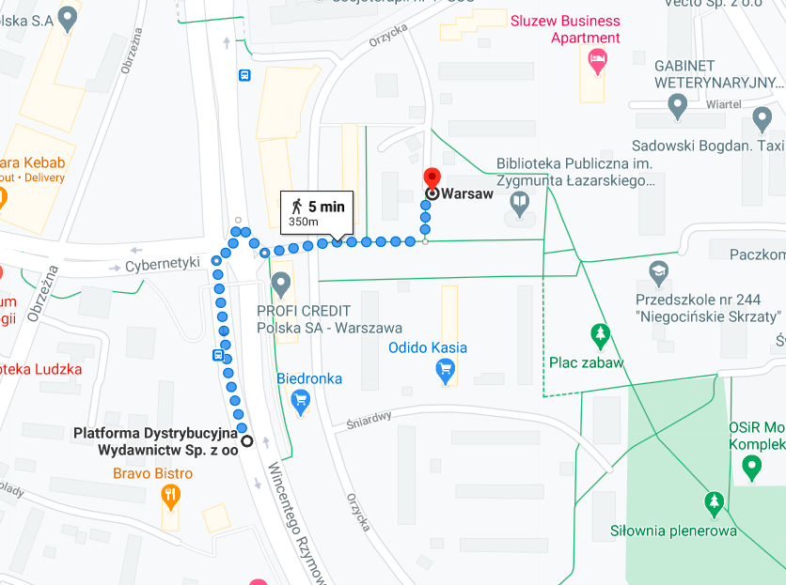
T-Mobile 5G Drive Route Location: 5G to 4G & 4G to 5G (Platforma Dystrybucyjna Wydawnictw Sp. z o.o., Wincentego Rzymowskiego 28, 02-697 Warszawa, Poland) to (Służew, 02-695 Warsaw, Poland)

Slide 21
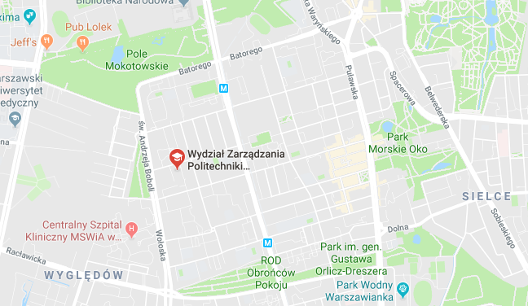
ALL Operator 4G Near Cell Location: Politechnika warszawska Lat:52.2045588 Lat:20.9939397

Slide 22
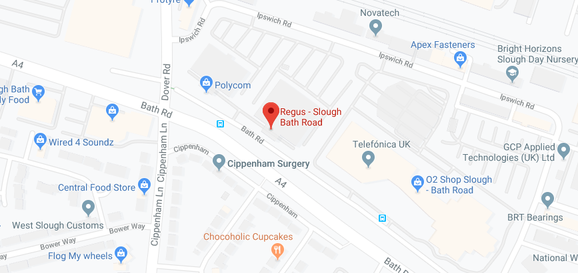
Out Of Service Location: Regus sloec Lat:52.2324427 Lat:21.036711,17

Slide 23
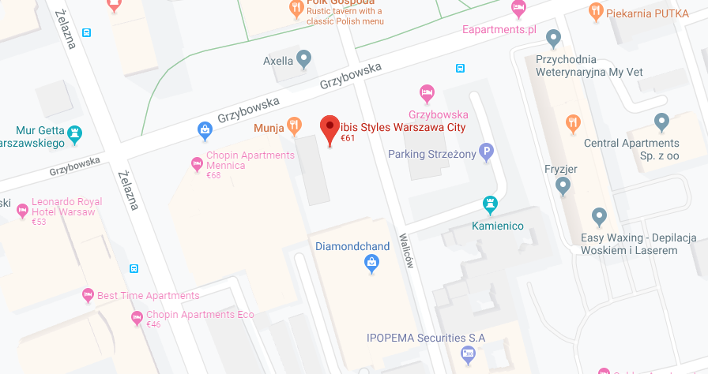
IRAT Location ibis Styles Warszawa Lat:52.2346922 Lat:20.9911446,18

Slide 24
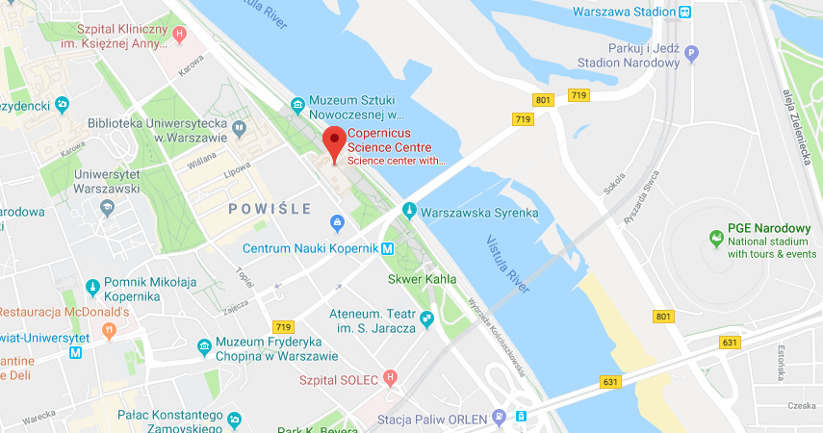
Mixed Mobility Coverage: centrum nauki Lat: 52.2418585 Lat: 21.0265384

Slide 25
Band Handover Area: centrum nauki Lat: 52.2418585 Lat: 21.0265384

Slide 26
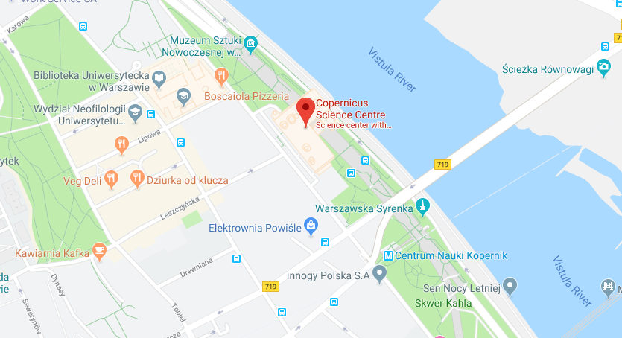
T-Mobile SRVCC: Centrum Nauki Lat:52.2418581 Lat:21.0243498

Slide 27
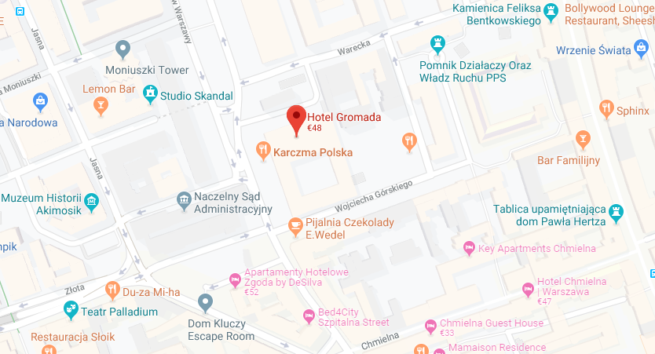
4G Cell Edge : Hotel Gromada, Lat: 52.2342629 Lat: 21.012582,17

Slide 28
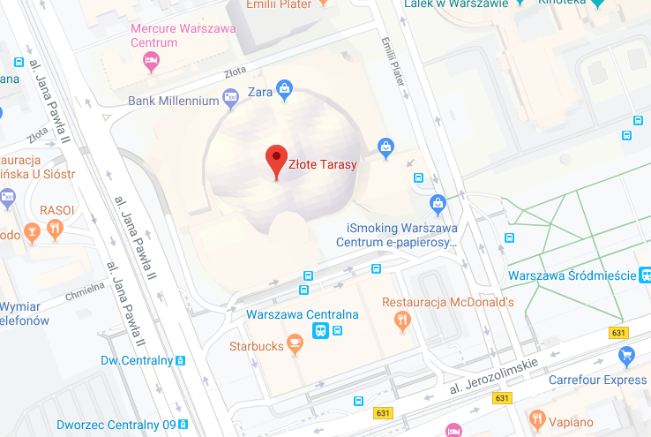
Crowded Area: zloty terasy mall Lat: 52.2299789 Lat: 21.0003887

Slide 29
Top Most Popular Android Apps used in POLAND
Jak dojade
Gdansk4U
Dictionary Linguee
Duo
Google Translate
Memrise
Phrasebook
Quizlet
Rosetta Stone
Speak Tribe
Mytaxi
Yanosik.pl

Slide 30
Local EM number used in Poland:
European general emergency phone number | 112
Local Police | 997
Ambulance | 999
Fire Brigade | 998
Road Assistance | 981

Slide 31
THANK YOU
MARQUIS TECHNOLOGIES
www.marquistech.com

